Slide 1
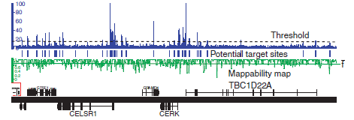
Peak Calling and Enriched Region Identification
Generate the signal profile
Threshold the signal and identify the candidate peaks
Simulation (PeakSeq), Local window based Poisson, Local window based Poisson (MACS), Fold change statistics (SPP)
Score against the control
New Challenges:
Different shapes and scales of the ChIP-Seq profiles determines the mode of study.
Non-uniform mappability of the genome tends to fragment large peaks, e.g. histone marks.

Slide 2
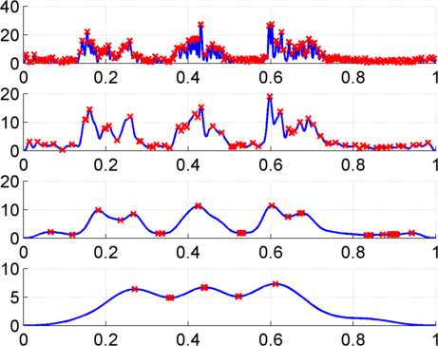
Multiscale Analysis, Minima/Maxima based Coarse Segmentation
Multiscale analysis is a natural way to analyze the ChIP-Seq data
Window Length
1kb
4kb
16kb
Maxima
64kb
Minima
Notes:
Shown is the H3K36me3 track over 200kb regions with 3 active genes, indicated by green lines. The signal increases on the 3 genes. Our problem is to identify 3 enriched regions corresponding to these 3 genes. Thresholding usually overfragments these regions. To get around this issue, we apply a a multiscale filtering that smooths the signal with a sliding window using different window lengths, or scale lengths. At the top scale one can see that 3 peaks are identified.

Slide 3
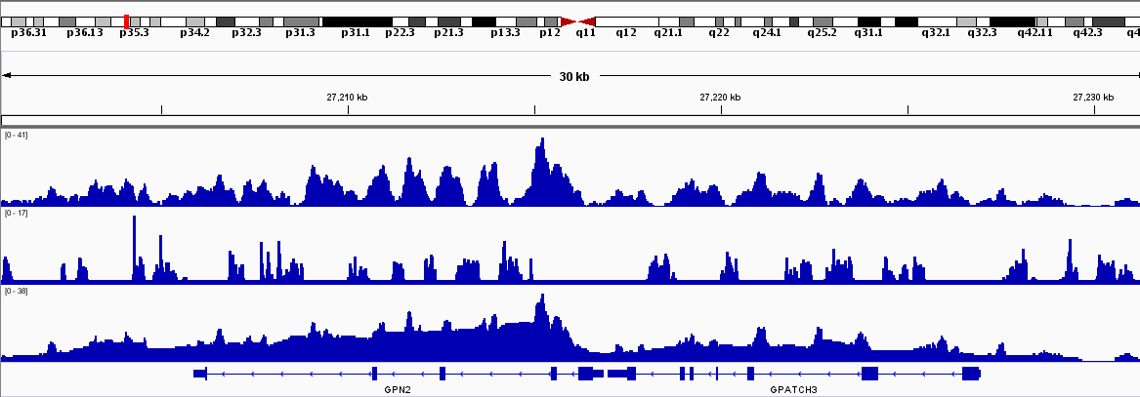
Multi-mappability based Correction
Low mapability regions cause loss of signal and introduce burst-like noise
To characterize the mappability of the genome, we build the multi-mappability profile
High multi-mappability signal ↔ Low mappability
Correction Procedure:
“Whenever there is a lowly mappable position, use the surrounding regions with high mappability to correct the value”
H3K36me3
Loss of read depth signal due to low mappability
Multi-mapability
Corrected
Notes:
We proposed a correction procedure whose basic idea is summarized as in here. We generate the corrected signal from the multi-mappability profile.

Slide 4
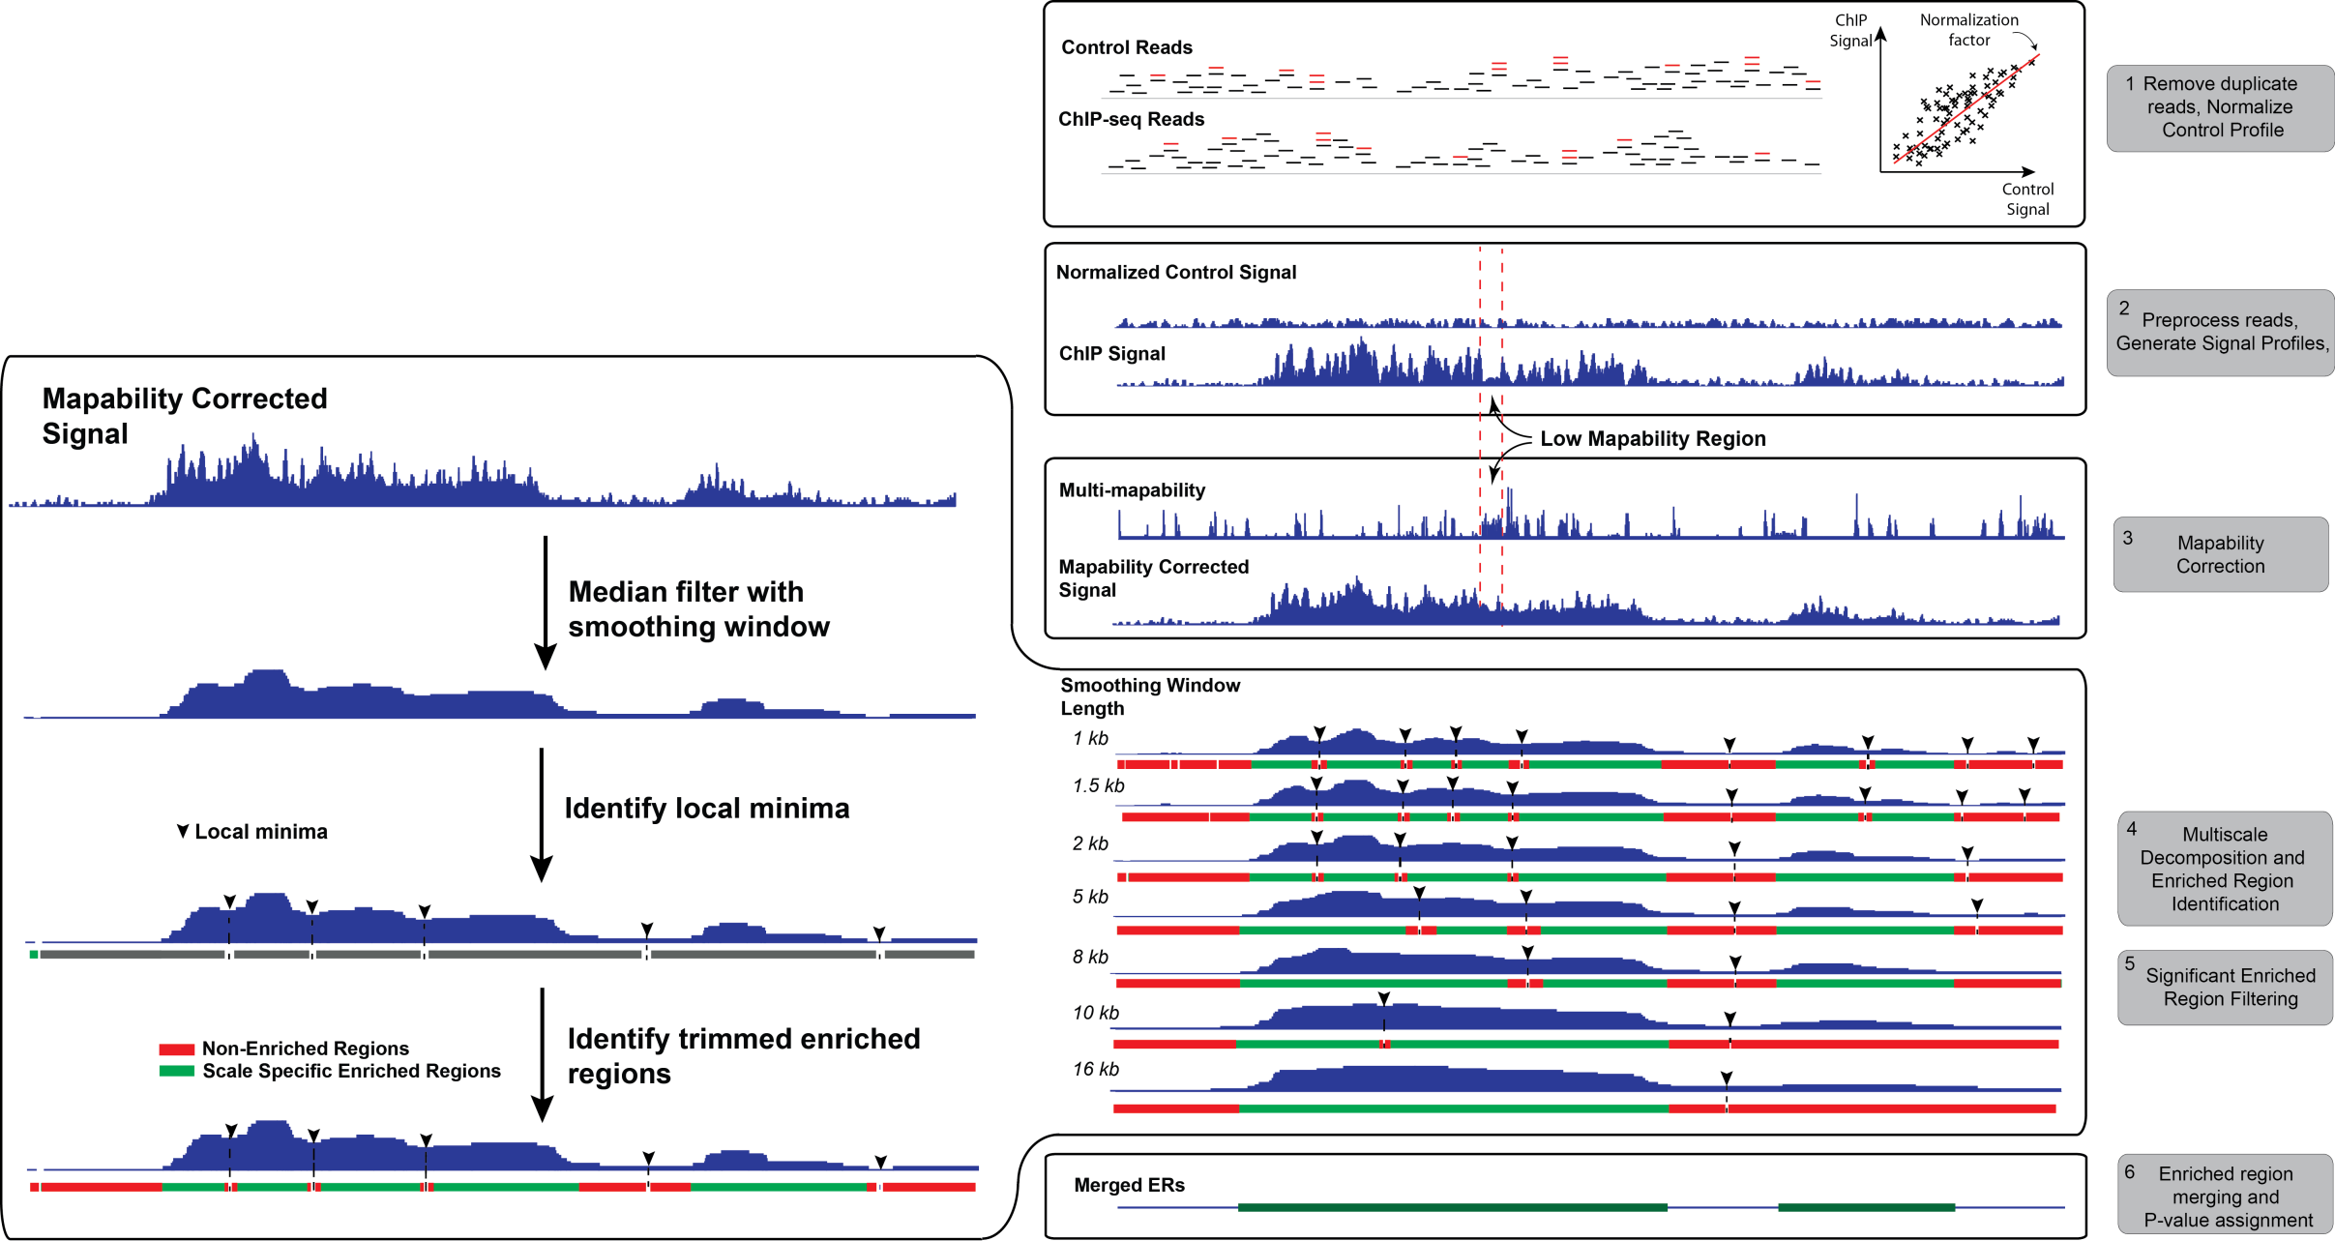
MUSIC Algorithm
Notes:
Put all these together

