Slide 1
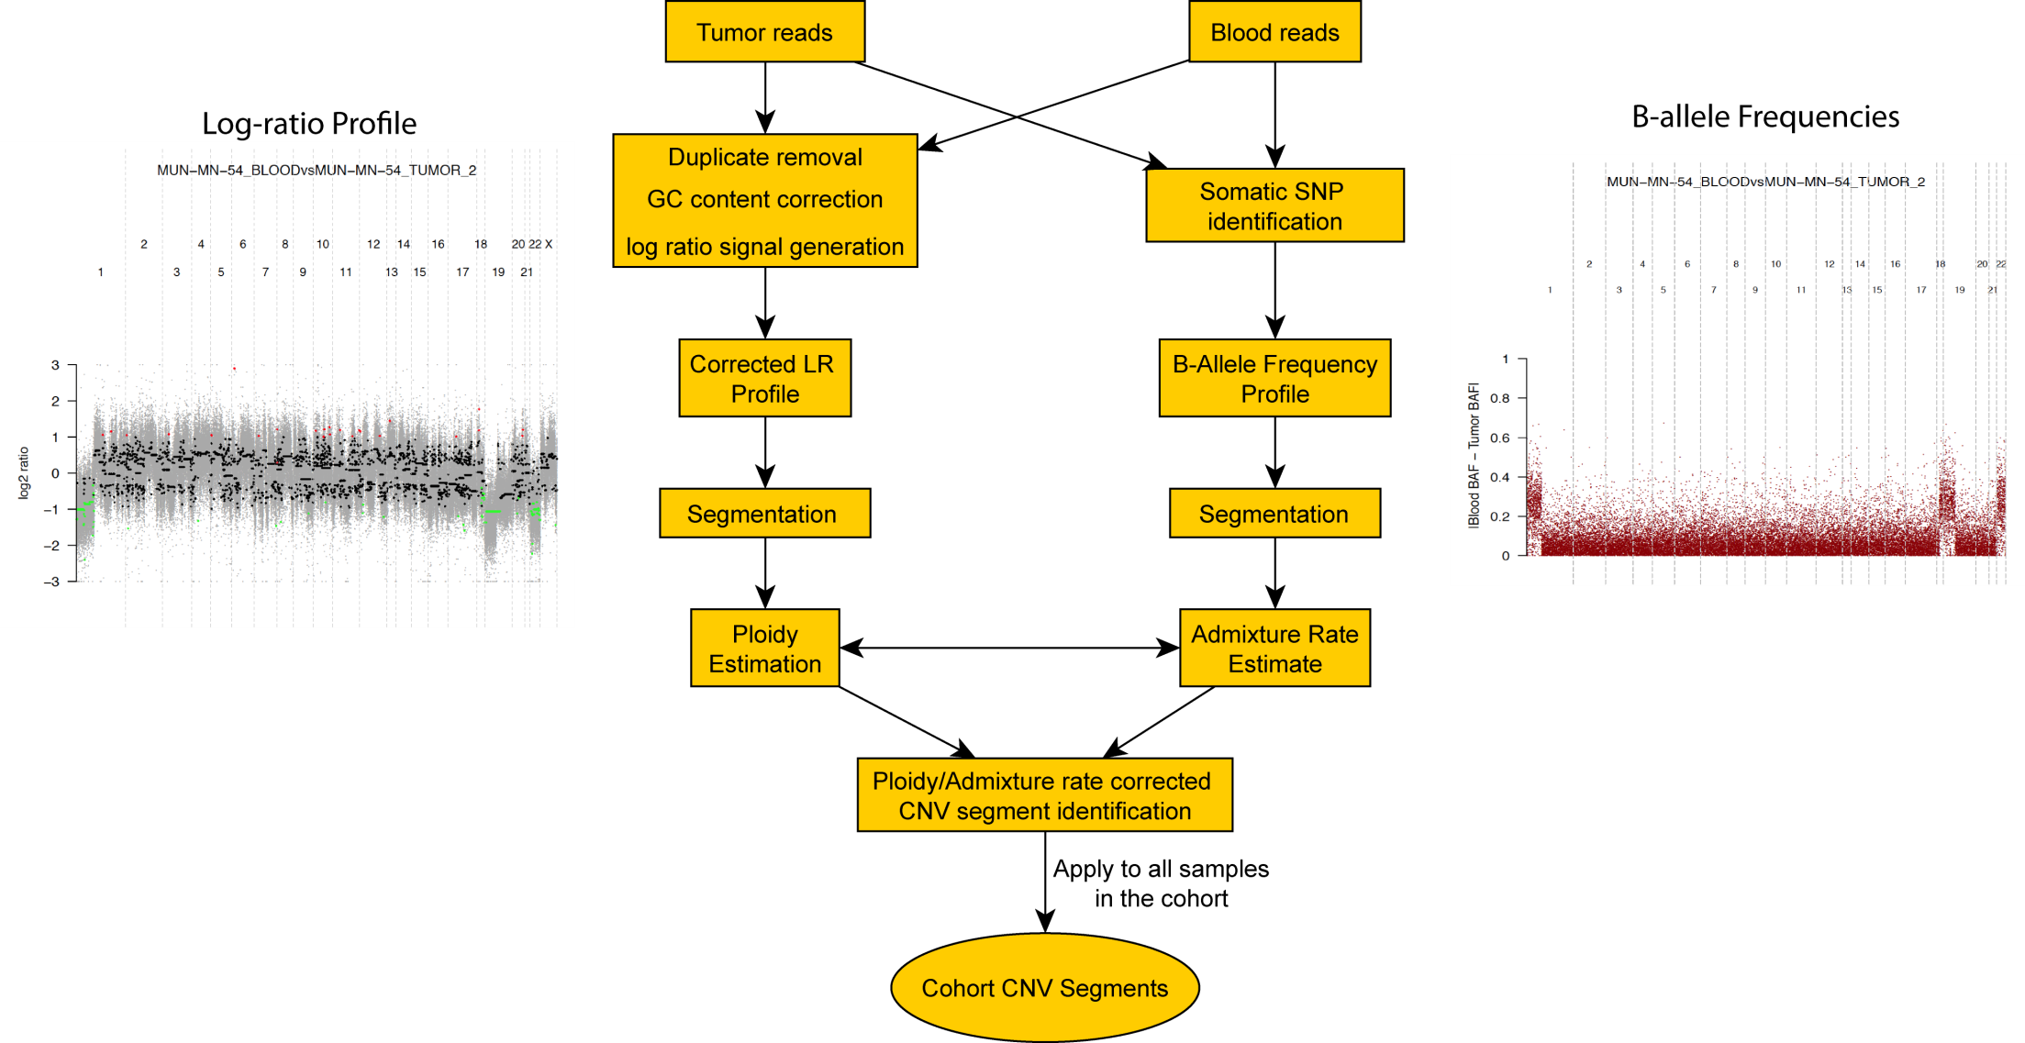
Our New Super-Duper Somatic CNV Calling Method

