Slide 1
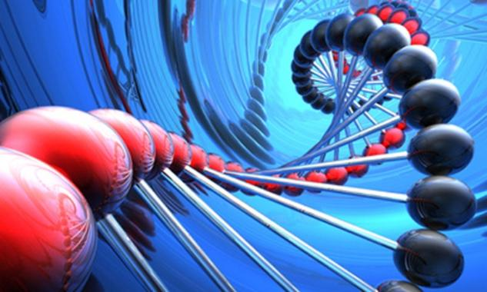
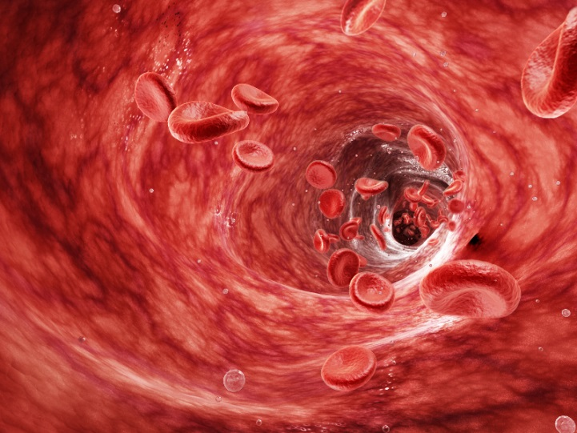
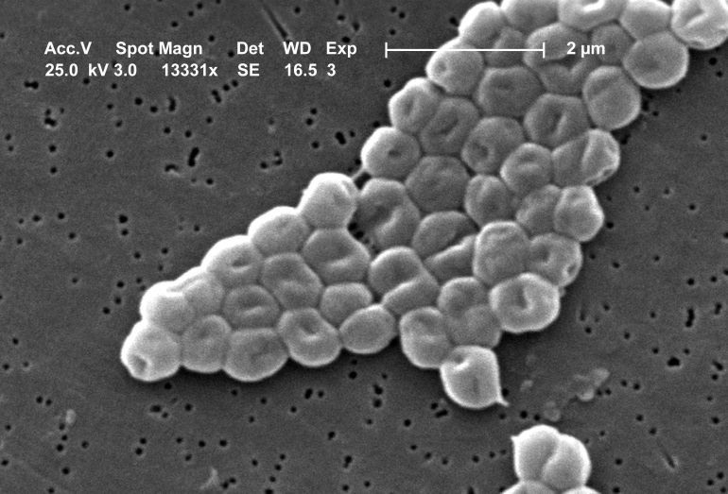
Exogenous RNA extension of a small extracellular RNA analysis pipeline
Will Meyerson
Gerstein Lab
2014 - 09 - 23

Slide 2
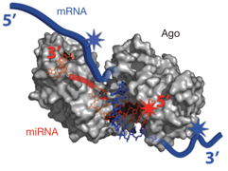
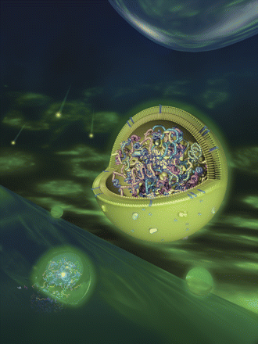
exRNA – a mysterious new class of molecules
exRNA:
recent surprise
protected by Argonaute and exosomes
Role TBD, biomarker potential anticipated
notable for microRNAs
ATP-dependent release occurs in absence of cell lysis
$17M pledge for grants
good time for a suite of exRNA bioinformatic tools
Core pipeline:
Developed by Dr. Robert Kitchen
after mapping to host, 25-50% reads remain unmapped
what are they? Potential microbial origins?

Slide 3
Why Quantification of Extracellular Microbial Reads Matters
Worldwide, microbial infections are the greatest cause of lost years of life
Microbial infection of the blood is the number one cause of mortality in US intensive care units
Scientific applications:
better understand microbiome and exRNA
Clinical applications:
diagnose diseases from unculturable agents
predict patients at risk for septic shock
monitor the real-time progress of antibiotic and antiviral therapies for better stewardship

Slide 4
Extension Workflow
Sm-end-ex-RNA pipline remnant ->
remove lingering host reads [Bowtie2] ->
metagenomic mapping [Bowtie2]->
expectation maximization [eXpress] ->
phylogenetic analysis [original R script]
~ 10 min/sample

Slide 5
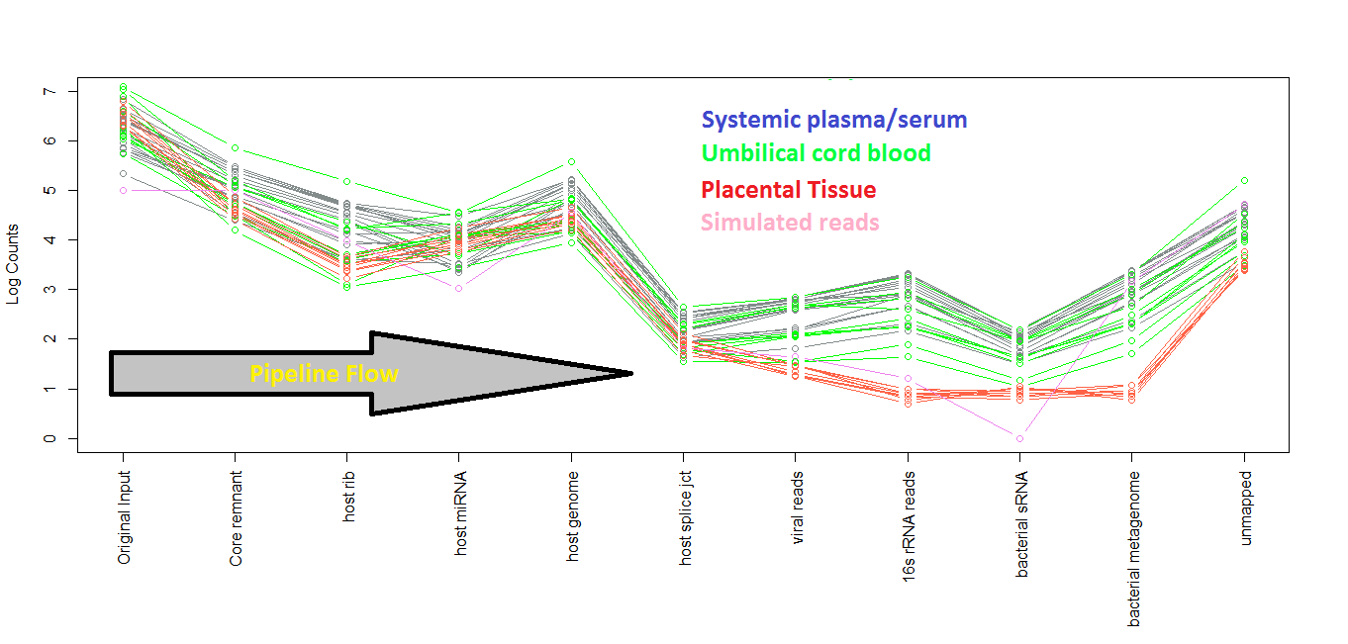
Accounting of Reads
“metagenomic”

Slide 6
Are these real?
About 200-2,000 unique 16S rRNA reads detected among 200K-7,000K unique reads per systemic blood sample
Random k-mer hypothesis: sequencing errors and chimera formation between host fragments, calibrators, and adaptors leads to bizarre short fragments that also happen to map to the metagenome
Contamination hypothesis: Microbial RNA is inadvertently introduced into samples during sample prep
Ambient ex-ex-RNA hypothesis: Even healthy humans carry non-human RNA in their extracellular fluid
Ex-ex-RNA of bacteremia hypothesis: Humans systemically infected with pathogens have clinically detectable non-human RNA in their extracellular fluid

Slide 7
Substantially larger metagenomic component in representative systemic sample (left ) than in equally many length-matched random words ( right) Evidence against mere “random k-mer hypothesis”
13%
9.7%
52%
36%
0.15%
0.04%
0.05%
0%
16%
52%
15%
1.0%
0.06%
1.3%
0.016%
1.7%
1.4%
0.1%
80-fold more 16S rRNA mapped reads in sample
Bacterial genomes much more prone to spurious mapping than 16S rRNA so their analysis is discontinued in the pipeline.
3 mm to host rRNA
3 mm to host miRNA
I wonder what these are…
No random words mapped to sRNAs
2 mm to host genome
2 mm to host splice junctions
exact match to viral genomes
exact match to bacterial 16S rRNA
exact match to bacterial sRNA
exact match to bacterial genomes

Slide 8
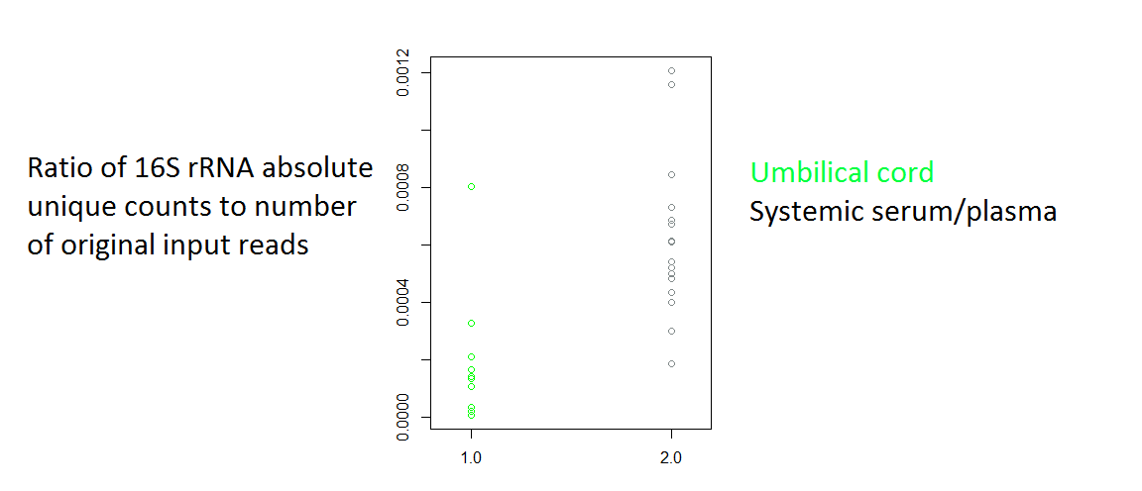
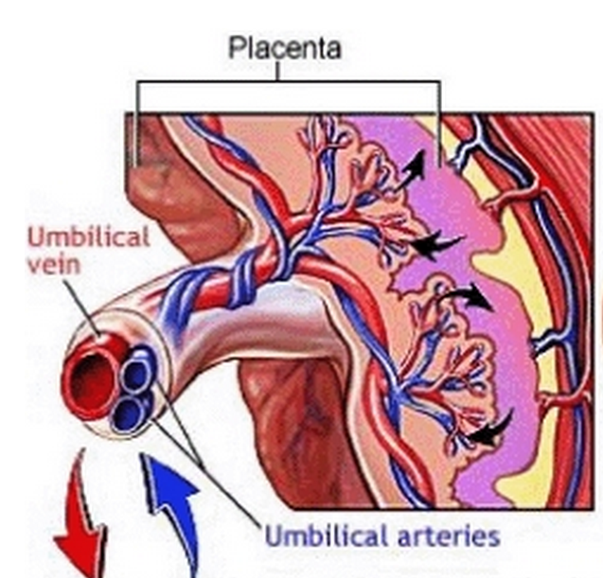
3-fold fewer bacterial reads from umbilical cord blood reflects placental barrier: Evidence against mere “contamination hypothesis”
Umbilical blood
Systemic blood

Slide 9
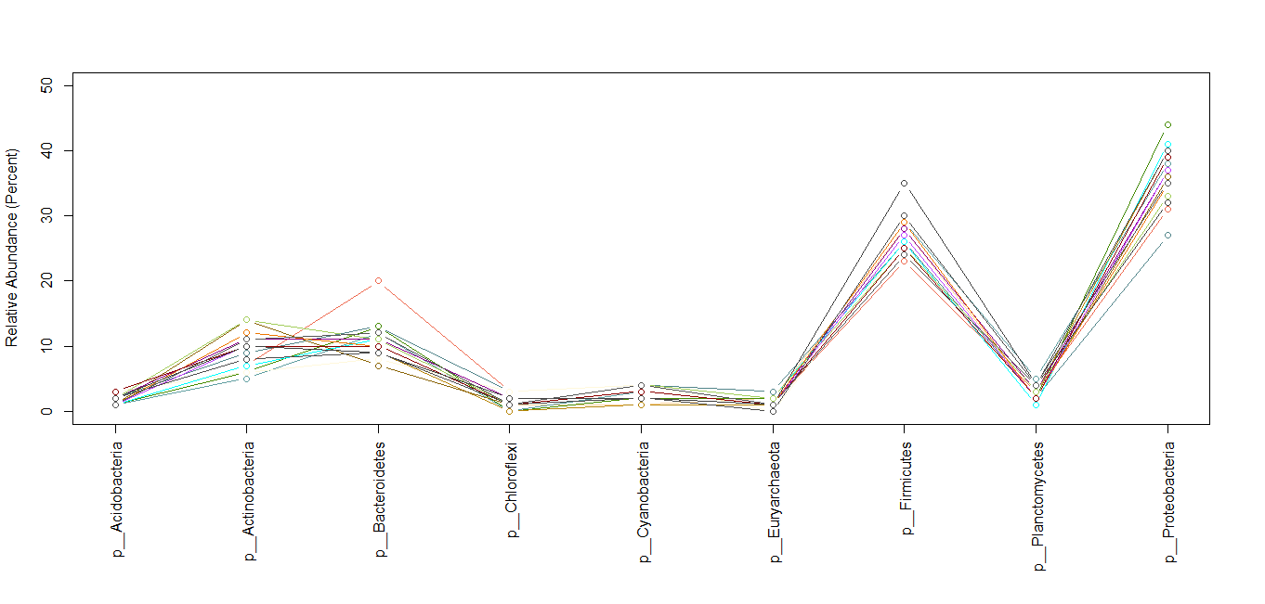
Relative abundances of top 9 (of 89) bacterial phyla in 17 exRNA samples show consistency, and strong representation from expected groups
These are also the top 4 bacterial phyla previously observed in the human gut.

Slide 10
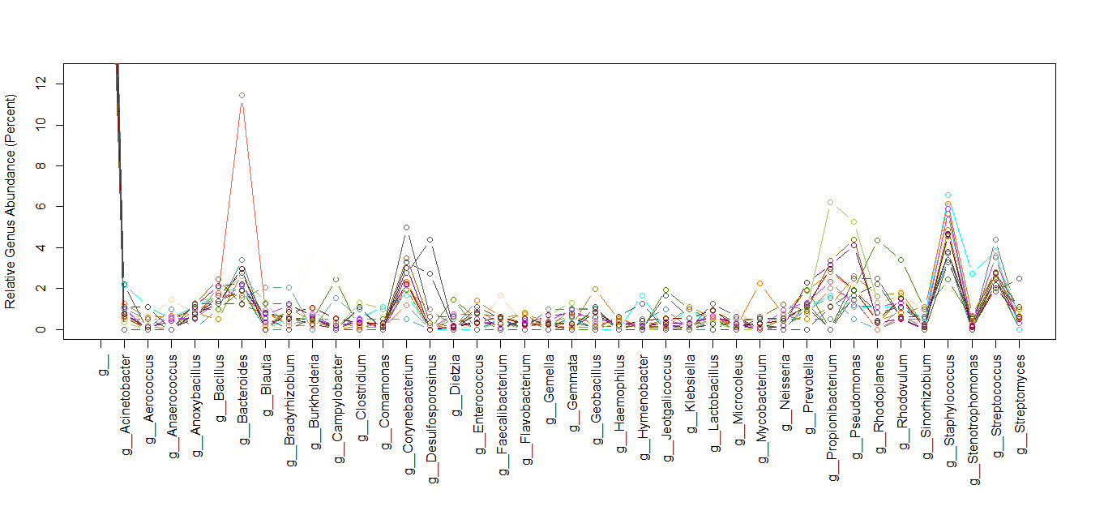
Top 39/1200 Genera
Out of 1200 genera, this known most common gut flora genus registers 136 unique hits to the 16S rRNA in one subject.

Slide 11
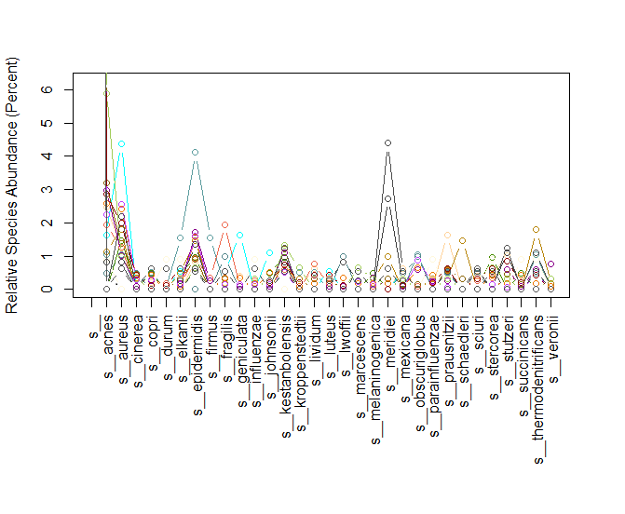
Species Distribution
3 of 4 top species are common skin commensals – contamination from needle passing through skin on the way to blood?
skin

Slide 12
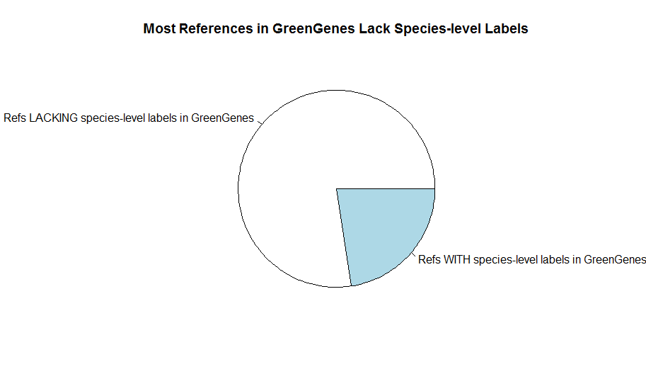
The Popular GreenGenes Reference DB is Inappropriate for Species-Level Classification
3 of 4 top species are common skin commensals – contamination from needle passing through skin on the way to blood? PERHAPS NOT
1,262,986 References
285,289 References

Slide 13
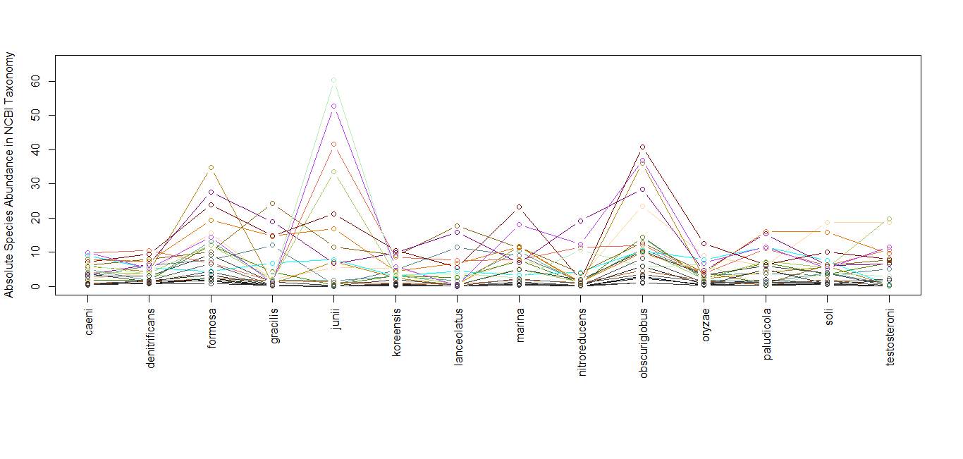
NCBI 16S Species: ex-ex-RNA unique pre/diagnostic potential?
“The true incidence of infections by A. junii might be underestimated, since phenotypical identification is difficult” - Septicemia Due to Acinetobacter junii, (2002) J. of Clinical Microbiology

Slide 14
Viral Reads – Enterobacteria phages and other phages dominate
266 gi|390933132|ref|NC_017992.1| | Thermoanaerobacterium saccharolyticum [NOT ACTUALLY A VIRUS, WILL REMOVE FROM REF DB]
49 gi|29366675|ref|NC_000866.4| | Enterobacteria phage T4,
27 gi|9627425|ref|NC_001604.1| | Enterobacteria phage T7
23 gi|639438672|ref|NC_024125.1| | Enterobacteria phage JS98
22 gi|414086362|ref|NC_019399.1| | Enterobacteria phage vB_EcoM_ACG-C40
22 gi|228860932|ref|NC_012635.1| | Enterobacteria phage RB51
21 gi|422934783|ref|NC_019505.1| | Escherichia phage wV7
20 gi|116326222|ref|NC_008515.1| | Bacteriophage RB32
15 gi|422934421|ref|NC_019503.1| | Enterobacteria phage ime09
15 gi|330858525|ref|NC_015457.1| | Shigella phage Shfl2
12 gi|30387453|ref|NC_004777.1| | Yersinia pestis phage phiA1122
10 gi|228861315|ref|NC_012638.1| | Enterobacteria phage RB14
10 gi|194100359|ref|NC_011045.1| | Enterobacteria phage 13a
8 gi|56718463|ref|NC_003287.2| | Enterobacteria phage M13
4 gi|418489681|ref|NC_019488.1| | Salmonella phage RE-2010

Slide 15
Conclusions & Future Directions
Ex-ex-RNA is intriguing for scientific and clinical applications
There is evidence that the hits from the systemic circulation are not fully explained by random k-mer mapping or sample contamination
This pipeline extension is swift and convenient
For comparison, could apply to patients with bacteremia and to subjects whose microbiomes have been extensively surveyed

Slide 16
Acknowledgements
Gerstein Lab
Dr. Robert Kitchen
Dr. Joel Rozowsky
Mr. Ian Gonzalez
Mr. Patrick McGilivray
Dr. Mihali Felipe
Ms. Lori Iannicelli
Professor Mark Gerstein
Yale Office of Student Research
Ms. Donna Carranzo
Ms. Mae Geter
Dr. John Forrest, Jr.
Yale High Performance Computing Center
Mr. Jason Ignatius
Dr. Robert Bjornson
The National Institutes of Health

Slide 17
Post-presentation Addendum
A discussion with Dan Spakowicz convinced me that the small bacterial RNA component is worth making better sense of because these sRNAs may be secreted to confuse or otherwise communicate with the host, and better fit the size-selection protocols, and nearly obviate the need for exact species identification
As a preliminary finding from my data, RNAI “RNA-one,” a suppressor of bacterial plasmids is by far the most abundant bacterial sRNA

