Slide 1
Analysis of motifs/TFs + Recurrence Algorithm
Jason Liu
Gerstein Lab
Mentor: EK
9/17/14

Slide 2
Basic Network
Gene
Cancer Gene
(eg: onc, tsg)
gene1
(UTR)
gene2
mut4
Coding
mut1
gene3
(enhancer)
mut5
mut7
gene4
Notes:
Currently: “database” containing relation (edges) between: noncoding region mutation (attribute: region type attached [enhancer, promoter, etc.]) -> target gene (CANG or non-CANG);
Target Gene has attached attribute of CODING mutation

Slide 3
Transcription Factors
Gene
Cancer Gene
(eg: onc, tsg)
Coding
TF - 1
mut6
(enhancer)
mut2
(promoter)
TF - 2
mut3
mut8
Notes:
TFs:
TF can be CANG or can be non-CANG; TF contain attribute: coding mutation
Noncoding mutation (node) (w/ attribute: region type) points to TF

Slide 4
Network
Gene
gene1
(UTR)
gene2
mut4
Cancer Gene
(eg: onc, tsg)
mut1
gene3
Coding
(enhancer)
mut5
mut7
gene4
Regulation
TF - 1
mut6
(enhancer)
mut2
(promoter)
TF - 2
mut3
mut8
Notes:
Connect CANG network w/ TF network
Each node (mutation nodes) can point to multiple things.

Slide 5
Preliminary Network
Gene
gene1
(UTR)
gene2
mut4
Cancer Gene
(eg: onc, tsg)
mut1
gene3
Coding
(enhancer)
mut5
Activator
mut7
gene4
Suppressor
TF - 1
mut6
(enhancer)
mut2
(promoter)
TF - 2
mut3
mut8
Notes:
length of arrow can be inversely proportional to FunSeq Score?
Split on chromosome?

Slide 6
# of Mutations in Non-coding Region Type For Cancer Type
 | Enhancer | Promoter | UTR | E&P | E&U | P&U
AML | 10 | 1 | 2 | 0 | 0 | 0
Breast | 1745 | 231 | 267 | 1 | 0 | 23
CLL | 104 | 10 | 10 | 0 | 0 | 3
Liver | 1904 | 211 | 288 | 1 | 0 | 17
Lung | 3173 | 310 | 307 | 1 | 0 | 51
Lymphoma | 252 | 59 | 58 | 0 | 0 | 48
Medull | 312 | 38 | 40 | 0 | 0 | 3
Pancreas | 250 | 35 | 29 | 0 | 0 | 8
Pilo | 41 | 3 | 6 | 0 | 0 | 0
Prostate | 751 | 106 | 95 | 0 | 0 | 21
% of Mutations in Non-coding Region Type For Cancer Type
 | Enhancer | Promoter | UTR | E&P | E&U | P&U
AML | 0.172413793 | 0.017241379 | 0.034482759 | 0 | 0 | 0
Breast | 0.137879267 | 0.018252212 | 0.021096713 | 7.90139E-05 | 0 | 0.00181732
CLL | 0.10935857 | 0.010515247 | 0.010515247 | 0 | 0 | 0.003154574
Liver | 0.11634586 | 0.01289337 | 0.017598533 | 6.1106E-05 | 0 | 0.001038802
Lung | 0.148015114 | 0.014460979 | 0.014321034 | 4.66483E-05 | 0 | 0.002379064
Lymphoma | 0.093959732 | 0.021998509 | 0.021625652 | 0 | 0 | 0.017897092
Medull | 0.140794224 | 0.017148014 | 0.018050542 | 0 | 0 | 0.001353791
Pancreas | 0.126774848 | 0.017748479 | 0.014705882 | 0 | 0 | 0.004056795
Pilo | 0.191588785 | 0.014018692 | 0.028037383 | 0 | 0 | 0
Prostate | 0.120661954 | 0.017030848 | 0.015263496 | 0 | 0 | 0.003374036
All somatic mutations – Alexandrov, et al.
Notes:
Next: compare for onc vs tsg
Organization of VCF. Let each breast sample be its own group. then find averages in samples.
doesn’t contain TFs

Slide 7
Pan-cancer Observations
X=(#BR+#G)/#ONC
MOTIFG% = G/(BR+G)
MOTIFBR% = 1-MOTIFG%
CANCER TYPE | X=(BR+G)/ONC | MOTIFG % | MOTIFBR %
BREAST | 1.702 | 0.5253 | 0.4747
LIVER | 2.459 | 0.5055 | 0.4945
LUNG | 2.290 | 0.5987 | 0.4013
PROSTATE | 1.852 | 0.7198 | 0.2802
In prostate cancer, there is a significantly larger percentage of MOTIFG than MOTIFBR compared to the other cancer types for oncogenes.
Next step: Perform statistical testing with a null (random generated mutations) to determine if percentages are significant
Notes:
Add eq
No control

Slide 8
+: 79
PAN CAN Somatic Mutations
ONC follow trends
G: 232
-: 21
ONC: 88
+ TF Activator
- TF Repressor
G: motif gain
BR: motif break
BR: 189
+: 42
-: 57
TSG trend not obvious
+: 48
Next steps:
Compare to null
Analysis for all genes
G: 111
-: 0
TSG: 49
BR: 95
+: 31
-: 63

Slide 9
+: 11
Prostate Onc and Tsg
ONC trend not obvious
G: 36
-: 6
ONC: 27
+ TF Activator
- TF Repressor
G: motif gain
BR: motif break
BR: 14
+: 5
-: 3
+: 5
G: 19
-: 0
TSG: 19
BR: 8
+: 2
-: 0

Slide 10
+: 6
Prostate Differential Expression
G: 29
-: 6
UP: 24
+ TF Activator
- TF Repressor
G: motif gain
BR: motif break
BR: 15
+: 3
-: 9
UP: Increased DE
DOWN: Decreased DE
+: 1
G: 2
-: 0
DOWN: 2
BR: 0
+: 0
-: 0

Slide 11
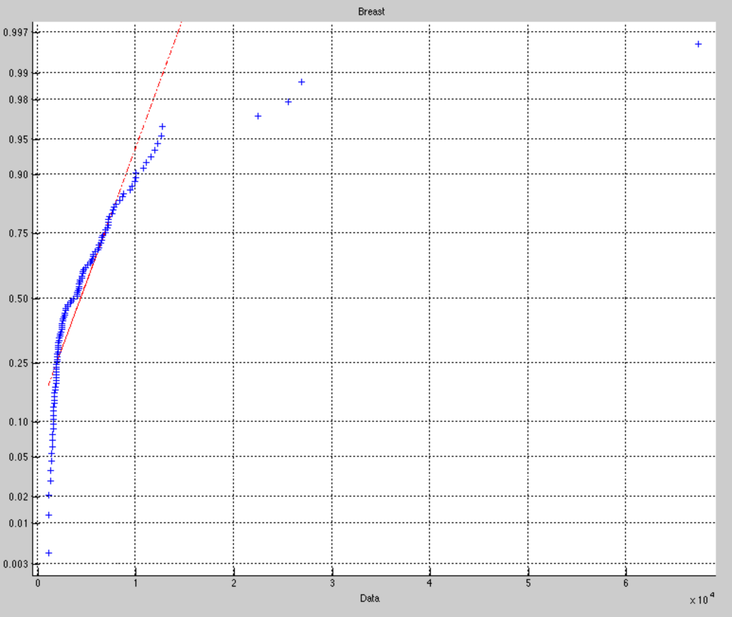
Development of randomly generated somatic mutations
Blue – data from breast cancer patients
Red – based on data, what a normal distribution of mutations looks like
Note: Existence of outliers
Next step: introduce standard deviation
Theoretical Percentile

Slide 12
Next steps:
Make random generated patient mutations more robust
Use signatures from Alexandrov, et al.
Introduce standard deviation for normal distribution
Test TF activator and repressor data against background (random generated)

Slide 13
Recurrence

Slide 14
Recurrence – window algorithm Goal: amplify signal + continuity
Variable length

Slide 15
Recurrence – signal Goal: amplify signal + continuity

