Slide 1
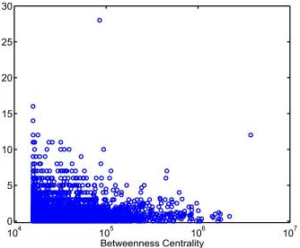
PPI
R package dependency network
r= -0.1, P=4x10⁻⁴
Nonsynonymous to synonymous SNP Ratio
r= +0.34, P<2.2x10⁻¹⁶
Kim et al PNAS 2007

Slide 2
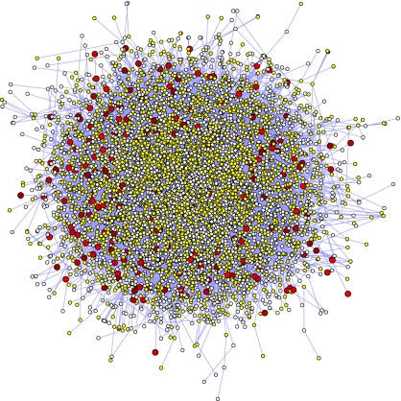
Kim et al PNAS 2007

