Slide 1
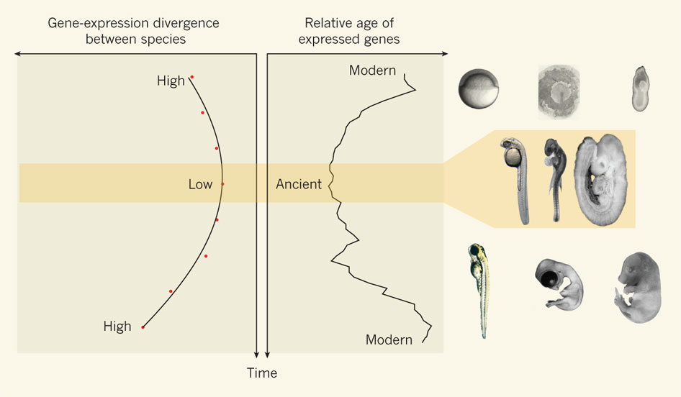
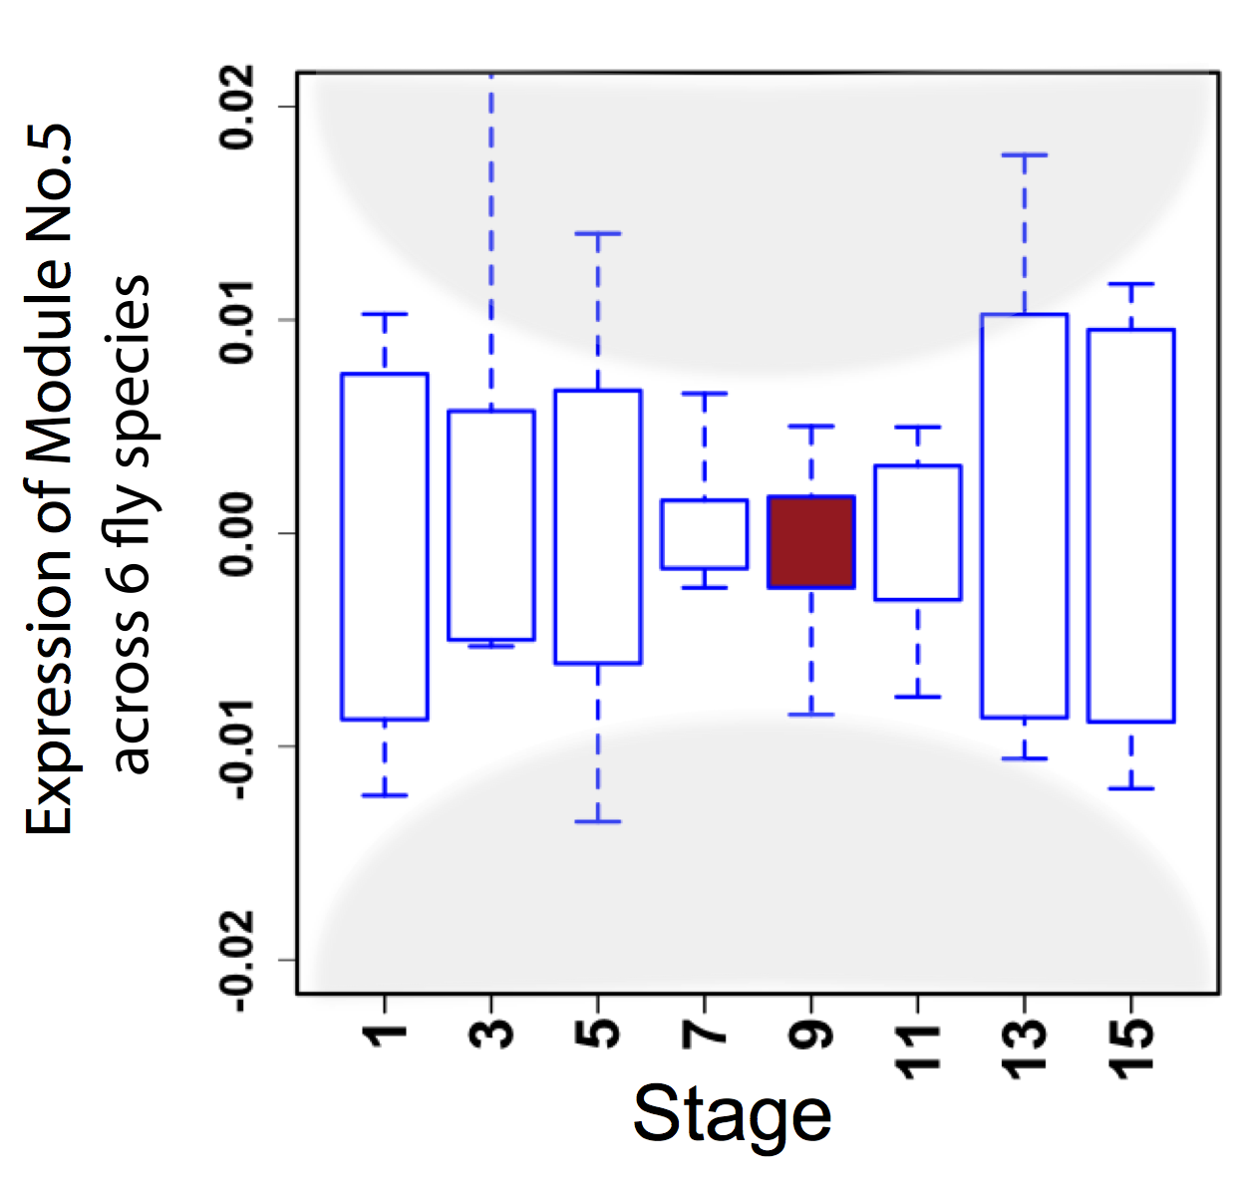
Hourglass Behavior
The developmental hourglass, as revealed by comparative genomics
Nature 468, 768–769 (09 December 2010)
Canonical Inter-organism Behavior
“Hourglass hypothesis”: all organisms go through a particular stage in embryonic development ("phylotypic" stage) where inter-organism expression differences of orthologous genes are smallest.
We identify modules (12 out of 16) which have this behavior at the phylotypic stage.
[ENCODE-modencode Transcriptome paper, Nature 512, 445–448, 2014]
phylotypic stage

Slide 2
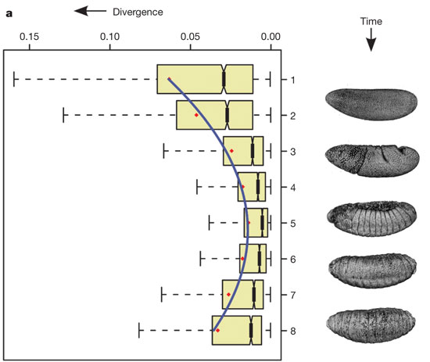
Hourglass Behavior
Temporal expression divergence is minimized during the phylotypic period.
AT Kalinka et al. Nature 468, 811-814 (2010) doi:10.1038/nature09634
Canonical Inter-organism Behavior
“Hourglass hypothesis”: all organisms go through a particular stage in embryonic development ("phylotypic" stage) where inter-organism expression differences of orthologous genes are smallest.
We identify modules (12 out of 16) which have this behavior at the phylotypic stage.
[ENCODE-modencode Transcriptome paper, Nature 512, 445–448, 2014]
phylotypic stage

