Slide 1
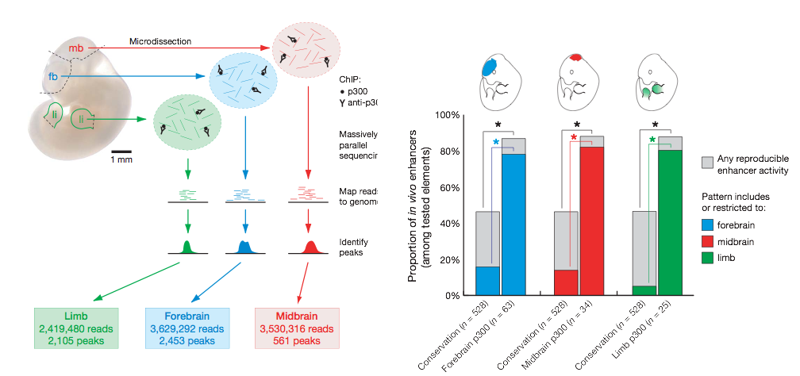
CBP/p300 is a cofactor that is important for enhancer function
p300 peaks were shown to be good predictors of enhancer activity.
Visel, et al., Nature 2009

Slide 2
H3K27ac is an important mechanism to regulate the activity of enhancers in different developmental stages
Epigenetically, H3K27ac marks are present near active enhancers.
Nord, et al., Cell, 2013

Slide 3
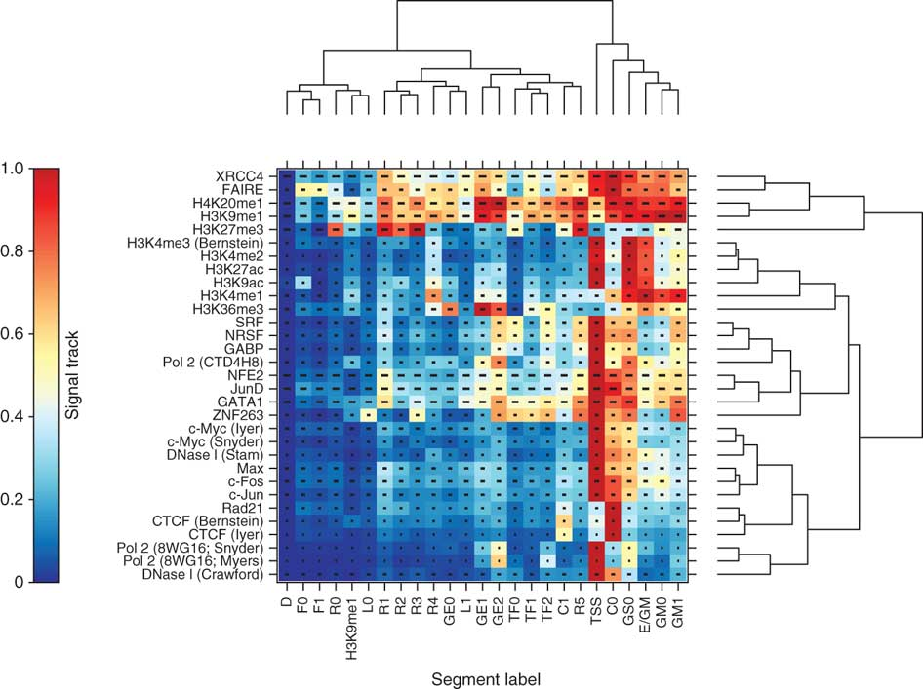
Unsupervised segmentation of genomes based on epigenomic datasets are often used to predict enhancers
Ernst, et al, Nature Methods, 2011
Hoffman, et al, Nature Methods, 2012

