Slide 1
MTS-biotin, an improved reagent for RNA Turnover experiments
Michael Rutenberg Schoenberg
P2-TECH
August 28, 2014
Gerstein Lab

Slide 2
RNA turnover
RNA-Seq tells us how much of a given RNA is present
but… How long does each individual RNA last?

Slide 3


RNA turnover: Experimental scheme
Feed cells “4SU”, a replacement for U in RNA
“New” RNA contains 4SU, “old” RNA does not
Purify 4SU-containing RNA away from 4SU-free RNA
Sequence “new”, “old”, and total RNA with spike-ins
U
4SU
Examples of this method: Schwanhausser et al. Nature 2010, Gregersen et al. Mol. Cell 2014

Slide 4
Half life measurement
Intuition: If an RNA has a short half life, it will need to be transcribed more to maintain the same RNA level
OR
Dolan et al. RNA 2008

Slide 5
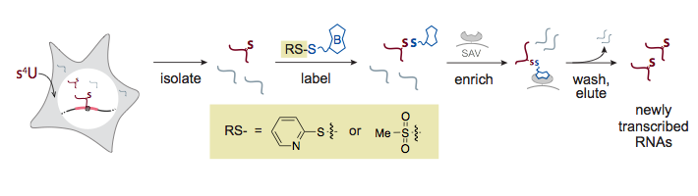
Experimental Scheme (nitty gritty)
Steps to purify 4SU-containing RNA
  Connect biotin to 4SU
  Precipitate with streptavidin beads
Problem: HPDP-biotin only biotinylates 1% of 4SUs
Experimental finding: MTS-biotin biotinylates ~50% of 4SUs

Slide 6
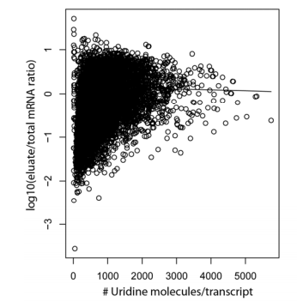
Implications of inefficient 4SU biotinylation
Short transcripts will be pulled down less efficiently → biased half life measurements
Schwanhausser et al. Nature 2010

Slide 7
Analysis pipeline
1. Align to human + pombe genomes and annotated transcriptomes (TopHat 2)
hg19/Gencode 19
Ensembl Fungi 22
2. Filter Unique Reads
hg19/Gencode 19
Ensembl Fungi 22
3. Quantify annotated transcripts using on fixed annotation (Gencode 19/Ensembl Fungi 22)

Slide 8
Analysis pipeline (cont.)
4. Normalize human FPKMs to S pombe spike-ins
Pombe Genes
S_{norm} = 9.6
HPDP (old) Pulldown
Input (Total RNA-Seq)

Slide 9
MTS (new) has much less length bias than HPDP (old)
Dominant transcript isoforms (>90% of total expression for gene)

Slide 10
Future directions
Half life calculations from current data
  Possible, but experimental design not ideal
Long term
  Connect chromatin regulation (e.g. Chao’s models) more directly to transcription, as opposed to RNA levels
  Connect miRNAs to RNA degradation rates

Slide 11
Acknowledgements
Erin Duffy
Catherine Stark
Matthew Simon
Jing Zhang
Joel Rozowsky
Mark Gerstein

