Slide 1
Summary of PAWG-2,9,14
Mark Gerstein, Jakob Skou Pedersen, Nuria Lopez Bigas
for the PAWG-2,9,14 leaders
PAWG-WGL call, 29 Aug 2014

Slide 2
PAWG-2,9,14: Group Structure
Partially merged 2,9,14 since the 3 groups all had proposals for looking at driver elements
Regular call at 8a ET on Mon. alternating between 2,9,14
We've had number of calls together during the summer.
Our schedule gdoc:
https://docs.google.com/spreadsheets/d/12JepS27WEsocyxQ5i6hz_tVIRNvD78oHgnwCR8yQqi8/edit#gid=0
[Mark]

Slide 3
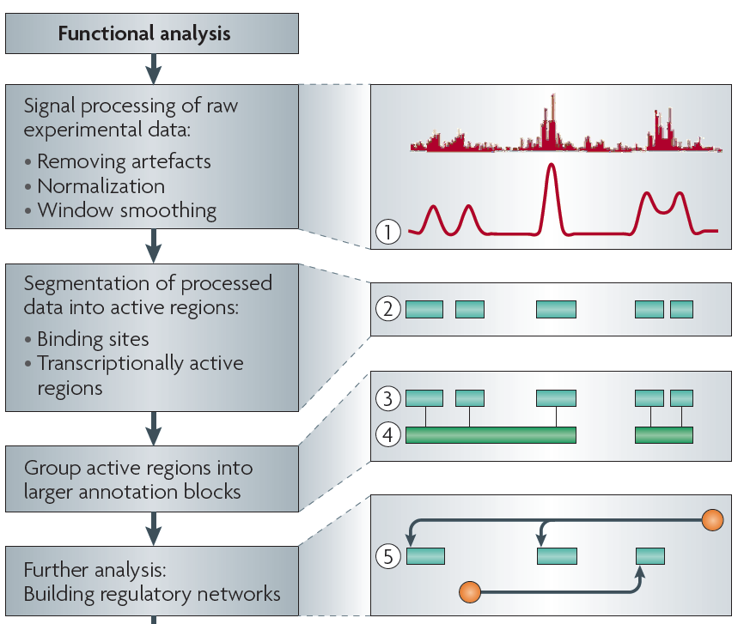
Non-coding Annotations: Overview
There are several collections of information "tracks" related to non-coding features
Sequence features, incl. Conservation
Functional Genomics
Chip-seq (Epigenome & seq. specific TF) and ncRNA & un-annotated transcription
[Nat. Rev. Genet. (2010) 11: 559]
[Mark]

Slide 4
Functional Genomics Annotations
A) PEAKS
1. DNase peaks at the UCSC genome browser {on many cell lines}
2. The regulation track at the UCSC genome browser, with compilation of TF ChIP-seq peaks from uniform processing (individual peaks are annotated with TF and cell line)
3. Blacklist Regions
B) RNA BASICS [ ~Regulatory ]
4. A matrix of expression data of known genes (or exons) for protein-coding genes & known ncRNAs [Gencode version (V19)] {on many cell lines}
5. Novel RNA contigs track, i.e., possible novel transcripts. "Transcriptionally Active Regions (TARs)”
6. Novel junctions
C) PROMOTERS
Annotated GENCODE TSSes (TSSes with FANTOM CAGE support ?)
D) ENHANCERS (Supervised)
- Yip et al., Ren et al. &c
E) UNSUPERVISED SEGMENTATIONS, INCLUDING ENHANCERS
- ChromHMM, SegWay, HiHMM....
F) HOT/LOT REGIONS
G) CONNECTIVITY
7. Enhancer-target gene connection
8. TF-target network connectivity.
9. TADs: Topologically Associated Domains.
H) OTHER [ ~Regulatory ]
10. List of Allelic SNPs & Regions
[Mark]

Slide 5
Regulatory Annotations
preliminary gdoc
https://docs.google.com/spreadsheets/d/1zRQJ6O7Cqzqyf6K28pEY3BvcOp7bz__tF0mnWcIbvlQ/edit#gid=104785709
[Mark]

Slide 6
Annotations: ncRNA
[Jakob, 2-3 slides, incl. miRNA SOP]

Slide 7
Tools
Collection of tools to identify drivers:
https://docs.google.com/document/d/10K4hrajD1y8zuO70wUfiOHTqo8vP87Lgx0I0_NudDEM/edit?usp=sharing
20 tools from 14 different labs listed at the moment
2 main types of methods:
- Methods to annotate and prioritize individual mutations (eg. FunSeq, Oncotator, 3D_SNP, CanDrA)
- Methods to detect signals of positive selection in genes/elements (eg. MutSig, OncodriveFM, MuSiC, ActiveDriver)
[Nuria]

Slide 8
Method | Authors | Description | Coding genes | Promoters | Enhancers | UTRs | lncRNAs | microRNAs | ...
OncodriveFM | Lopez-Bigas lab | Identifies genes/elements with a significant bias towards the accumulation of functional variants | XXX | XX | XX | XX | XX | XX
OncodriveCLUST | Lopez-Bigas lab | Identifies genes/elements with mutations significantly clustered in particular regions | XXX | X | X | X | X | X
Two methods inspired on dN/dS | Inigo Martincorena (Peter Campbell’s lab) | They identify genes and non-coding elements with significant recurrence, considering the mutation spectrum, the sequence composition and the variation of the mutation rate along the genome, with or without covariates. Ready to run but unpublished for WGS. | XXX | XX | XX | XX | XX | XX
FunSeq | Ekta Khurana and Yao Fu (Mark Gerstein’s lab) | Identifies somatic mutations predicted to have high functional impact, specially noncoding ones | XXX | XXX | XXX | XXX | X | X
LARVA | Lucas Lochovsky (Mark Gerstein’s lab) | Identifies elements with more recurrent mutations than expected randomly | XX | XX | XX | XX | X | X
ActiveDriver | Jüri Reimand (Gary Bader’s Lab) | Site-specific mutational enrichment analysis of genes and other genomic regions | XXX | XX | XX | XX | XX | XX
MIMP | Jüri Reimand, Mohamed Helmy, Omar Wagih (Gary Bader Lab) | Predicting mutational rewiring of sequence elements | XXX | X | X | X | X | X
ExInAtor | Rory Johnson / Andres Lanzos (Roderic Guigo Lab) | Identifies lncRNAs with excess of exonic mutations. First version ready, undergoing testing. |  |  |  |  | XX
InterScreener | Lars Feuerbach (Brors Lab) | Integrative screener for functional non-coding SNVs. Integrates SNVs, CNV, SVs, mRNA, miRNA and methylation data |  | XX | X | XX
HIT’nDRIVE | Raunak Shrestha, Ermin Hodzic (Cenk Sahinalp's Lab) | Integrates genome (SNVs, CNVs, SVs) and transcriptome (mRNA) (and/or epigenome) data from a number of tumor samples identifying and prioritizing altered genes as potential drivers. | XXX
3D_permutation | Akihiro Fujimoto (Riken) | Analysis of mutation clusters in 3D protein structures. Applied to Riken liver cancer data and COSMIC data. Functional analysis will be started. | XX |  |  |  | X
3D_SNP | Francisco Martínez-Jiménez (Marti-Renom Lab) | Functional impact of non-synonymous SNPs in modeled 3D structures of proteins from coding-regions of the genome. | X
wKinMut | Jose MG Izarzugaza (CBS/DTU) and Alfonso Valencia Lab | Analysis and classification of mutations in protein kinases. | XX
ncDriver | Henrik Hornshøj (Jakob Skou Pedersen lab) | Multi-step significance evaluation of mutation rates and intensities in non-coding elements. Combines four separate tests on: intensity, cancer type specificity, local conservation, & global conservation. | XX | XX | XX | XX | XX | XX
rwClust | Jakob Skou Pedersen lab | Significance evaluation of mutation clusters within genomic elements using Random Walk theory. | X | X | X | X | X | X
Significance evaluation of mutational hot spots | Jakob Skou Pedersen & Asger Hobolth labs | Significance evaluation of mutational hotspots based on probabilistic null model capturing different levels of mutational heterogeneity (between samples, along genome, mutational context). | X | X | X | X | X | X
CanDrA | Ken Chen lab | Identify the driver potential of somatic mutations | XXX
Identification of driver mutational hotspots | Ken Chen lab | Identification of driver mutational hotspots in a knowledge based statistical model (cancer type-specific, gene-specific, sequence context, etc) | XX | X | X | X | X | X
MuSiC2 - Mutation Significance in Cancer: | Ding Lab | A suite of tools equipped to identify genetic loci contributing to cancer on the gene, pathway, and clinical level. Calculations of significance incorporate mutation rates, protein databases, drug databases, and previous literature. | XXX | XX | XX | XX | XX | XX

Slide 9
Plan for Analysis
To test annotation methods few samples might be enough and could be done with Train 1 data. To run methods that identify signals of positive selection in genes and non-coding elements we will need larger number of samples, instead of waiting until Train 2 data is ready, we decided to prepare a pilot dataset with published data to do a pilot analysis.
Dataset prepared by Loris Mularoni (UPF) with help from Ludmil Alexandrov (Sanger)
[Nuria]

Slide 10
Plan for Analysis
TIMING of the pilot analysis:
- 1st September - pilot datasets should be ready and available to everyone
- 1st to 15th September - people will run their methods with the pilot dataset
- 15th to 30th September - upload of results in the SFTP
- October - Intersection of results
- 4th-5th November - Presentation of results in Boston meeting
[Nuria]

Slide 11
Plans for Sharing
Our impression
- We need to use NCI TCGA DCC sftp site for sharing. Correct? Only for US Data?
- We can not use synapse. (However, Kevin White suggested an installation of synapse on the Bionimbus PDC.)
Created sftp://tcgaftps.nci.nih.gov/pancan/pcawg2914
- can we put our analyses here?
- is there an organization plan? How to link this with wiki, &c ?
[Mark]

Slide 12
Qs for the WGL[eaders]
We would like to have an indication of the regions of the genome without mutation calls (eg a mask)
Also, how to filter the mutations on quality level ?
What's the plan/timeline for germline mutations ?
We would like to reuse the standard RNAseq SOP as much as possible for the lncRNA expression profiling. What is the status of the RNAseq SOP ?
[Mark]

