Slide 1
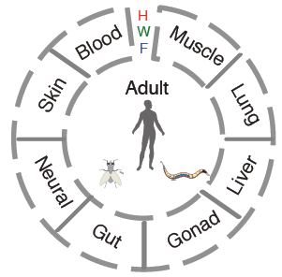
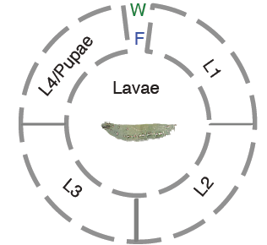
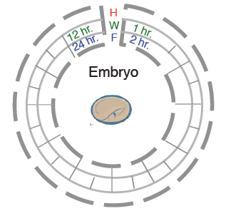
modENCODE/ENCODE Funcational Genomics Resource
Broad sampling of conditions across transcriptomes and regulomes of human, worm and fly
  >100 billion reads (>1000 datasets)
Comparisons
  Transcription factor binding, histone modifications and gene expression
  Effects of orthologous transcription factors
  Transcription factor regulatory networks
Adult
Larvae
Embryo

Slide 2
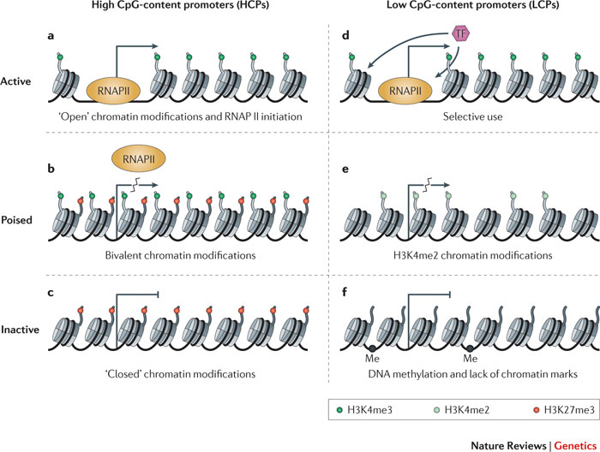
Focus on Promoters
Active Promoter
Key Questions
  How do we define the active regions of promoter?
  How do we relate the epigenetic marks on a promoter & its chromatin state to the level of transcription?
  Are these general principles conserved between phyla?
Histone modifications
Repressed Promoter
Zhou et al. Nat. Rev. Genetics 2011

Slide 3
Focus on Promoters
Active Promoter
Broader Significance
  Unified understand of “ancient” principles of metazoan gene expression
  Useful in better annotating the genome
  Useful in understanding how epigenetic changes (e.g. in cancer) drive expression
Histone modifications
Repressed Promoter
Zhou et al. Nat. Rev. Genetics 2011

