Slide 1
Initial tissue-based miRNA analysis
8/6/14

Slide 2
Overview
Goal: learning from existing miRNA expression data from a variety of tissues to predict the tissue of origin for exRNA samples.
Data: 11 total tissues, ~540 samples of the expression levels of ~2400 miRNAs.
Initial focus: Determining which miRNAs give the most discriminatory information
Notes:
We searched DNA nexus for as much openly accessible miRNA data as possible and pruned runs that were from non-wild type tissues such as cancer or tissues actively involved in psoriasis. The idea was to find miRNAs or groups of miRNAs within the 2400 we have information about with highly differential expression.

Slide 3
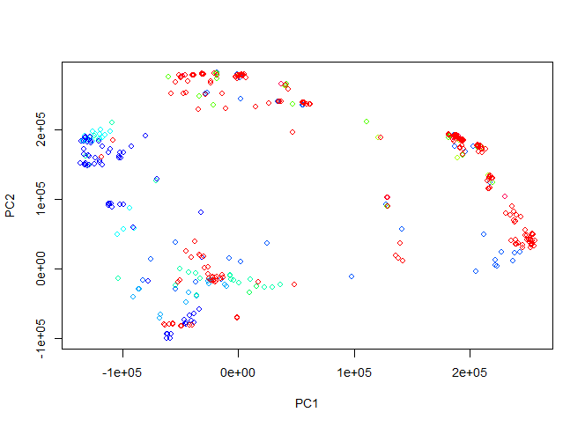
True Tissue Clusters (PC projected)
Notes:
Here’s a quick visualization of the miRNA data set. As you can see, one of the major problems with the data is a varying number of samples for each tissue – it’s hard to pick out 11 different colors from this graph. The clustering of the tissues is not immediately obvious, but that’s to be expected since this is a projection onto to first 2 PCs.

Slide 4
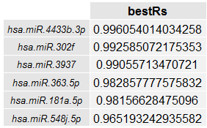
Summary of top R squared values for individual miRNAs:
Notes:
The first important result was that certain miRNAs were surprisingly good predictors of tissue type – there were multiple miRNAs with an R squared value above 0.95. However, it’s possible that these single miRNAs are actually distinguishing between experiments rather than tissue types (If the top miRNA was actually just highly variable it would produce results similar to these, since each tissue would end up with varying values). Such an miRNA would have essentially 0 predictive power. If we want to be more certain of the predictive power of our model, we are better off looking at clusters of miRNAs.

Slide 5
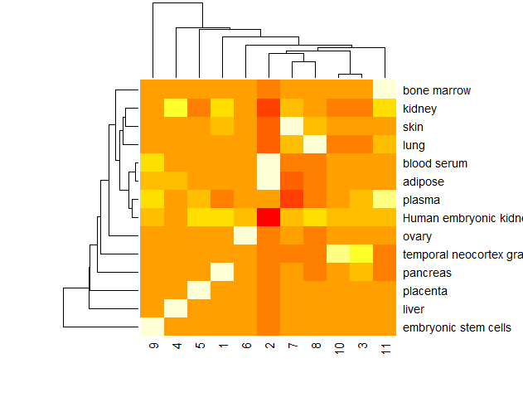
Kmeans clustering of miRNAs, mean normalized (top 200). 0.89 adj R sq
Notes:
This is the first of the two most promising clustering results. The 200 miRNAs with the highest R squared values from the previous step were clustered into 11 groups using k means clustering and the averages from each cluster were used to predict tissues across all samples. As the heatmap demonstrates, each tissue appears to have at least one cluster with a significantly higher or significantly lower average expression compared to the rest of the tissues. The white boxes appearing in only one column and one row are highly promising, and the high adjusted R sq corroborates this. Note that all the miRNA expression data here has undergone feature scaling – prior to clustering, all the values in each column were mean normalized (val – mean/stdev), putting all the expression data in the same range. This was necessary due to the highly variable nature of the expression data, and the clusters it produced were more promising than performing a log normalization.

Slide 6
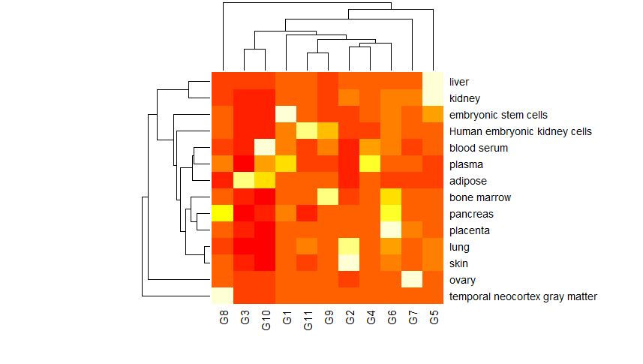
Hierarchical clustering of miRNAs (mean normalized): 0.96 adj R sq
Notes:
Using hierarchical clustering with all the miRNA samples produced even better results, although the visualization is not as striking here. Since this model has a better R sq and uses more of the miRNAs the rest of the analysis was done with this one.

Slide 7
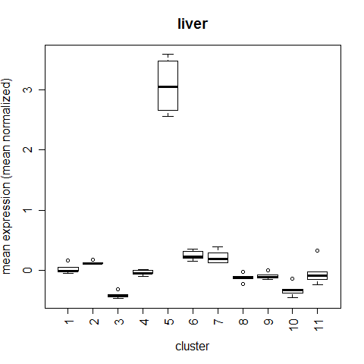
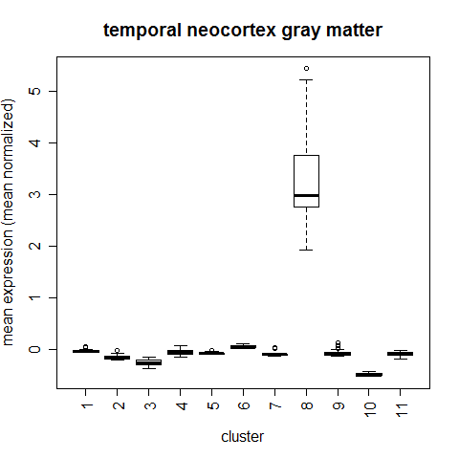
Differentiating Tissues: Example
Notes:
A striking example of how easy it is to differentiate tissues based on this clustering model. The y axis is just the mean normalized expression for a given cluster. As you can see, liver tissue is highly enriched for cluster 5 and brain tissue is highly enriched for cluster 8.

Slide 8
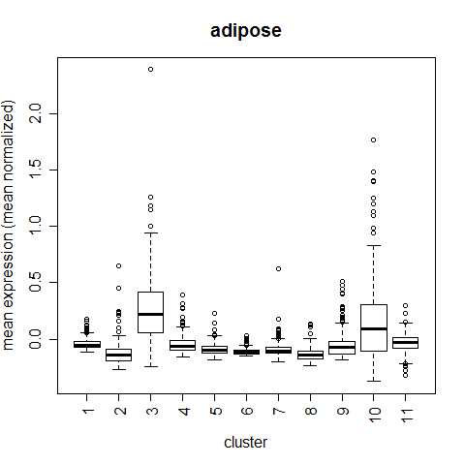
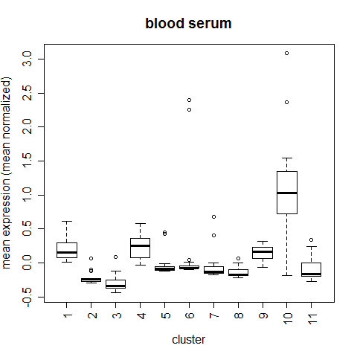
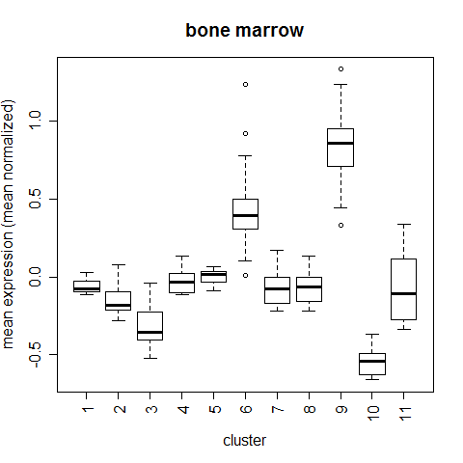
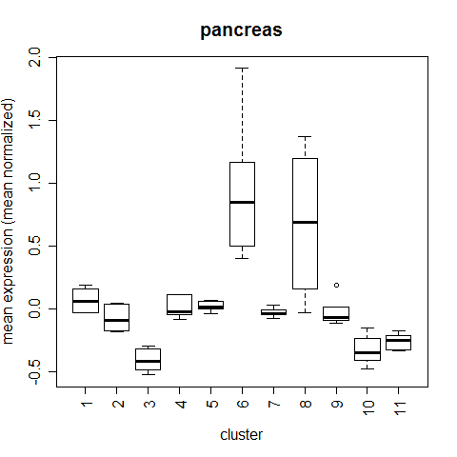
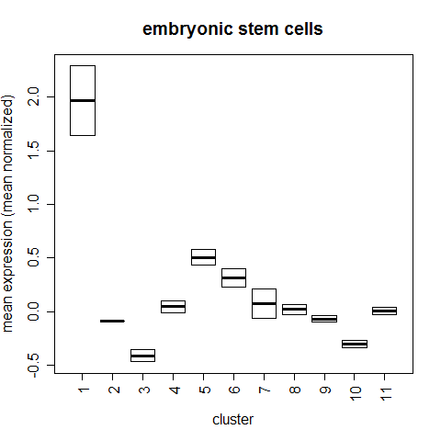
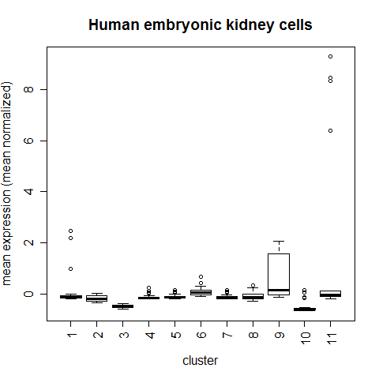
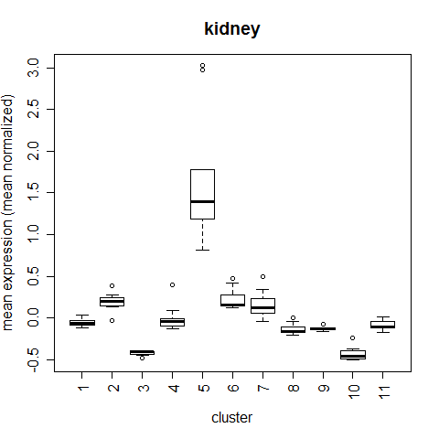
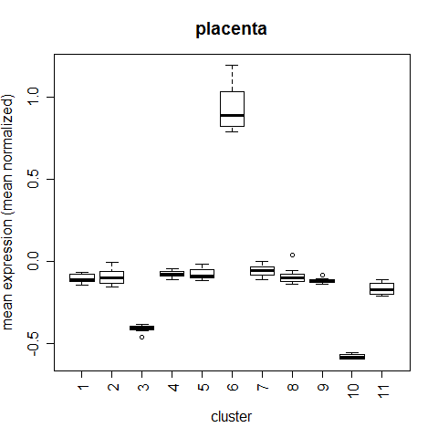
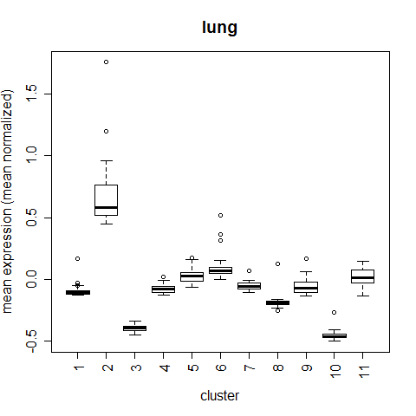
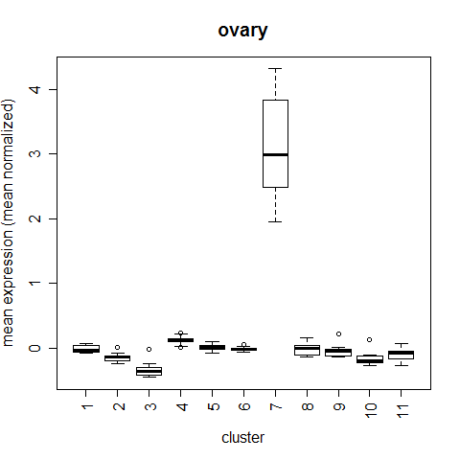
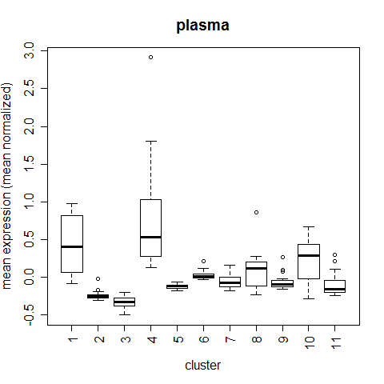
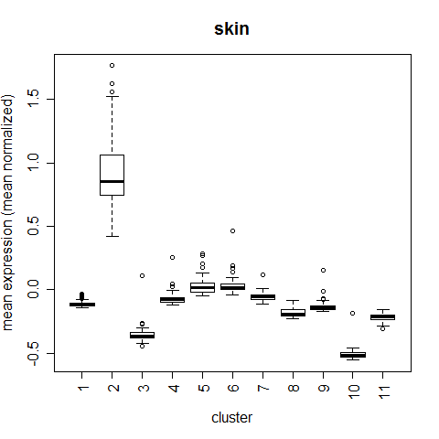
Notes:
This is the same data as we saw in the heatmap, but it might be a little easier to see the differentiating characteristics in these boxplots. Each tissue has a fairly unique “fingerprint” of miRNA cluster expression, usually with at least one standout cluster.

Slide 9
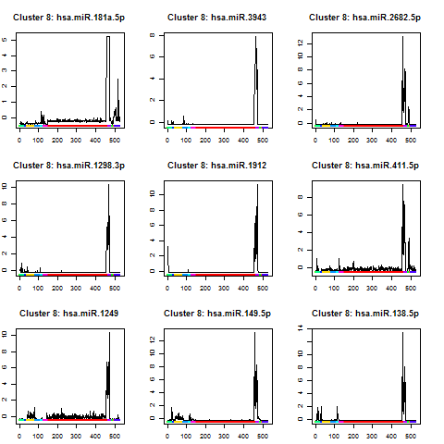
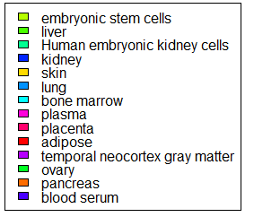
Notes:
If we look closer at each cluster, we can confirm that miRNAs from these clusters are highly correlated with certain tissues and highly correlated with each other. The dimensionality of the data could likely be reduced by simply averaging across these clusters (or at least the miRNAs within each cluster that are sufficiently correlated).
Looking at the individual miRNAs more closely also gives us the chance to determine whether the results are plausible by looking at existing literature on each miRNA. For example, miR-181a, the miRNA in the top right, is involved in glioma suppression, so its elevated presence in brain tissue makes sense.

Slide 10
Next steps
Check the results against miRNAbodymap.org.
Consider feature pruning, dimensionality reduction of miRNA clusters. Look into clustering by genome location.
Use modified/normalized miRNA data to train tissue classifier
Notes:
There’s still some work left to be done with this data. We’d like to “validate” the results by checking expression levels of miRNAs in human tissues as discovered by the miRNAbodymap tool, which uses qPCR analysis data sets instead of RNAseq. Hopefully we will see similar miRNAs at relatively high or low expression levels in the tissues we analyzed.
We also want to look into whether or not the miRNAs in these clusters are located near each other on the genome. It would make sense that tissue-specific miRNA modules would all be transcribed together, so this would be an interesting finding on its own (the extent to which these clusterings agree might also help verify our result).
Lastly, we’ll produce a tool that can be used on exRNA data to determine the most probable tissue of origin. With any luck, we will also be able to determine the extent to which each tissue contributes to a given miRNA pool (although this goal may be too ambitious).

