Slide 1
OrthoClust^{N}
Paul Muir
7/31/2014

Slide 2
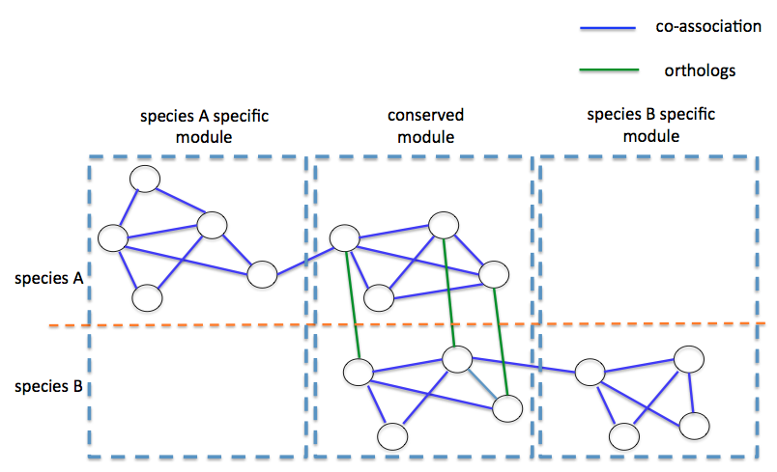
OrthoClust: Cross Species Clustering
Inputs:
species-specific co-association networks
orthology relationships
Represents the data as a multi-layer network.
Gene networks are constructed based on co-expression data within species.
Orthologous relationships are used to add edges between nodes in different species.
Orthoclust energy function for two species:

Slide 3
Extensions of OrthoClust
Write the program in Python for ease of integration with Kbase.
Implement a heuristic that speeds up the rate of the calculation (steepest descent)
Extend the algorithm to support clustering of N species

Slide 4
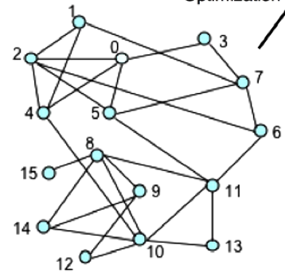
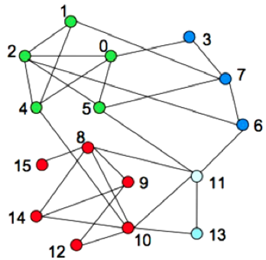
Louvian Steepest Descent Heuristic
Algorithm:
Assign a cluster to each node (gene)
For each node i, evaluate whether reassigning it to a the cluster of each of its j neighbors would improve modularity
Reassign node i to the cluster with the greatest resultant positive change.
Repeat this calculation until a local maxima in modularity is reached.
Notes:
Deterministic (seed with a random sequence for each iteration to overcome this)
V. D. Blondel, J.-loup Guillaume, R. Lambiotte, E. Lefebvre, Networks , 1-6 (2008).

Slide 5
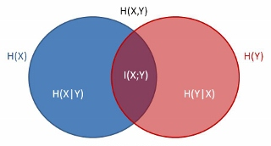
Comparison of steepest descent to simulated annealing
Mutual information was used to compare the similarity of clusters from simulated annealing OrthoClust and steepest descent Orthoclust
The results exhibit a high degree of mutual information. (Not as high as inter-run comparisons)
Normalized Mutual Information
Between Methods | 0.7262
Between runs (steepest descent) | 0.9229
A. Lancichinetti, S. Fortunato, Physical Review E 80 (2009). http://physics.stackexchange.com/questions/36260/quantum-mutual-information-scaling

Slide 6
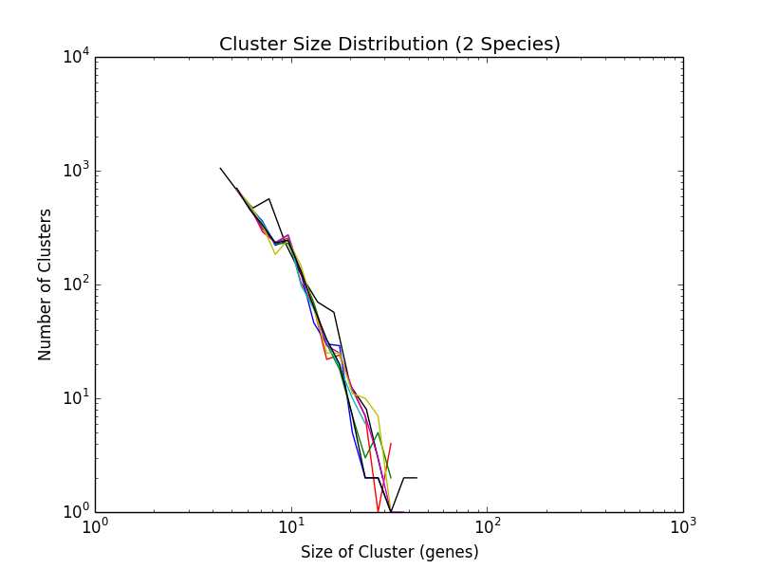
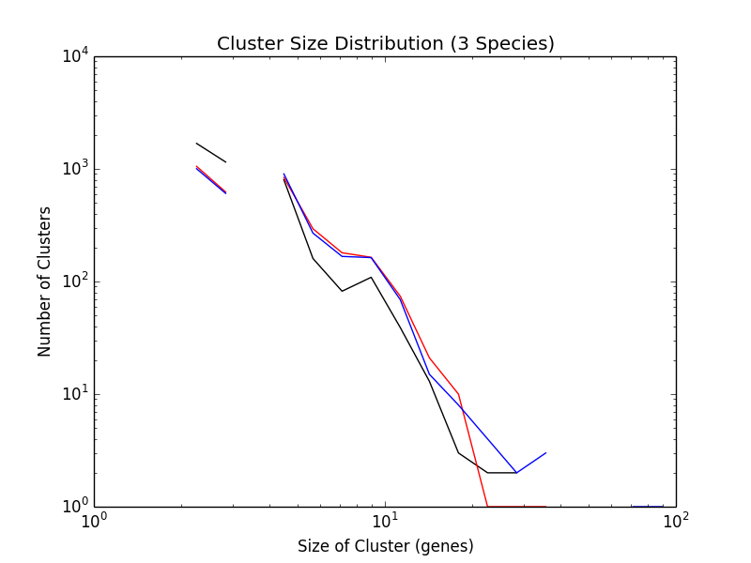
The cluster size distribution for OrthoClust remains similar across many values of kappa.

Slide 7
Cluster heterogeneity increases with kappa. (3 species)

Slide 8
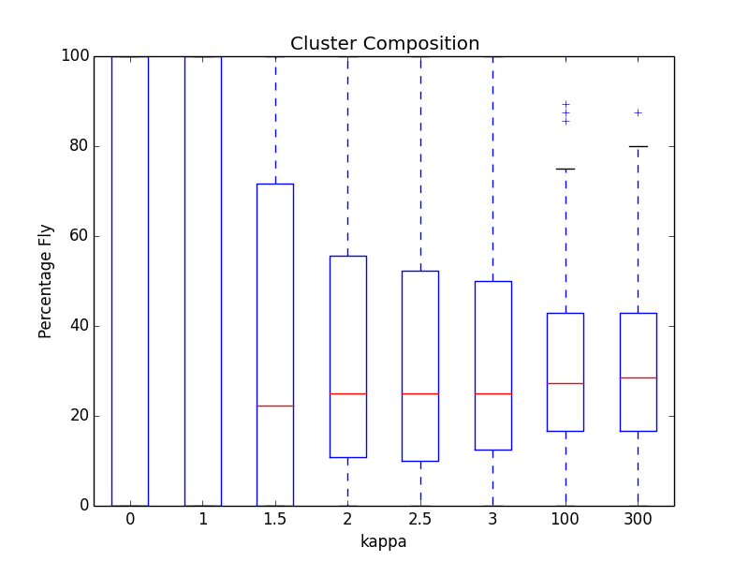
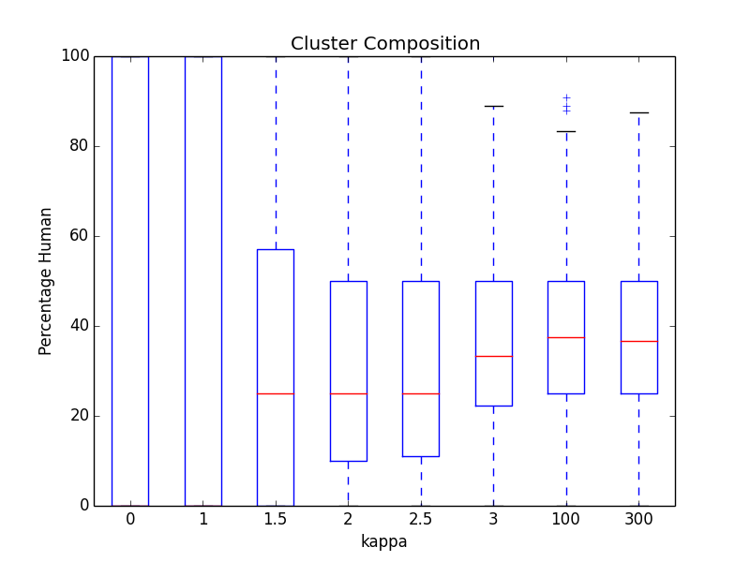
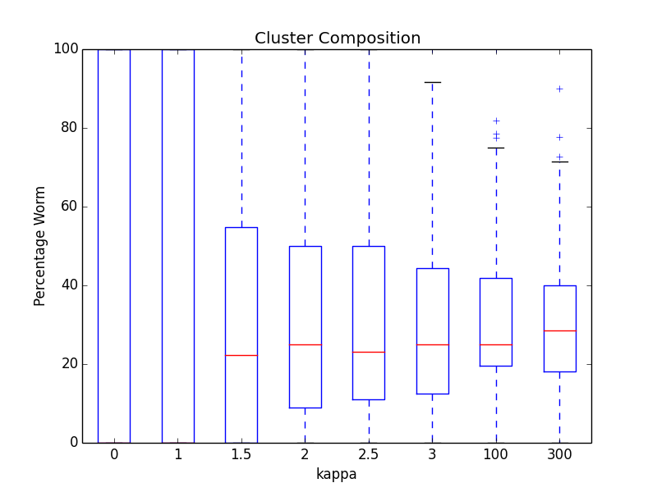
Cluster heterogeneity increases with kappa. (3 species)
4349 Fly Genes
5575 Human Genes
4486 Worm Genes

Slide 9
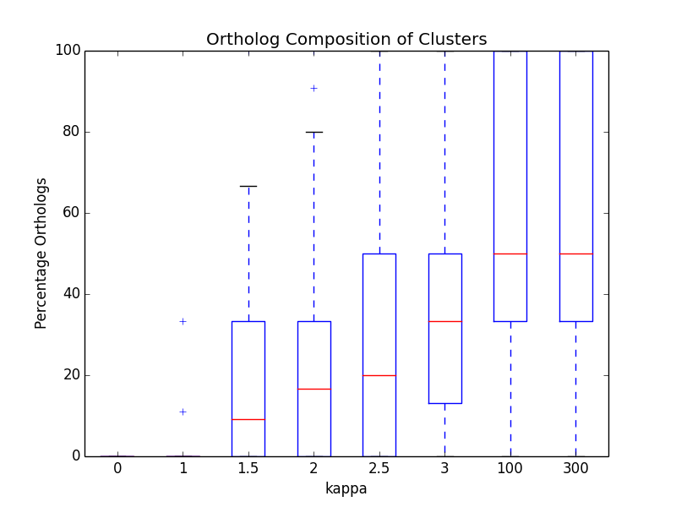
Increasing kappa leads to an increase in the ortholog composition of clusters

Slide 10
Future Directions
Evaluate clusters for enriched GO terms.
Cluster data from 4+ species
Apply to protein interaction networks
Package the program as a user friendly tool
Add energy term to represent conserved one-to-one-to-one orthologs
Orthoclust energy function for three species with unique triples included:

