Slide 1
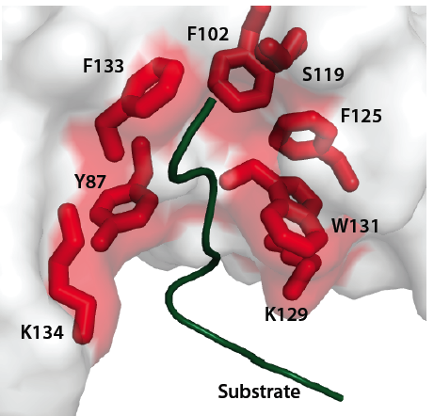
SPOP mutations affect substrate binding
Barbieri et al, Nature Genetics 2012

Slide 3
Red = prostate
Blue = endometrial

