Slide 1
MotifVar
Jieming
Variation

Slide 2
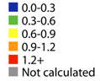
Hypervariability might infer function
Magliery & Regan, BMC Bioinformatics, 2005
Hypervariable: 2,5,9,12,13,33,34
Conserved sites: 8,11,15,20,24,27,32

Slide 3
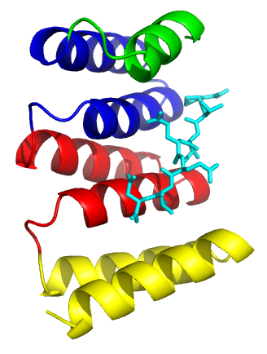
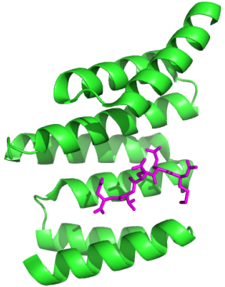
Hsp70/Hsp90-Organizing Protein (HOP)
A co-chaperone that links molecular chaperones Hsp90 and Hsp70 together
Hsp90 → a family of chaperones that assists in protein-folding of particularly many signaling proteins → dysregulation leads to cancer – Hsp90 inhibitors in cancer treatment
Hsp70 → a family of chaperones implicated in cell apoptosis (more Hsp70, less apoptosis) → also implicated in cancer (assoc with higher Hsp70 levels)
TPR1 (PDB: 1ELW)
-binds Hsp70
-PTIVEED
TPR2A (PDB: 1ELR)
-binds Hsp90
-MEEVD
TPR2B (PDB: 3UPV)
-binds both Hsp90
and Hsp70 (low
affinity)
TPR1
TPR2A
TPR2B
cv
cv
Notes:
1ELW, 1ELR schefluer 2000
3UPV buchner 2012 PTVEEVD

Slide 4
Hsp70/Hsp90-Organizing Protein (HOP)
chr | start | end | maf | NS | resNum
chr11 | 63960553 | 63960554 | 0.0014 | nonsynonymous | 2 | TPR1(1)
chr11 | 63960599 | 63960600 | 0.0009 | synonymous | 17 | TPR1(1)
chr11 | 63960620 | 63960621 | 0.0023 | synonymous | 24 | TPR1(1)
chr11 | 63964813 | 63964814 | 0.01 | synonymous | 24 | TPR2A(1)
chr11 | 63970624 | 63970625 | 0.06 | synonymous | 10 | TPR2B(3)
chr11 | 63964746 | 63964747 | 0.0005 | nonsynonymous | 2 | TPR2A(1)
chr11 | 63961704 | 63961705 | 0.0005 | synonymous | 17 | TPR1(3)
chr11 | 63960611 | 63960612 | 0.0005 | synonymous | 21 | TPR1(1)
chr11 | 63970658 | 63970659 | 0.0005 | nonsynonymous | 22 | TPR2B(3)
chr11 | 63967664 | 63967665 | 0.0005 | nonsynonymous | 23 | TPR2B(1)
chr11 | 63960623 | 63960624 | 0.0005 | synonymous | 25 | TPR1(1)
chr11 | 63961743 | 63961744 | 0.0005 | synonymous | 30 | TPR1(3)

Slide 5
TPR1-Hsp70
0.0014 | nonsynonymous | 2
0.0009 | synonymous | 17
0.0023 | synonymous | 24
Notes:
Clamp residues = cyan
Other Peptide binding = magenta

Slide 6
TPR2A-Hsp90
0.01 | synonymous | 24

Slide 7
TPR2B
0.06 | synonymous | 10

Slide 8
20 8 24 11 27 15 17 4 28 16 7 32 26 30 19 6 21 23 10 3 14 29 1 25 18 34 31 5 33 22 12 13 9 2

Slide 9
TPR1-Hsp70
0.0014 | nonsynonymous | 2
0.0009 | synonymous | 17
0.0023 | synonymous | 24
Notes:
Clamp residues = cyan
Other Peptide binding = magenta

Slide 10
TPR2A-Hsp90

Slide 11
TPR2B

