Slide 1
TCGA data organization OR How to fill up Grace
Michael Rutenberg Schoenberg
P2-Variation
14 July 2014

Slide 2
Data types
Whole Genome Sequencing (WGS)
Whole Exome Sequencing
RNA-Seq
miRNA-Seq
(Bisulfite-Seq)

Slide 3
Stategies
All of a single data type
All data types in specific cancers
All data types for as many individuals as possible

Slide 4
Getting information on TCGA Resource
CGHub Summary stats
https://cghub.ucsc.edu/summary_stats.html
Data manifest
https://cghub.ucsc.edu/manifest_description.html
Easy to analyze, then download using cgquery/gtdownload

Slide 5
Total data by cancer type
GB
CGHub

Slide 6
Whole Genomes
Everything
959.59 TB, 7,183 samples
PRAD
16 TB, 312 samples
BRCA
47.4 TB, 457 samples
Notes:
----- Meeting Notes (7/14/14 18:48) -----
Coverage? -

Slide 7
Whole Exomes
Everything
309.2 TB, 27,721 Samples
PRAD
9.6 TB, 1,009 Samples
BRCA
21.4 TB, 2,177 Samples

Slide 8
RNA-Seq
Everything
137.6 TB, 22,221 samples
PRAD
4.7 TB, 777 samples
BRCA
15.7 TB, 2,486 samples
Notes:
https://cghub.ucsc.edu/docs/tcga/UNC_mRNAseq_summary.pdf
----- Meeting Notes (7/14/14 18:48) -----
All prostate, all breast, all kidney (all types)?
WGS TN - coverage (~30X)
Exome TN
RNA TN +
miRNA-Seq
miRNA (?)
Mutations, Indels, SV
RNA-Seq
miRNA-Seq
(matched)
(all)

Slide 9
miRNA-Seq
Everything
4TB, 17,926 Samples
PRAD
219.19 TB, 708 Samples
BRCA
335.22 TB, 2,207 Samples

Slide 10
Patient-centric stats
Samples with all four major expts:
1709 cancer only
530 TB
182 normal
71 TB
173 cancer+normal
67 TB
153 samples not under embargo!

Slide 11
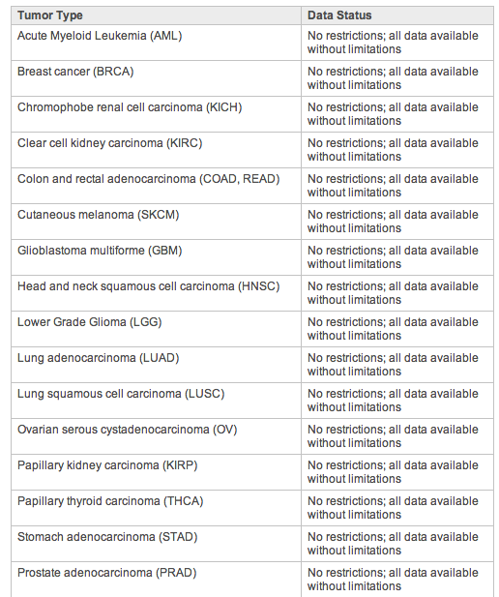
Publication Moratoria?

Slide 12
Patient-centric info
TCGA_full_tumor.txt
Stats for # of samples/patient
TCGA_full_tumor+normal_analysis_ids.txt
Same file, but with analysis_ids (unique identifier for each expt), for each.

Slide 13
Discussion
Other possible analyses
Primary Tumor vs. Metastatic
Patient Outcome Metadata
Organizing calculations
Grace
Download/analyze, then delete?
Benchmark pipelines

