Slide 1
“SV” eQTL based on Linear Mixed model (preliminary)
June 26th, 2014

Slide 2
The main blame in GWAS : population stratification
A simple example for spurious association
Then all the variations that is population specific would be under significant association! (up to 10000+)
Population A
Population B
Ref Allele
Alt Allele
High expression
Low expression

Slide 3
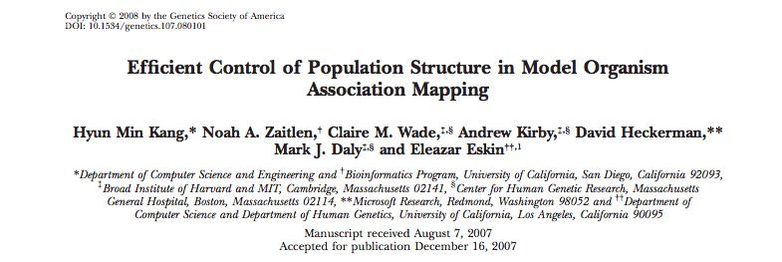
Stratification Correction Options
Matched case and control association
Not possible in eQTL studies…
Remove samples? hidden relatedness, sub-population structures, reduced statistical power
PCA based association studies (after 2007)
Not enough for complicated population structures
Linear Mixed Models (pioneer paper on 2007, simplified but still under extensive computation)

Slide 4
A Simple Linear Mixed Model
 | Log(gene expression)
 | Genotype info
 | Indicator function for population
Parameters for eQTL studies
Fixed coefficient to be estimated
Random variables
Assumptions:
Genotype effect is fixed across all populations
b₁ and b₂ are multivariable normally distributed, basically we are assuming different intercept for different population groups to control population difference
is the i.i.d. random variables for the error items
To test whether β=0 or not

Slide 5
Challenges at first glance
How many populations could we assume?
Dimension of z equal to # of samples (Different from the Lobster eQTLs where just 2 groups are used)
Computational Burden
Large Matrix inversion during Newton-Raphson Method
SVD decomposition for the matrix inversion steps with predefined relatedness matrix estimation
Relatedness Matrix Computation
use the common SNPs to calculate the matrix (tentative, suggested)

Slide 6
The non SNV variants overview - length

Slide 7
The non SNV variants overview - missingness
High Missingness != rare, since missingness = uncertein due to coverage or other issue
Around half of the variants have imputation rate > 0.15, which are not believable for further association test (although can be used anyway)
Somehow: the length>500 variants all with imputation rate = 0.128 (need to be checked up later)
Longer variants are supposed to have larger number of missingness

Slide 8
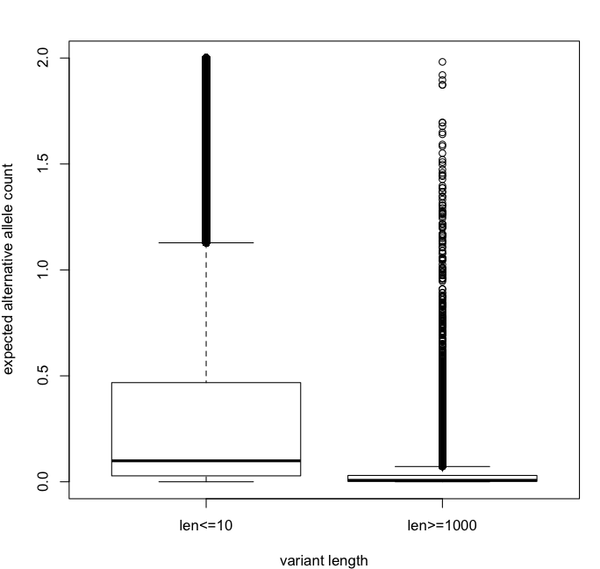
The non SNV variants overview – rare alleles
Larger SVs are usually rare (even after ignoring of missingness), how to do the association study? (collapsed tests?)

Slide 9
Current Scheme
Relatedness matrix
SVs used
Search all SNVs
Require imputation rate < 0.7 (probably too high…, would decrease)
Require MAF >= 0.05, common SNP definition
Centralized covariant matrix used
Search all non-SNV variants
Just use genotype for association
Imputation rate filter: <0.70
MAF filter: >=0.05
Cis-element association: for each gene search the region within up and downstream 100kbp (and inside gene body and introns)
BH correction for P values

Slide 10
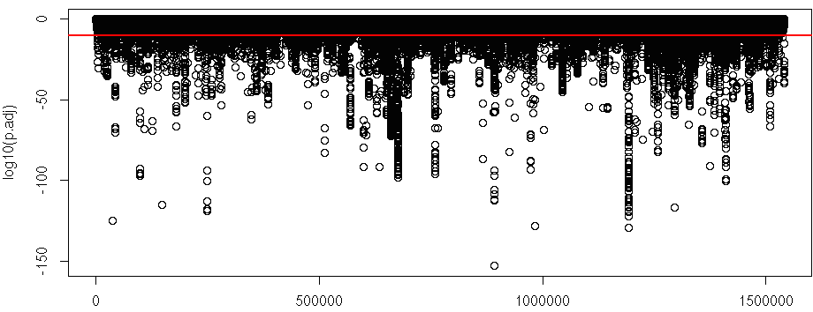
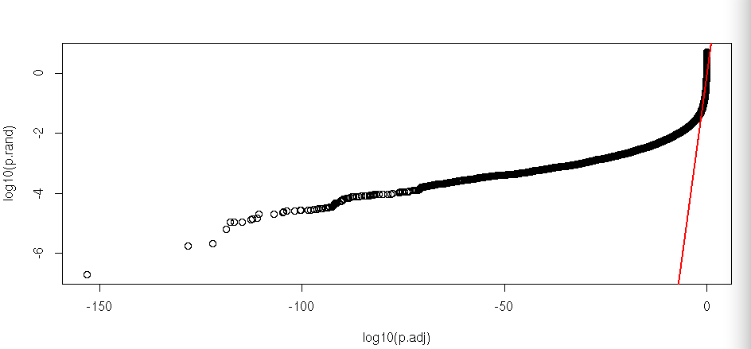

Slide 11
Next Step
Reliable SV calls (other than phase 1 data?)
Missingness: no way to avoid, just remove some or directly use anything from imputation
Rare variants: pooled regression within a whole region
Repressor used?
SV length as x? not a good option for longer SVs
Functional impact score? Max/average/impact score, such as single base resolution Funseq scores?
Model comparison: before and after the stratification correction

