Slide 1
Repeat proteins - motif variation analysis -
Jieming
Variation

Slide 2
Objective
Genomic annotation of SNVs associated with protein-protein interactions in the coding region
To see if we can identify variations involved in protein-protein interactions
Using repeat protein motif analyses

Slide 3
Background
Many types of repeat motifs in proteins
varied length
varied complexity
2. Categorized by structural classes
- varied functions
Kajava, Journal of Struct Biol, 2012

Slide 4
Background
Class III
→ non-globular solenoid structures e.g. TPR, ankyrins
Class IV
globular structures
e.g. WD40, beta-barrel
3. Focus on a group of repeat proteins
→ Modular (motifs)
higher sequence complexity
Repeat cooperativity in function
4. Primary function:
protein-protein interactions
Kajava, Journal of Struct Biol, 2012
Notes:
Range of interactions
Short range vs long range

Slide 5
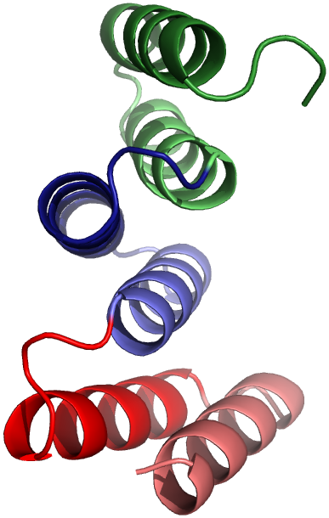
Repeats domains Example: tetratricopeptide repeat (TPR)
DOMAIN
MOTIF/
REPEAT

Slide 6
Motif variation analysis Hypervariability suggests functional residues
Motifs across proteins
TPR
TPR
TPR
TPR
TPR
TPR
TPR
Align
TPR
TPR
Notes:
Motif alignment across all TPRs from all species

Slide 7
Motif variation analysis Hypervariability suggests functional residues
Motifs across proteins
TPR
TPR
TPR
TPR
TPR
TPR
TPR
Align
TPR
TPR
Some sites are really highly conserved, some aren’t.
With Rahim Hashim
Human only (Ensembl/SMART):
623 uniq motif sequences in 377 proteins
B1
A1
A1
B1
Notes:
Motif alignment across all TPRs from all species

Slide 8
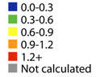
Motif variation analysis Hypervariability suggests functional residues
Magliery & Regan, BMC Bioinformatics, 2005
Hypervariable: 2,5,9,12,13,33,34
Conserved sites: 8,11,15,20,24,27,32
B1
A1
A1
B1

Slide 9
TPR motifs in human genome
Bars : 377 proteins
Lines : 128 genes
Notes:
By proteins, not genes

Slide 10
Question
Hypervariable sites: 2,5,9,12,13,33,34
Random
Functional (structural or for interaction)
Mix of both
Q: Can we distinguish them?
Notes:
Human distribution of motif number?
Human motif vs smart
Differences between ensembl and smart interms of number
427 proteins = have TPRs that may be != 34 but not included here

Slide 11
What features of the variants can we use for prediction
Mapping population and mutation features onto human reference alignment
Allele frequency (do we see an accumulation of rare variants?)
Non-synonymous

Slide 12
Total variants

Slide 13
Rare – 0.5%

Slide 14
Singletons

Slide 15
Singletons (1 chromosome in 2184)
-- Position 25 has no common SNVs
-- No obvious trend

Slide 16
Total variants

Slide 17
Non-synonymous
Notes:
Including prematureStop, splicePverlap and deletionFS

Slide 18
Remove Singletons
Notes:
Note that the premature stop and splce are singletons (thus removed in pink)
But the deletionFS is NOT a singleton

Slide 19
Remove Singletons
-- Position 20, all non-synonymous are singletons
-- Position 24, low number of non-synonymous
Notes:
Note that the premature stop and splce are singletons (thus removed in pink)
But the deletionFS is NOT a singleton

Slide 20
Total variants

Slide 21
Combination – freq + effect

Slide 22
Combination – freq + effect Remove singletons
Notes:
Remove singletons = red and pink shrink
expected
Pos 20,24 – no rare,NS
unexpected
Pos 25 – all rare
Pos 6,12,14,27 – why comm NS in all other pos?? I expect no comm NS in most pos if functional

Slide 23
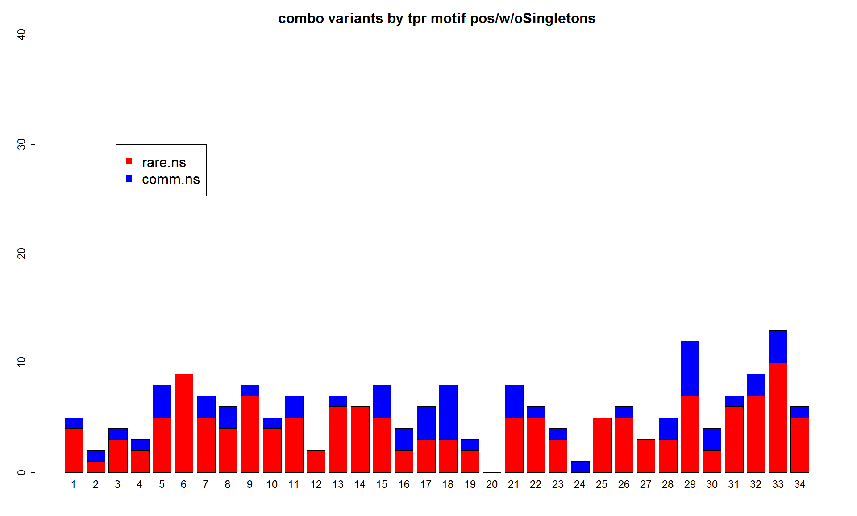
Combination – freq + effect, NS only
Positive control: 8, 20, 24, 27
Hypervariable: 2,5,9,12,13,33,34
V>M – 33% MAF

Slide 24
Combination – freq + effect, NS only
Positive control: 8, 20, 24
Hypervariable: 2,5,9,12,13,33,34
V>M – 33% MAF

Slide 25
Combination – freq + effect, NS only
Positive control: 8, 20, 24, 27
Hypervariable: 2,5,9,12,13,33,34
V>M – 33% MAF

Slide 26
Position 8 – BLOSUM score and #transcripts affected seem to be predictive
 | BLOSUM | MAF
A->S | 1 | 0.01 | ENST00000371809
A->T | 0 | 0.01 | ENST00000245105 | ENST00000539824
A->T | 0 | 0.0041 | ENST00000337331
G->D | -2 | 0.0027 | ENST00000408939
A->V | 0 | 0.0023 | ENST00000470402 | ENST00000391946 | ENST00000585434
G->R | -2 | 0.0009 | ENST00000553443
G->S | 0 | 0.0005 | ENST00000324266 | ENST00000382110
A->V | 0 | 0.0005 | ENST00000261819 | ENST00000541887 | ENST00000344395 | ENST00000441917 | ENST00000535482 | ENST00000544314
A->T | 0 | 0.0005 | ENST00000338104 | ENST00000345383 | ENST00000346301 | ENST00000380656 | ENST00000358622 | ENST00000536576
G->V | -3 | 0.0005 | ENST00000373289 | ENST00000393748
-- singletons = MAF ≤ 0.0005 (*2184=1.092)
-> more transcripts affected singletons
-> BLOSUM62 score > should we use BLOSUM matrix with higher seq identity?

Slide 27
Future directions
a) Workflow:
Identify conserved versus hypervariable positions based on information content of alignment
Form some sort of predictor with features: → BLOSUM score or a combination of features (e.g. rare, non-synonymous) to predict effect
b) Compare results with existing functional prediction software, e.g. SIFT
c) Apply to other repeat and non-repeat motifs

Slide 28
Which domains
1018
All SMART domains (June 2012)
41
Manually identify protein interaction domains
Found in Ensembl Human
18
Repeat domains
16
Non-repeat domains
34
3484p
2320p
With Everett Sussman
Notes:
***What is the average number of motifs in the repeat domains?
Took out LRRCT, LRRNT, LRRcap
Added LRR_TYP

