Slide 1
MUSIC Figures

Slide 2
Figure 1
Notes:
Figure 1: Flowchart of the processing steps of MUSIC using the H3k36me3 ChIP and control data from ENCODE project in region chr1:55,170,679-55,240,996 for K562 cell line. (1) ChIP and control reads (represented by short horizontal lines) are filtered for duplicates (red colored) and control signal is normalized with respect to ChIP signal. (2) RD profiles are generated. (3) ChIP-seq profile is corrected for mapability (labeled “Mapability Corrected Signal” profile) using the multi-mapability profile. Note the region indicated between the dashed lines that lost signal because of low mapability are filled with correction. (4) 7 scale decomposition of the ChIP-seq signal. Under each decomposition the Ers with the corresponding local minima and local maxima are shown. Connected window shows the processing performed for generating the SSERs for each scale. The mapability corrected signal is smoothed, the local minima are identified and candidate ERs are formed (shown in grey), than candidate ER is are trimmed and filtered (shown in red) with respect to significance to identify the SSERS (shown in green) (5):SSERs for each scale is shown under the corresponding decomposition. (6): The final set of ERs are formed by merging the SSERs.

Slide 3
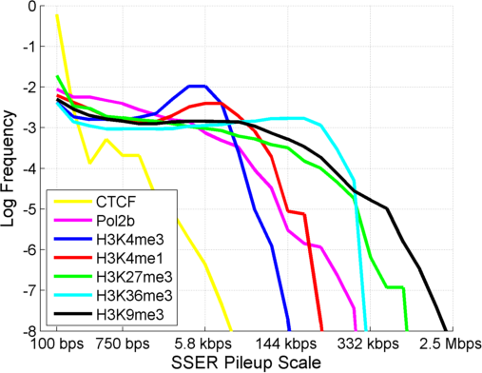
Figure 2
Notes:
Figure 2: Distribution of SSER pileup scale for CTCF, RNA Polymerase II (Pol2b), and several different HMs on chromosome 1. The smoothing window length is from 100 bps to 2.5 megabases shown on X-axis. Y-axis shows the log frequency. ChIP-Seq data K562 cell line from ENCODE project was used.

Slide 4
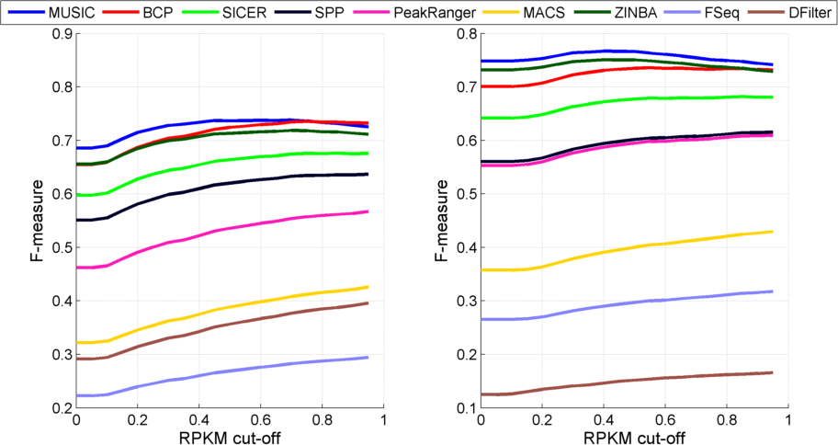
Figure 3 [[REVISED]]
(a)
(b)
Notes:
Figure 3: F-measure vs RPKM threshold (Used to generate the ground truth expressed regions) for H3k36me3 peaks for K562 (a) and GM12878 (b). The F-measure vs RPKM cut-off for H3k36me3 peaks for K562 and GM12878 with (blue) and without mapability correction (red) The F-measure versus RPKM cutoff with (red) and without (blue) mapability correction (c). Average of the overlap fractions of replicates for H3k36me3 and H3k27me3 ERs identified by each method (d).

Slide 5
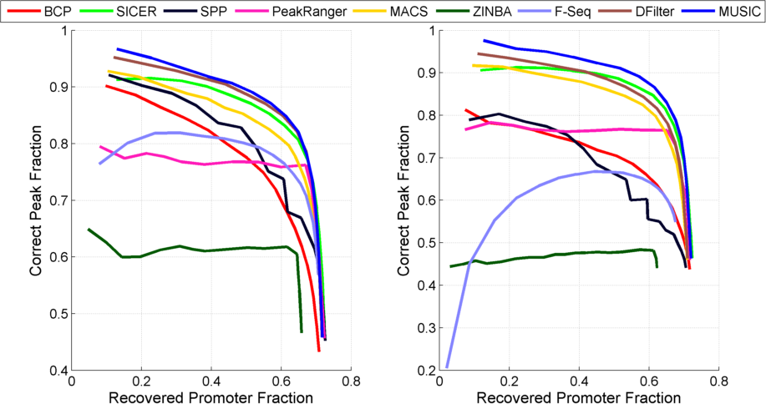
Figure 3
(c)
(d)

Slide 6
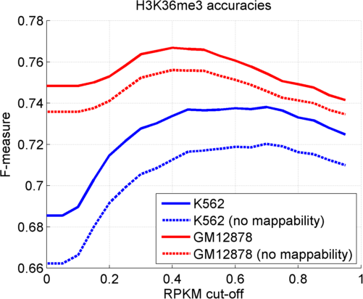
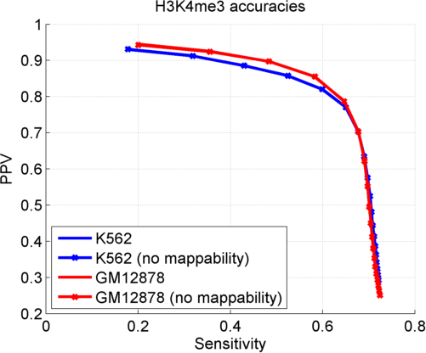
Figure 3 [[UPDATE K4me3 WTH NEW PARAMETERS]]
(e)
(f)

Slide 7
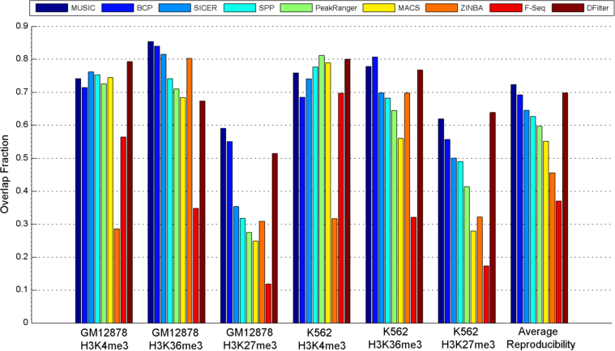
Figure 3
(f)

Slide 8
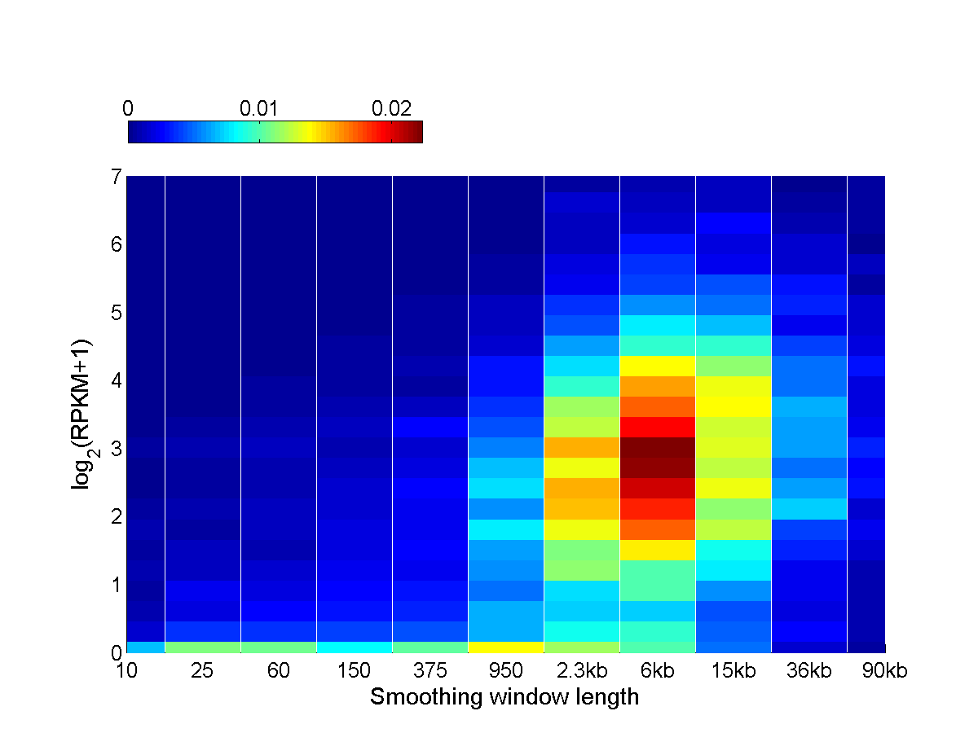
Figure 4
(a)
Elongating
(Broad-High)
Stalled
(Punctate-Low)
Notes:
Figure 4: (a) The 2 dimensional normalized histogram of enrichment scale versus gene expression levels for protein coding genes. X-axis is the smoothing window length at which the polymerase enrichment is identified at the promoter. Y-axis is the log gene expression. The first component, stalled polymerase binding (Indicated on the graph with “Stalled”) are positions with log expression smaller than 0.1 and window lengths smaller than 950 base pairs. The second component (Indicated on the graph with “Elongating”) corresponds to the the elongating polymerase with log expression levels. The polymerase 2 ChIP-Seq line is useddataset for K562 cell in this plot. (b) Aggregation of elongating Pol2s2 signal around promoters of genes with low expression and punctate polymerase binding (“Punctate-Low”), genes with high expression and punctate polymerase binding (“Punctate-High”). The aggregation signal for stalled polymerase bound promoters (“Punctate-Low”) show the smallest Pol2s2 signal levels.

Slide 9
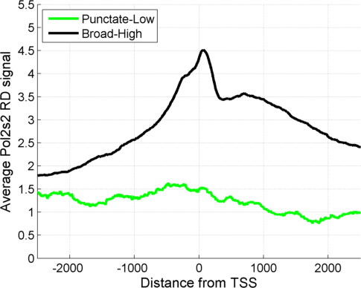
Figure 4
(b)
Upstream
Gene body
Notes:
Figure 4: (b) Aggregation of elongating Pol2s2 signal around promoters of genes with low expression and punctate polymerase binding (“Punctate-Low”), genes with high expression and punctate polymerase binding (“Punctate-High”). The aggregation signal for stalled polymerase bound promoters (“Punctate-Low”) show the smallest Pol2s2 signal levels.

Slide 10
Table S1
 | K562 ERs |  | GM12878 ERs
 | Number | Coverage (base pairs) | Number | Coverage (base pairs)
MUSIC | 16,768 | 390,296,556 | 13,704 | 469,576,029
BCP | 10,521 | 347,394,000 | 10,190 | 393,830,600
SICER | 40,352 | 314,022,848 | 33,817 | 349,352,583
SPP | 76,215 | 269,242,136 | 75,675 | 278,092,847
PeakRanger | 96,966 | 209,984,550 | 117,836 | 275,866,850
MACS | 62,201 | 125,919,021 | 46,515 | 146,737,896
DFilter | 5,688 | 224,967,800 | 2,520 | 94,333,200
F-Seq | 510,235 | 86,053,106 | 619,748 | 107,425,384
ZINBA | 33,594 | 359,815,781 | 31,562 | 462,042,813
Notes:
Table S1: Counts and coverages of identified H3K36me3 ER statistics for different methods for K562 and GM12878 cell lines.

Slide 11
Table S2
 | Fraction of K562 ER summits within 150 bps of CTCF Motif | Fraction of GM12878 ER summits within 150 bps of CTCF Motif
MUSIC | .724 | .728
BCP | .695 | NA
SICER | .398 | .440
SPP | .708 | .725
PeakRanger | .430 | .472
MACS | .716 | .721
DFilter | .728 | .720
F-Seq | .625 | .678
ZINBA | .540 | .529

Slide 12
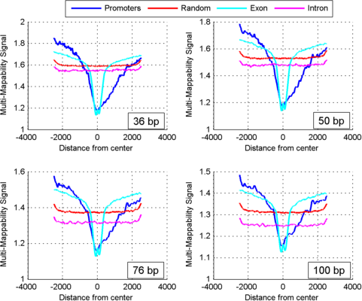
Figure S1
Notes:
Figure S1: The aggregation of the multi-mapability signal profiles over promoters, exon, introns, and random regions with at least 1 read that is mapped in any control dataset. 4 different read lengths, as indicated in the textbox in bottom right corner of each plot, are used: 36 bp, 50 bp, 76 bp, and 100 bps. Aggregation over promoters is performed in a strand specific manner such that left side corresponds to the upstream of the promoter and the right side corresponds to the downstream.

Slide 13
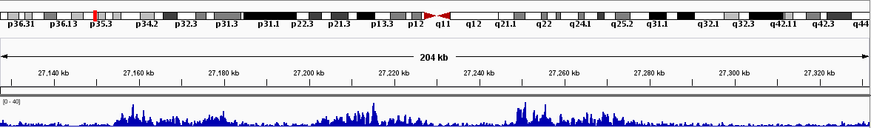
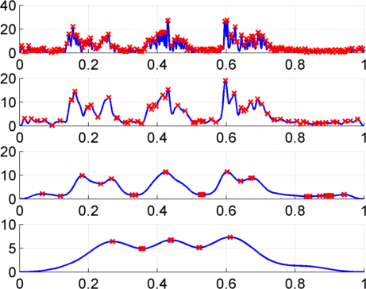
Figure S2
1kb
4kb
Smoothing
window
length
16kb
Maxima
64kb
Minima
Notes:
Figure S2: Illustration of smoothing process. 4 scale decomposition of HM signal using 1 kb, 4kb, 16 kb and 64 kb long smoothing windows. The local extrema point in the decompositions are highlighted with red markers on each smoothed signal. The three broad peaks can be identified with the 3 maxima at the decomposition scale with smoothing window length 64kb.

Slide 14
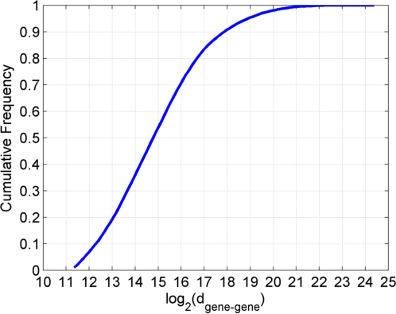
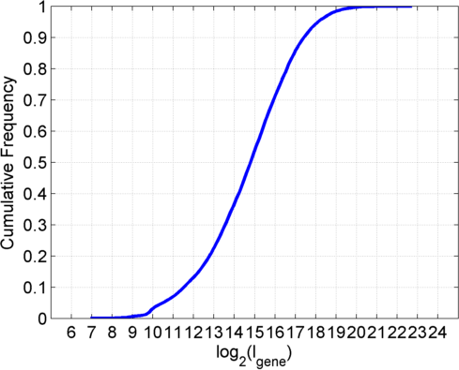











Figure S3
(a)
$$l_{gene}$$
$$d_{gene−gene}$$
(d)
(b)
$$x$$
$$l_{1}$$
$$x_{filtered}$$
Output is zero for $l_{filter}>({2×l}_{1})$
(c)
(e)
$$l_{1}$$
$$l_{2}$$
$$d_{1−2}$$
$$x_{filtered}$$
$$l_{filter}>{(2×d}_{1−2})$$
Notes:
Figure S3: The illustration for gene-gene distance computation (a). Illustration of failure of detection when the smoothing window length (filter length) is longer than the twice the size of gene body (b). Illustration of overmerging when the smoothing window length is longer than twice the size of gene-gene distance (c). The cumulative distribution plot for intergene distance for genes that are at least 2.5kb apart (d). The cumulative distribution plot for gene lengths (e).

Slide 15
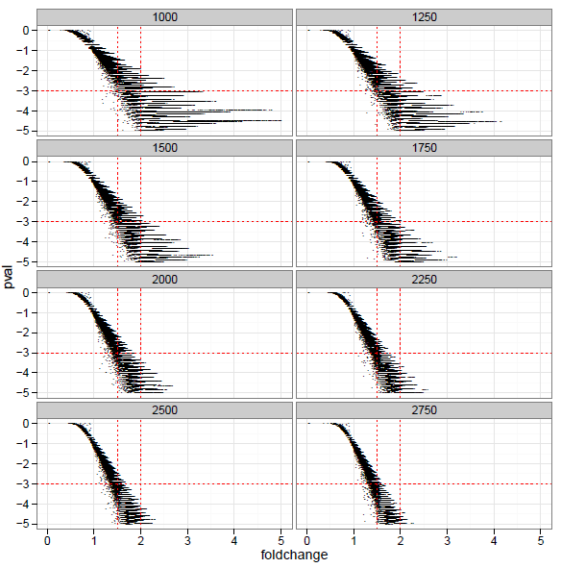
Figure S4
Notes:
Figure S4: The plot for p-value versus fold change using the different p-value normalization window lengths. Fold changes 1.5 and 2 are indicated with vertical red dashed lines and p-value of 0.05 (log p-value of -3) is marked with horizontal red dashed line.

Slide 16
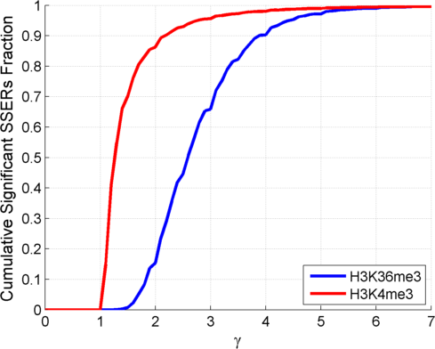
Figure S5

Slide 17
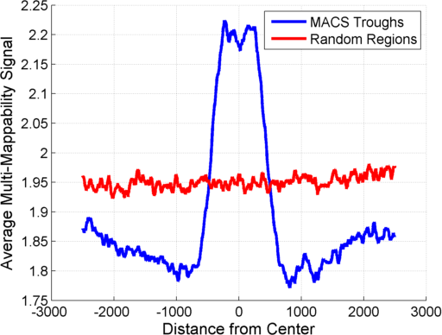
Figure S6

