Slide 1
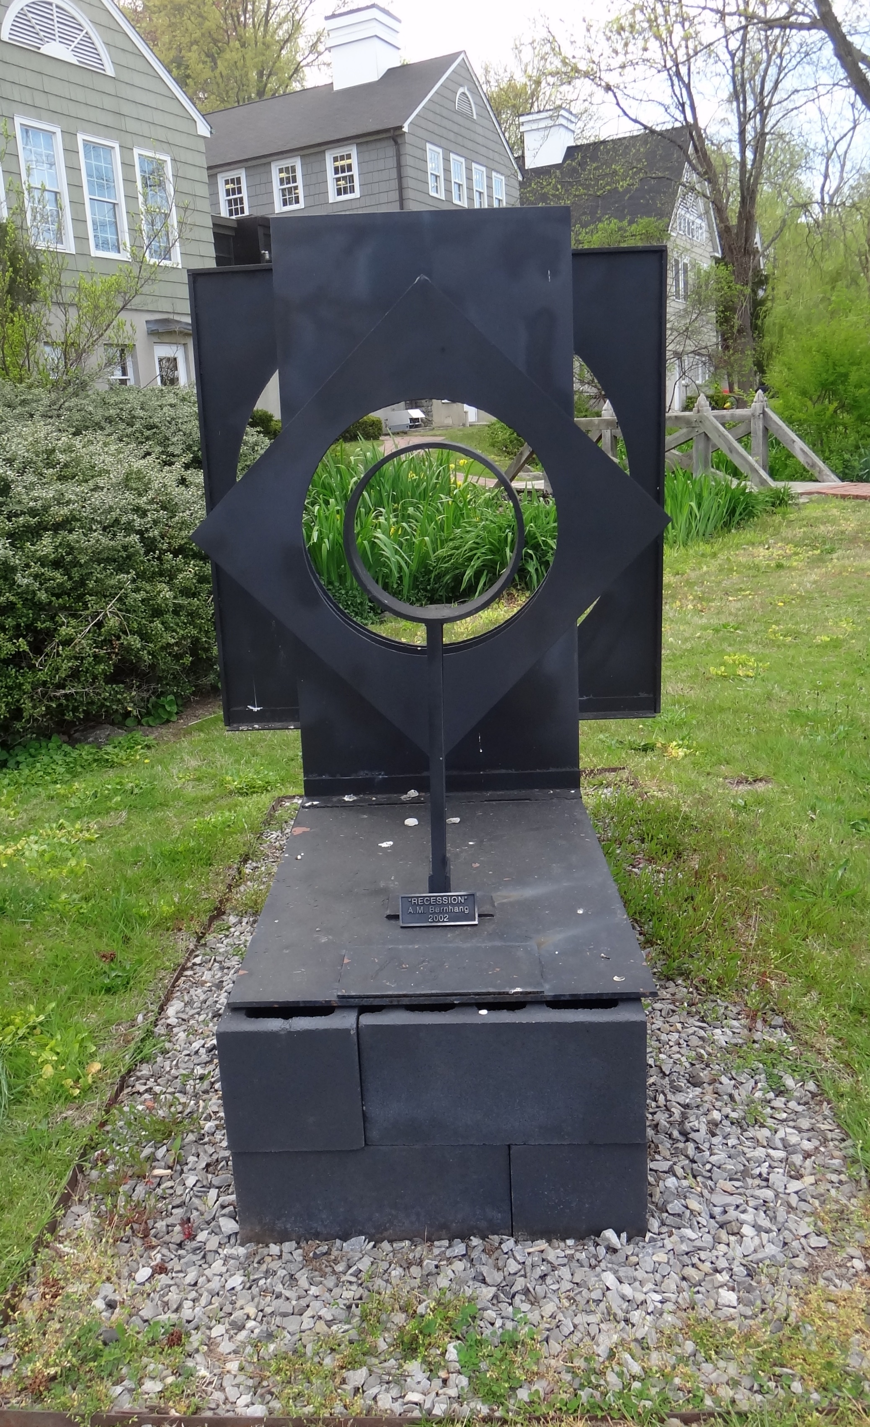
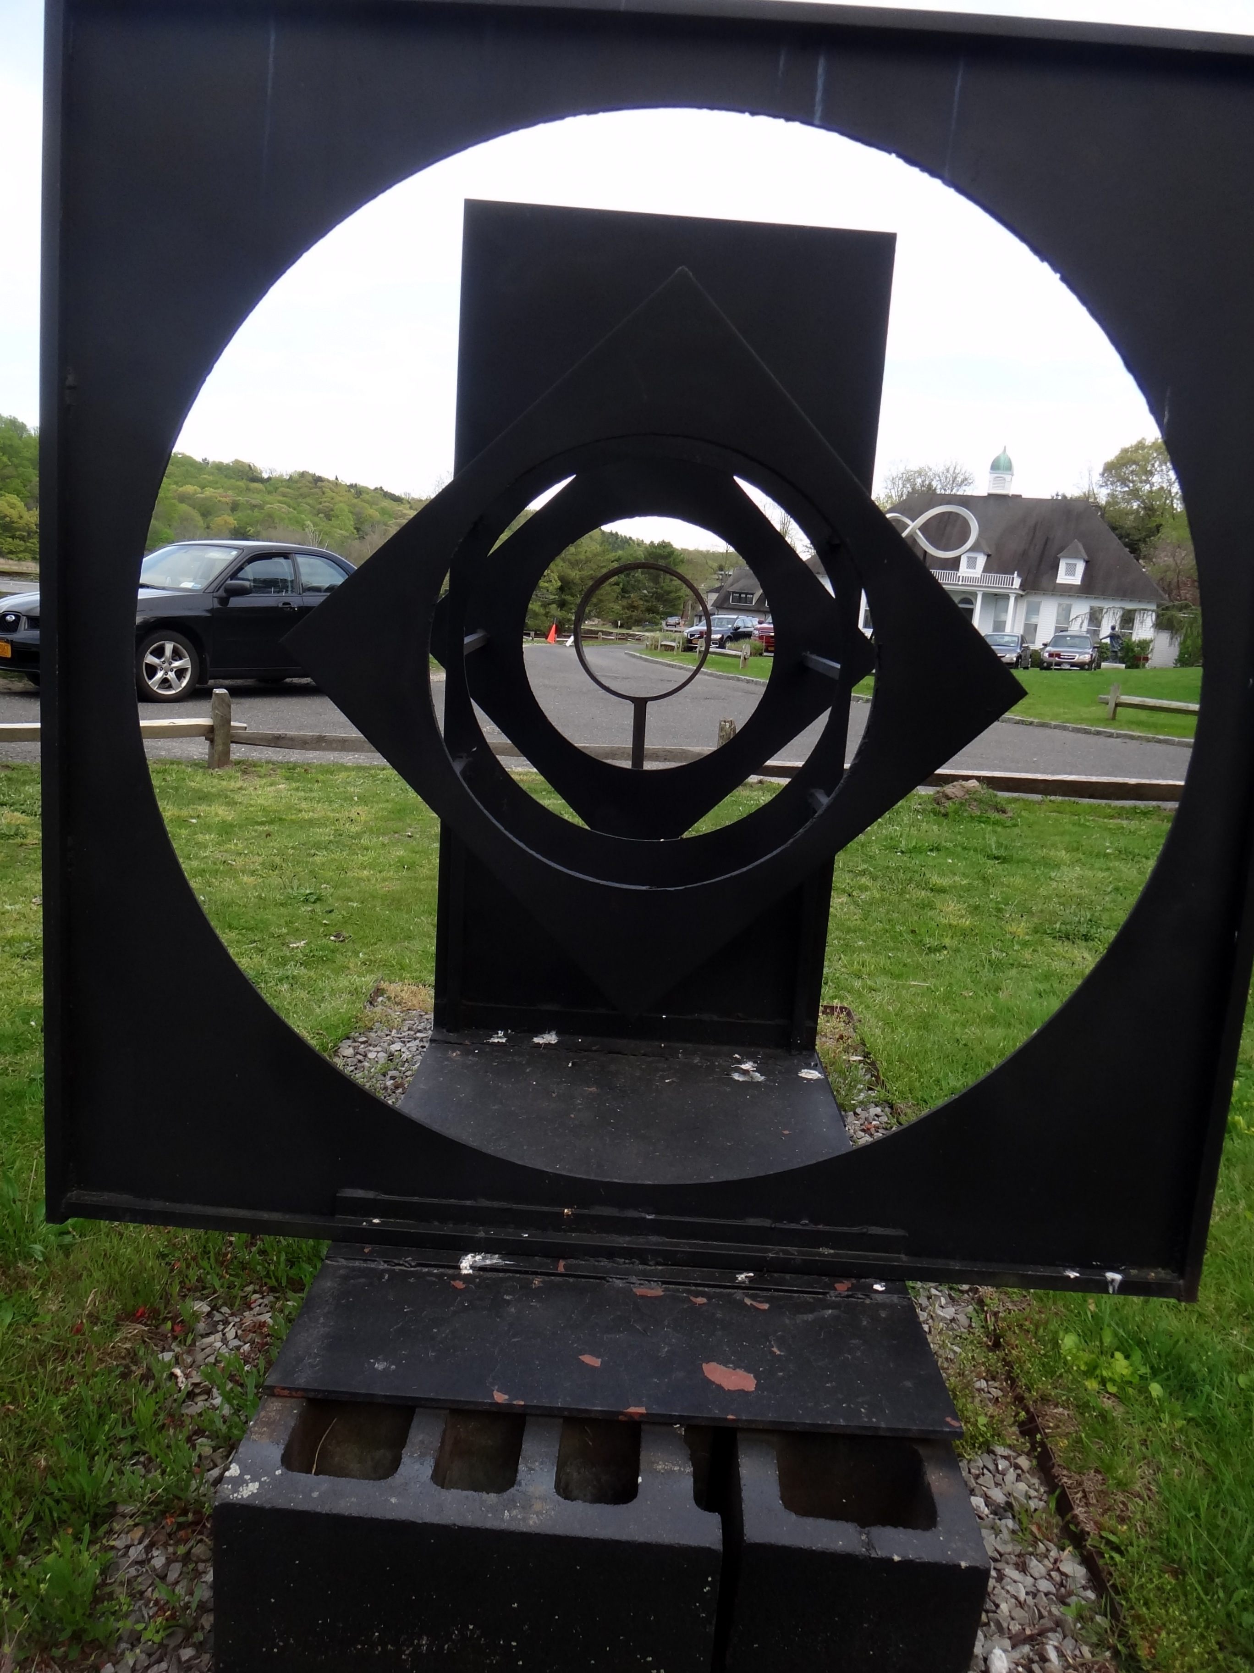
Statistical Methods in Functional Genomics – or How Biology Grapples with Big Data
(Illustrations of
Models, Networks & Practical Tools)
Mark Gerstein
Yale
1 (c) Mark Gerstein, 2002, Yale, bioinfo.mbb.yale.edu
Slides freely downloadable from
Lectures.GersteinLab.org
& “tweetable” (via @markgerstein).
See last slide
for references & more info.
Notes:
1

Slide 2

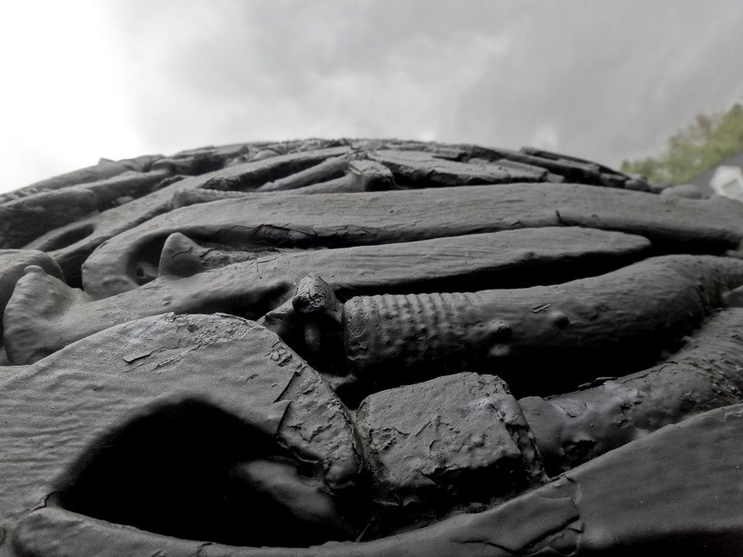

Comparative network analysis of ENCODE and modENCODE data:
Inter-phyla Comparison of Regulation & Transcription
2 (c) Mark Gerstein, 2002, Yale, bioinfo.mbb.yale.edu
Mark Gerstein
Yale
Material “tweetable” (via @markgerstein)
Notes:
2

Slide 3
How might we annotate a human text?
Color is Function
Lines are Similarity
[B Hayes, Am. Sci. (Jul.- Aug. ’06)]

Slide 4
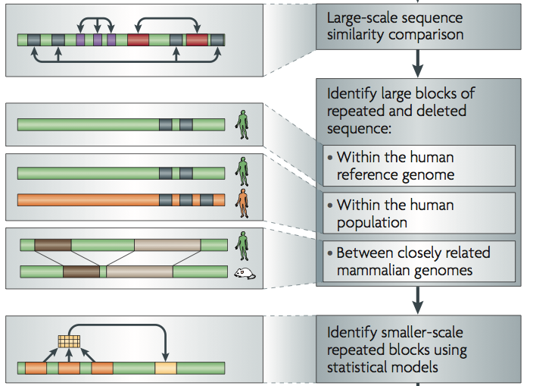
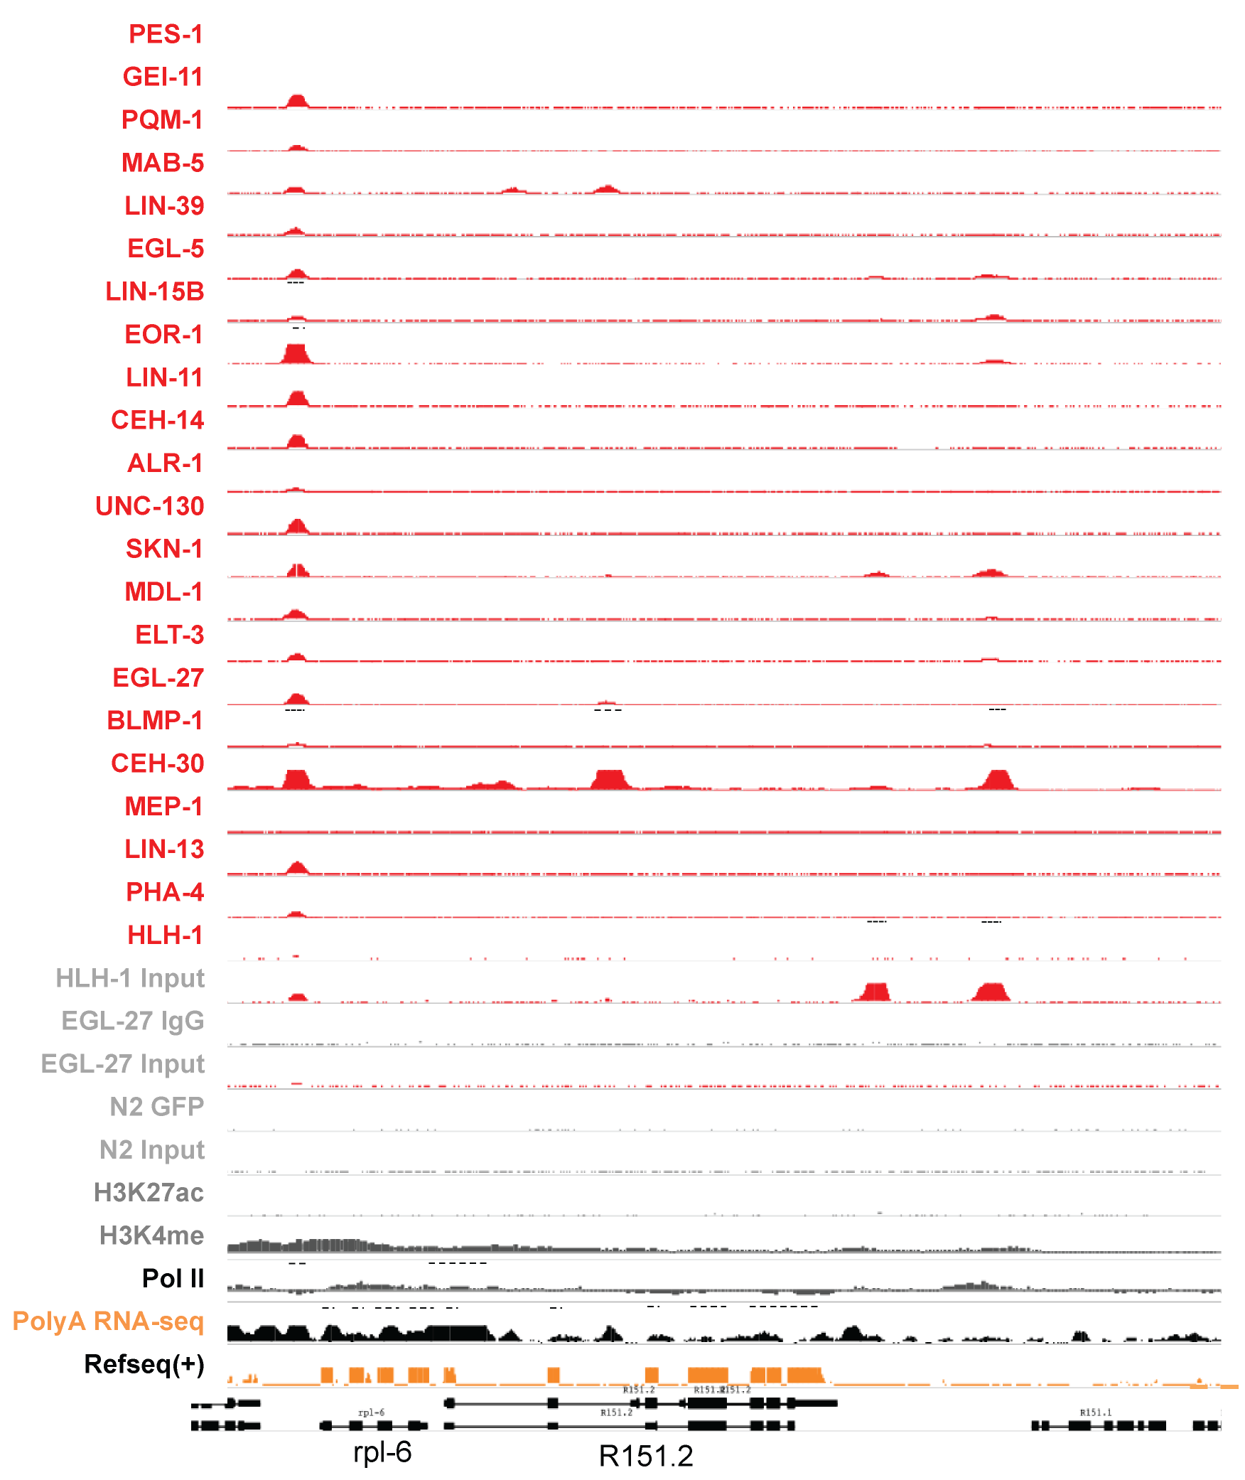
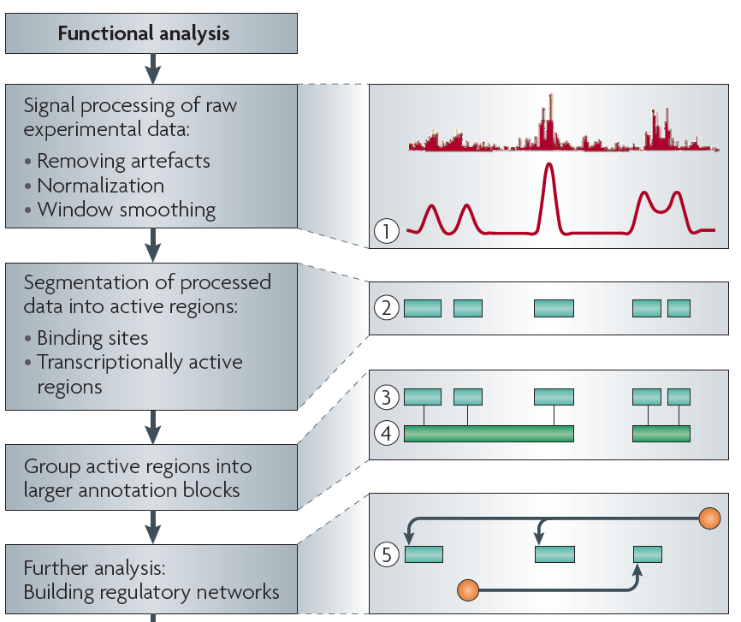
Sources of Annotation:
Comparative
&
Functional
[Nat. Rev. Genet. (2010) 11: 559]
[Science 330:6012]

Slide 5
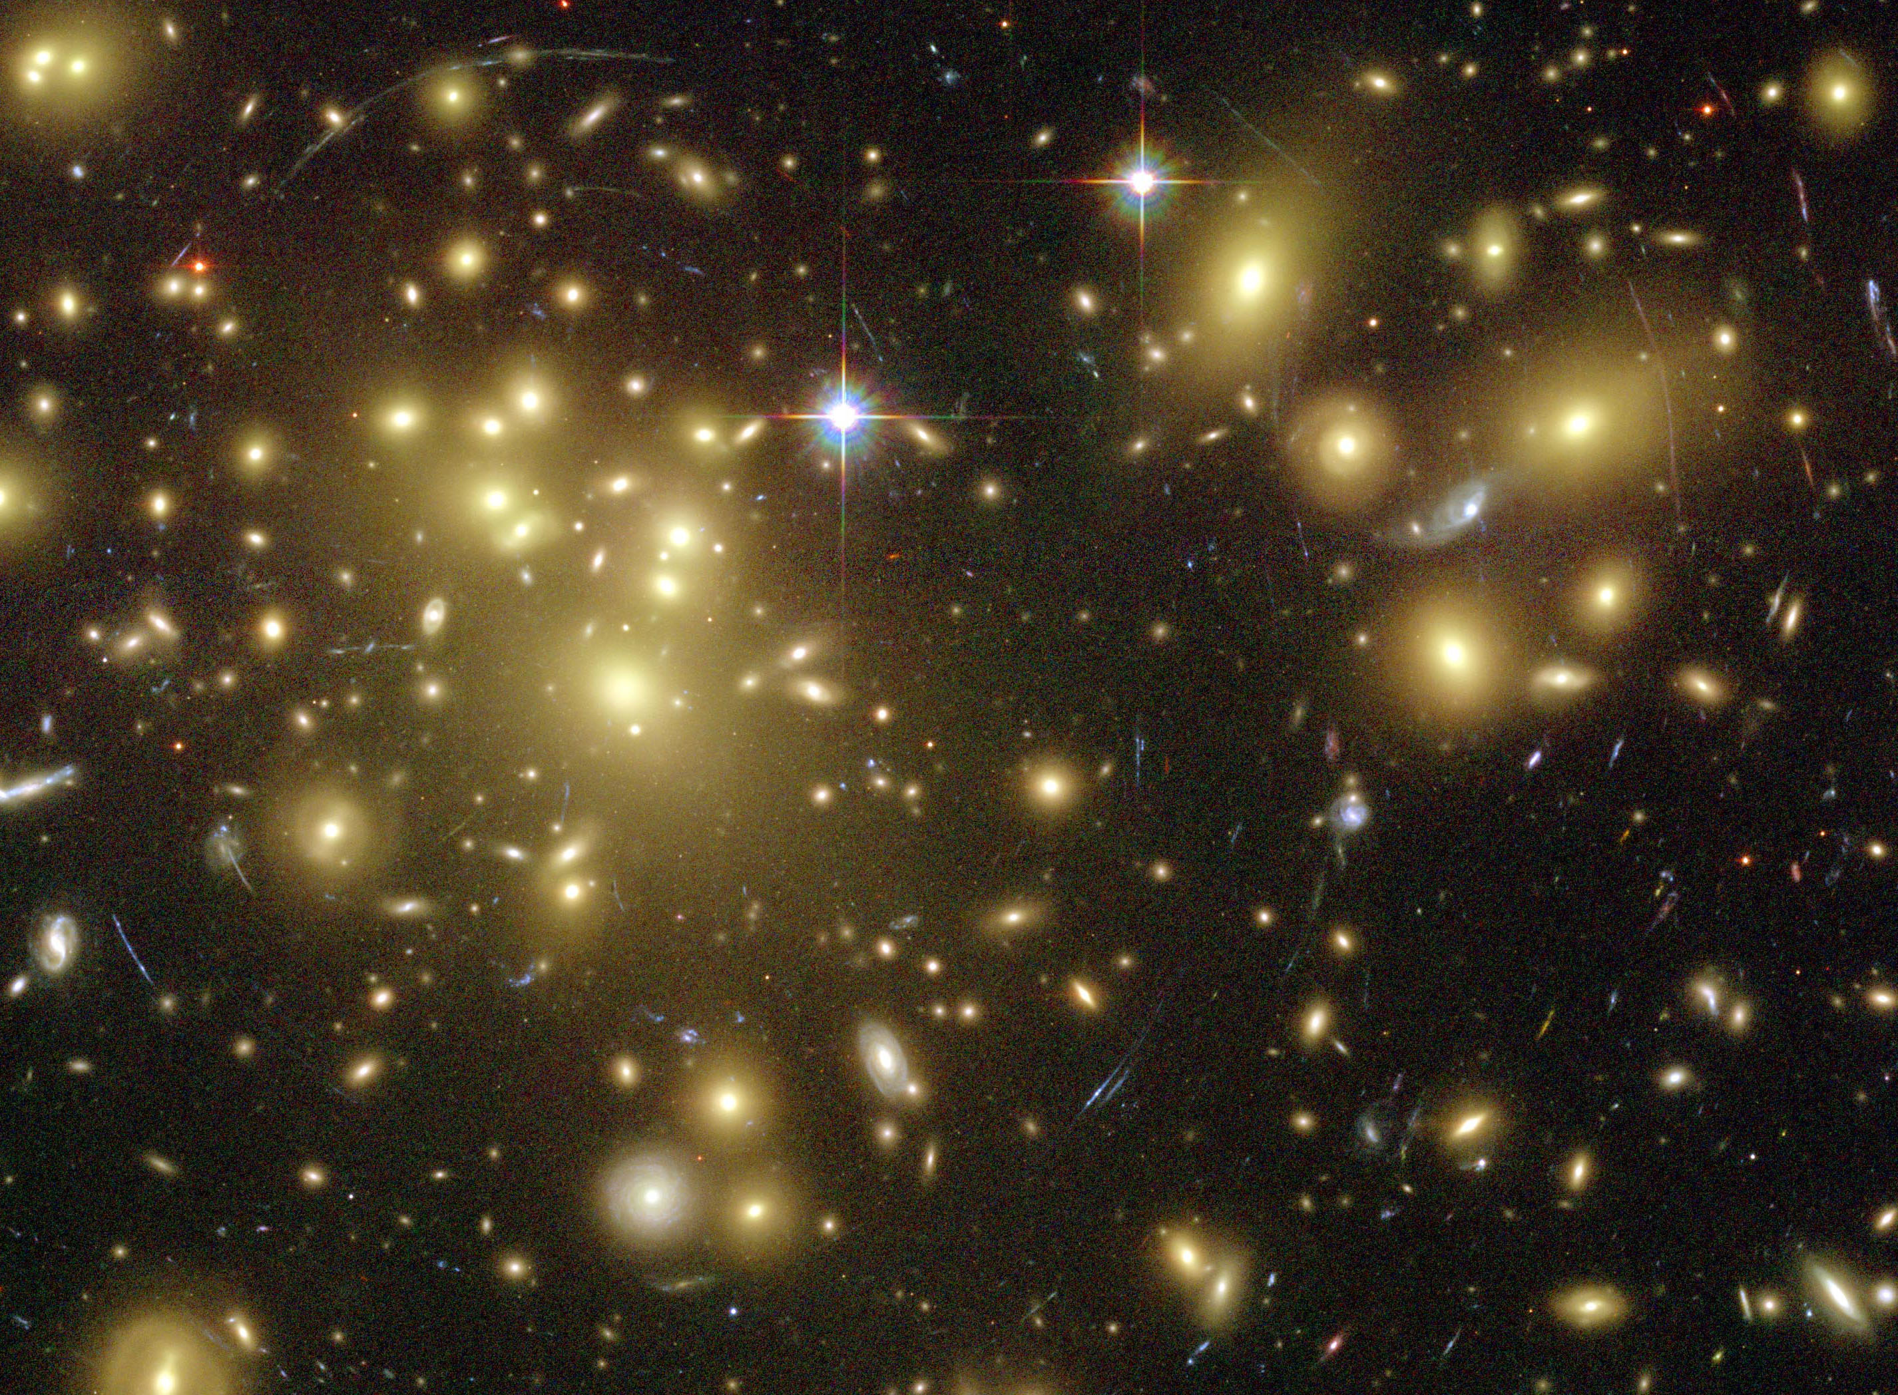
Importance of
Dark Matter of the Genome
  Non-coding regions contain the control elements
  for coding regions.
  Some non-coding regions are functional
  & are pervasively transcribed.
  “Molecular Fossils” in the non-coding genome
  represent a historical record of the genome
  Most disease-associated mutations (e.g. GWAS hits)
  are in non-coding regions.
[Gravitational lensing by dark matter in Abell 1689 – HST (NASA, ESA)]

Slide 6

Only ~1% of personal genome sequences are canonical protein coding genes regions (CDS).
The remaining 99% are non-coding.

Slide 7
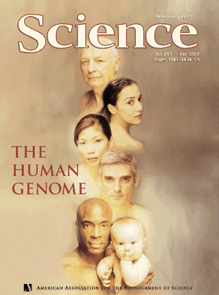
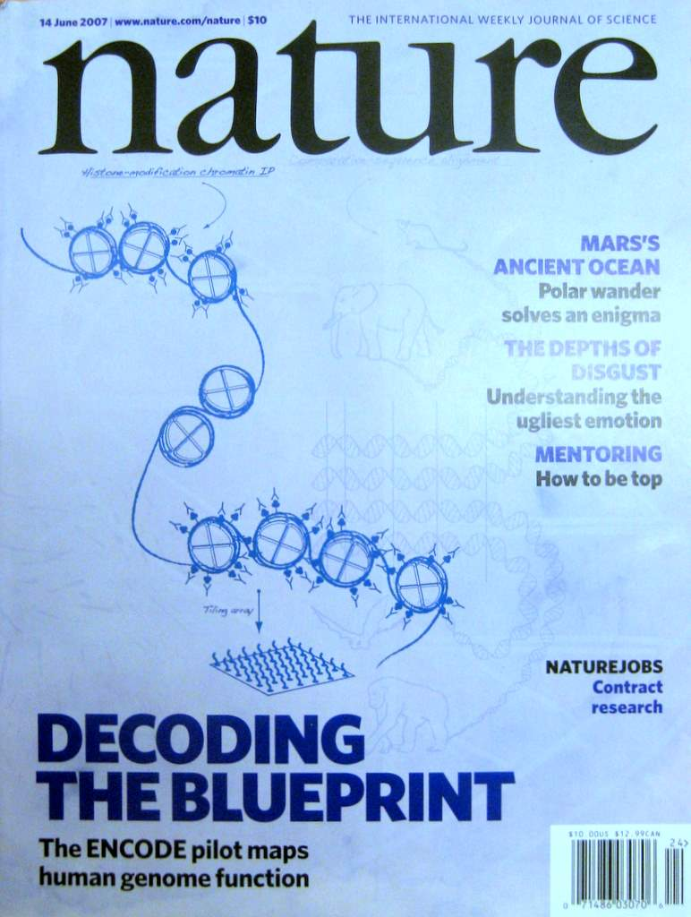


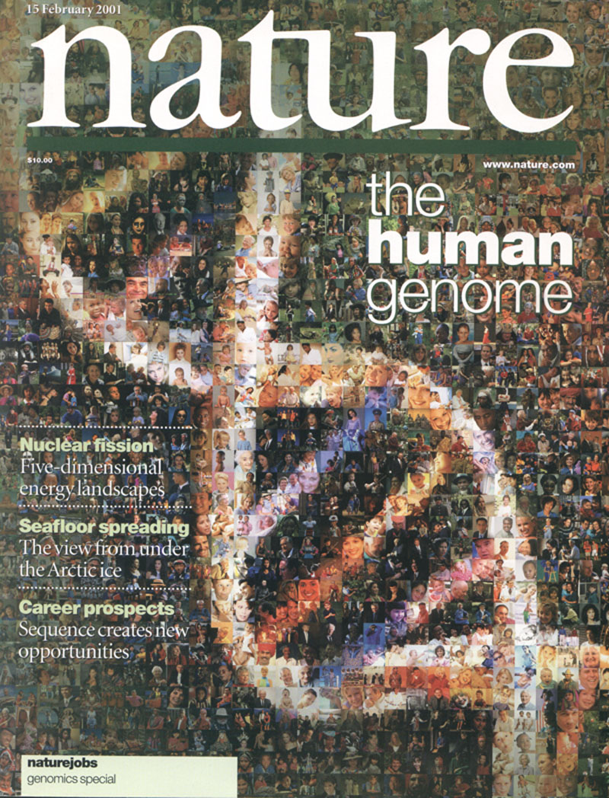

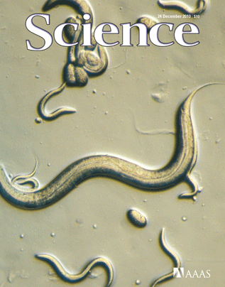
1998
1999
2000
2002
2003
2004
2005
2006
2008
2009
2010
2011
2012
2013
2014
2001
2007
Consortium
Comprises
~50 Labs
Subprojects:
Transcriptome
+
Chromatin
+
TFs
Comparative Papers
Subprojects:
Transcriptome
+
Chromatin
+
TFs

Slide 8
Inter-phyla Comparison of Regulation & Transcription
Previous functional genomics analyses on animals have focused on
  Integrated (cross data type) analyses of single organisms (eg ChIP-seq & RNA-seq just in humans)
  Comparisons of a 1 data type within closely related organisms (e.g. RNA-seq within mammals, Brawand et al. '11)
Here, integrated comparison across phyla
  Of extensive, matched functional genomics data
  (on human, worm & fly)
  Revealing ancient “features” of transcription & regulation
  help with annotating core features of the human genome

Slide 9
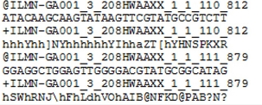
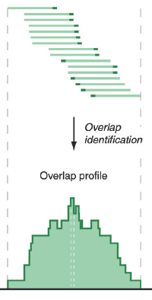
Low-Level Data for RNA-seq & Chip-seq
Reads (fasta)
+ quality scores (fastq)
+ mapping (BAM)
Reads => Signal (Intermediate file)
Accumulating @ >1 Pbp/yr (currently),
~20% of tot. HiSeq output
[PLOS CB 4:e1000158]

Slide 10
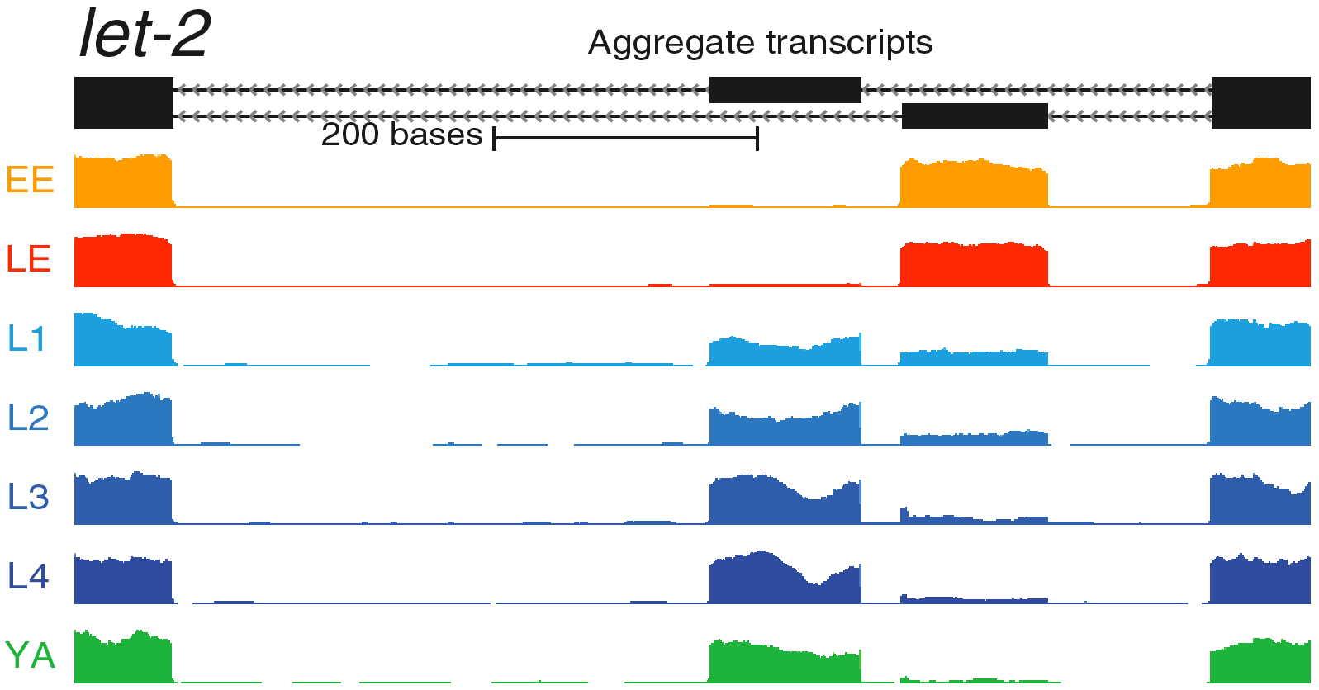
Concepts:
Raw Tracks to Networks
&
Relating Genomic Inputs to Outputs
[Nat. Rev. Genet. (2010) 11: 559]
Inputs (mostly Chip-seq
of TFs & Chromatin)
[Science 330:6012]
Outputs (mostly RNA-seq)

Slide 11
Statistical Methods in Functional Genomics
-- or How Biology Grapples with Big Data
(Illustrations of Models, Networks & Practical Tools)
A networks view
on organizing genomic elements
  Motivating & constructing the regulatory network
  Understanding the human regulatory network as a hierarchy with information flow bottlenecks
  Seeing the impact of variation and constraint on the network
Practical tools & data formats for genomics
  ChipSeq: PeakSeq, ACT, tYNA
  RNA-Seq: RSeqTools, IncRNA, FusionSeq, IQSeq
  Privacy advantages of high-level formats (MRF)
  Illustration of use of
  low-level variant data :
  Allelic effects probed by AlleleSeq
Large-scale inter-relation of genomic elements through statistical models
  Using His. Mods. to predict gene expression
  Comparing this with TF binding

Slide 12
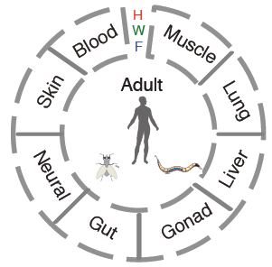
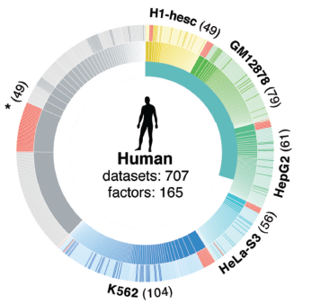
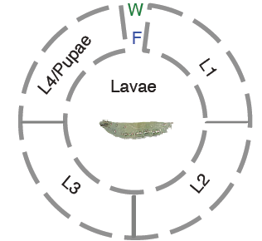
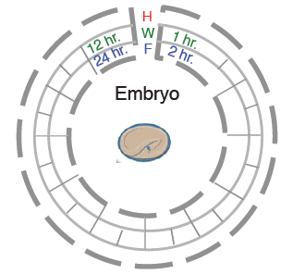
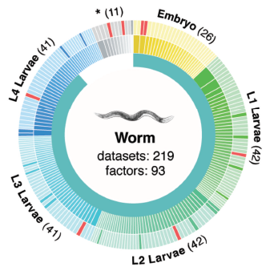
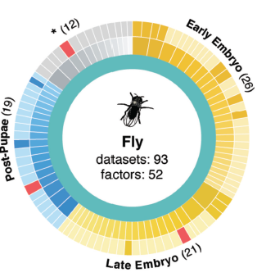
ENCODE/modENCODE data
(encodeproject.org, modencode.org)
Transcriptomes
Regulomes
Also,
large-scale chromatin data
575 different experiments containing >67B reads,

Slide 13
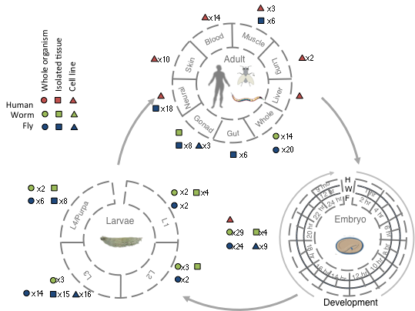
modENCODE/ENCODE RNA Resource
Broad sampling of conditions across transcriptomes of human, worm and fly
  65 billion reads (585 datasets)
Comparisons
  Poly(A)+ RNA
  embryo & embryonic stem cells
  developmental time course (worm-fly)

Slide 14
Inter-phyla Comparisons of Regulation & Transcription
Even though human, fly and worm are highly divergent they share many ancient features of transcription:
Transcription: Expression clustering
  16 Conserved co-expression modules
  Inter- and intra-species hourglass behavior of 12 of these modules
  Expression clustering, particularly of hourglass modules, able to align the developmental stages of worm & fly
Regulation: Hierarchical regulatory network
with many FFLs
Both: Statistical Models "Predicting" Expression
  Small numbers of TF can reliably "predict"
  Possible to construct a universal HM model for gene expression which works for mRNAs and ncRNAs

Slide 15
Statistical Methods in Functional Genomics
-- or How Biology Grapples with Big Data
(Illustrations of Models, Networks & Practical Tools)
A networks view
on organizing genomic elements
  Motivating & constructing the regulatory network
  Understanding the human regulatory network as a hierarchy with information flow bottlenecks
  Seeing the impact of variation and constraint on the network
Practical tools & data formats for genomics
  ChipSeq: PeakSeq, ACT, tYNA
  RNA-Seq: RSeqTools, IncRNA, FusionSeq, IQSeq
  Privacy advantages of high-level formats (MRF)
  Illustration of use of
  low-level variant data :
  Allelic effects probed by AlleleSeq
Large-scale inter-relation of genomic elements through statistical models
  Using His. Mods. to predict gene expression
  Comparing this with TF binding

Slide 17
Protein Coding Genes
Comparison of protein coding gene annotations:
Human, Worm & Fly

Slide 18
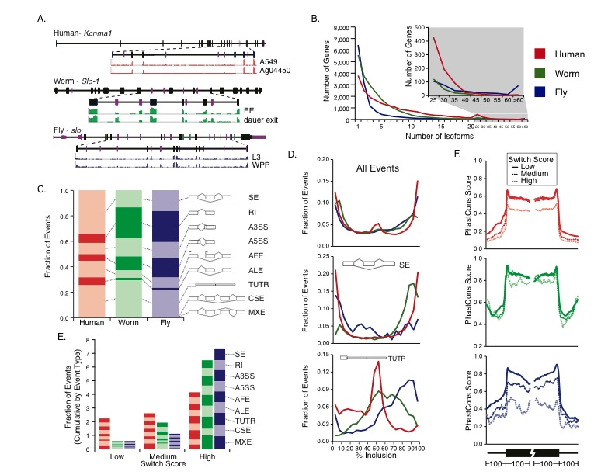
Comparison of Protein-Coding Gene Annotation:
Similarities in distribution of alternative splicing
Comparison of protein coding gene annotations: 19,901 (human), 20,377 (worm) & 13,623 (fly)
No examples of orthologs which share “orthologous” transcript splice isoforms
Similar overall distribution & distribution of mechanisms
Some fly genes with extreme numbers of isoforms
Ortholog Example

Slide 19
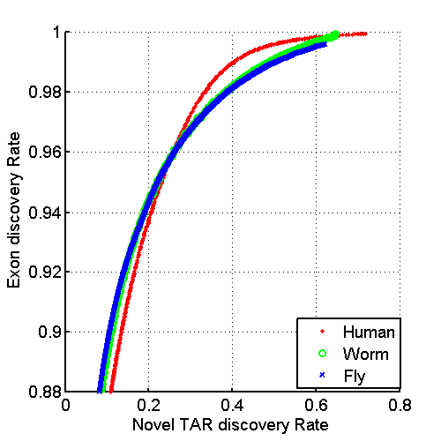
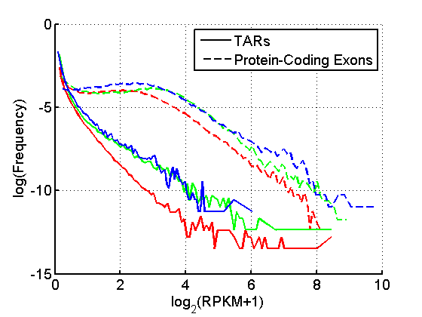
consistent annotation of nc elements
Fig S2c

Slide 20
Annotated ncRNAs
 |  |  | Human |  |  | Worm |  |  | Fly
 |  |  | Elements | Genome Coverage |  | Elements | Genome Coverage |  | Elements | Genome Coverage
 |  |  |  | Kb | % |  | Kb | % |  | Kb | %
mRNAs (exons) |  |  | 20,007 | 86,560 | 3.0 | 21,192 | 34,437 | 34.3 | 13,940 | 35,970 | 28.0
Pseudogenes |  |  | 11,216 | 27,089 | 0.95 | 881 | 1,343 | 1.3 | 145 | 155 | 0.12
Annotated ncRNAs | Comparable ncRNAs | pri-miRNA | 58 | 1,158 | 0.04 | 44 | 16 | 0.02 | 43 | 300 | 0.23
 |  | pre-miRNAs | 1,756 | 162 | 0.006 | 221 | 20 | 0.02 | 236 | 22 | 0.02
 |  | tRNAs | 624 | 47 | 0.002 | 609 | 45 | 0.04 | 314 | 22 | 0.02
 |  | snoRNAs | 1,521 | 168 | 0.006 | 141 | 16 | 0.02 | 287 | 34 | 0.03
 |  | snRNAs | 1,944 | 210 | 0.007 | 114 | 14 | 0.01 | 47 | 7 | 0.006
 |  | lncRNAs | 10,840 | 10,581 | 0.37 | 233 | 184 | 0.18 | 852 | 868 | 0.68
 | Other ncRNAs |  | 5,411 | 3,268 | 0.11 | 40,104 | 2,329 | 2.3 | 376 | 2,103 | 1.6
 |  | nc-piRNA loci | 88 | 1,272 | 0.04 | 35,329 | 449 | 0.45 | 27 | 1,473 | 1.1
Total |  |  | 22,154 | 17,770 | 0.62 | 41,466 | 2,611 | 2.6 | 2,155 | 3,279 | 2.6
Identify non-canonical transcription in regions of the genome excluding mRNA exons, pseudogenes or annotated ncRNAs.

Slide 21
& Non-Canonical Transcription
 |  |  | Human |  |  | Worm |  |  | Fly
 |  |  | Elements | Genome Coverage |  | Elements | Genome Coverage |  | Elements | Genome Coverage
 |  |  |  | Kb | % |  | Kb | % |  | Kb | %
Total ncRNAs |  |  | 22,154 | 17,770 | 0.62 | 41,466 | 2,611 | 2.6 | 2,155 | 3,279 | 2.6
Regions Excluding mRNAs, Pseudogenes or Annotated ncRNAs |  |  | 283,816 | 2,731,811 | 95.5 | 143,372 | 63,520 | 63.3 | 60,108 | 89,445 | 69.6
 | Transcription Detected (TARs) |  | 708,253 | 916,401 | 32.0 | 232,150 | 37,029 | 36.9 | 83,618 | 44,256 | 34.5
 |  | Supervised Predictions | 104,016 | 13,835 | 0.48 | 2,525 | 392 | 0.39 | 599 | 164 | 0.13
Similar fraction of non-canonical transcription of non-canonical transcription in human, worm and fly
  32-37% of each genome

