Slide 1
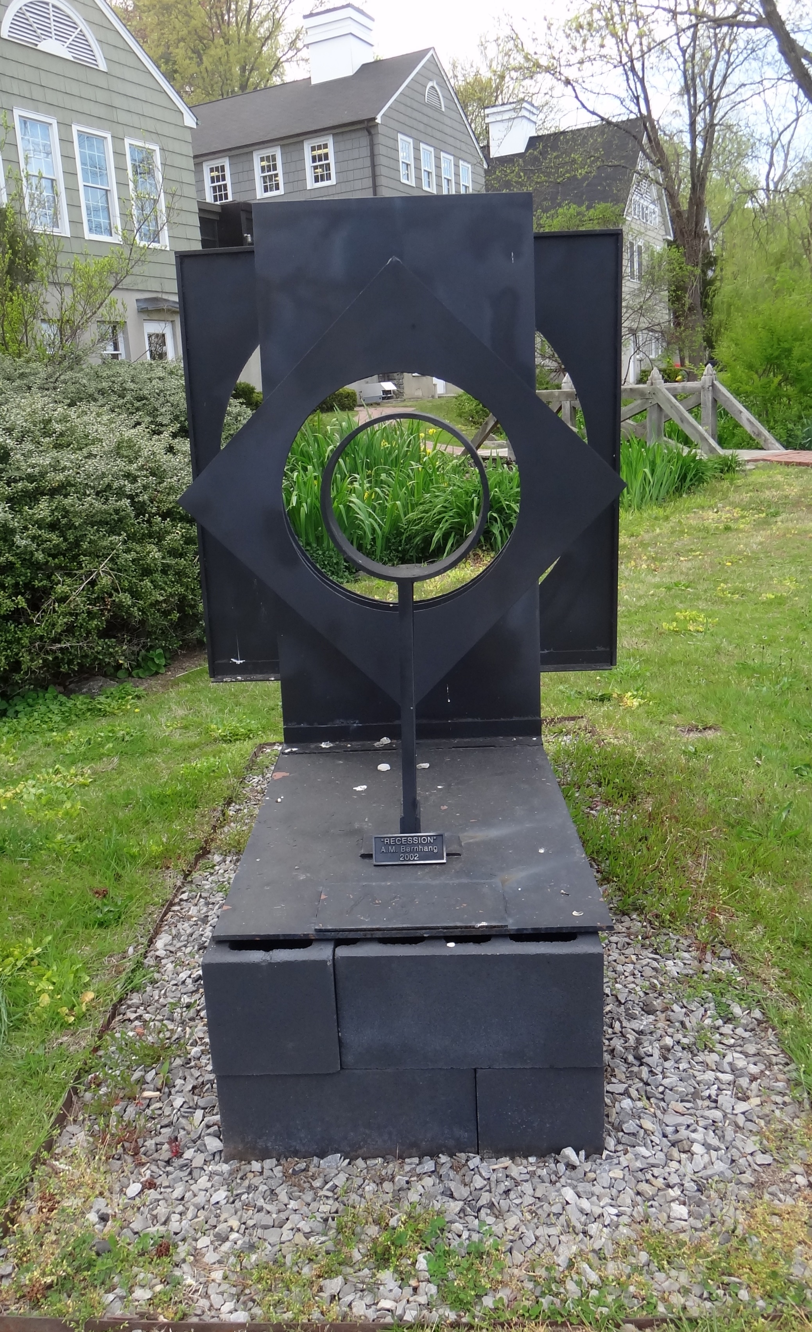
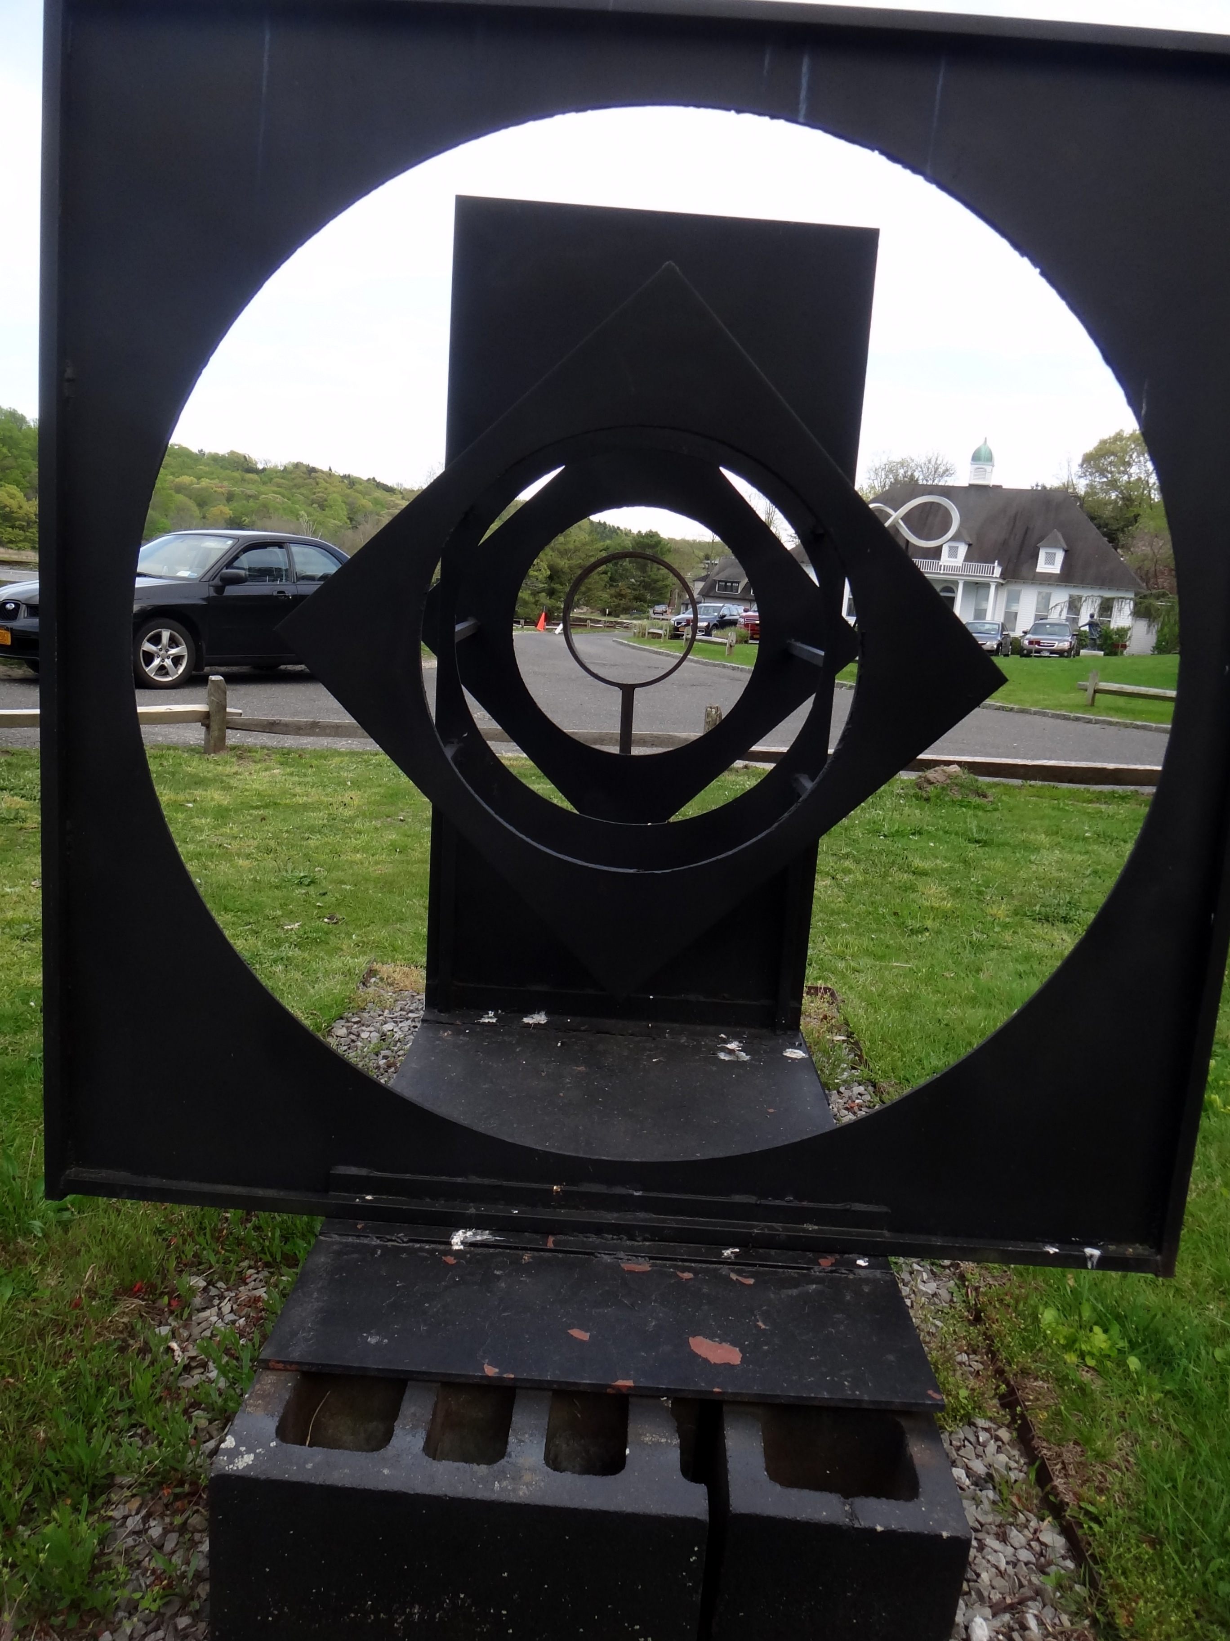
Statistical Methods in Functional Genomics – or How Biology Grapples with Big Data
(Illustrations of
Models, Networks & Practical Tools)
Mark Gerstein
Yale
1 (c) Mark Gerstein, 2002, Yale, bioinfo.mbb.yale.edu
Slides freely downloadable from
Lectures.GersteinLab.org
& “tweetable” (via @markgerstein).
See last slide
for references & more info.
Notes:
1

Slide 2
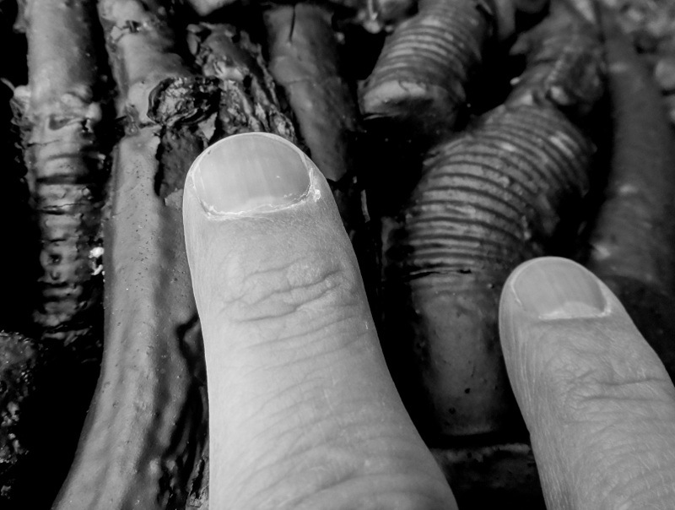
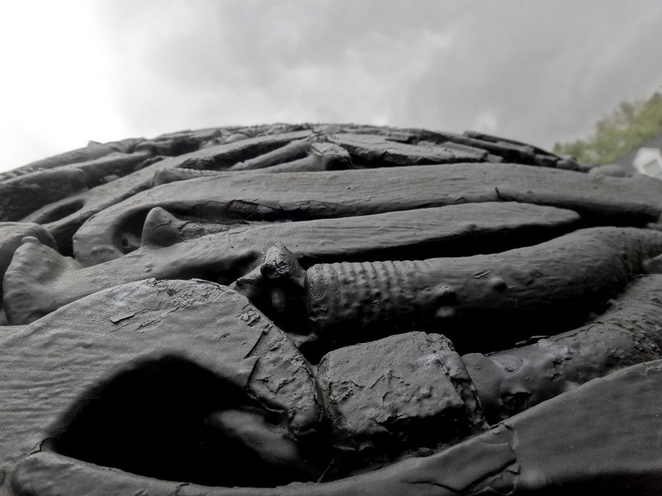
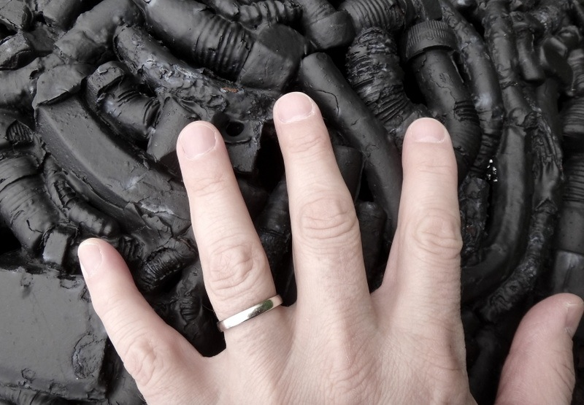
Comparative network analysis of ENCODE and modENCODE data:
Inter-phyla Comparison of Regulation & Transcription
2 (c) Mark Gerstein, 2002, Yale, bioinfo.mbb.yale.edu
Mark Gerstein
Yale
Material “tweetable” (via @markgerstein)
Notes:
2

Slide 3
How might we annotate a human text?
Color is Function
Lines are Similarity
[B Hayes, Am. Sci. (Jul.- Aug. ’06)]

Slide 4
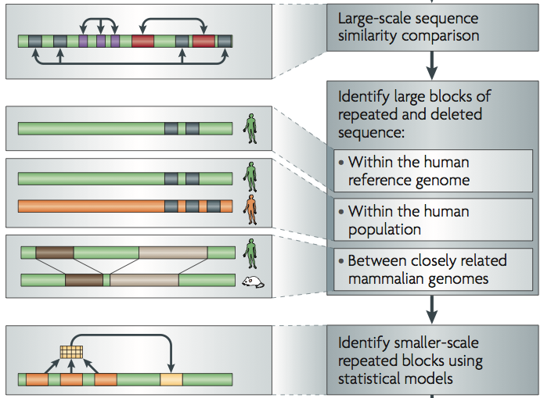
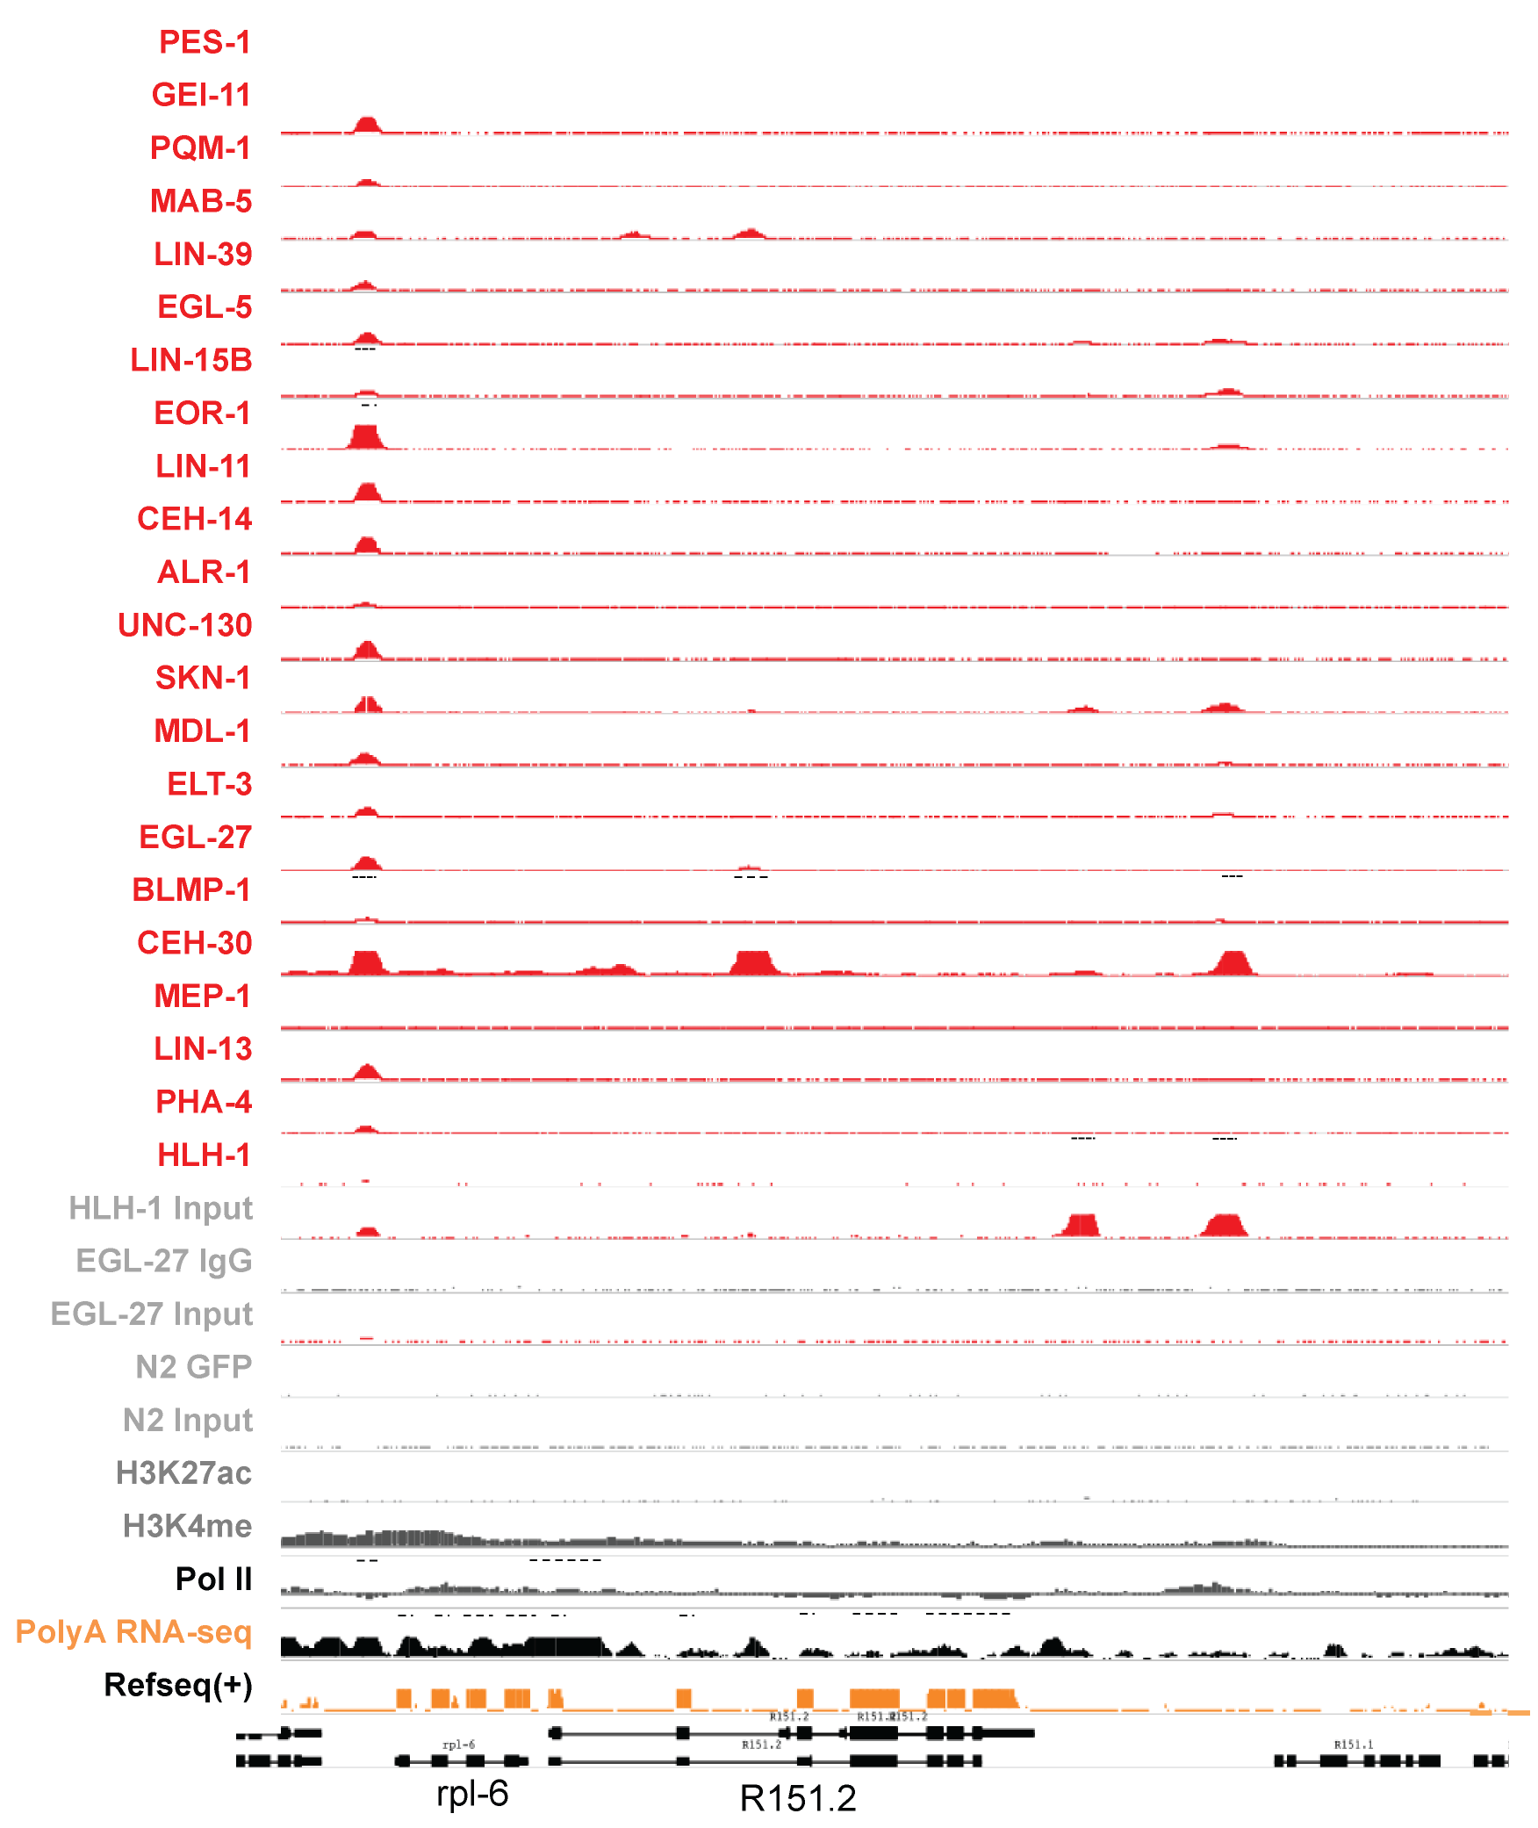
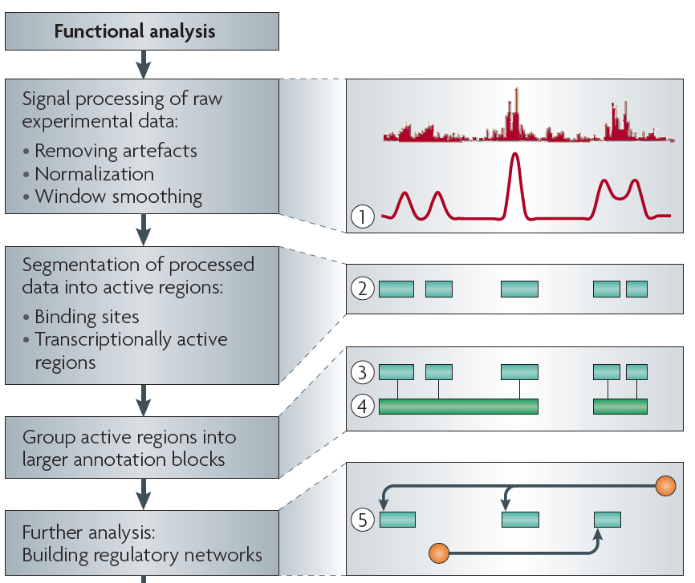
Sources of Annotation:
Comparative
&
Functional
[Nat. Rev. Genet. (2010) 11: 559]
[Science 330:6012]

Slide 5
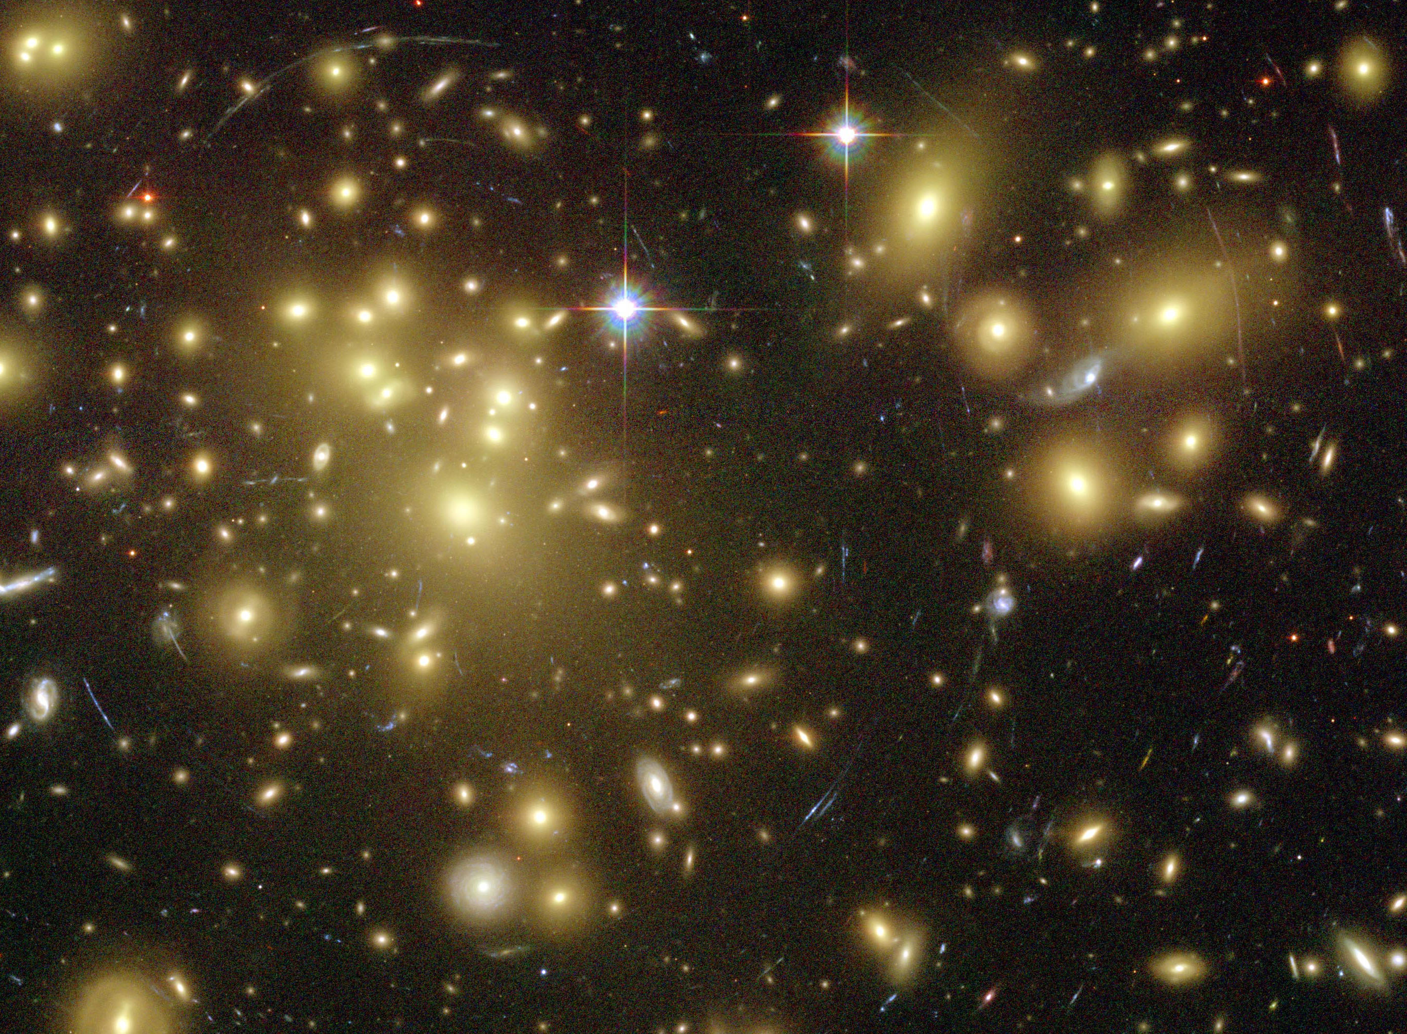
Importance of
Dark Matter of the Genome
  Non-coding regions contain the control elements
  for coding regions.
  Some non-coding regions are functional
  & are pervasively transcribed.
  “Molecular Fossils” in the non-coding genome
  represent a historical record of the genome
  Most disease-associated mutations (e.g. GWAS hits)
  are in non-coding regions.
[Gravitational lensing by dark matter in Abell 1689 – HST (NASA, ESA)]

Slide 6

Only ~1% of personal genome sequences are canonical protein coding genes regions (CDS).
The remaining 99% are non-coding.

Slide 7
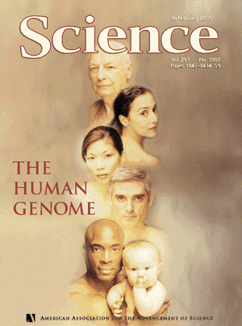
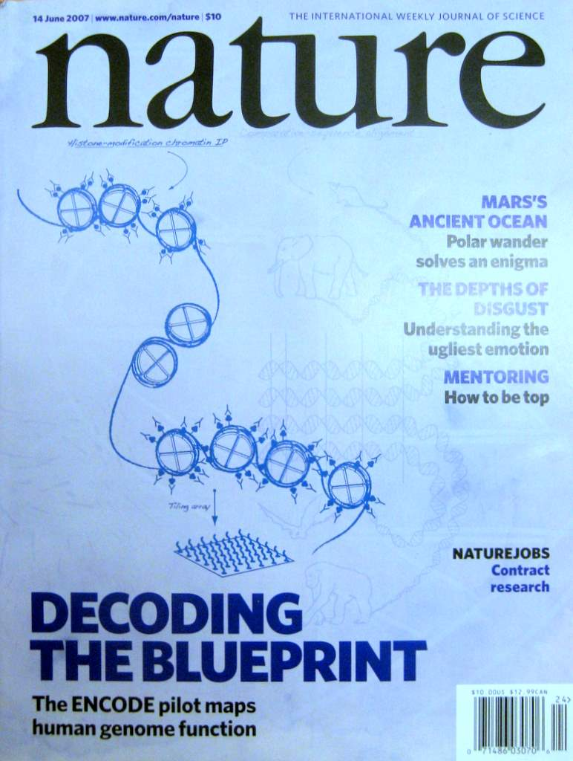


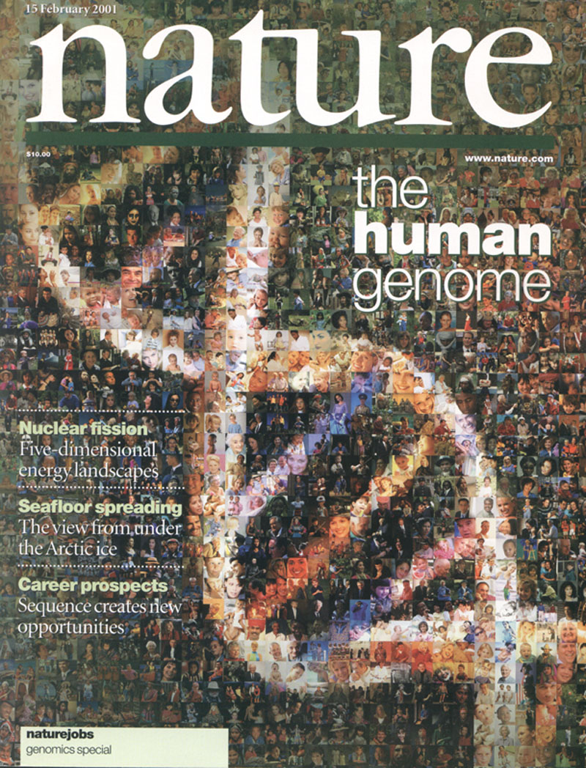

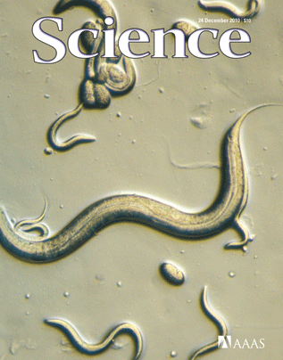
update timeline slide to incl. comparative papers
1998
1999
2000
2001
2002
2003
2004
2005
2006
2007
2008
2009
2010
2011
2012
Consortium
Comprises
~50 Labs
Subprojects:
Transcriptome
+
Chromatin
+
TFs

Slide 8
Inter-phyla Comparison of Regulation & Transcription
Previous functional genomics analyses on animals have focused on
  Integrated (cross data type) analyses of single organisms (eg ChIP-seq & RNA-seq just in humans)
  Comparisons of a 1 data type within closely related organisms (e.g. RNA-seq within mammals, Brawand et al. '11)
Here, integrated comparison across phyla
  Of extensive, matched functional genomics data
  (on human, worm & fly)
  Revealing ancient “features” of transcription & regulation
  help with annotating core features of the human genome
update intro. slide w more context + pic wfh & wfh genome

Slide 9
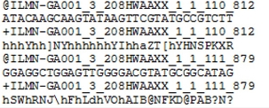
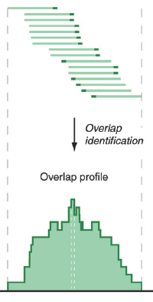
Low-Level Data for RNA-seq & Chip-seq
Reads (fasta)
+ quality scores (fastq)
+ mapping (BAM)
Reads => Signal (Intermediate file)
Accumulating @ >1 Pbp/yr (currently),
~20% of tot. HiSeq output
[PLOS CB 4:e1000158]

Slide 10
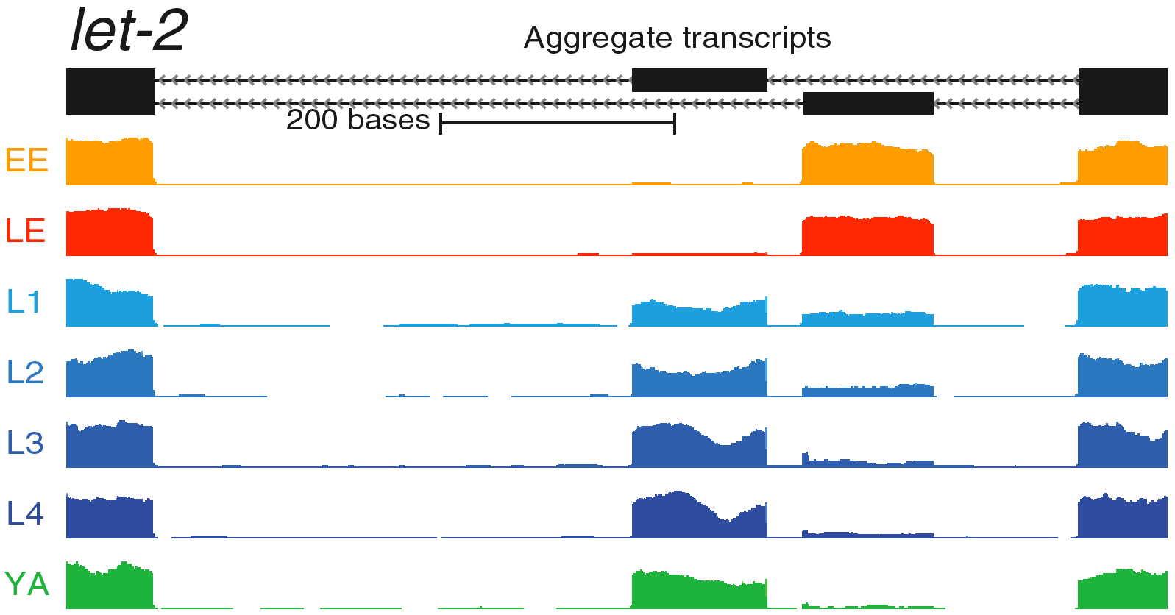
Concepts:
Raw Tracks to Networks
&
Relating Genomic Inputs to Outputs
[Nat. Rev. Genet. (2010) 11: 559]
Inputs (mostly Chip-seq
of TFs & Chromatin)
[Science 330:6012]
Outputs (mostly RNA-seq)

Slide 11
Statistical Methods in Functional Genomics
-- or How Biology Grapples with Big Data
(Illustrations of Models, Networks & Practical Tools)
A networks view
on organizing genomic elements
  Motivating & constructing the regulatory network
  Understanding the human regulatory network as a hierarchy with information flow bottlenecks
  Seeing the impact of variation and constraint on the network
Practical tools & data formats for genomics
  ChipSeq: PeakSeq, ACT, tYNA
  RNA-Seq: RSeqTools, IncRNA, FusionSeq, IQSeq
  Privacy advantages of high-level formats (MRF)
  Illustration of use of
  low-level variant data :
  Allelic effects probed by AlleleSeq
Large-scale inter-relation of genomic elements through statistical models
  Using His. Mods. to predict gene expression
  Comparing this with TF binding

Slide 12
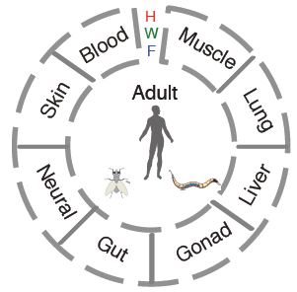
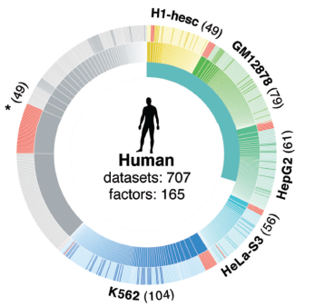
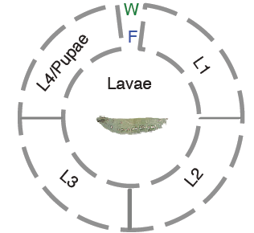
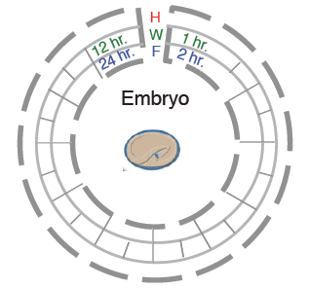
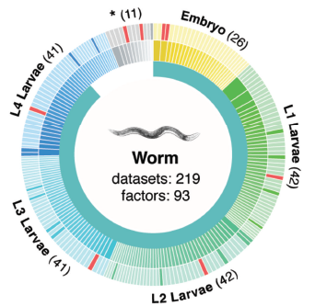
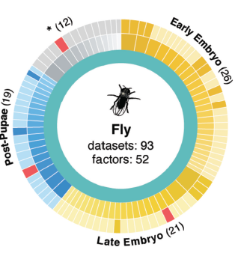
ENCODE/modENCODE data
(encodeproject.org, modencode.org)
Transcriptomes
Regulomes
Also,
large-scale chromatin data
575 different experiments containing >67B reads,

Slide 13
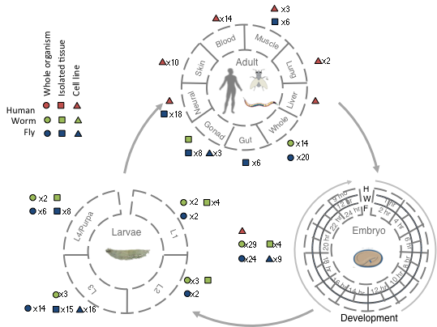
modENCODE/ENCODE RNA Resource
Broad sampling of conditions across transcriptomes of human, worm and fly
  65 billion reads (585 datasets)
Comparisons
  Poly(A)+ RNA
  embryo & embryonic stem cells
  developmental time course (worm-fly)

Slide 14
Inter-phyla Comparisons of Regulation & Transcription
Even though human, fly and worm are highly divergent they share many ancient features of transcription:
Transcription: Expression clustering
  16 Conserved co-expression modules
  Inter- and intra-species hourglass behavior of 12 of these modules
  Expression clustering, particularly of hourglass modules, able to align the developmental stages of worm & fly
Regulation: Hierarchical regulatory network
with many FFLs
Both: Statistical Models "Predicting" Expression
  Small numbers of TF can reliably "predict"
  Possible to construct a universal HM model for gene expression which works for mRNAs and ncRNAs

Slide 15
Statistical Methods in Functional Genomics
-- or How Biology Grapples with Big Data
(Illustrations of Models, Networks & Practical Tools)
A networks view
on organizing genomic elements
  Motivating & constructing the regulatory network
  Understanding the human regulatory network as a hierarchy with information flow bottlenecks
  Seeing the impact of variation and constraint on the network
Practical tools & data formats for genomics
  ChipSeq: PeakSeq, ACT, tYNA
  RNA-Seq: RSeqTools, IncRNA, FusionSeq, IQSeq
  Privacy advantages of high-level formats (MRF)
  Illustration of use of
  low-level variant data :
  Allelic effects probed by AlleleSeq
Large-scale inter-relation of genomic elements through statistical models
  Using His. Mods. to predict gene expression
  Comparing this with TF binding

Slide 16
Protein Coding Genes
Comparison of protein coding gene annotations:
Human, Worm & Fly

Slide 17
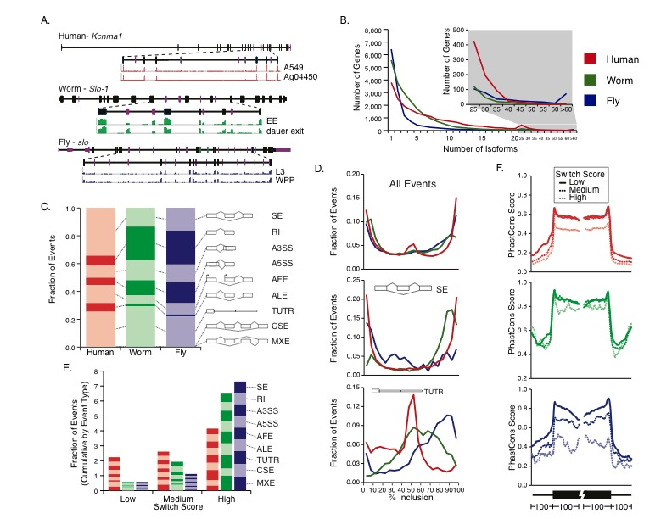
Comparison of Protein-Coding Gene Annotation:
Similarities in distribution of alternative splicing
Comparison of protein coding gene annotations: 19,901 (human), 20,377 (worm) & 13,623 (fly)
No examples of orthologs which share “orthologous” transcript splice isoforms
Similar overall distribution & distribution of mechanisms
Some fly genes with extreme numbers of isoforms
Ortholog Example

Slide 18
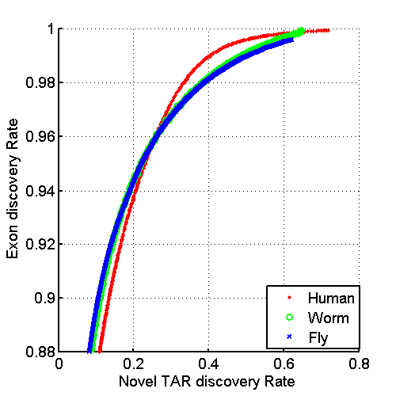
Annotated ncRNAs
 |  |  | Human |  |  | Worm |  |  | Fly
 |  |  | Elements | Genome Coverage |  | Elements | Genome Coverage |  | Elements | Genome Coverage
 |  |  |  | Kb | % |  | Kb | % |  | Kb | %
mRNAs (exons) |  |  | 20,007 | 86,560 | 3.0 | 21,192 | 34,437 | 34.3 | 13,940 | 35,970 | 28.0
Pseudogenes |  |  | 11,216 | 27,089 | 0.95 | 881 | 1,343 | 1.3 | 145 | 155 | 0.12
Annotated ncRNAs | Comparable ncRNAs | pri-miRNA | 58 | 1,158 | 0.04 | 44 | 16 | 0.02 | 43 | 300 | 0.23
 |  | pre-miRNAs | 1,756 | 162 | 0.006 | 221 | 20 | 0.02 | 236 | 22 | 0.02
 |  | tRNAs | 624 | 47 | 0.002 | 609 | 45 | 0.04 | 314 | 22 | 0.02
 |  | snoRNAs | 1,521 | 168 | 0.006 | 141 | 16 | 0.02 | 287 | 34 | 0.03
 |  | snRNAs | 1,944 | 210 | 0.007 | 114 | 14 | 0.01 | 47 | 7 | 0.006
 |  | lncRNAs | 10,840 | 10,581 | 0.37 | 233 | 184 | 0.18 | 852 | 868 | 0.68
 | Other ncRNAs |  | 5,411 | 3,268 | 0.11 | 40,104 | 2,329 | 2.3 | 376 | 2,103 | 1.6
 |  | nc-piRNA loci | 88 | 1,272 | 0.04 | 35,329 | 449 | 0.45 | 27 | 1,473 | 1.1
Total |  |  | 22,154 | 17,770 | 0.62 | 41,466 | 2,611 | 2.6 | 2,155 | 3,279 | 2.6
Identify non-canonical transcription in regions of the genome excluding mRNA exons, pseudogenes or annotated ncRNAs.

Slide 19
& Non-Canonical Transcription
 |  |  | Human |  |  | Worm |  |  | Fly
 |  |  | Elements | Genome Coverage |  | Elements | Genome Coverage |  | Elements | Genome Coverage
 |  |  |  | Kb | % |  | Kb | % |  | Kb | %
Total ncRNAs |  |  | 22,154 | 17,770 | 0.62 | 41,466 | 2,611 | 2.6 | 2,155 | 3,279 | 2.6
Regions Excluding mRNAs, Pseudogenes or Annotated ncRNAs |  |  | 283,816 | 2,731,811 | 95.5 | 143,372 | 63,520 | 63.3 | 60,108 | 89,445 | 69.6
 | Transcription Detected (TARs) |  | 708,253 | 916,401 | 32.0 | 232,150 | 37,029 | 36.9 | 83,618 | 44,256 | 34.5
 |  | Supervised Predictions | 104,016 | 13,835 | 0.48 | 2,525 | 392 | 0.39 | 599 | 164 | 0.13
Similar fraction of non-canonical transcription of non-canonical transcription in human, worm and fly
  32-37% of each genome

Slide 20
TAR Characterization
Non-canonical transcription (TARs):
Mostly transcribed at lower levels than protein-coding genes.
We identify a small subset of TARs that are likely to be novel ncRNAs using a machine learning algorithm trained on known ncRNAs using RNA-Seq data and more.
Enrichment for overlap of TARs with ENCODE enhancers and distal HOT regions -> potential enhancer RNAs (eRNAs).
HOT Regions = High TF Co-occupancy

Slide 21
Inter-phyla Comparisons of Regulation & Transcription
Even though human, fly and worm are highly divergent they share many ancient features of transcription:
Transcription: Expression clustering
  16 Conserved co-expression modules
  Inter- and intra-species hourglass behavior of 12 of these modules
  Expression clustering, particularly of hourglass modules, able to align the developmental stages of worm & fly
Regulation: Hierarchical regulatory network
with many FFLs
Both: Statistical Models "Predicting" Expression
  Small numbers of TF can reliably "predict"
  Possible to construct a universal HM model for gene expression which works for mRNAs and ncRNAs

Slide 22
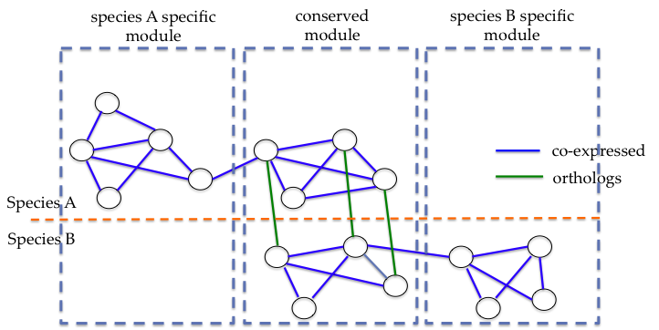
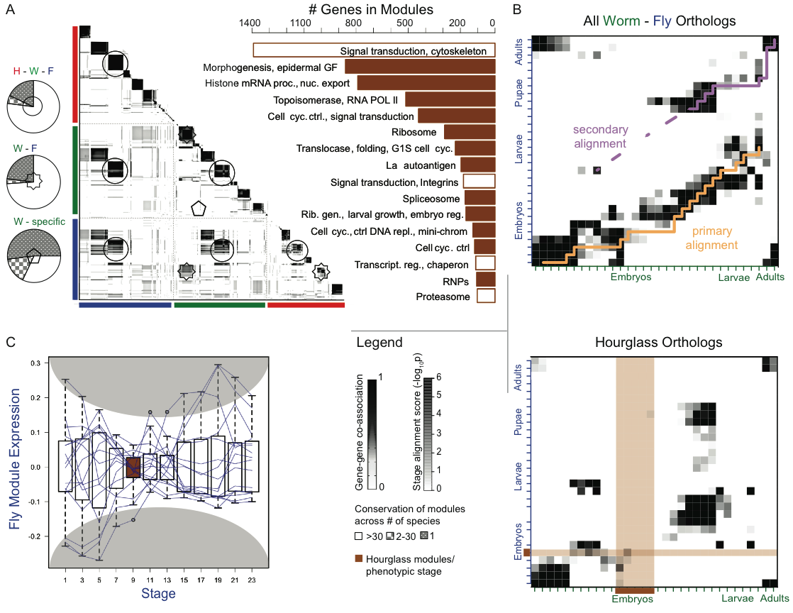
Cross-Species Co-expression Clustering
Use Potts model (generalized Ising model) to simultaneously cluster co-expressed genes within an organism as well as orthologs shared between organisms.
ncRNAs can also be assigned to modules base of co-expression.
more orthoclust?
Conservation of module across number of species
16 conserved
modules
Talk by
Koon-Kiu Yan

Slide 23
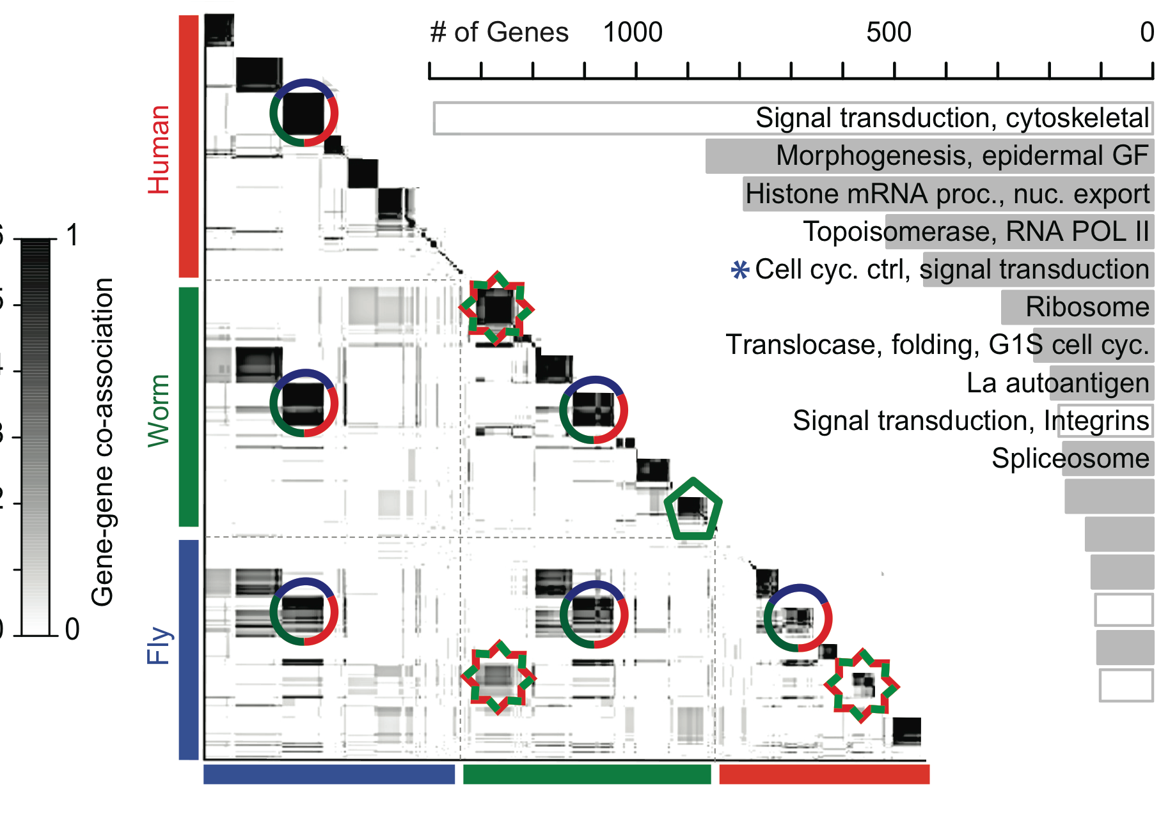
Cross-Species Co-expression Clustering
Use Potts model (generalized Ising model) to simultaneously cluster co-expressed genes within an organism as well as ~2000 orthologs shared between organisms.
ncRNAs can also be assigned to modules base of co-expression.
Conservation of module across number of species
[ENCODE-modencode Transcriptome paper, submitted]
16 Conserved Modules

Slide 24
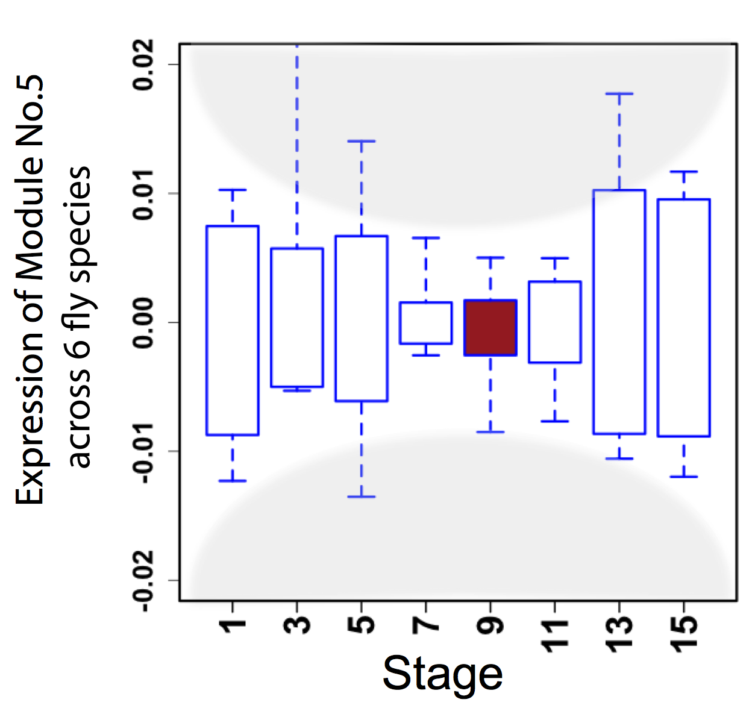
Hourglass Behavior
phylotypic stage
Canonical Inter-organism Behavior
“Hourglass hypothesis”: all organisms go through a particular stage in embryonic development ("phylotypic" stage) where
inter-organism expression differences of orthologous genes are smallest.
We identify modules (12 out of 16) which have this behavior at the phylotypic stage.
[ENCODE-modencode Transcriptome paper, submitted]

Slide 25
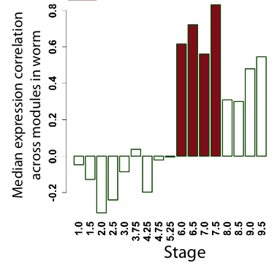
Hourglass Behavior
phylotypic stage
Intra-organism Behavior also Present
We observe that the expression of genes across 12 modules are the most tightly coordinated at the phylotypic stage (fly).
Strongly correlated correlation at phylotypic stage (worm).
[ENCODE-modencode Transcriptome paper, submitted]

Slide 26
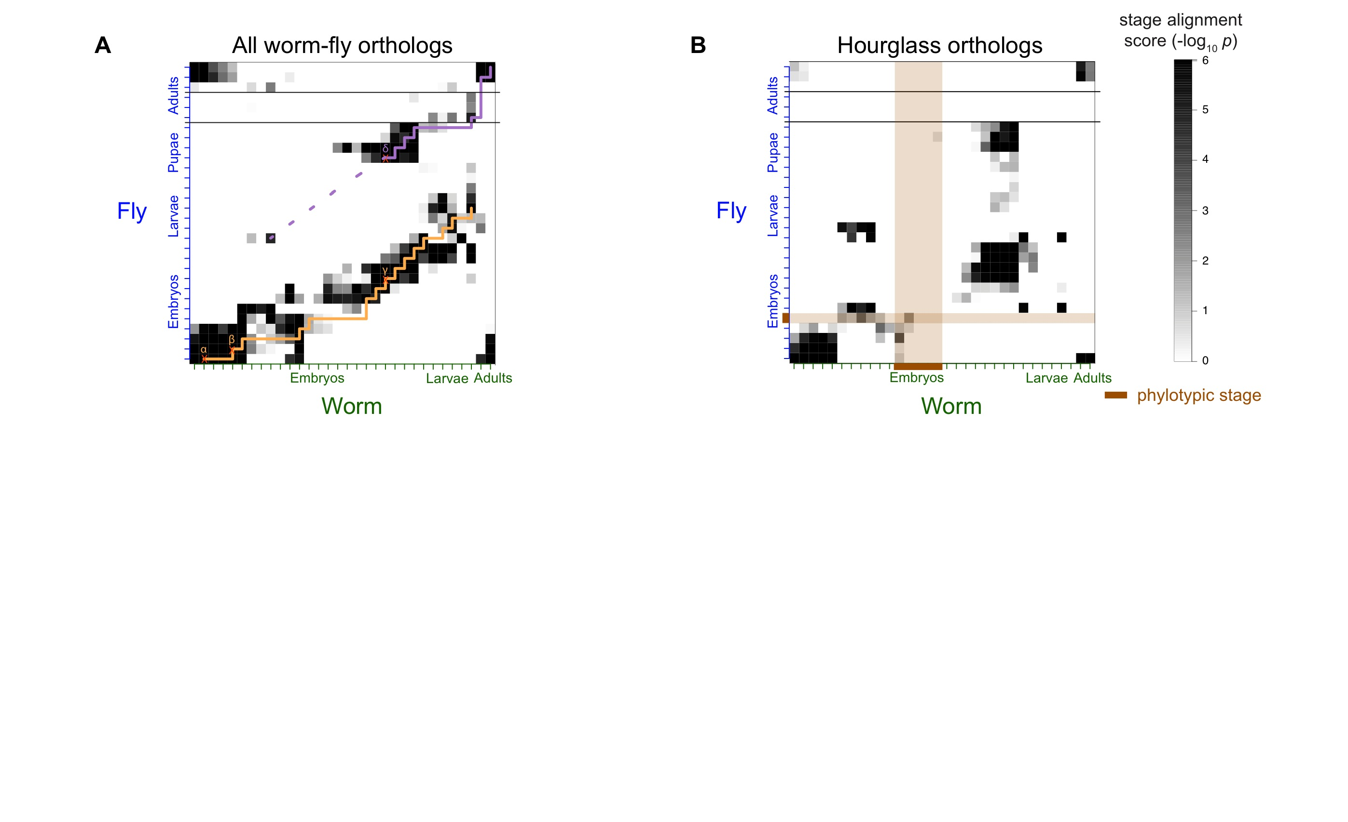
Alignment of Developmental Time-Course
For worm & fly find stage-specific genes
We can align developmental stages using fraction of shared orthologs between worm and fly amongst these
Reuse of genes from LE in worm in fly pupa
Fly
Align developmental stages using shared orthologs between worm and fly
  Reuse of genes from LE in worm in fly pupa
Using only orthologs in hourglass modules we find similar behavior except for absence of genes at the phylotypic stage
primary alignment
secondary alignment
Worm
[ENCODE-modencode Transcriptome paper, submitted]

Slide 27
Alignment of Developmental Time-Course
Using only orthologs in 12 "hourglass" modules show stronger alignment except for absence of genes at the phylotypic stage
  By definition genes in hourglass modules are not phylotypic stage specific, hence the gap
[ENCODE-modencode Transcriptome paper, submitted]

Slide 28
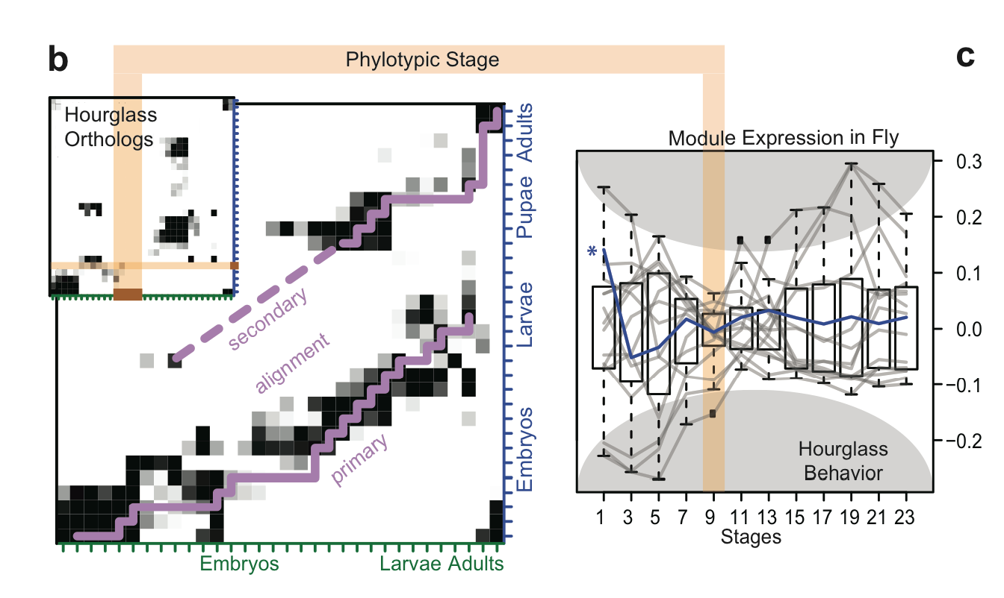
thoughts on hrglass slides

Slide 29
TAR Characterization
Non-canonical transcription (TARs):
Identify TARs that are significantly correlated and anti-correlated with genes in the 16 modules.
HOT Regions = High TF Co-occupancy

Slide 30
Statistical Methods in Functional Genomics
-- or How Biology Grapples with Big Data
(Illustrations of Models, Networks & Practical Tools)
A networks view
on organizing genomic elements
  Motivating & constructing the regulatory network
  Understanding the human regulatory network as a hierarchy with information flow bottlenecks
  Seeing the impact of variation and constraint on the network
Practical tools & data formats for genomics
  ChipSeq: PeakSeq, ACT, tYNA
  RNA-Seq: RSeqTools, IncRNA, FusionSeq, IQSeq
  Privacy advantages of high-level formats (MRF)
  Illustration of use of
  low-level variant data :
  Allelic effects probed by AlleleSeq
Large-scale inter-relation of genomic elements through statistical models
  Using His. Mods. to predict gene expression
  Comparing this with TF binding

Slide 31
Histone Modification (HM) model
TSS
TTS
Gene k
40
1
80
120
81
[Cheng et al. (’11) Genome Biol. 12: R15]
4 …
41 ….44
121
160
Bin 40-1
(TSS-4kb to TSS)
Bin 41-80
(TSS to TSS+4kb)
Bin 120-81
(TTS-4kb to TTS)
Bin 121-160
(TTS to TTS+4kb)
RNA-Seq data
Chromatin features:
Histone modifications
Prediction target:
Gene expression level
Predictors
~10000 refseq genes
HM1, 2, 3, ……
……
Bin 1
Bin 2
Bin160

Slide 32
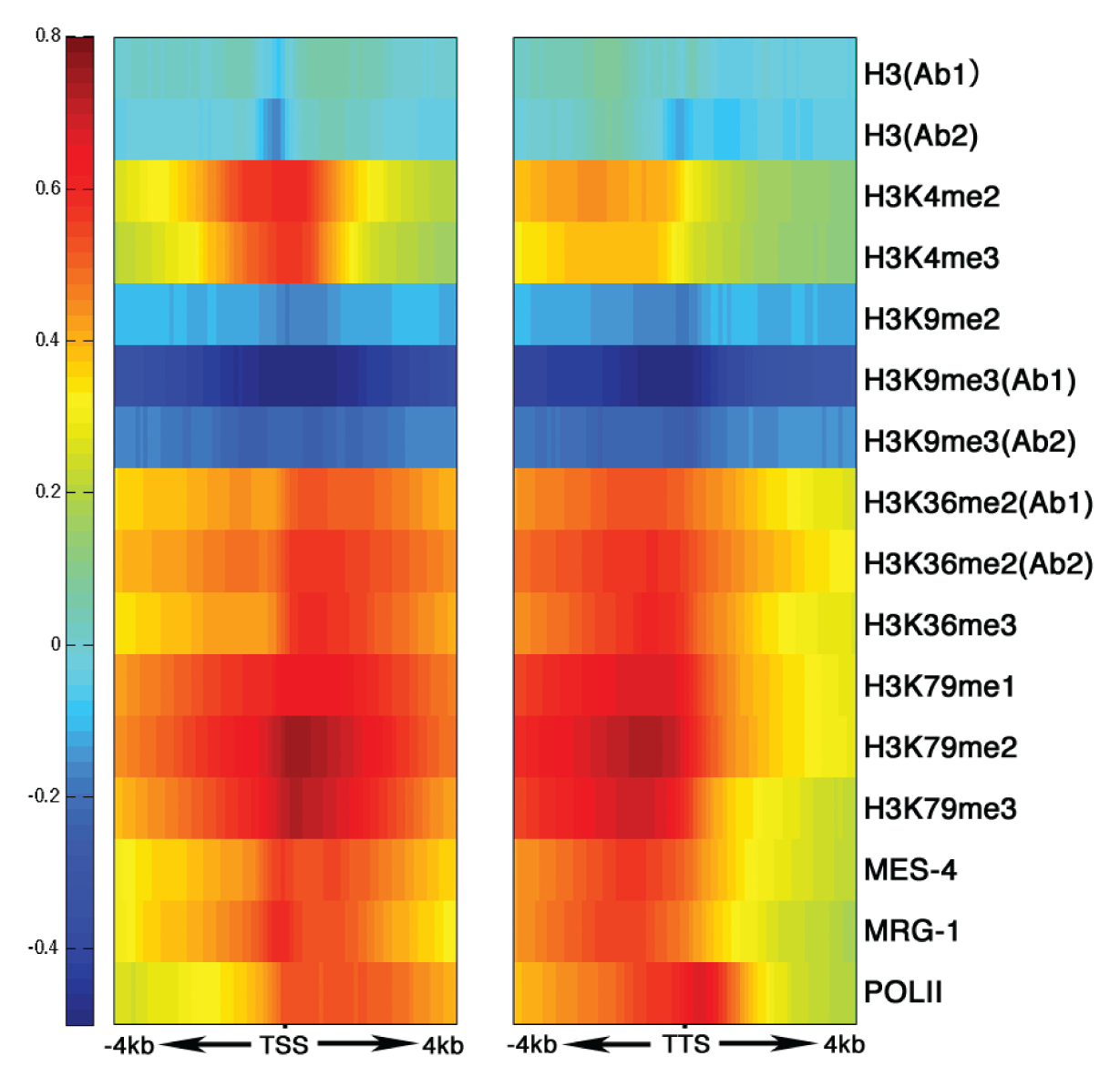
His. mods around TSS & TTS are clearly related to level of gene expression, in a position-dependent fashion
START
STOP
[Science 330:6012]
[Related work: Ouyang et al. (‘09) PNAS; Karlic et al. (‘10) PNAS]

Slide 33
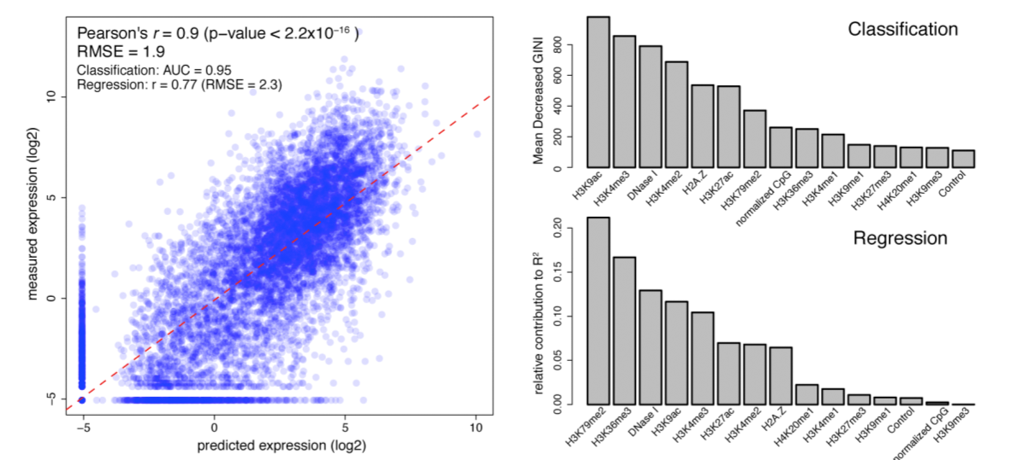
Human
Results
[Encode Consortium et al. Nature (in press, '12)]

Slide 34
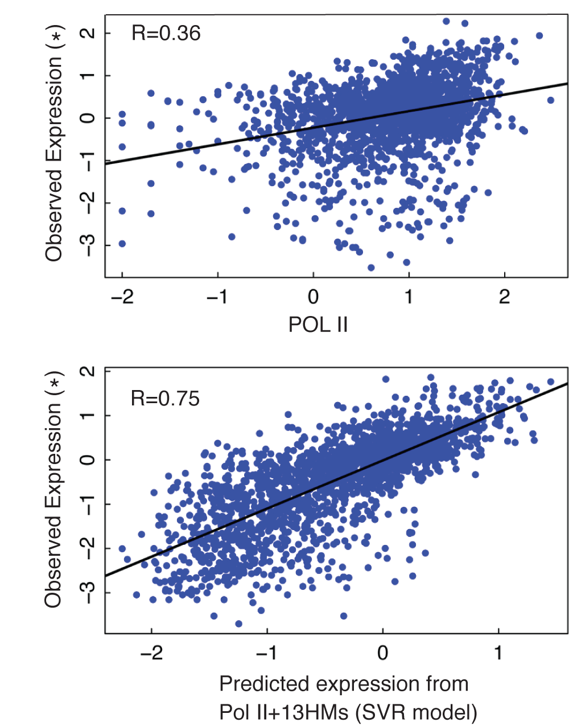
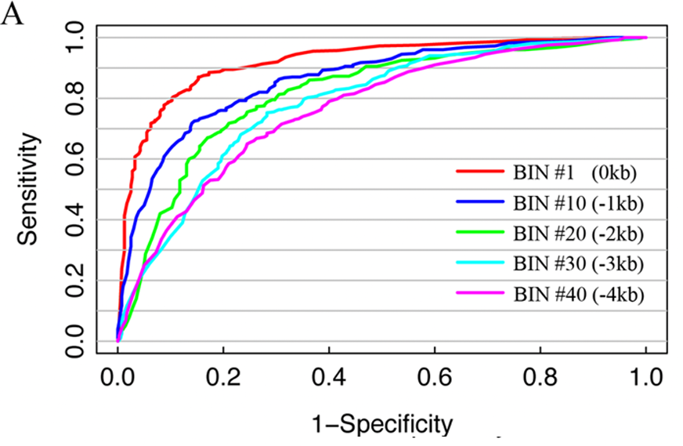
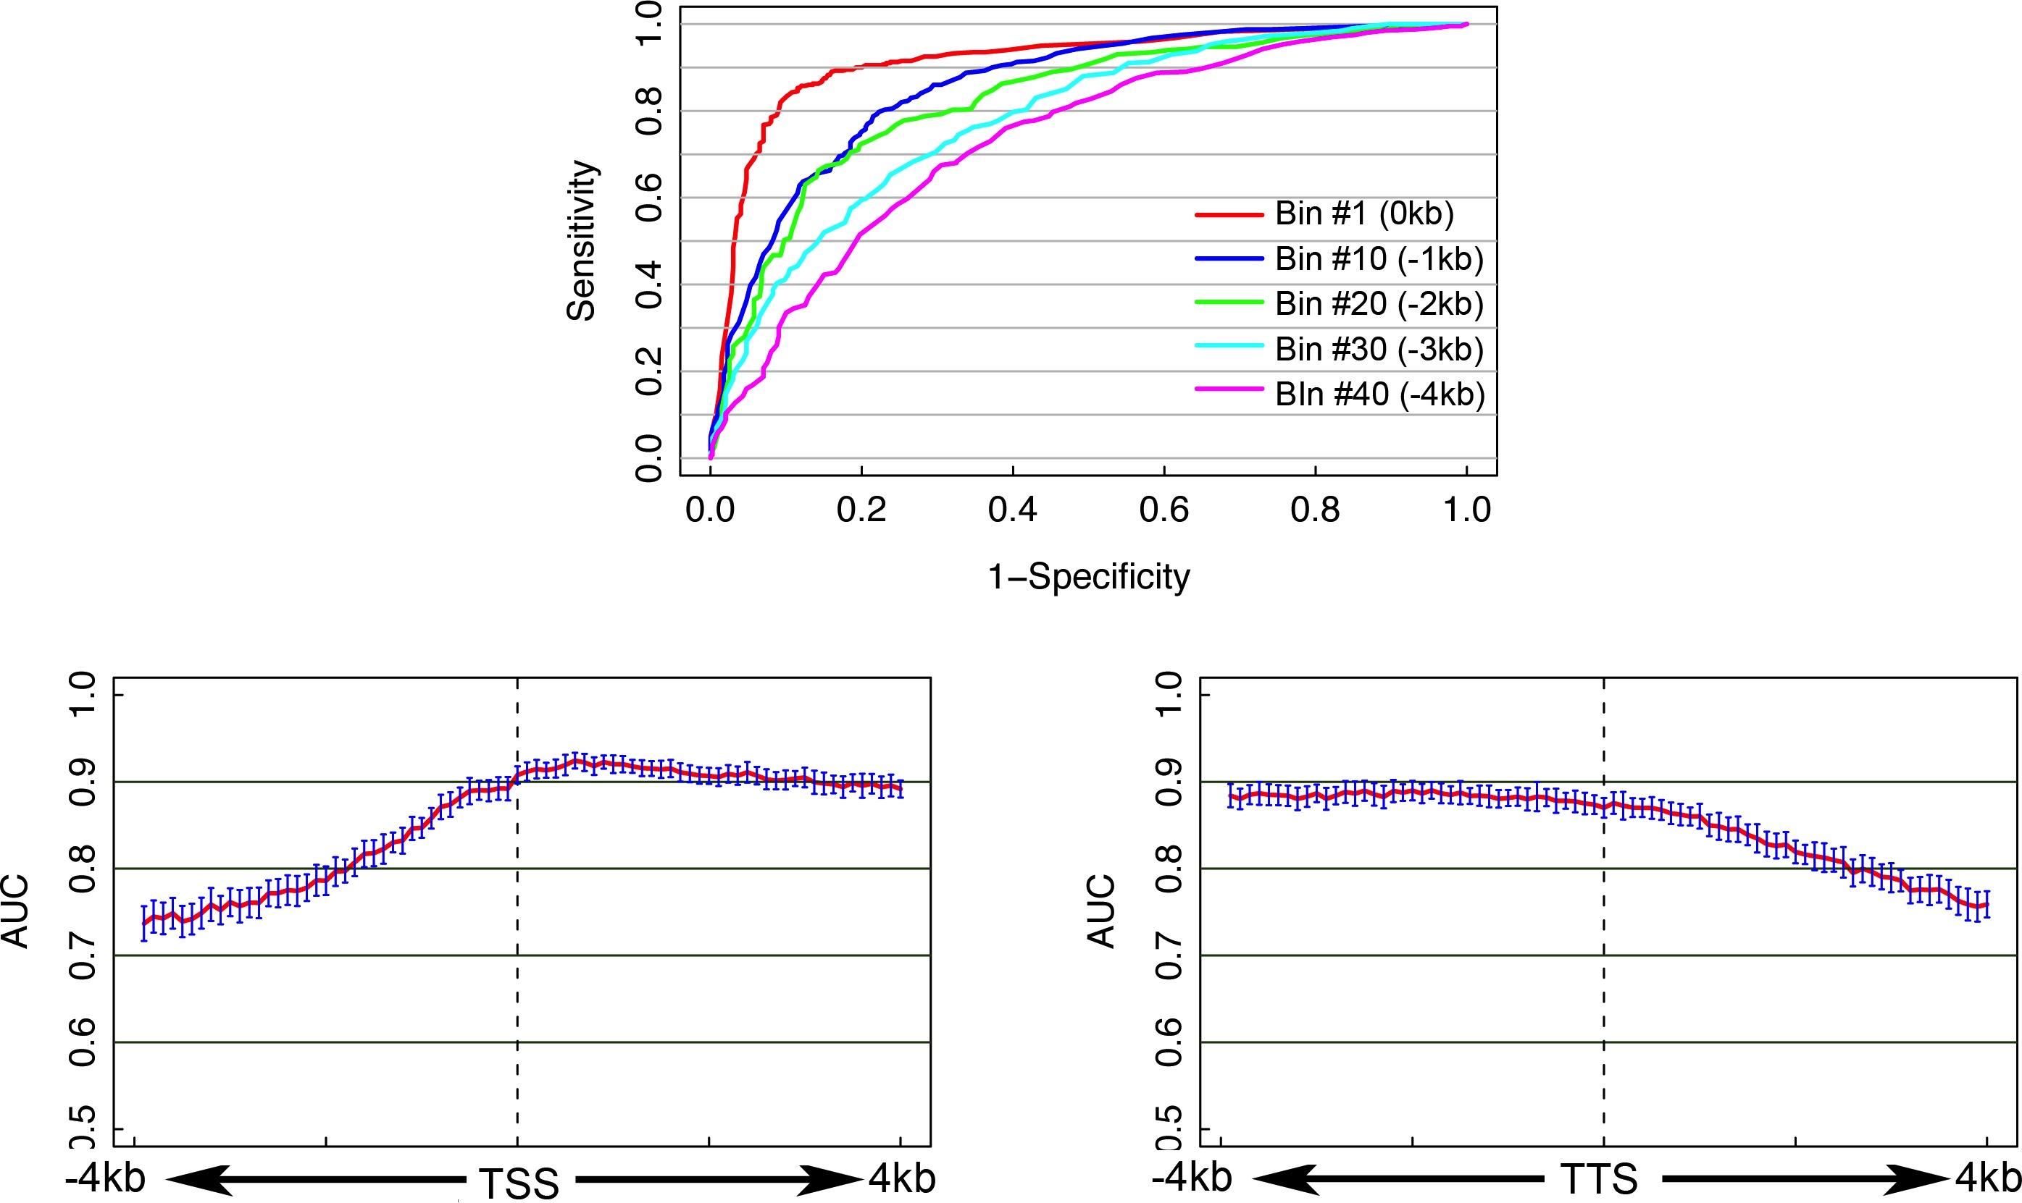
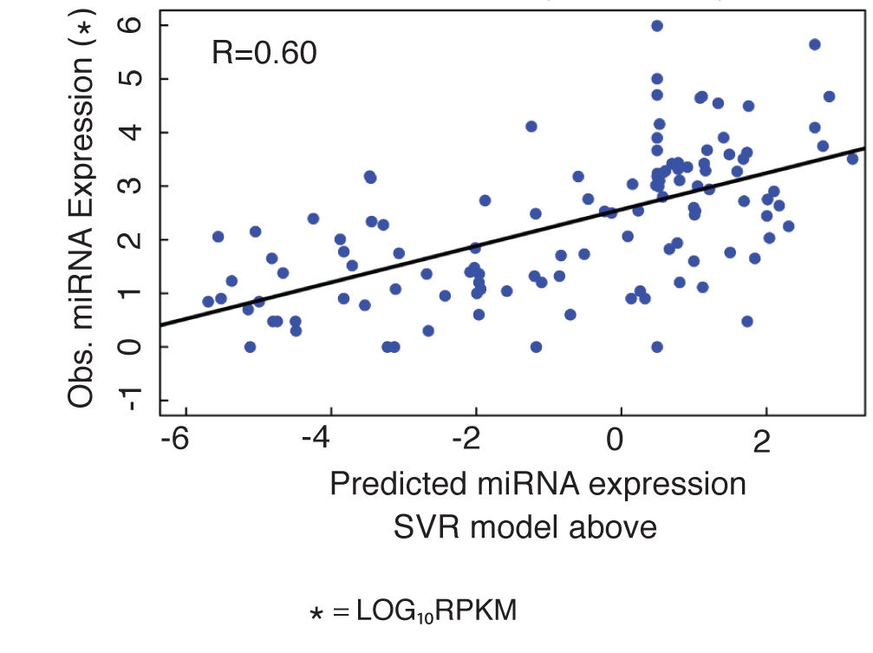
Integrate all histone modifications to predict gene expression levels
Classify H/L genes (SVM)
Predict expression values
[Cheng et al. (’11) Genome Biol. 12: R15]
#Bin1
Magnitude of Prediction from a “bin” around the TSS

Slide 35
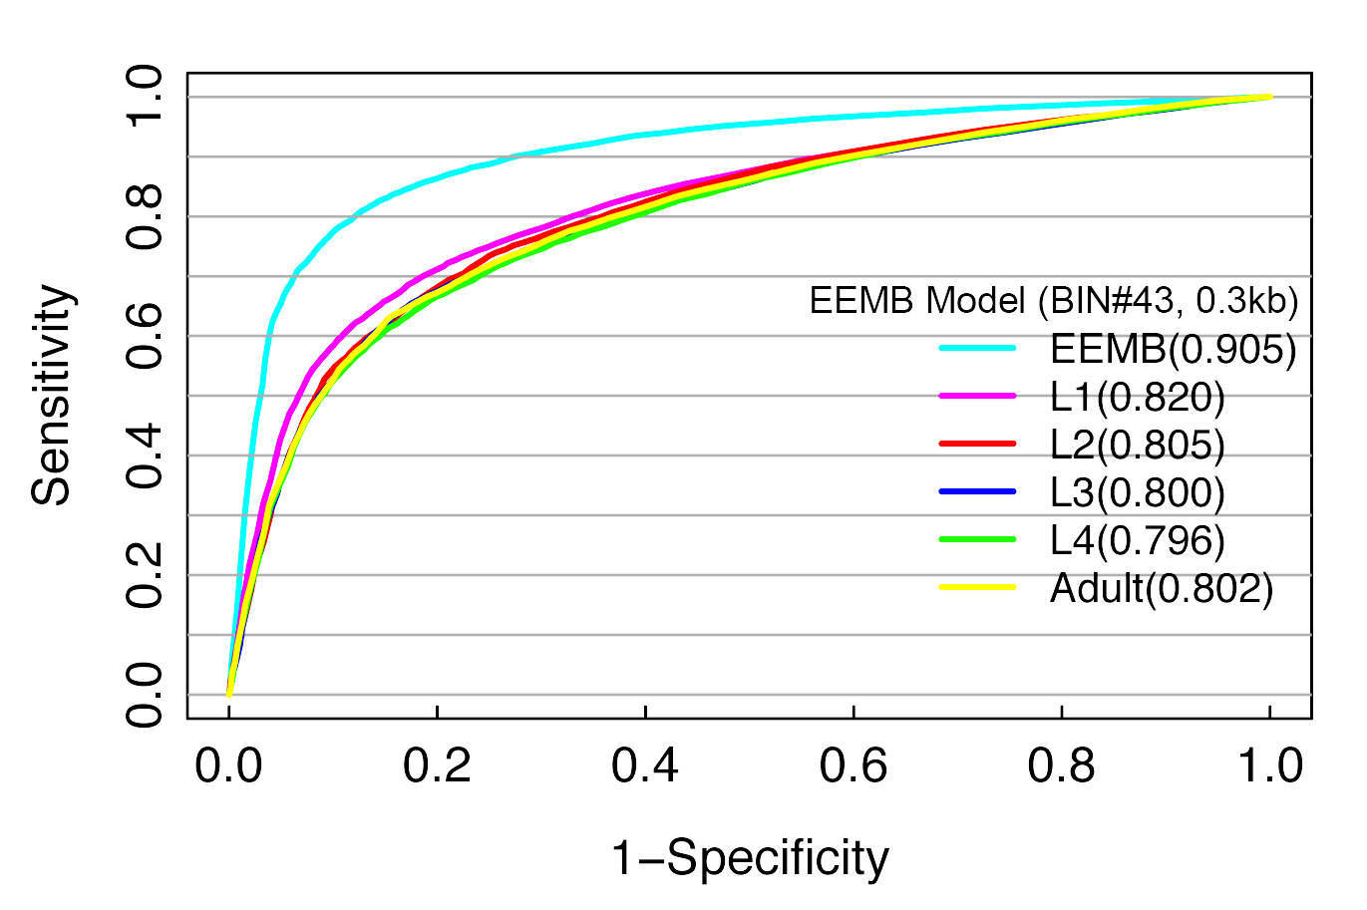
HM models are tissue specific
HM model-- Best prediction is achieved by using histone modification and expression data from the same developmental stage
[Cheng et al. (’11) Genome Biol. 12: R15]

Slide 36
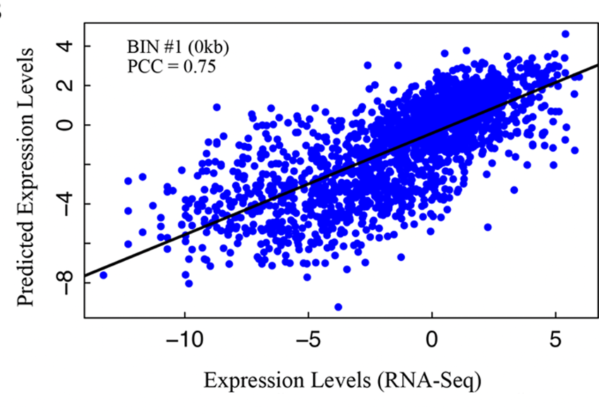
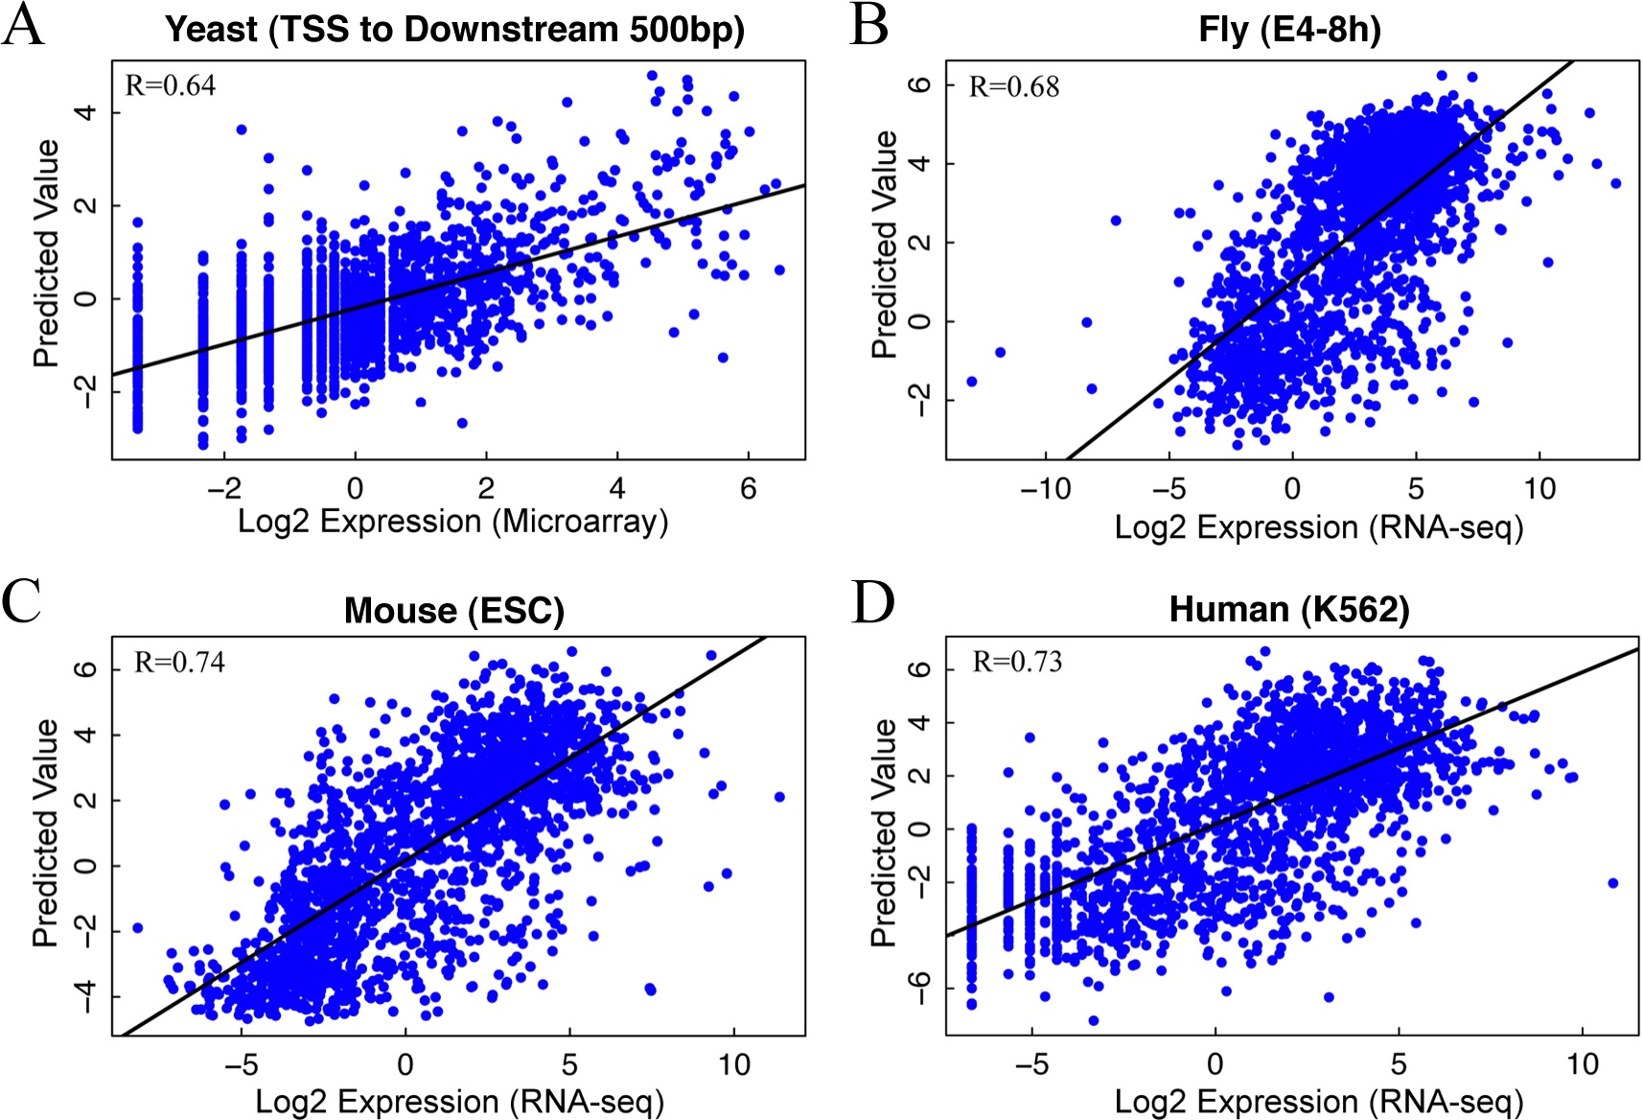
Application of chromatin model in 5 species:
Consistent Performance
Worm (L3)
>50% of variation of expression levels can be explained by HMs
[Cheng et al. Genome Biol. (‘11) 12: R15]

Slide 37
Models for Gene Expression
-2Kb
TSS
+2Kb
Construct non-linear model for predicting gene expression
works for mRNAs and ncRNAs
models use either histone marks or TFs

Slide 38
Universal, cross-organism Model
Human
Worm
Fly
Fly
Worm
Human
Comparison of TF model and HM models around TSS
We construct single universal HM model
(one set of parameters)
works almost as well as species specific models
works for both mRNAs and ncRNAs
[ENCODE-modencode Transcriptome paper, submitted]
[ENCODE-modencode Transcriptome paper, submitted]

Slide 39
Inter-phyla Comparisons of Regulation & Transcription
Even though human, fly and worm are highly divergent they share many ancient features of transcription:
Transcription: Expression clustering
  16 Conserved co-expression modules
  Inter- and intra-species hourglass behavior of 12 of these modules
  Expression clustering, particularly of hourglass modules, able to align the developmental stages of worm & fly
Regulation: Hierarchical regulatory network
with many FFLs
Both: Statistical Models "Predicting" Expression
  Small numbers of TF can reliably "predict"
  Possible to construct a universal HM model for gene expression which works for mRNAs and ncRNAs

Slide 40
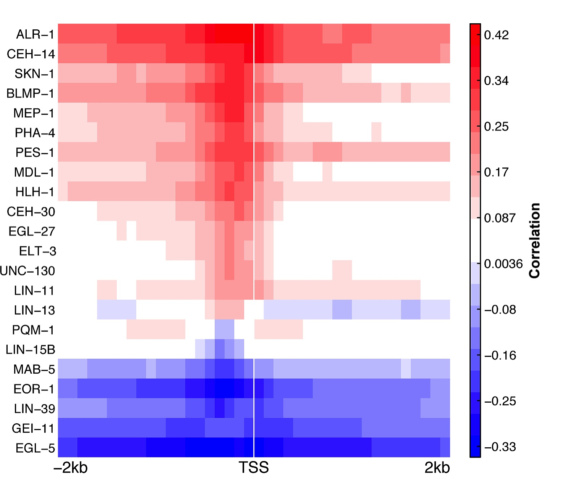
Doing a Model with TFs:
Positive and negative regulators from correlating TF signal at TSS with gene expression
[Cheng et al. (’11) PLOS CB]

Slide 41
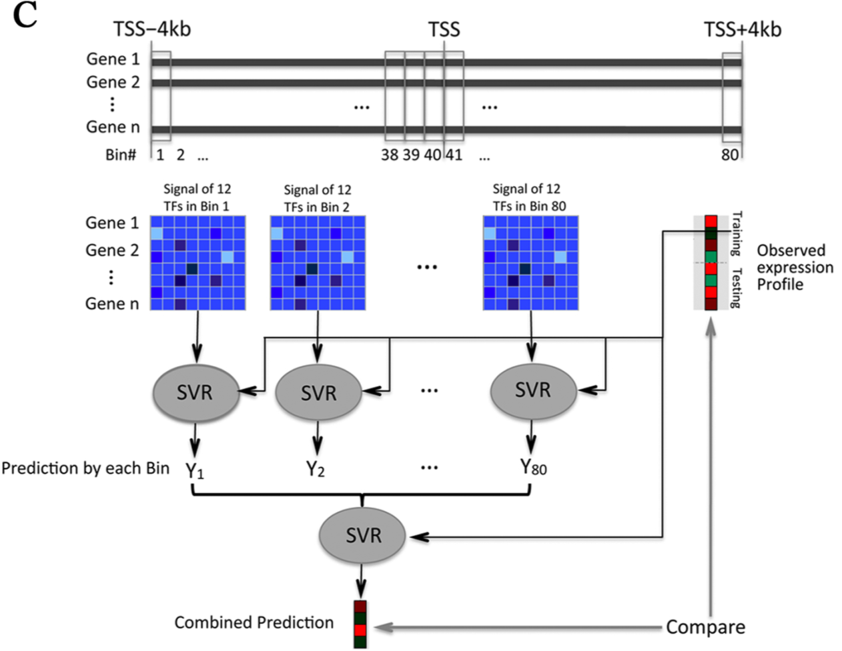
Predictor v2:
2-levels, now with TFs
[Cheng et al. NAR ('11)]

Slide 42
Human Results
[Encode Consortium et al. Nature (in press, '12)]

Slide 43
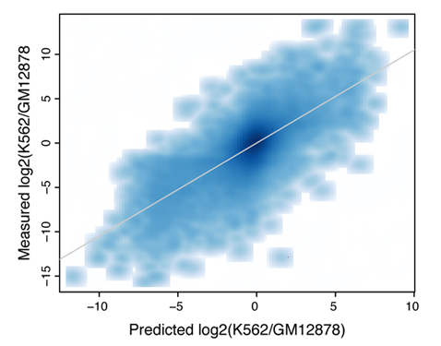
Prediction of Differential Expression
PCC=0.73
TF model– differential TF binding signals are predictive of differential expression levels between two human cell lines
[Cheng et al. Gen. Res. (in press, '12)]

Slide 44
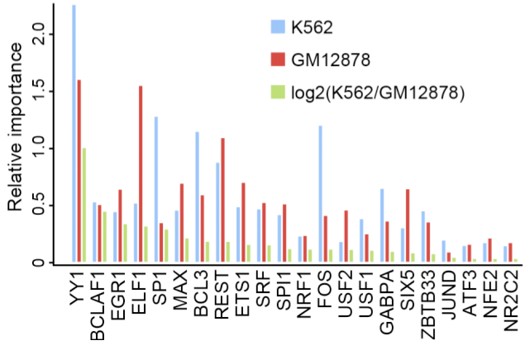
TFs active in a particular cell type are the strongest predictors in that cell
[Cheng et al. Gen. Res. (in press, '12)]

Slide 45
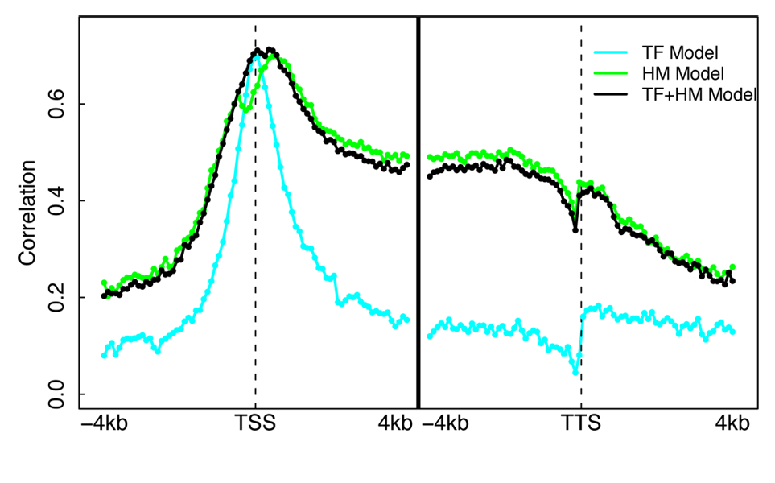
Models Illuminates Different Regions of Influence for TFs vs HMs
Datasets
  ChIP-Seq for 12 TFs
  (Chen et al. 2008)
  ChIP-Seq for 7 HMs
  (Meissner et al.’08; Mikkelsen et al. ’07)
  RNA-Seq (Cloonan et al. 2008)
A TF+HM model that combine TF and HM features does NOT improve accuracy!
Cheng et al. 2011, Nucleic Acids Res.

Slide 46
[ENCODE-modencode Transcriptome paper, submitted]
[ENCODE-modencode Transcriptome paper, submitted]

Slide 47
TF Model for Gene Expression
Construct non-linear model for predicting gene expression from signals of multiple TFs binding in promotor
Correlations of individual TFs with expression (activators & repressors)
Integrating correlations into model
Good accuracy for mRNAs & ncRNAs
TF model accuracy only needs a small number of TFs for high accuracy (>90%)
[ENCODE-modencode Transcriptome paper, submitted]

Slide 48
Statistical Methods in Functional Genomics
-- or How Biology Grapples with Big Data
(Illustrations of Models, Networks & Practical Tools)
A networks view
on organizing genomic elements
  Motivating & constructing the regulatory network
  Understanding the human regulatory network as a hierarchy with information flow bottlenecks
  Seeing the impact of variation and constraint on the network
Practical tools & data formats for genomics
  ChipSeq: PeakSeq, ACT, tYNA
  RNA-Seq: RSeqTools, IncRNA, FusionSeq, IQSeq
  Privacy advantages of high-level formats (MRF)
  Illustration of use of
  low-level variant data :
  Allelic effects probed by AlleleSeq
Large-scale inter-relation of genomic elements through statistical models
  Using His. Mods. to predict gene expression
  Comparing this with TF binding

Slide 49
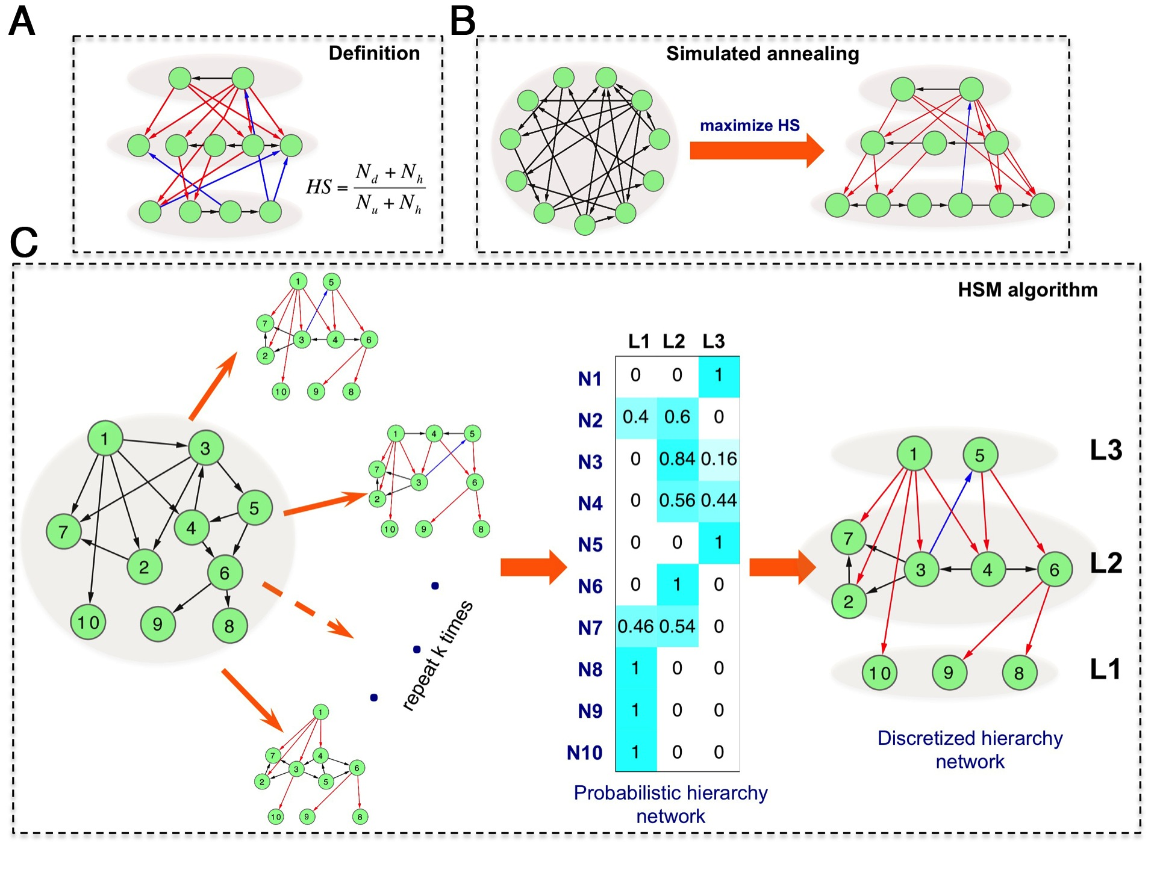
Algorithms for Hierarchy Inference
[Cheng et al., submitted]

Slide 50
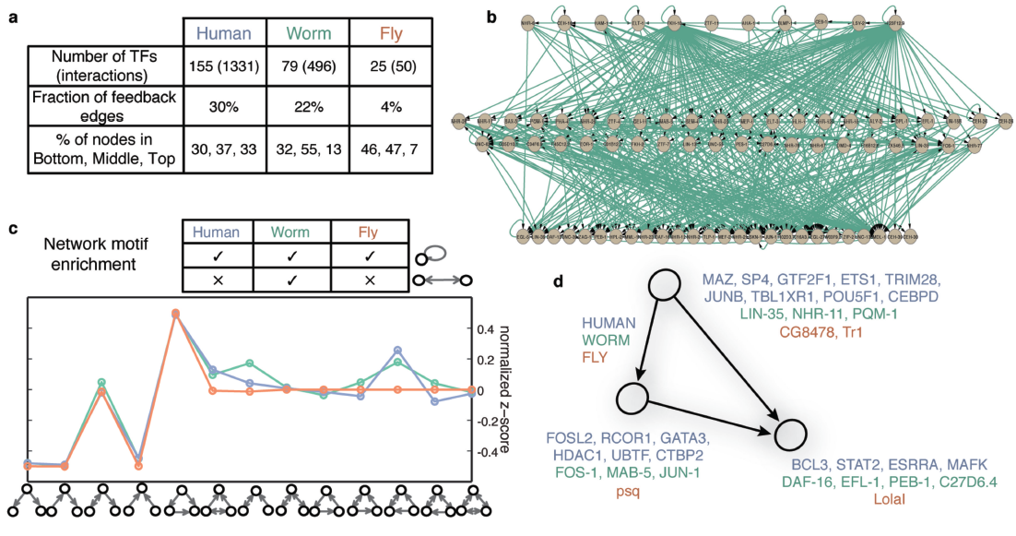
Conservation of regulatory networks rewiring
[ENCODE-modencode Regulation paper, submitted]

Slide 51
Inter-phyla Comparisons of Regulation & Transcription
Even though human, fly and worm are highly divergent they share many ancient features of transcription:
Transcription: Expression clustering
  16 Conserved co-expression modules
  Inter- and intra-species hourglass behavior of 12 of these modules
  Expression clustering, particularly of hourglass modules, able to align the developmental stages of worm & fly
Regulation: Hierarchical regulatory network
with many FFLs
Both: Statistical Models "Predicting" Expression
  Small numbers of TF can reliably "predict"
  Possible to construct a universal HM model for gene expression which works for mRNAs and ncRNAs

Slide 52
Models of Transcription Relating
Various Genome Tracks of Information –
His. Mods, TF Binding & Gene Expression
Predictive models of gene expression
  Applicable in many contexts
  Work for miRNAs as well as genes
  Show variable importance of regions around genes for chromatin & TFs
  Show TF & HM signals are redundant for ‘predicting’ gene expression
  Surprisingly, a few TFs, particularly TFSSs, are quite predictive

Slide 53
Conclusions
Even though human, fly and worm are highly divergent they share many general principals of transcription:
We identify conserved modules of genes with conserved GO functions between organisms
We show inter- and intra-species hourglass behavior for worm and fly
We map developmental stages between worm and fly
Similar fractions of (unannotated) non-canonical transcription
We construct a universal HM model for gene expression which works for mRNAs and ncRNAs

Slide 54


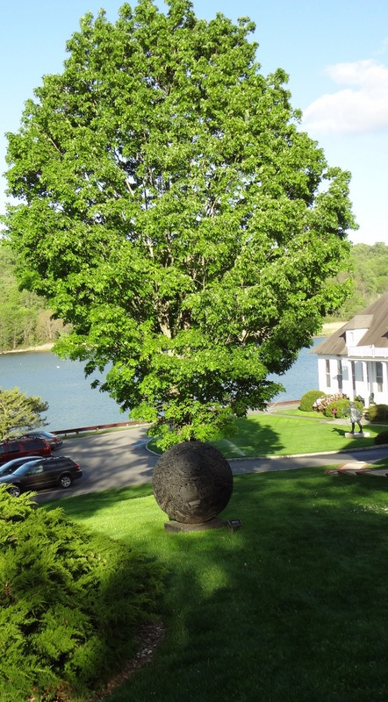
Acknowledgements
modENCODE/ENCODE Transcriptome Group
Joel Rozowsky, Koon-Kiu Yan, Daifeng Wang, Chao Cheng, James B. Brown, Carrie A. Davis, LaDeana Hillier, Cristina Sisu, Jingyi Jessica Li, Baikang Pei, Arif O. Harmanci, Michael O. Duff, Sarah Djebali, Roger P. Alexander, Burak H. Alver, Raymond K. Auerbach, Kimberly Bell, Peter J. Bickel, Max E. Boeck, Nathan P. Boley, Benjamin W. Booth, Lucy Cherbas, Peter Cherbas, Chao Di, Alex Dobin, Jorg Drenkow, Brent Ewing, Gang Fang, Megan Fastuca, Elise A. Feingold, Adam Frankish, Guanjun Gao, Peter J. Good, Phil Green, Roderic Guigó, Ann Hammonds, Jen Harrow, Roger A. Hoskins, Cédric Howald, Long Hu, Haiyan Huang, Tim J. P. Hubbard, Chau Huynh, Sonali Jha, Dionna Kasper, Masaomi Kato, Thomas C. Kaufman, Rob Kitchen, Erik Ladewig, Julien Lagarde, Eric Lai, Jing Leng, Zhi Lu, Michael MacCoss, Gemma May, Rebecca McWhirter, Gennifer Merrihew, David M. Miller, Ali Mortazavi, Rabi Murad, Brian Oliver, Sara Olson, Peter Park, Michael J. Pazin, Norbert Perrimon, Dmitri Pervouchine, Valerie Reinke, Alexandre Reymond, Garrett Robinson, Anastasia Samsonova, Gary I. Saunders, Felix Schlesinger, Anurag Sethi, Frank J. Slack, William C. Spencer, Marcus H. Stoiber, Pnina Strasbourger, Andrea Tanzer, Owen A. Thompson, Kenneth H. Wan, Guilin Wang, Huaien Wang, Kathie L. Watkins, Jiayu Wen, Kejia Wen, Chenghai Xue, Li Yang, Kevin Yip, Chris Zaleski, Yan Zhang, Henry Zheng, Steven E. Brenner, Brenton R. Graveley, Susan E. Celniker, Thomas R Gingeras, Robert Waterston
modENCODE/ENCODE Regulation Group
Alan P. Boyle, Carlos L. Araya, Cathleen Brdlik, Philip Cayting, Chao Cheng, Yong Cheng, Kathryn Gardner, LaDeana Hillier, Judith Janette, Lixia Jiang, Dionna Kasper, Trupti Kawli, Pouya Kheradpour, Anshul Kundaje, Jingyi Jessica Li, Lijia Ma, Wei Niu, E. Jay Rehm, Joel Rozowsky, Matthew Slattery, Rebecca Spokony, Robert Terrell, Dionne Vafeados, Daifeng Wang, Peter Weisdepp, Yi-Chieh Wu, Dan Xie, Koon-Kiu Yan, Elise A. Feingold, Peter J. Good Michael J. Pazin, Haiyan Huang, Peter J. Bickel, Steven E. Brenner, Valerie Reinke, Robert H. Waterston, Kevin P. White, Manolis Kellis, Michael Snyder

Slide 55




TF-v-expr:
Cheng C, Yan KK, Hwang W, Qian J, Bhardwaj N, Rozowsky J, Lu ZJ, Niu W, Alves P, Kato M, Snyder M
worm-HM:
Cheng C, Yan KK, Yip KY, Rozowsky J, Alexander R, Shou C
ENCODE:
Chao Cheng, Roger Alexander, Renqiang Min, Kevin Y. Yip, Jing Leng, Joel Rozowsky, Koon-kiu Yan, Xianjun Dong, Sarah Djebali, Yijun Ruan, Carrie A Davis, Piero Carninci, Timo Lassman, Thomas R. Gingeras, Roderic Guigó Serra, Ewan Birney, Zhiping Weng, Michael Snyder
Models Acknowledgements

Slide 56


Network
Acknowledgements
A Kundaje, M Hariharan,
S Landt, K Yan, C Cheng,
X Mu, E Khurana,
J Rozowsky,
R Alexander, R Min, P Alves,
A Abyzov, N Addleman, N Bhardwaj,
A Boyle, P Cayting, A Charos, D Chen,
Y Cheng, D Clarke, C Eastman,
G Euskirchen, S Frietze, Y Fu, J Gertz,
F Grubert, A Harmanci, P Jain,
M Kasowski, P Lacroute, J Leng, J Lian,
H Monahan, H O'Geen, Z Ouyang,
E Partridge, D Patacsil, F Pauli, D Raha,
L Ramirez, T Reddy, B Reed, M Shi, T Slifer, J Wang, L Wu, X Yang, K Yip,
G Zilberman-Schapira, S Batzoglou,
A Sidow, P Farnham, R Myers,
S Weissman, M Snyder
+ (for enhancers) E Birney, P Bickel,
& B Brown & (for variation)
P Kim & J Korbel
(11 Main Projects, ~50 labs, >350 substantial contributors + NHGRI)
Networks/Elements
(~60 participants):

Slide 57
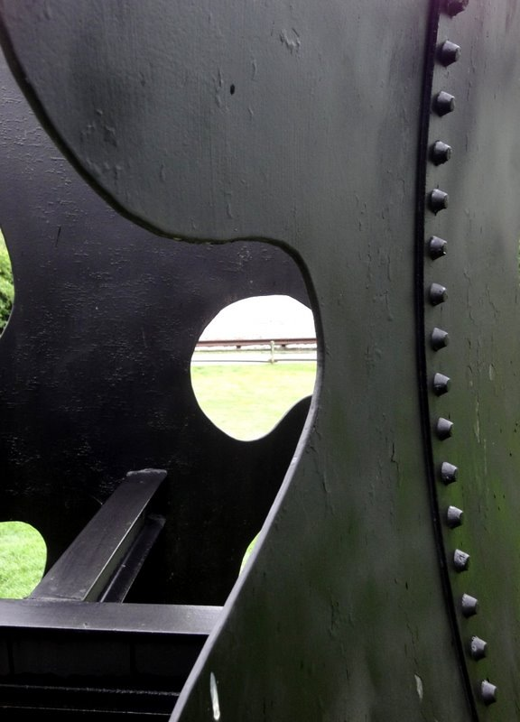
Peakseq: J Rozowsky, G Euskirchen, RK Auerbach, ZD Zhang, T Gibson, R Bjornson, N Carriero, M Snyder
RSeqTools: L Habegger, A Sboner, TA Gianoulis, J Rozowsky, A Agarwal, M Snyder
IncRNA: ZJ Lu, KY Yip, G Wang, C Shou, LW Hillier, E Khurana, A Agarwal, R Auerbach, J Rozowsky, C Cheng, M Kato, DM Miller, F Slack, M Snyder, RH Waterston, V Reinke
ACT.gersteinlab.org : J Jee, J Rozowsky, KY Yip, L Lochovsky, R Bjornson, G Zhong, Z Zhang, Y Fu, J Wang, Z Weng
IQSeq: J Du, J Leng, L Habegger, A Sboner, D McDermott,
FusionSeq: A Sboner, L Habegger, D Pflueger, S Terry, DZ Chen, JS Rozowsky, AK Tewari, N Kitabayashi, BJ Moss, MS Chee, F Demichelis, MA Rubin
Privacy: D Greenbaum, A Sboner, XJ Mu
Alleleseq.gersteinlab.org:
J Rozowsky, A Abyzov, J Wang, P Alves, D Raha, A Harmanci, J Leng, R Bjornson, Y Kong, N Kitabayashi, N Bhardwaj, M Rubin, M Snyder
tYNA.gersteinlab.org : KY Yip, H Yu, PM Kim, M Schultz
Tools Acknowledgements
info.gersteinlab.org/Tools

Slide 58
Default Theme
Default Outline Level 1
  Level 2

Slide 59
More Information on this Talk
SUBJECT: Networks
DESCRIPTION:
NOTES:
This PPT should work on mac & PC. Paper references in the talk were mostly from Papers.GersteinLab.org.
PERMISSIONS: This Presentation is copyright Mark Gerstein, Yale University, 2010. Please read permissions statement at http://www.gersteinlab.org/misc/permissions.html . Feel free to use images in the talk with PROPER acknowledgement (via citation to relevant papers or link to gersteinlab.org).
PHOTOS & IMAGES. For thoughts on the source and permissions of many of the photos and clipped images in this presentation see http://streams.gerstein.info . In particular, many of the images have particular EXIF tags, such as kwpotppt , that can be easily queried from flickr, viz: http://www.flickr.com/photos/mbgmbg/tags/kwpotppt .
Notes:
59

