Slide 1
AlleleDB Figure Pack
- Uniform survey of allele-specific binding and expression across 383 individuals -
Jieming
Allele
Notes:
Allelic != allele-specific

Slide 2
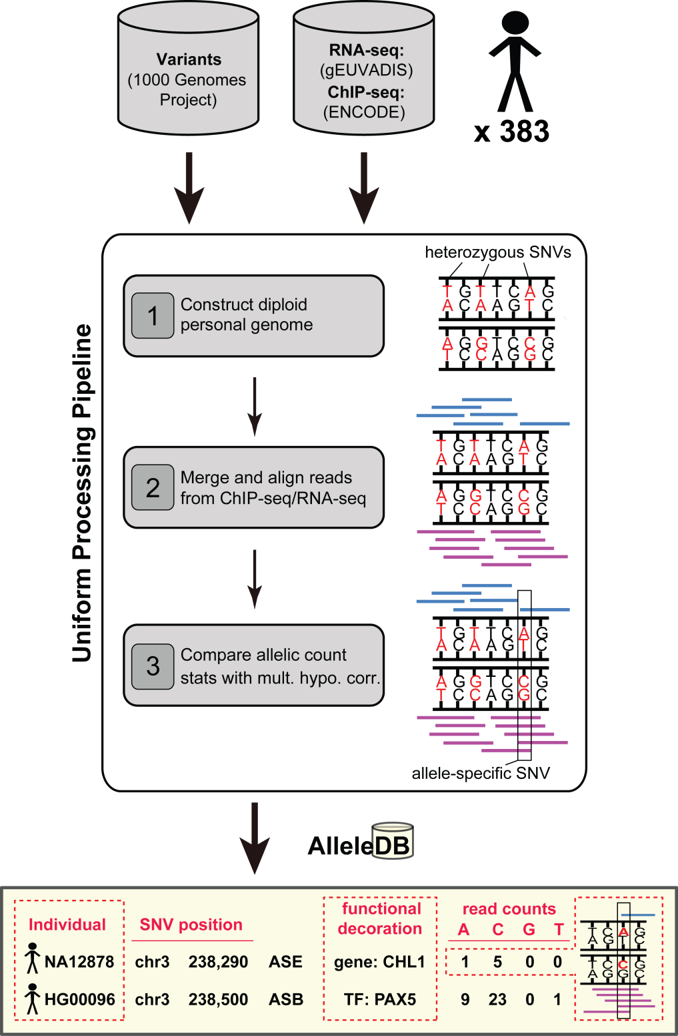
Figure 1. Uniform processing of data from 383 individuals and construction of AlleleDB.

Slide 3
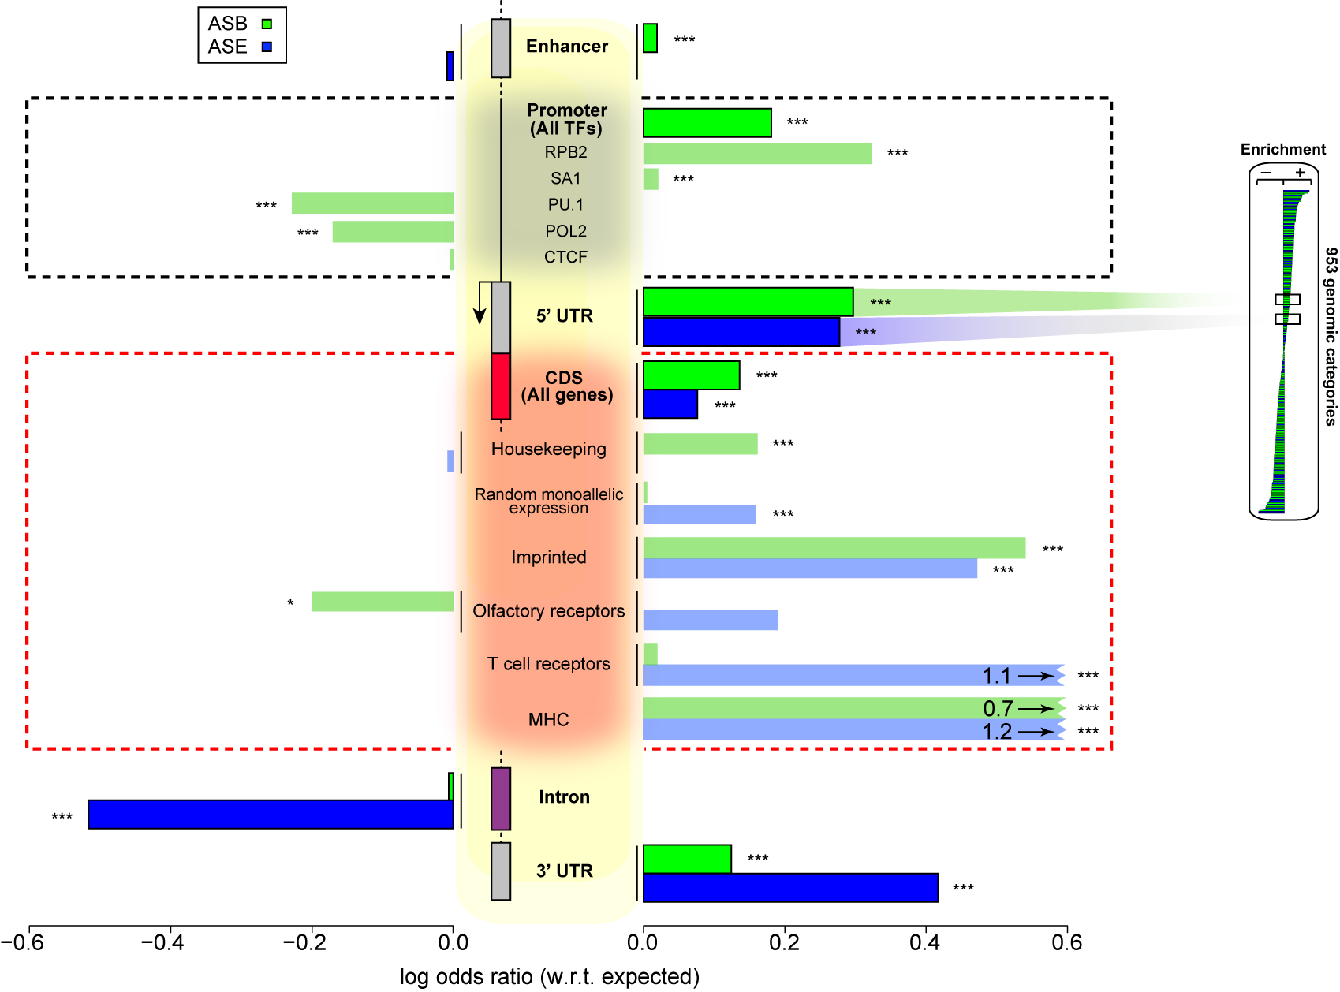
Figure 2. Some genomic regions are more susceptible to allele-specific regulation.
Notes:
Bonferonni corrected p

Slide 4
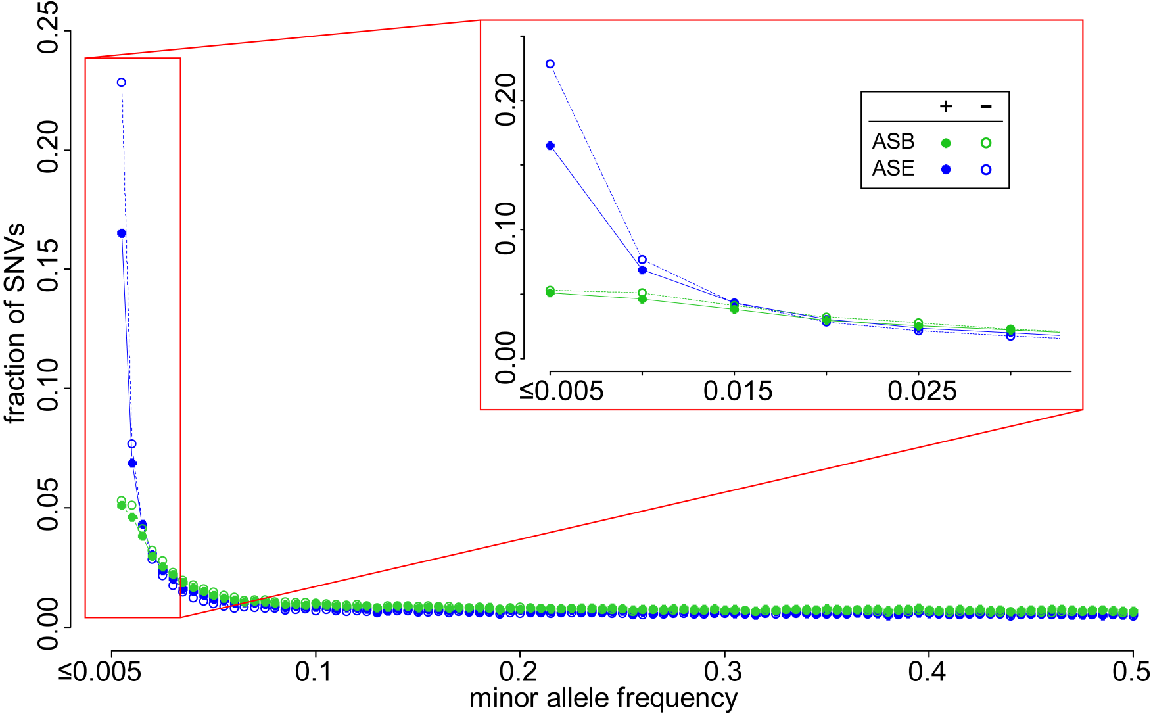
Figure 3. A considerable fraction of AS variants are rare but do not form the majority. Lesser proportion of AS SNVs than non-AS SNVs are rare, suggesting less selective constraints in AS SNVs.

Slide 5
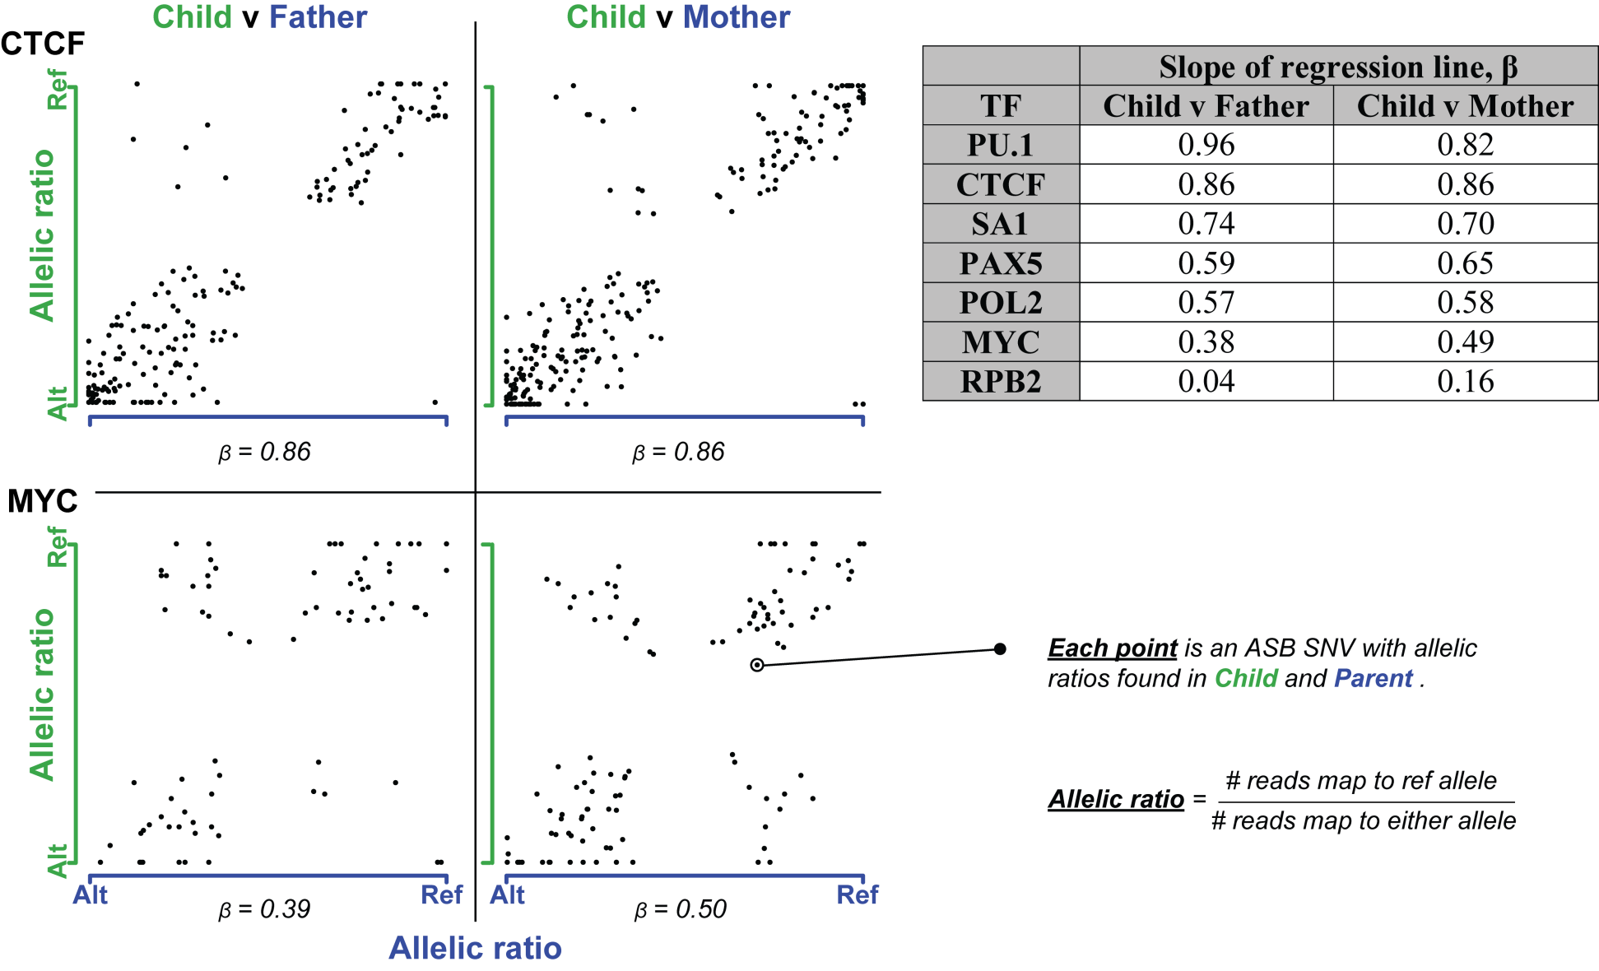
Figure 4. Inheritance of allele-specific binding events is evident in some TFs but not so apparent in others.

Slide 6
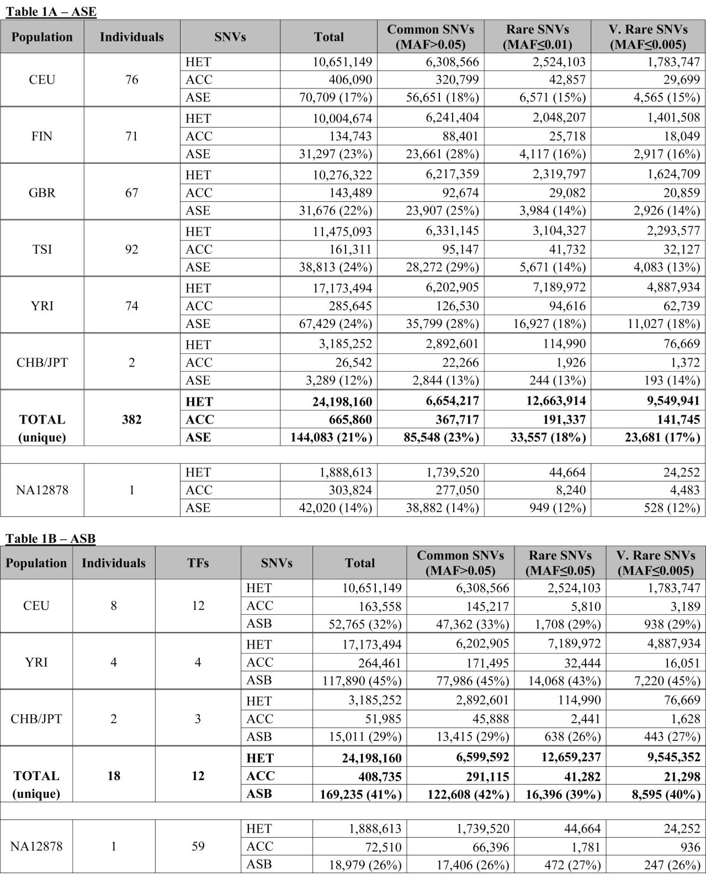
Table 1.

Slide 7
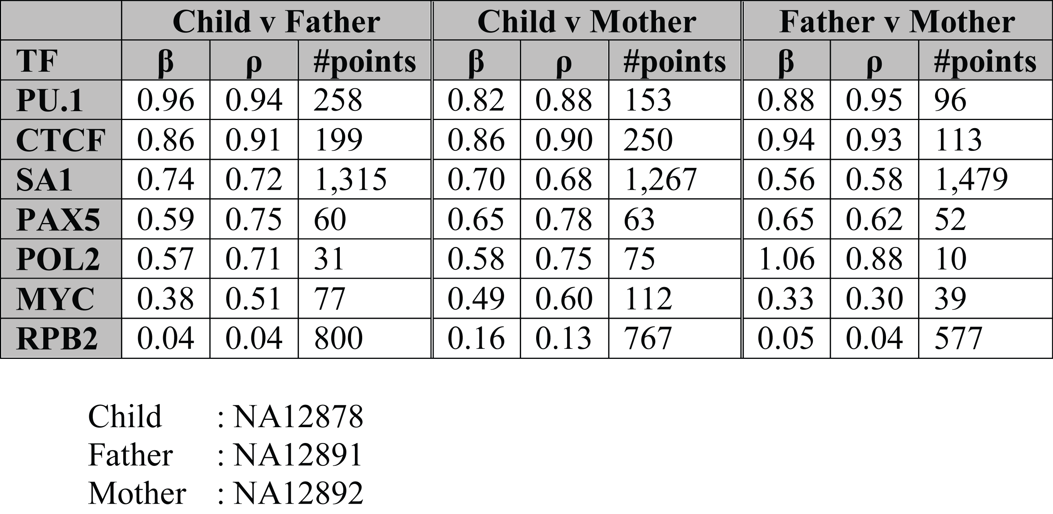
Supplementary Table 1
Allelic inheritance
Notes:
Bonferonni correct it

Slide 8
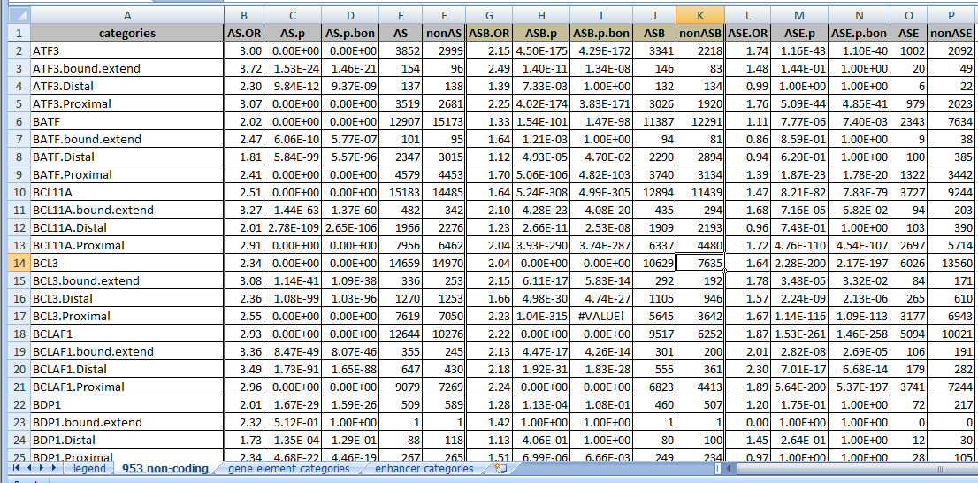
Supplementary File 1
953 non-coding categories, gene elements, enhancers
ASB, ASE and AS, with Bonferroni-corrected p values

Slide 9
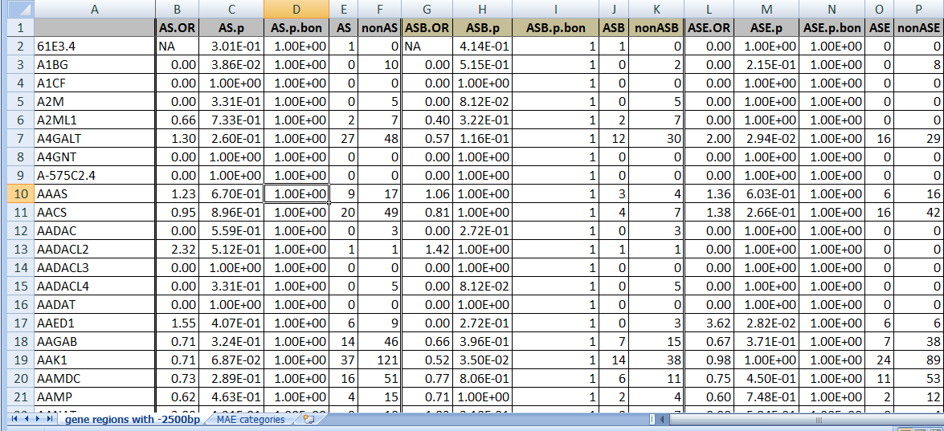
Supplementary File 2
20,144 genes, MAE categories
ASB, ASE and AS, with Bonferroni-corrected p values

Slide 10
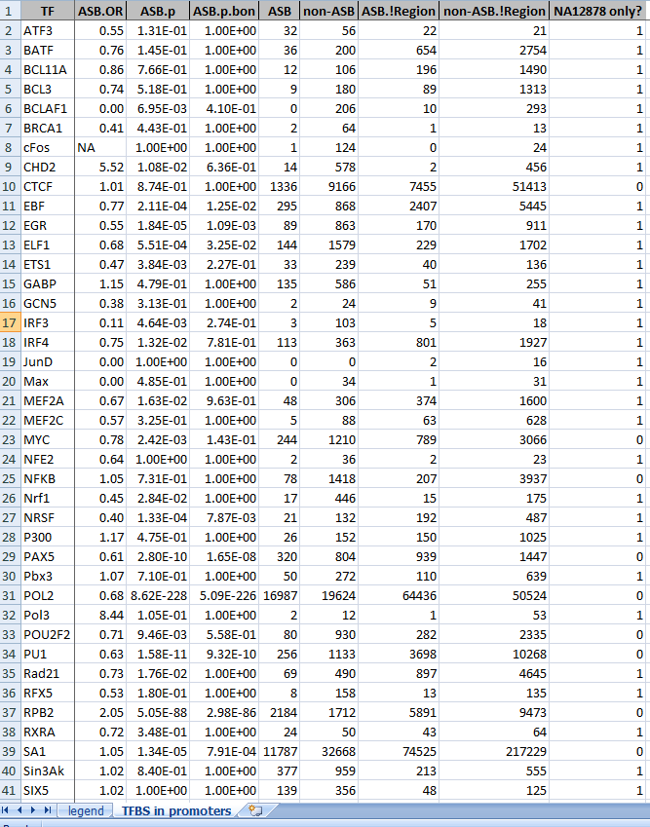
Supplementary File 3
TFs in promoters
ASB, ASE and AS, with Bonferroni-corrected p values

