Slide 1
Retrodup (exome) update
Yan Zhang
5/21/2014

Slide 2
Summary of retrodup calls
In a total of 1850 people from 19 populations, 11386 retrodups have been called, having in total 46436 supporting junctions, 540100 supporting reads.
Mapped to 386 unique gene IDs.

Slide 4
Supporting junctions and reads

Slide 5
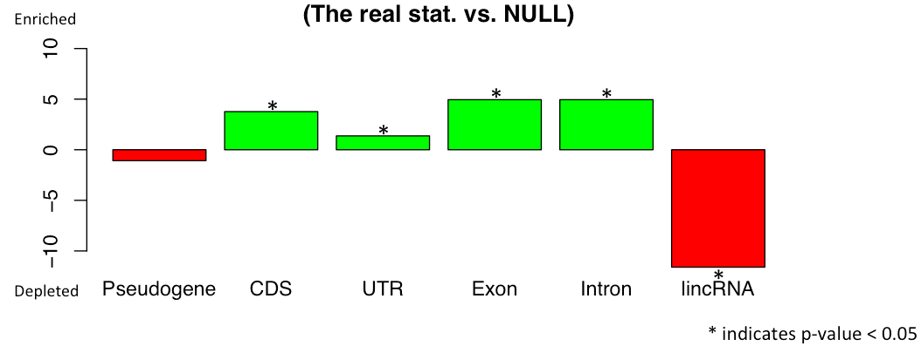
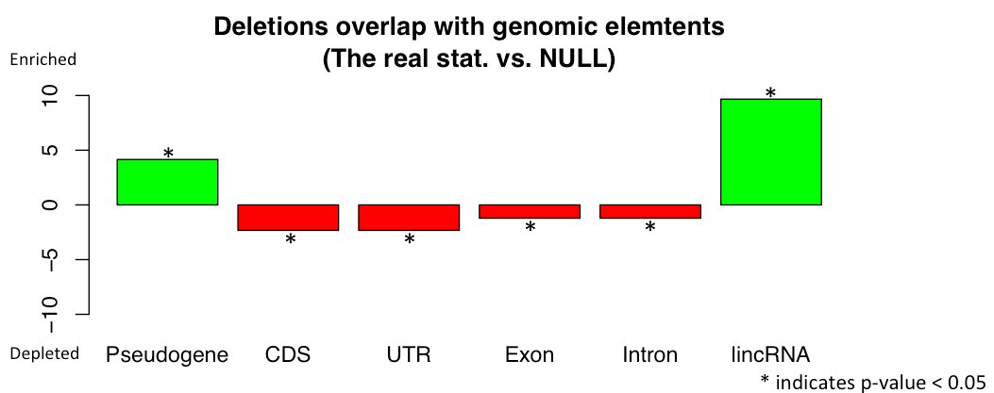
[Skipped region between junctions] overlap with [elements in ref. genome]
Skipped regions occured in retrodups, NOT in real coding regions where they are mapped to.
Compare w/: Deletions overlap with [elements in ref. genome]

Slide 6
Phylogenetic tree based on retrodup calls
(hierarchical clustering, complete linkage)
East Asian
African
European
Ad Mixed American
European
Ad Mixed American
South Asian
European
Hispanic
Ad Mixed American

Slide 8
Functional enrichment
(DAVID, Functional Annotation Clustering)
1) All genes
Top 4 clusters:
  ribosome/RNA binding/structural molecule activity
  non-membrane-bounded organell
  UBI conjugation/isopeptide bond/cross-link
  Intracellular organelle lumen/nucleoplasm
2) 10 genes in common in 19 populations
All 3 clusters:
  organelle envelope/organelle membrane
  cytoplasm/alternative splicing
  membrane/transmembrane
Notes:
In common in 19 populations:
ENSG00000004455 ENSG00000070756 ENSG00000092445 ENSG00000122565 ENSG00000137414 ENSG00000139372 ENSG00000165480 ENSG00000168958 ENSG00000177879 ENSG00000180228

Slide 9
To do:
Insertion site detection
Overlap between insertions and genomic elements; compare with deletions
Distribution of retrodup-parent distance (many tandem? Even controlled by the same regulator?)
Features of upstream region?
Compare with open chromatin region?
Compare with regions with known selection pressure?
Genotype?
Expression/CNV?
Translation of common retrodups?

