Slide 1
~ Conditional Functional Flow
~ π and Cancer SNPs
~ Breakpoints and RR
Wyatt Clark

Slide 2

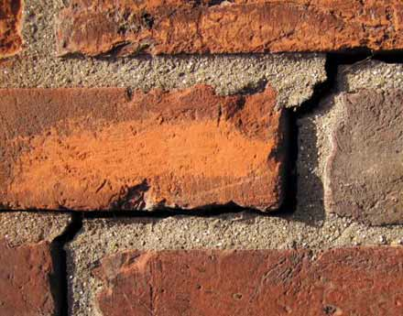
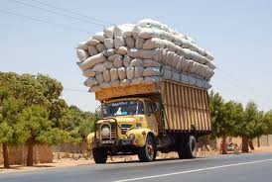
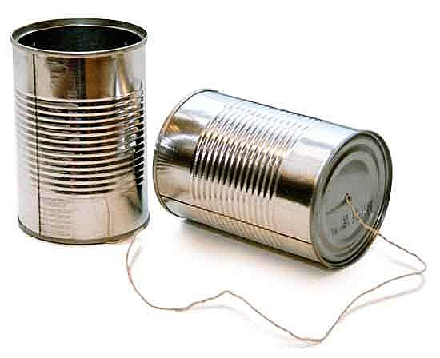
What Do Proteins Do?
Signaling
Structure
Transport
Communication
Notes:
Signaling, building block of life, involved in cell transport and communication, involved in almost every of the cell function and they rarely act alone

Slide 3
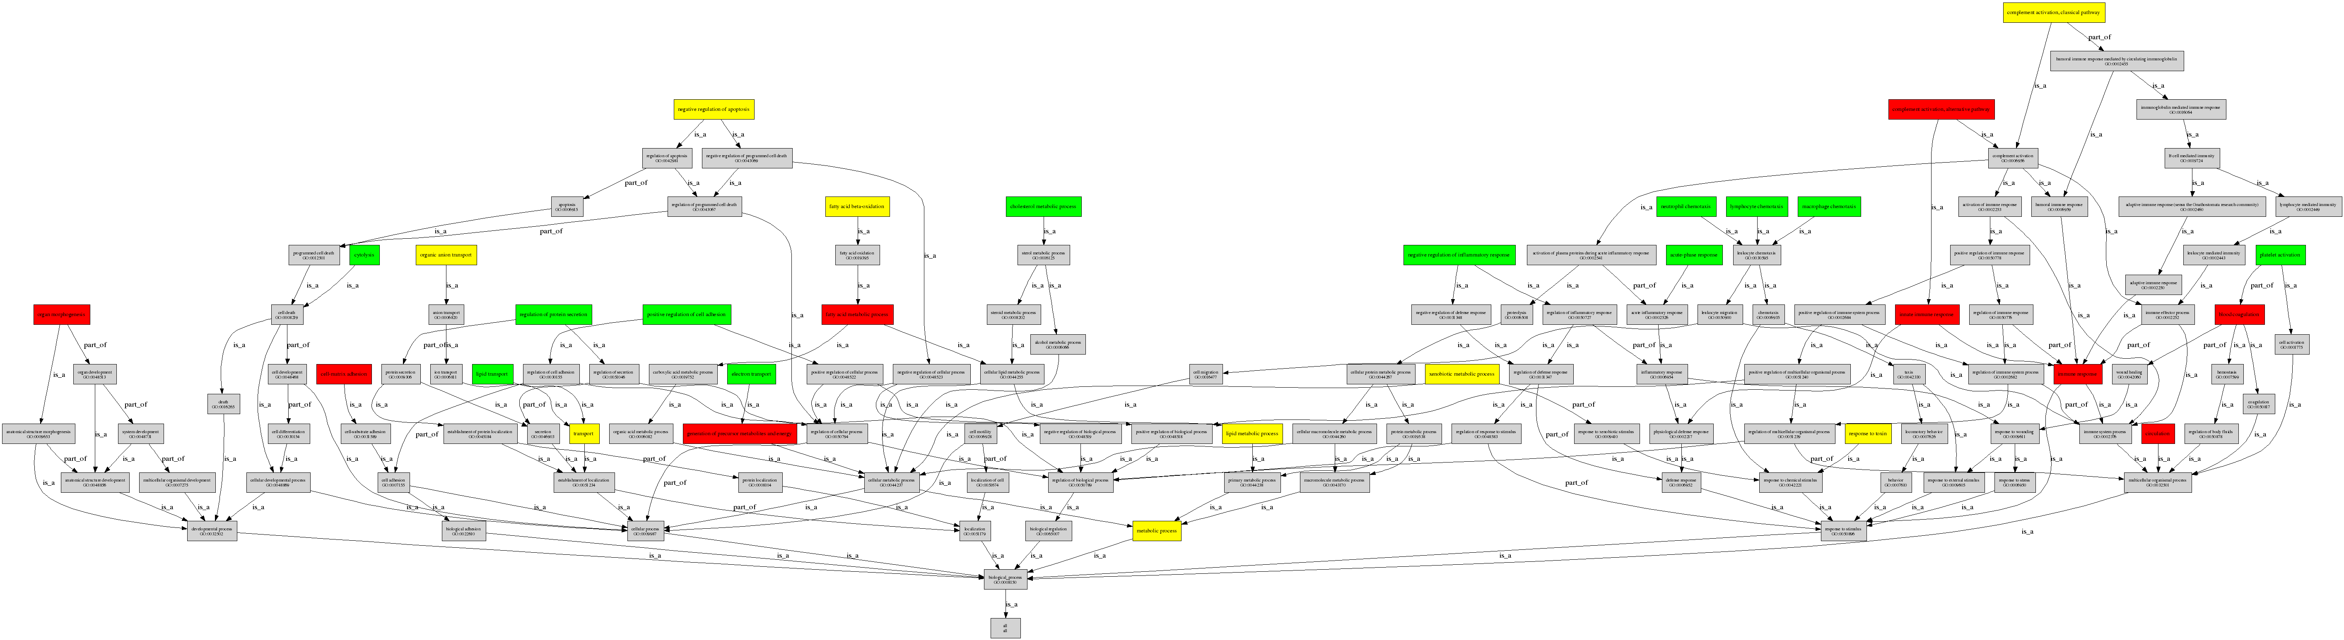
Gene Ontology
Standardizes Function Vocabulary
  Biological Process (BPO)
  Molecular Function (MFO)
  Cellular Component (CCO)
Sample GO BPO directed acyclic graph
Notes:
CCO – the parts of the cell or its extracellular envrion
MFO – activities at the molecular level
BPO – funcitons of cells , tissues, rogans and organims
The GO ontology is structured as a directed acyclic graph, and each term has defined relationships to one or more other terms in the same domain, and sometimes to other domains. The GO vocabulary is designed to be species-neutral, and includes terms applicable to prokaryotes and eukaryotes, single and multicellular organisms.
The controlled vocabularies are structured so that they can be queried at different levels: for example, you can use GO to find all the gene products in the mouse genome that are involved in signal transduction, or you can zoom in on all the receptor tyrosine kinases.

Slide 4
Standardizing Function: Gene Ontology
=2/3
DNA binding
=2/5
rRNA binding

Slide 5
Neighborhood-Based Methods
Simple Transfer
{F₇, F₁₀}
{F₇, F₁₀}
{F₇, F₁₀}
{F₇, F₁₀}
{F₇, F₁₀}
Schwikowski et al. (2000)

Slide 6
Functional Flow
  “Whole-proteome prediction of protein function via graph-theoretic analysis of interaction maps”, Nabieva et al. (2005)
Diffuses function annotations through protein-protein interaction network

Slide 7
Functional Flow
Iteration = 0
?
?
0
0
0
?
F₁
∞
?
?
0
0
?
0
?
0
∞
F₁
Nabieva et al. (2005)
Notes:
Add author name

Slide 8
Functional Flow
Iteration = 1
0
0
0
∞
0
0
0
0
∞
Nabieva et al. (2005)

Slide 9
Functional Flow
Iteration = 1
1
1
0
∞
1
0
1
0
∞
Nabieva et al. (2005)

Slide 10
Functional Flow
Iteration = 2
2
2
.33
∞
2
.5
2
.33
∞
Nabieva et al. (2005)

Slide 11
Conditional Function Flow
Extends Functional Flow by allowing flow between functions based on conditional probability
Notes:
Shows that

Slide 12
Conditional Probabilities
 | F1 | F2 | F3 | F4
F1 | P(F1|F1)
F2 |  | P(F2|F2)
F3 |  |  | P(F3|F3)
F4 |  |  |  | P(F4|F4)

Slide 13
Conditional Probabilities
 | F1 | F2 | F3 | F4
F1 | P(F1|F1) | P(F1|F2) | P(F1|F3) | P(F1|F4)
F2 | P(F2|F1) | P(F2|F2) | P(F2|F3) | P(F2|F4)
F3 | P(F3|F1) | P(F3|F2) | P(F3|F3) | P(F3|F14)
F4 | P(F4|F1) | P(F4|F2) | P(F4|F3) | P(F4|F4)

Slide 17
Biologically Relevant?
Term 1 | Term 2 | Expected Pair Count | Observed Pair Count | Pvalue
exonuclease activity | ribonuclease activity | 0.89031 | 20 | 0
3'-5' exonuclease activity | ribonuclease activity | 0.58875 | 16 | 0
exoribonuclease activity | exonuclease activity | 0.51376 | 13 | 0
exoribonuclease activity | 3'-5' exonuclease activity | 0.45792 | 12 | 0
passive transmembrane transporter activity | substrate-specific transporter activity | 0.89509 | 11 | 0
channel activity | substrate-specific transporter activity | 0.89509 | 11 | 0
passive transmembrane transporter activity | substrate-specific transmembrane transporter activity | 0.74252 | 11 | 0
channel activity | substrate-specific transmembrane transporter activity | 0.74252 | 11 | 0

Slide 18
Conclusion
Conditional Functional Flow works for molecular function
Does not work for “higher level” definitions of function
Captures “ontological bias”
Can be applied to other graph based data where “guilt by association” might not be the rule

Slide 19
Cancer Mutations Revisited
Compare somatic mutations to “background” population mutations (1KG)
  Do both types of mutations occur in the same areas of the genome?
  Are somatic mutations filtered by recombination?

Slide 20
Correlation: Spearman Rho
Cancer Type | P-value (spearman) | Spearman Stat Sig
ALL | 0.8899 | NS
AML | 0.2479 | NS
Bladder | 0.1555 | NS
Breast | 0.01089 | 0.02511277
Cervix | 0.3267 | NS
CLL | 0.1844 | NS
Colorectum | 0.009286 | 0.02275337
Esophageal | 6.15E-05 | 0.04767969
Glioblastoma | 0.1257 | NS
Glioma Low Grade | 0.0005826 | 0.03987819
Head and Neck | 0.0002819 | 0.03497883
Kidney Chromophobe | 0.9082 | NS
Kidney Clear Cell | 0.9469 | NS
Kidney Papillary | 0.1571 | NS
Liver | 0.7482 | NS
Lung Adeno | 2.20E-16 | 0.1082819
Lung Small Cell | 1.31E-06 | 0.0647506
Lung Squamous | 2.20E-16 | 0.08570654
Lymphoma B-cell | 0.3341 | NS
Medulloblastoma | 0.4836 | NS
Melanoma | 2.20E-16 | 0.2153476
Myeloma | 0.7692 | NS
Neuroblastoma | 5.85E-05 | 0.07922083
Ovary | 0.0002894 | 0.04165659
Pancreas | 0.4378 | NS
Pilocytic Astrocytoma | 0.9782 | NS
Prostate | 0.3583 | NS
Stomach | 0.353 | NS
Thyroid | 0.2964 | NS
Uterus | 0.4025 | NS
Notes:
Summary:
-interpretation: heterogeneity in cancers – some more correlated to 1000 G than others
-interpretation: with higher correlation datasets (e.g. melanoma, lung adeno) – more potential null genes in common.
----- Meeting Notes (3/15/14 23:30) -----
-talk more about interpretation of dataset: dataset with correlation – perhaps can find potential null genes in these datasets.
-further suggestive steps: with weak correlation, may want to look at subclasses of genes.
-transition into KaKs calculation

Slide 21
Genetic Diversity
Measured using π
  Average pairwise differences between individuals

Slide 23
π and cM/Mb
Chromosome 17

Slide 24
Cancer SNP π
×100
Would this look different for an unbiased (disease free) sample?

Slide 25
Notes:
Is this the confounding factor?

Slide 28
Breakpoints and Recombination

Slide 29
Thank you!
Mark Gerstein
Sharon Qian
Ian Gonzalez
Shantao Li
Lucas Lochovsky
Yao Fu
Alex Abyzov
Ekta Khurana

