Slide 1
Loregic
DW
May 15 2014

Slide 2
Loregic flow-chart

Slide 3
Identify dominate logic gate(s)
Gene | 20 samples
RF1=TF 1 | 0 | 0 | 1 | 1 | 0 | 0 | 1 | 1 | 0 | 0 | 1 | 1 | 0 | 0 | 1 | 1 | 0 | 0 | 1 | 1
RF2=TF 2 | 0 | 1 | 0 | 1 | 0 | 1 | 0 | 1 | 0 | 1 | 0 | 1 | 0 | 1 | 0 | 1 | 0 | 1 | 0 | 1
T=Gene 1 | 0 | 0 | 0 | 1 | 0 | 1 | 0 | 1 | 0 | 0 | 0 | 0 | 0 | 0 | 0 | 1 | 0 | 0 | 0 | 1
RF1
0
0
0
1
1
0
1
1
RF2
5 0
4 1
5 0
1 4
T
0
1
0
1
0
1
0
1
RF1=TF 1 | 0 | 0 | 1 | 1
RF2=TF 2 | 0 | 1 | 0 | 1
T=Gene 1 | 0 | 0 | 0 | 1
TF1
AND
Gene 1
TF2
Test significance by replacing target 1000 times using random genes

Slide 4
TF1-TF2-targets in Yeast Cell Cycle
Consistent logic cooperative RF1-RF2 pairs
RF1 | RF2 | Common Target Gene (T) | Matched logic gate(s) with significant highest scores
YML113W | YBR083W | YER189W | AND
 |  | YER190W | AND
 |  | YLR463C | AND
 |  | YNL337W | AND
 |  | YLR467W | AND
 |  | YLR465C | NONE
RF1 | RF2 | Common Target Gene (T) | Matched logic gate(s) with significant highest scores
YHR084W | YBR083W | YBR082C | AND
YKL112W | YIL131C | YMR198W | OR
YMR043W | YER111C | YDR507C | OR | XOR
… | … | … | … | …
Inconsistent logic cooperative RF1-RF2 pairs
RF1 | RF2 | Common Target Gene (T) | Matched logic gate(s) with significant highest scores
YKL015W | YKL032C | YLL033W | T=~RF1*RF2 | XOR
 |  | YLL034C | T=~RF1*RF2
 |  | YLR143W | T=RF1*~RF2
 |  | YMR177W | AND
Non-logic cooperative RF1-RF2 pairs
RF1 | RF2 | Common Target Gene (T) | Matched logic gate(s) with significant highest scores
YMR037C | YOR344C | YER177W | NONE
 |  | YGR192C | NONE
 |  | YKL060C | NONE
 |  | YAL060W | NONE
 |  | YDR042C | NONE

Slide 5
RF1-RF2-targets in Human Leukemia
Human miRNA-miRNA-target …
Human miRNA-enhancer-target …
Human enhancer-enhancer-target …

Slide 6
MYC universally amplifies gene expressions
RF1 | RF2
MYC | other TFs
other TFs | MYC
-log₁₀(hypergeo p-value)

Slide 7
MYC and miRNAs down-regulate each other
miRNA
MYC
RF1=miRNA | RF2=MYC | Common Target Gene (T) | Matched logic gate(s) with significant highest scores
miRNA 1 | MYC | Gene 1 | T=RF2
miRNA 1 | MYC | Gene 1 | T=RF2
miRNA 2 | MYC | Gene 2 | T=~RF1+RF2
… | … | … | …
miRNA 10 | MYC | Gene 19 | T=~RF2
miRNA 11 | MYC | Gene 20 | T=~RF2
miRNA 12 | MYC | Gene 21 | T=~RF1*RF2
… | … | … | …
target
miRNA
MYC
target

Slide 8
AML cancer TFs
RF1 | RF2
AML genes | non-AML genes
non-AML genes | AML genes
non-AML genes | non-AML genes
-log₁₀(hypergeo p-value)

Slide 9
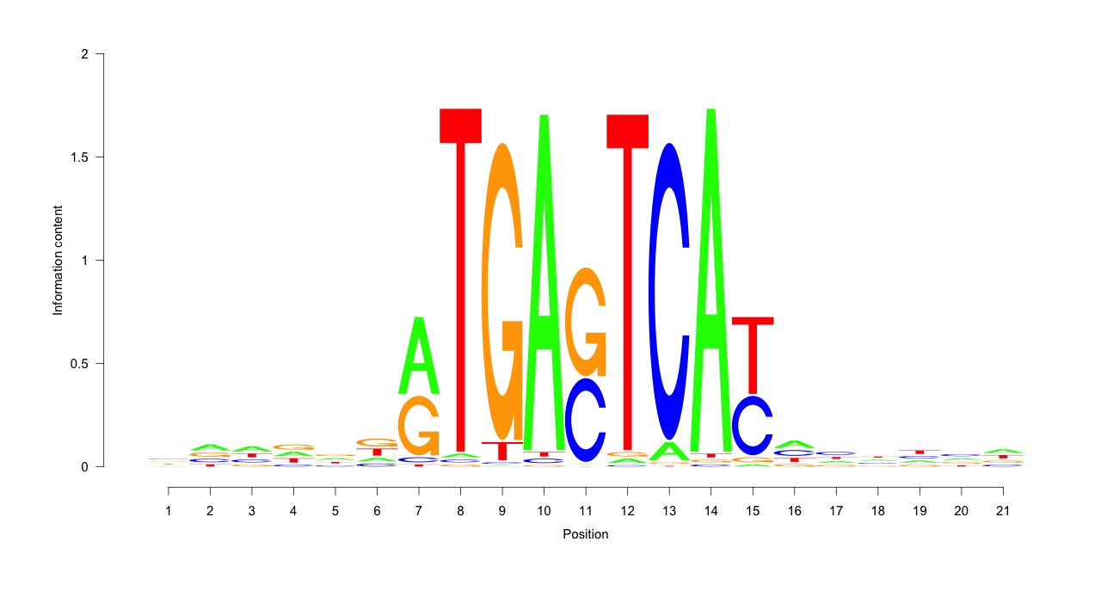
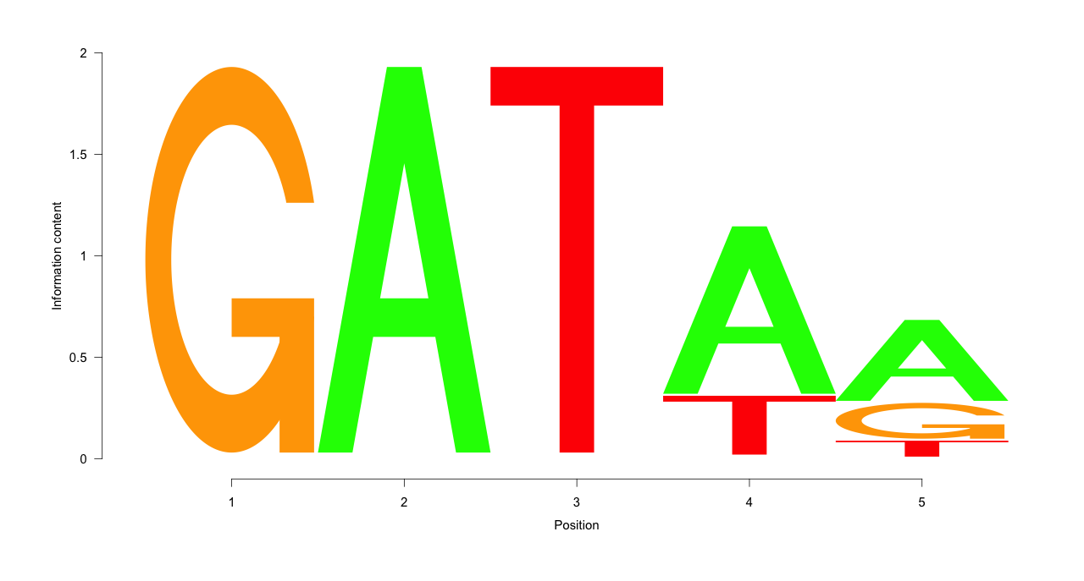
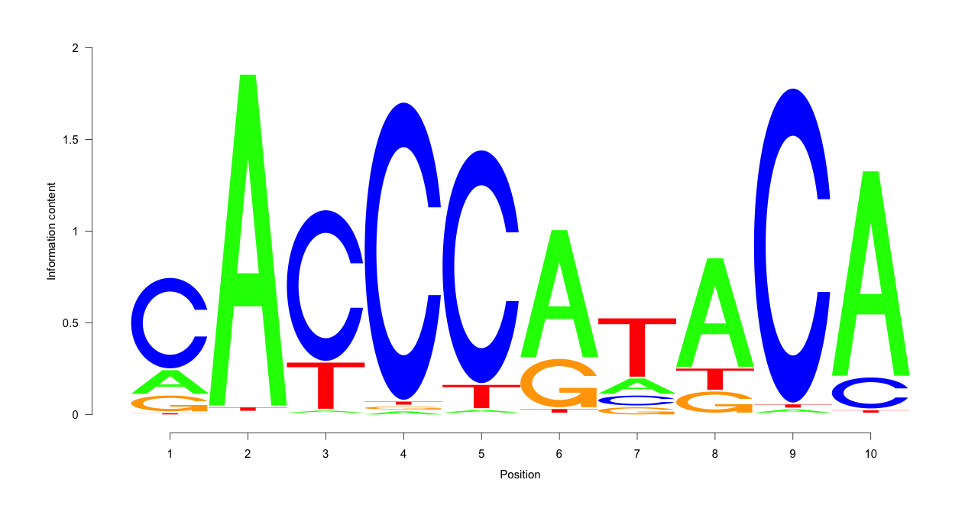
Indirect bindings identified by AND-like RF1-RF2 pairs
YEL009C
YDL066W
AND
YER040W
YEL009C
YER040W
YDL066W
YNL216W
YHR033W
AND
PPI
YNL167C
YNL167C
YNL216W
YHR033W

Slide 10
Top-Bottom and Middle-Bottom have more AND-like edges in hierarchical network
AND-like
other
Top (T)
Yeast
Middle (M)
Bottom (B)
Human
Notes:
P<0.05, s>0.1

Slide 11
backup

Slide 12
…
Regulatory Factor (RF) | Target Gene (T)
TF 1 | Gene 1
TF 2 | Gene 1
TF 3 | Gene 2
miRNA 1 | Gene 1
miRNA 2 | Gene 3
Enhancer 1 | Gene 2
Enhancer 2 | Gene 4
… | …
Gene Regulatory Network
…
…
RF
non-RF
Select RF1-RF2-Target
RF1 | RF2 | Common Target Gene (T)
TF 1 | miRNA 1 | Gene 1
TF 1 | TF 2 | Gene 1
TF 3 | Enhancer 1 | Gene 2
… | … | …
RF1=TF1
RF2=TF2
T=Gene 1
Query binarized gene expression data
Gene | Sample 1 | Sample 2 | … | Sample M
Gene 1 | 1 | 0 | … | 0
Gene 2 | 0 | 0 | … | 1
… | … | … | … | …
Gene 100 (TF 1) | 1 | 0 | … | 1
miRNA 1 | 0 | 1 | … | 0
… | … | … | … | …
Gene 500 (TF 2) | 1 | 1 | … | 0
miRNA 20 | 1 | 0 | … | 0
… | … | … | … | …
Gene | Sample 1 | Sample 2 | … | Sample M
TF 1 | 1 | 0 | … | 1
TF 2 | 1 | 1 | … | 0
Gene 1 | 1 | 0 | … | 0
Match all 16 possible 2-iput-1-output logic gates
Input (RF1, RF2) | RF1 | 0 | 0 | 1 | 1
 | RF2 | 0 | 1 | 0 | 1
Output T values of all 16 logic gates | T=0 | 0 | 0 | 0 | 0
 | T=RF1*RF2 (AND) | 0 | 0 | 0 | 1
 | T=RF1*~RF2 | 0 | 0 | 1 | 0
 | T=RF1 | 0 | 0 | 1 | 1
 | T=~RF1*RF2 | 0 | 1 | 0 | 0
 | T=RF2 | 0 | 1 | 0 | 1
 | T=~RF1*RF2+RF1*~RF2 (XOR) | 0 | 1 | 1 | 0
 | T=RF1+RF2 (OR) | 0 | 1 | 1 | 1
 | T=~RF1*~RF2 (NOR) | 1 | 0 | 0 | 0
 | T=~RF1*~RF2+RF1*RF2 (XNOR) | 1 | 0 | 0 | 1
 | T=~RF2 | 1 | 0 | 1 | 0
 | T=RF1+~RF2 | 1 | 0 | 1 | 1
 | T=~RF1 | 1 | 1 | 0 | 0
 | T=~RF1+RF2 | 1 | 1 | 0 | 1
 | T=~(RF1*RF2) (NAND) | 1 | 1 | 1 | 0
 | T=1 | 1 | 1 | 1 | 1
AND-like gate
Dominate logic gate(s) if any with significant highest scores
TF1
Gene 1 = TF1*TF2
RF1=TF1 | 0 | 0 | 1 | 1
RF2=TF2 | 0 | 1 | 0 | 1
T=Gene 1 | 0 | 0 | 0 | 1
AND
Gene 1
TF2

Slide 13
…
Select RF1-RF2-Target
Regulatory Factor (RF) | Target Gene (T)
TF 1 | Gene 1
TF 2 | Gene 1
TF 3 | Gene 2
miRNA 1 | Gene 1
miRNA 2 | Gene 3
Enhancer 1 | Gene 2
Enhancer 2 | Gene 4
… | …
Gene Regulatory Network
RF1 | RF2 | Common Target Gene (T)
TF 1 | miRNA 1 | Gene 1
TF 1 | TF 2 | Gene 1
TF 3 | Enhancer 1 | Gene 2
… | … | …
RF1=TF1
RF2=TF2
…
T=Gene 1
…
RF
non-RF
Query binarized gene expression data
Gene | Sample 1 | Sample 2 | … | Sample M
Gene 1 | 1 | 0 | … | 0
Gene 2 | 0 | 0 | … | 1
… | … | … | … | …
Gene 100 (TF 1) | 1 | 0 | … | 1
miRNA 1 | 0 | 1 | … | 0
… | … | … | … | …
Gene 500 (TF 2) | 1 | 1 | … | 0
miRNA 20 | 1 | 0 | … | 0
… | … | … | … | …
Match all 16 possible 2-iput-1-output logic gates
Gene | Sample 1 | Sample 2 | … | Sample M
TF 1 | 1 | 0 | … | 1
TF 2 | 1 | 1 | … | 0
Gene 1 | 1 | 0 | … | 0
T=RF1+RF2(OR)
RF1 | 0 | 0 | 1 | 1
RF2 | 0 | 1 | 0 | 1
T | 0 | 1 | 1 | 1
T=RF2
0 | 0 | 1 | 1
0 | 1 | 0 | 1
0 | 1 | 0 | 1
T=~RF1
0 | 0 | 1 | 1
0 | 1 | 0 | 1
1 | 1 | 0 | 0
T=RF1
0 | 0 | 1 | 1
0 | 1 | 0 | 1
0 | 0 | 1 | 1
T=~RF2
0 | 0 | 1 | 1
0 | 1 | 0 | 1
1 | 0 | 1 | 0
T=RF1*~RF2
RF1 | 0 | 0 | 1 | 1
RF2 | 0 | 1 | 0 | 1
T | 0 | 0 | 1 | 0
T=NOR
0 | 0 | 1 | 1
0 | 1 | 0 | 1
1 | 0 | 0 | 0
T=XNOR
0 | 0 | 1 | 1
0 | 1 | 0 | 1
1 | 0 | 0 | 1
T=XOR
0 | 0 | 1 | 1
0 | 1 | 0 | 1
0 | 1 | 1 | 0
T=0
0 | 0 | 1 | 1
0 | 1 | 0 | 1
0 | 0 | 0 | 0
Dominate logic gate(s) if any with significant highest scores
T=RF1+~RF2
RF1 | 0 | 0 | 1 | 1
RF2 | 0 | 1 | 0 | 1
T | 1 | 0 | 1 | 1
T=~RF1*RF2
0 | 0 | 1 | 1
0 | 1 | 0 | 1
0 | 1 | 0 | 0
T=~RF1+RF2
0 | 0 | 1 | 1
0 | 1 | 0 | 1
1 | 1 | 0 | 1
T=NAND
0 | 0 | 1 | 1
0 | 1 | 0 | 1
1 | 1 | 1 | 0
T=1
0 | 0 | 1 | 1
0 | 1 | 0 | 1
1 | 1 | 1 | 1
Gene 1 = TF1*TF2
TF1 | 0 | 0 | 1 | 1
TF2 | 0 | 1 | 0 | 1
Gene 1 | 0 | 0 | 0 | 1
TF1
AND
Gene 1
TF2

Slide 14
…
Select RF1-RF2-Target
Regulatory Factor (RF) | Target Gene (T)
TF 1 | Gene 1
TF 2 | Gene 1
TF 3 | Gene 2
miRNA 1 | Gene 1
miRNA 2 | Gene 3
Enhancer 1 | Gene 2
Enhancer 2 | Gene 4
… | …
Gene Regulatory Network
RF1 | RF2 | Common Target Gene (T)
TF 1 | miRNA 1 | Gene 1
TF 1 | TF 2 | Gene 1
TF 3 | Enhancer 1 | Gene 2
… | … | …
RF1=TF1
RF2=TF2
…
T=Gene 1
…
RF
non-RF
Query binarized gene expression data
Gene | Sample 1 | Sample 2 | … | Sample M
Gene 1 | 1 | 0 | … | 0
Gene 2 | 0 | 0 | … | 1
… | … | … | … | …
Gene 100 (TF 1) | 1 | 0 | … | 1
miRNA 1 | 0 | 1 | … | 0
… | … | … | … | …
Gene 500 (TF 2) | 1 | 1 | … | 0
miRNA 20 | 1 | 0 | … | 0
… | … | … | … | …
Input (RF1, RF2) | RF1 | 0 | 0 | 1 | 1
 | RF2 | 0 | 1 | 0 | 1
Output T values of all 16 logic gates | T=0 | 0 | 0 | 0 | 0
 | T=RF1*RF2 (AND) | 0 | 0 | 0 | 1
 | T=RF1*~RF2 | 0 | 0 | 1 | 0
 | T=RF1 | 0 | 0 | 1 | 1
 | T=~RF1*RF2 | 0 | 1 | 0 | 0
 | T=RF2 | 0 | 1 | 0 | 1
 | T=~RF1*RF2+RF1*~RF2 (XOR) | 0 | 1 | 1 | 0
 | T=RF1+RF2 (OR) | 0 | 1 | 1 | 1
 | T=~RF1*~RF2 (NOR) | 1 | 0 | 0 | 0
 | T=~RF1*~RF2+RF1*RF2 (XNOR) | 1 | 0 | 0 | 1
 | T=~RF2 | 1 | 0 | 1 | 0
 | T=RF1+~RF2 | 1 | 0 | 1 | 1
 | T=~RF1 | 1 | 1 | 0 | 0
 | T=~RF1+RF2 | 1 | 1 | 0 | 1
 | T=~(RF1*RF2) (NAND) | 1 | 1 | 1 | 0
 | T=1 | 1 | 1 | 1 | 1
Gene 1 = TF1*TF2
TF1 | 0 | 0 | 1 | 1
TF2 | 0 | 1 | 0 | 1
Gene 1 | 0 | 0 | 0 | 1
TF1
AND
Gene 1
TF2
Gene | Sample 1 | Sample 2 | … | Sample M
TF 1 | 1 | 0 | … | 1
TF 2 | 1 | 1 | … | 0
Gene 1 | 1 | 0 | … | 0
Dominate logic gate(s) if any with significant highest scores
Match all 16 possible 2-iput-1-output logic gates

