Slide 1
Genome-wide enrichment tests of deletions overlapping annotated biotypes
- Update
Yan Zhang
5/2/2014
Notes:
A better version of PPT explaining the results.

Slide 2
Results
GSC block_bootstrap, incorp. gap info, no segmentation,
Fraction to sample 0.04 – 0.25, iteration=1000
Annotations | P-value (Franction to sample = 0.04) | Z score (Fraction to sample = 0.04) | P-value (Fraction to sample = 0.25) | Z score (Fraction to sample = 0.25) | Ratio (Observed / NULL)
pseudogene | 0.0 | 20.07 | 0.0 | 18.08 | 4.15
Gene (longest overlap union) | 0.0 | 695.15 | 0.0 | 736.94 | 45.41
CDS | 7.00e-9 | -5.67 | 5.43e-11 | -6.45 | 0.43
UTR | 2.40e-8 | -5.46 | 3.58e-9 | -5.79 | 0.43
lincRNA | 0.0 | 57.73 | 0.0 | 64.42 | 9.66
Notes:
basepair_overlap_conditional
Covering: Deletions
Covered: Annotations
Intervals: Take union of overlapping intervals -> smaller number of non-overlapping intervals.
Will increase simulation times to obtain more stable results (Z score).
Iterate 1000 times.
To check the following:
Z score = (The real stat - The expected mean under the NULL) / The normalized bootstrap SD

Slide 3
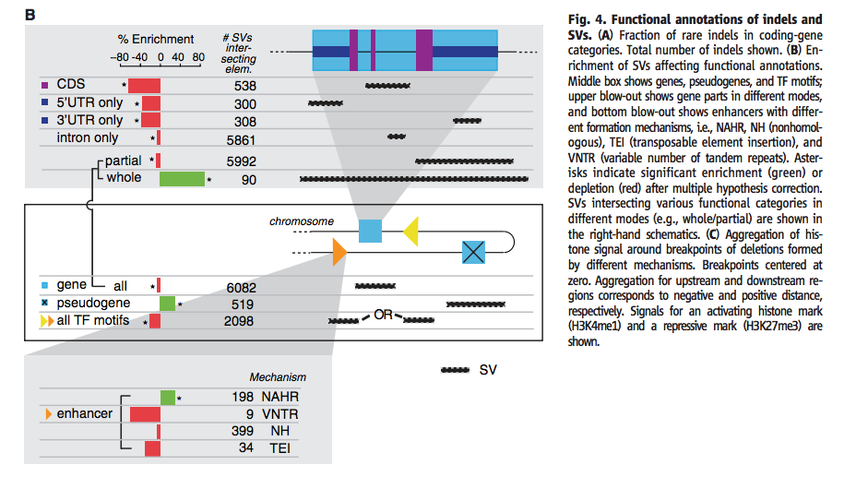
Revisit
Notes:
“Gene and gene elements are taken from the longest transcript of protein-coding genes in GENCODE annotations”
Whole: SV overlap with one or multiple whole genes
Partial: Partial overlap of SV with any gene

