Slide 1
AlleleDB Figure Pack
Jieming
Allele
2nd May 2014

Slide 2
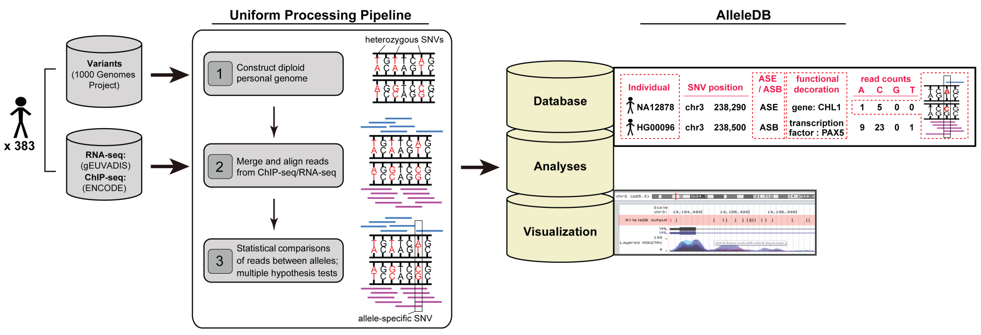
Figure 1. Uniform processing of data from 343 individuals and construction of AlleleDB.

Slide 3
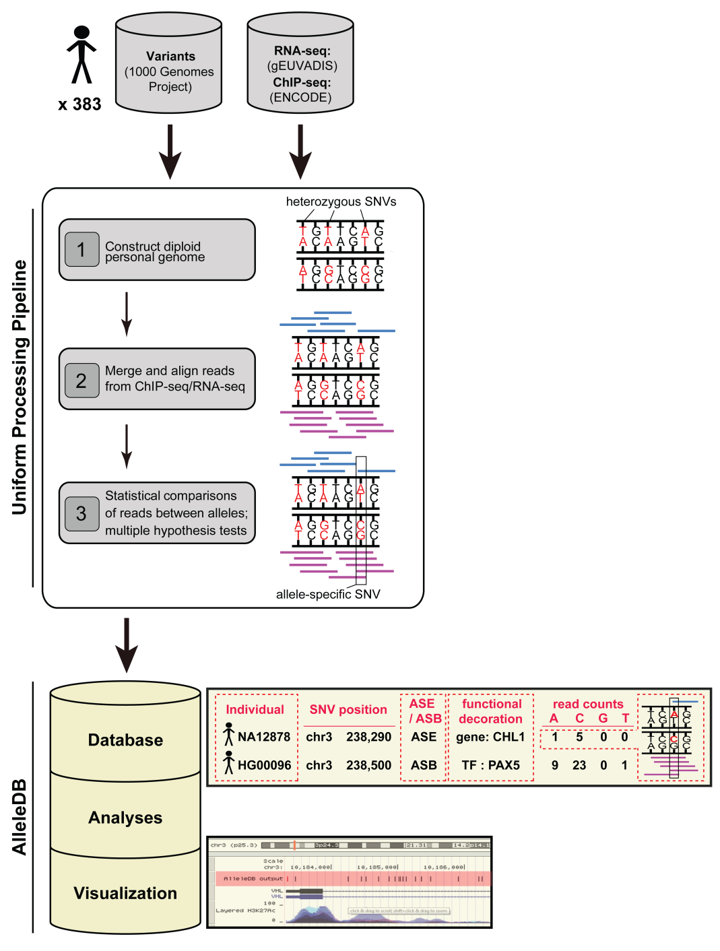
Figure 1. Uniform processing of data from 343 individuals and construction of AlleleDB.

Slide 4
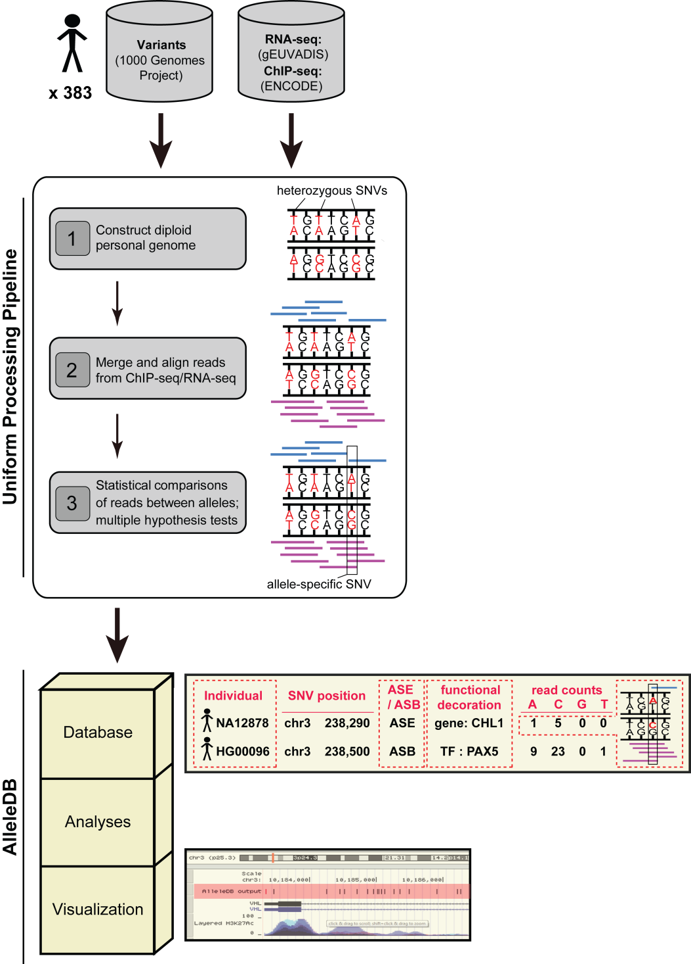
Figure 1. Uniform processing of data from 343 individuals and construction of AlleleDB.

Slide 5
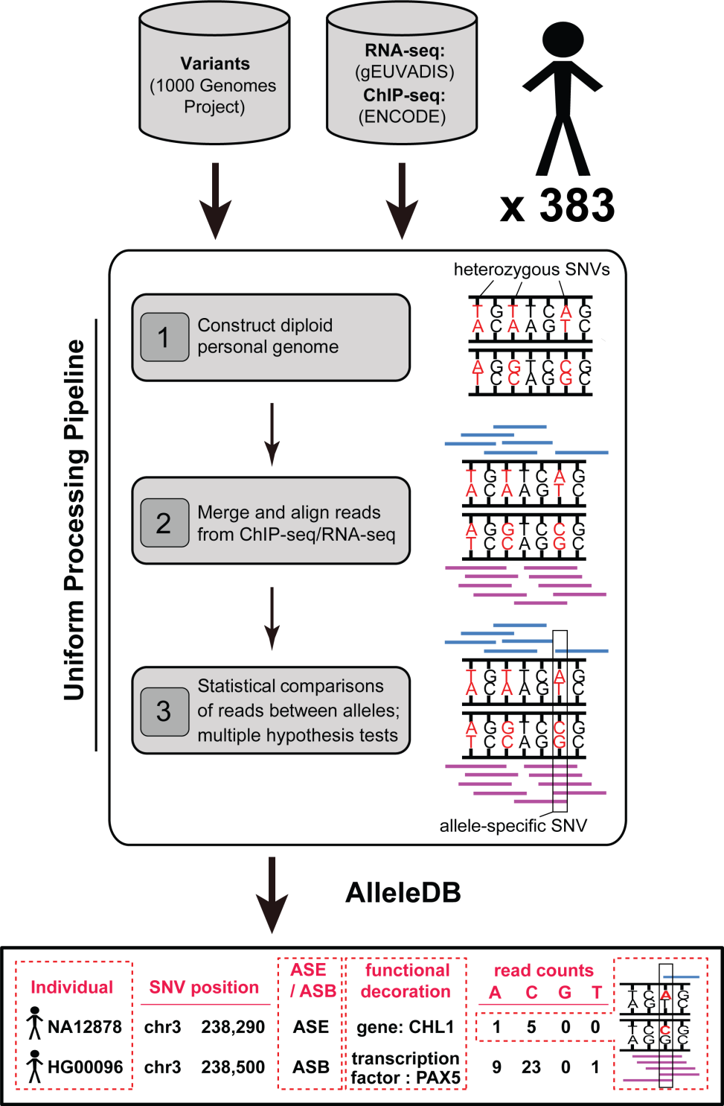
Figure 1. Uniform processing of data from 343 individuals and construction of AlleleDB.
Notes:
Transcripton factor = TF
Leave it blank
Get rid of the line under uniform
Abbreviations : multple hypthesis testing => mult hypo
Sense of 900+ categories

Slide 6
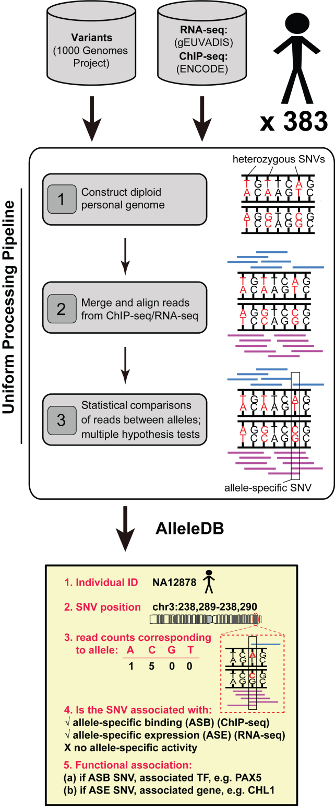
Figure 1. Uniform processing of data from 343 individuals and construction of AlleleDB.

Slide 7
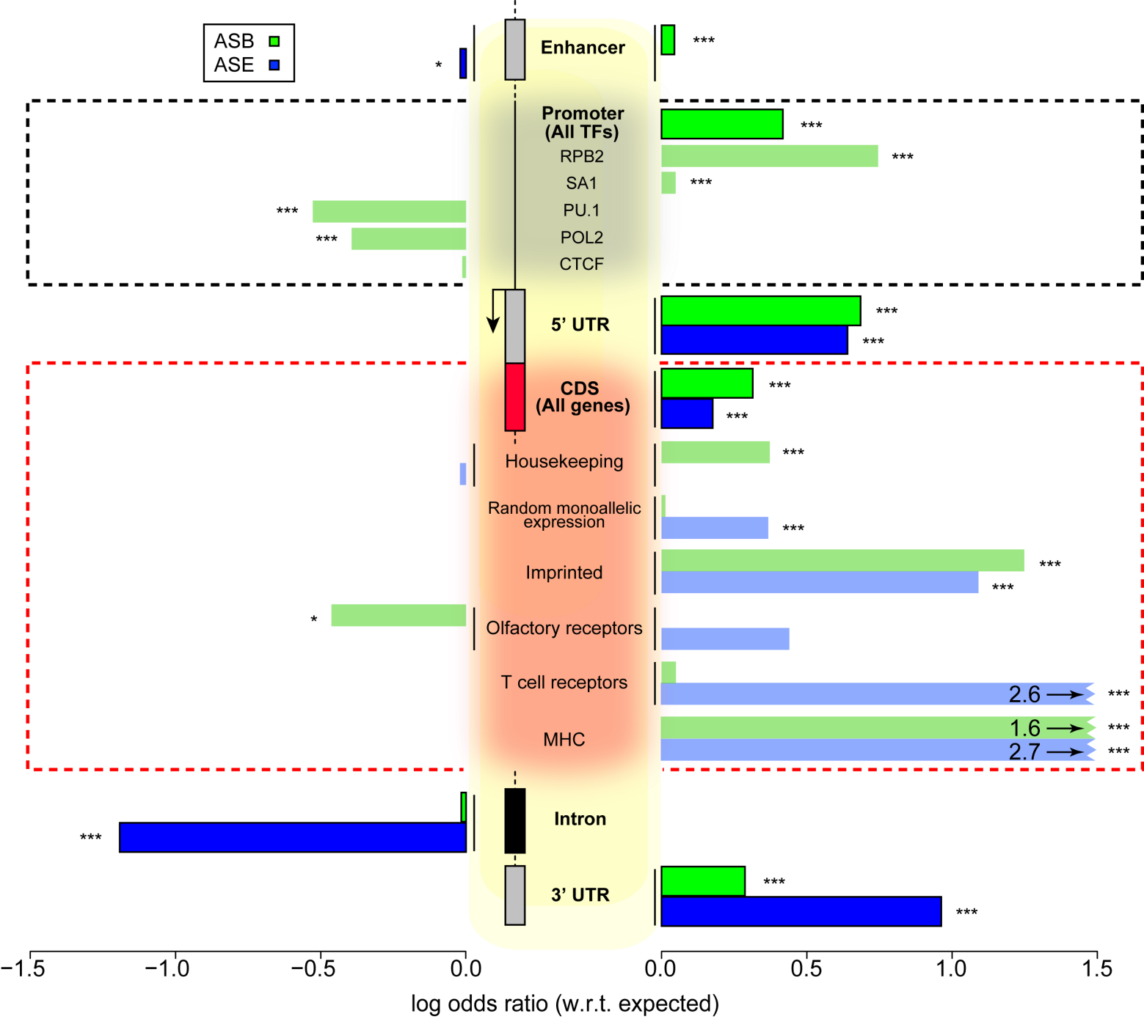
Figure 2. Some genomic regions are more susceptible to allele-specific regulation.
Notes:
Rank of enrichment thermometer
Rank by significance
Iconic – not precise – get the main idea across

Slide 8
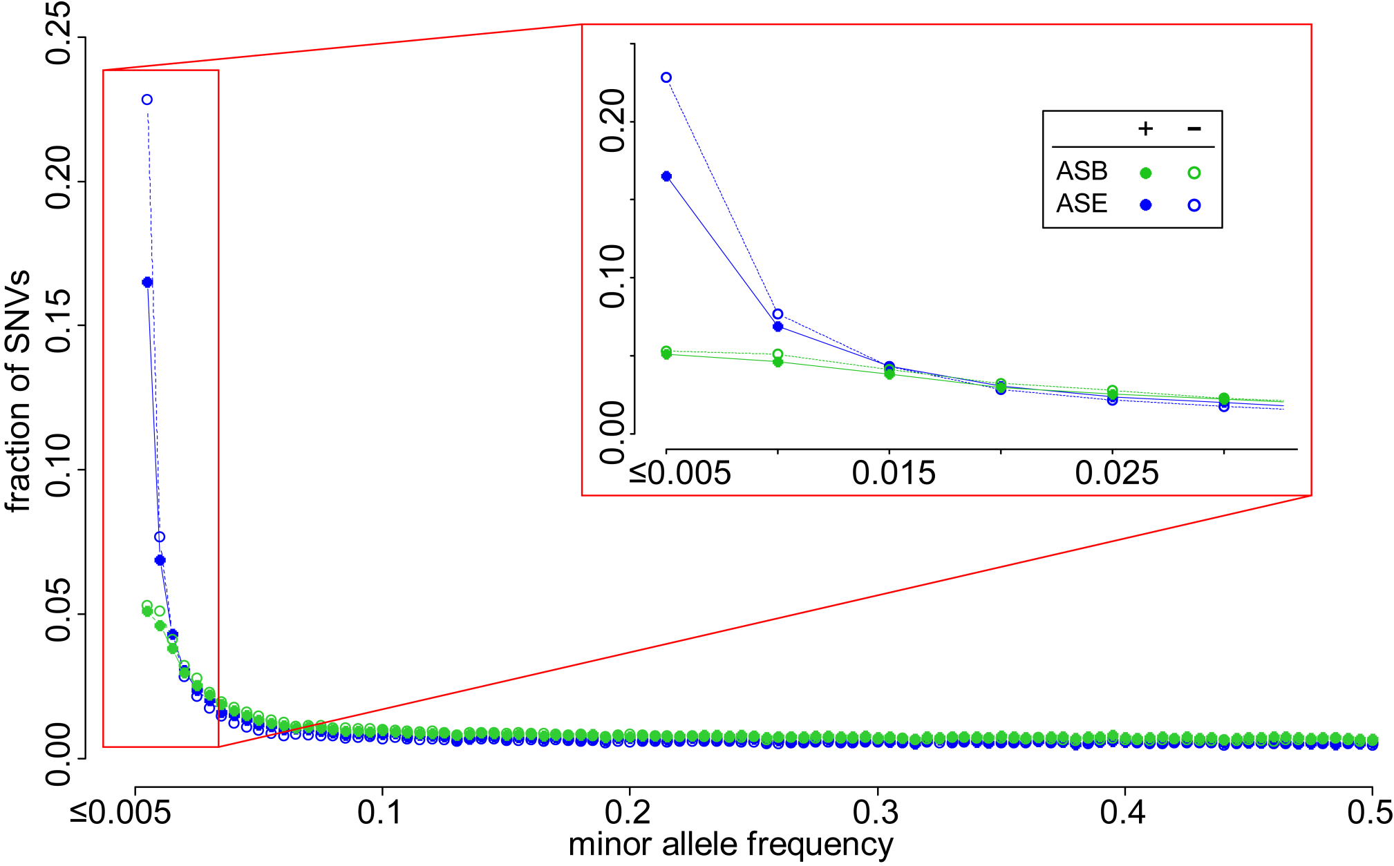
Figure 3. A considerable fraction of AS variants are rare but do not form the majority. Lesser proportion of AS SNVs than non-AS SNVs are rare, suggesting less selective constraints in AS SNVs.

Slide 9
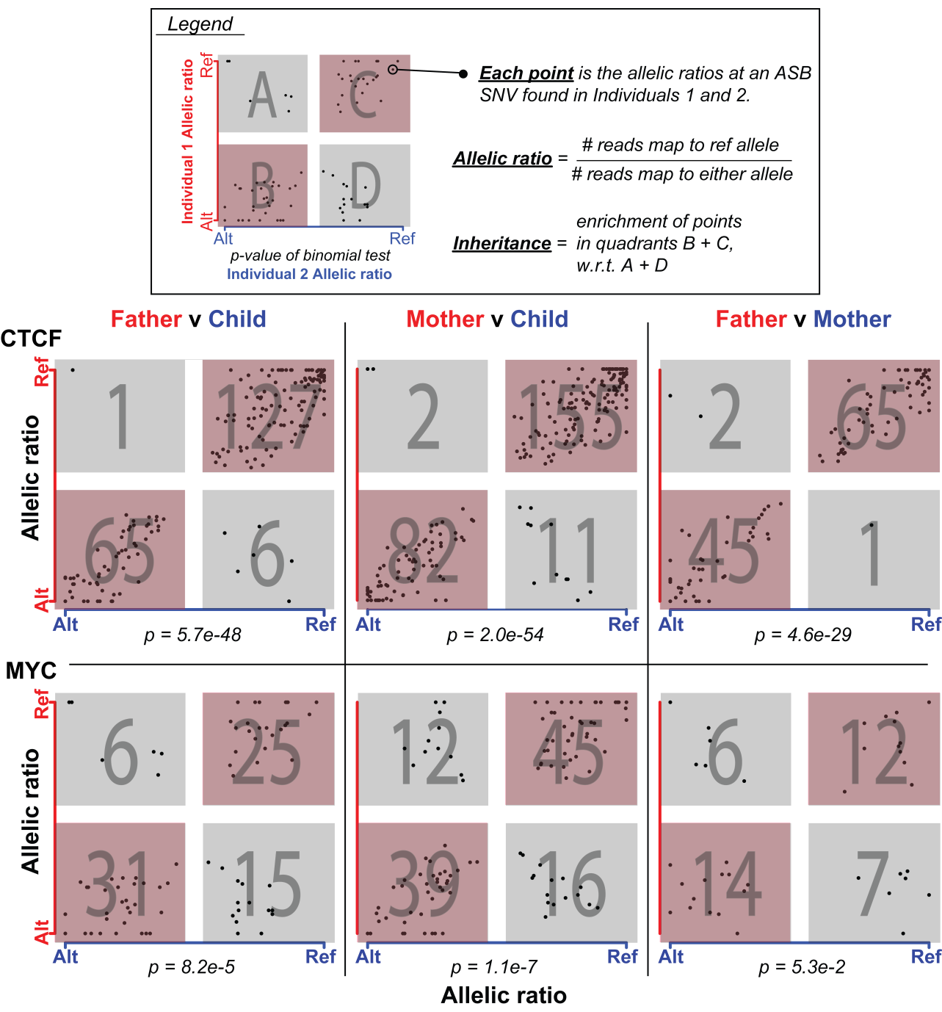
Figure 4. Inheritance of allele-specific binding events is evident in some TFs but not so apparent in others.
Notes:
Parent child
Change color blue to green
Each point is an snv with allelic ratios corresponding to the
Remove the middle alt refs
Remove legend
Father vs mother or with

Slide 10
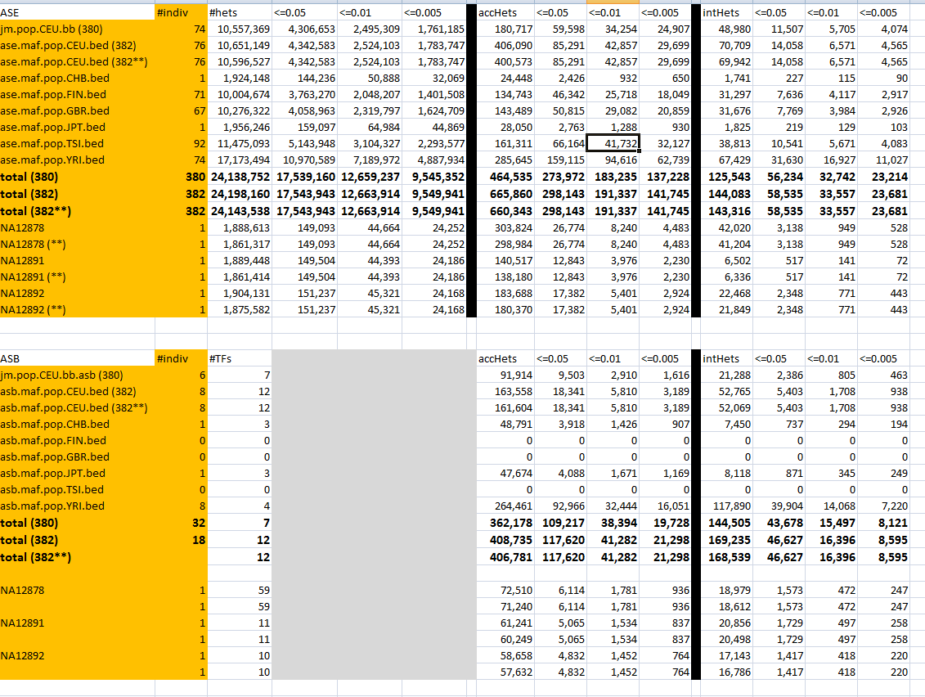
Table 1

Slide 11
Title
Allele-specific binding and expression variation in 383 individuals
Processing and detecting allele-specific binding and expression variation in 383 individuals
Allele-specific binding and expression variant detection in 383 individuals
Survey of allele-specific binding and expression variation in 383 individuals
Survey of allele-specific variation in 383 individuals
Survey of allelic variation in 383 individuals
Notes:
Uniform survey
Harmonized
Rid of variation
Across 383 indivudals

Slide 12
Abstract

