Slide 1
Genome-wide enrichment tests of deletions overlapping annotated biotypes
Yan Zhang
5/1/2014
Notes:
A better version of PPT explaining the results.

Slide 2
Goal
Genome-wide enrichment of overlaps:
Test the significance of overlaps between query (e.g. deletion, duplication) and reference (e.g. protein_coding, pseudogene), against random overlaps in the whole genome.
Chalk talk

Slide 3
Application to deletions
Test the significance of overlap between query intervals and reference intervals.
Query intervals: 8941 deletions in bps.bed
Reference intervals: Gencode v19 annotations of different biotypes, including
pseudogene
sense_intronic (i.e. Long non-coding transcript in introns of a coding gene that does not overlap any exons.)
lincrna (i.e. Long, intervening noncoding (linc) RNAs, that can be found in evolutionarily conserved, intergenic regions.)
3prime_overlapping_ncrna (i.e. Transcripts where ditag and/or published experimental data strongly supports the existence of short non-coding transcripts transcribed from the 3'UTR.)
protein_coding (i.e. Contains an open reading frame (ORF))
processed_transcript
Long ncRNA
Short ncRNA

Slide 4
Examples

Slide 5
Deletions
Notes:
Maybe centromere

Slide 6
Deletions

Slide 7
Deletions
Notes:
Maybe telomere

Slide 8
Deletions

Slide 9
Results GSC block_bootstrap, incorp. gap info, no segmentation, Fraction to sample 0.04 – 0.25
Annotations | P-value (Franction to sample = 0.04) | Z score (Fraction to sample = 0.04) | P-value (Fraction to sample = 0.25) | Z score (Fraction to sample = 0.25)
pseudogene | 0.0 | 25.60 | 0.0 | 14.65
Protein_coding | 0.0 | 417.30 | 0.0 | 498.98
Processed_transcript | 0.0 | 140.91 | 0.0 | 161.11
Sense_intronic | 0.000283812173976 | -3.45 | 0.0303295356177 | -1.88
3prime_overlapping_ncrna | 0.0 | -137.59 | 4.51485277637e-05 | -3.92
lincRNA | 0.0 | 67.92 | 0.0 | 61.70
Notes:
basepair_overlap_conditional
Covering: Deletions
Covered: Annotations
Intervals: Take union of overlapping intervals -> smaller number of non-overlapping intervals.

Slide 10
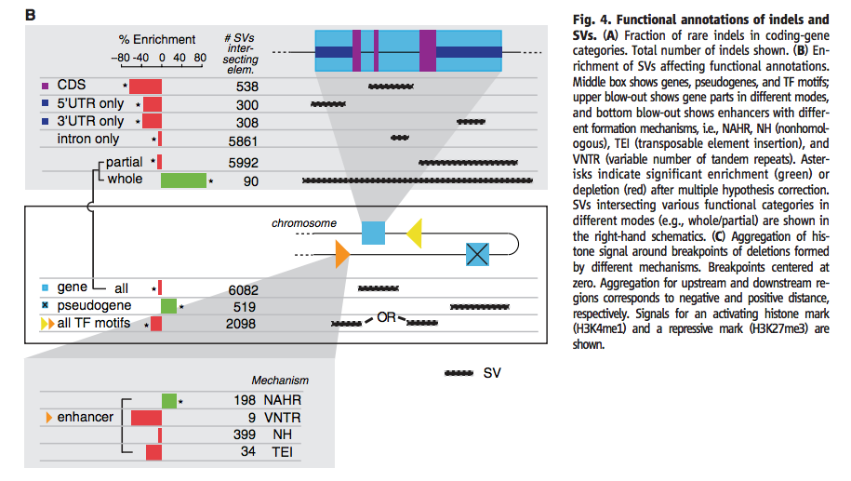
Revisit
Notes:
“Gene and gene elements are taken from the longest transcript of protein-coding genes in GENCODE annotations”
Whole: SV overlap with one or multiple whole genes
Partial: Partial overlap of SV with any gene

