Slide 1
Probing energy landscape of genomic alternation in cancer
KKY
April, 2014

Slide 2
Co-occurrence and anti-occurrence patterns
 |  |  |  | samples
1 |  |  |  |  |  | 1 | 1 | 1 | 1
1 |  |  |  |  |  | 1 | 1 | 1 | 1
 |  | 1 | 1 | 1 | 1
 | 1 |  |  |  |  | 1 |  | 1
1 |  | 1 |  |  | 1
co-occur
events
anti-occur
The existence or not of certain bacteria across different ecosystems (metagenomics samples)
Genomics alternations (point mutation, copy number changes etc) occur or not across different tumor samples
LoF variants across individuals

Slide 3
Methods of analyzing such data
Correlation (positive or negative) for each pair of events
Hypergeometric test for each pair of events
The problem of indirect effects.
Lots of work are devoted to get rid of indirect effects,
Partial correlation Cor(X,Y|Z)
To use generative model to learn the dependency (graphical models, e.g. Bayesian)

Slide 4
Ising model in a fully connected graph
x
 |  |  |  | samples
1 |  |  |  |  |  | 1 | 1 | 1 | 1
1 |  |  |  |  |  | 1 | 1 | 1 | 1
 |  | 1 | 1 | 1 | 1
 | 1 |  |  |  |  | 1 |  | 1
1 |  | 1 |  |  | 1
events
bias
positive and negative coupling
Generative model:
Given the samples, the aim is to infer the coupling parameters

Slide 5
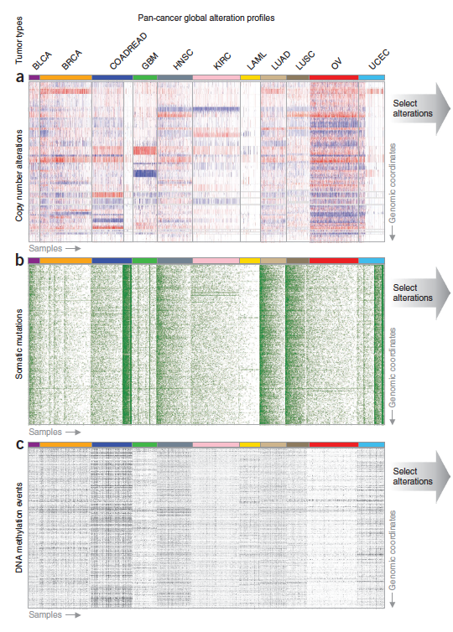
Data
TCGA
Pan Cancer
Ciriello…Sander
Nat.Gen 2013

Slide 6
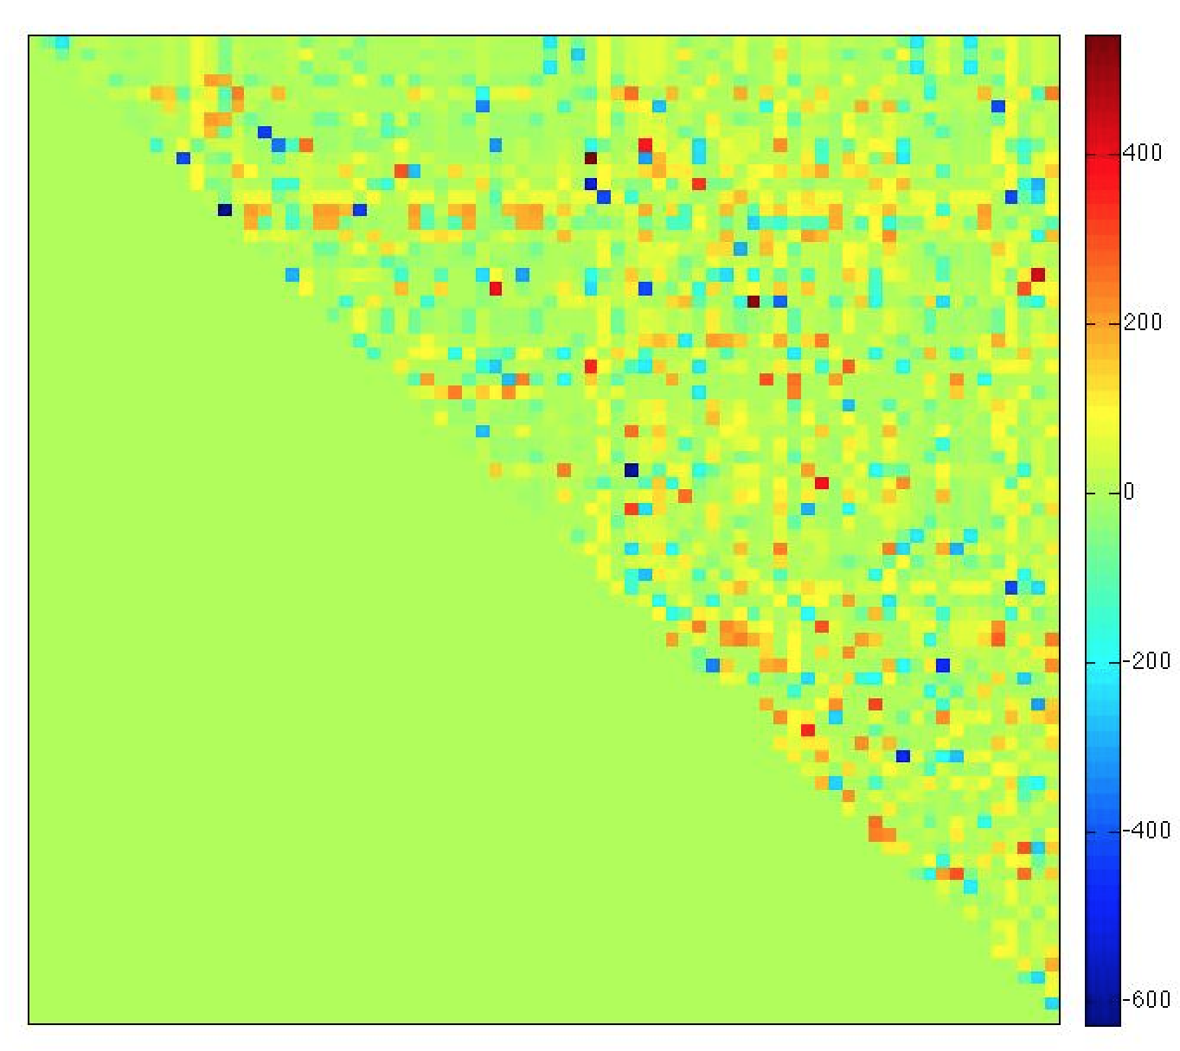
Some random results
Glioblastoma multiforme
500 samples
75 significant
genomic alternations
Co-occur pairs:
Across pathways
Positive coupling:
tend to be exclusive
Negative coupling:
tend to appear together
Exclusive pairs:
Within a pathway
MDM4,TP53
MDM2, CDKN2A
PIK3C2G, EGFR

