Slide 1
SV-bkpt-nc-pgene
Yan Zhang
4/23/2014

Slide 2
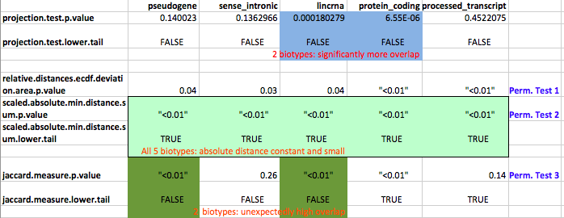
Genome-wide enrichment tests of bkpt & biotypes overlapping
Notes:
- Projection test: determine #midpoints of query interval overlapping the ref. interval, compare with random.
- Relative distance ecdf deviation: (distance btw closest query and ref) / inter-ref distance
- Scaled absolute min distance sum: For each query point, find the smallest abs. distance btw it and a ref. The absolute distances are scaled by the expectation of the distance between adjacent reference points.
- Jaccard measure: J(A,B)= Join(A,B)/Union(A,B)
Permute starts or interval&gap order.
----- Meeting Notes (4/23/14 18:58) -----
Compare different methods:
NCVAR paper
Funseq paper
Jasmine's paper
...

Slide 3
If look into more detail
Chromosome-wide enrichments
Results exists, plot not generated yet.
- Some chromosome might be outliers
- Large chromosomes might contribute more to the genome-wide enrichment

