Slide 1
PrivaSeq

Slide 2
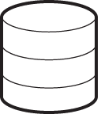
Relation Between Datasets
Age,Height, Weight, BMI, …
Phenotype
Genotype
Association
Databases
Gene Expression Levels
Gender
X and Y chromosomes
Race and Population
Phenotype Associated
Variants
Expression
Genotype
Association
Databases
Variants
Personally Identifying
Variants
Notes:
Fig1

Slide 3
External Datasets, Associations, and Reproducibility
RNA-seq eQTLs are reproducible among other RNA-seq datasets
E.g. Montgomery and Pickrell vs. GEUVADIS
Some of the GWAS SNPs overlap eQTLs
25 GWAS SNPs overlap with GEUVADIS eQTLs
Age is NOT correlated well with expression levels in LCLs
But, it does correlate with gene expression levels in skin and adipose tissue

Slide 4
External Datasets, Associations, and Reproducibility
An attacker is assumed to have access to public databases
We would like to remove the associations from the expression data
We do NOT want to identify associations, i.e., we would like to use only the publicly available associations in databases

Slide 5
PrivaSeq: Input and Output
RNA-seq Data
(Reads, Expression Levels)
Sensitive Information
Databases
Expression
Genotype
Association
Databases
Phenotype
Genotype
Association
Databases
PrivaSeq
Identification of vulnerable
individuals
Personally Identifying
Variants
Anonymization of data
Population genetic databases (1kG, HapMap)
Anonymized
RNA-seq data
(Public)
Sensitive
RNA-seq data
(Controlled)
Notes:
Fig1

Slide 6
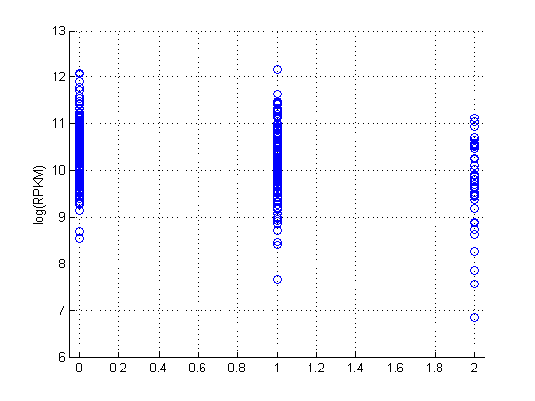
Basic Idea: rs11712723-ENSG00000077097
AA AG GG

Slide 7
Basic Idea: rs11712723-ENSG00000077097
H(G|log(E)>11)
H(G|11>log(E)>10)
H(G|10>log(E)>9)
H(G|9>log(E)>8)
H(G|8>log(E)>7)
H(G|log(E)<7)
AA AG GG

Slide 8
Basic Idea: rs11712723-ENSG00000077097
H(G|log(E)>11)
H(G|11>log(E)>10)
H(G|10>log(E)>9)
H(G|9>log(E)>8)
H(G|8>log(E)>7)
H(G|log(E)<7)
AA AG GG

