Slide 1
Splicing Regulator Targets Prediction
JZ
04/16/2014

Slide 2
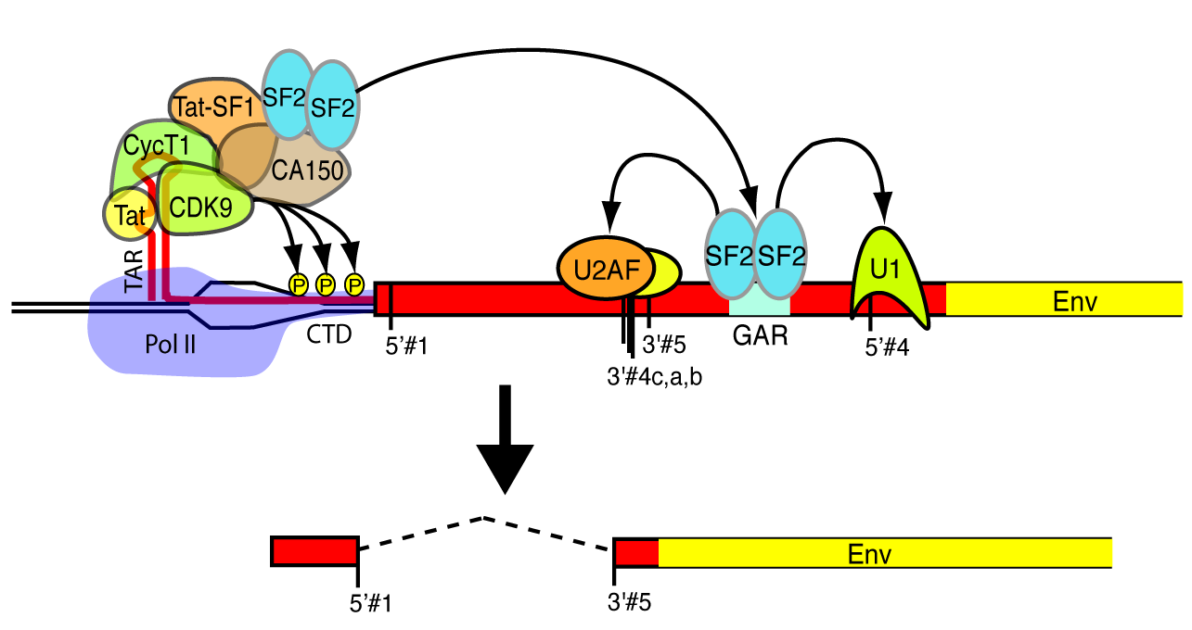
Role of RNA binding proteins during splicing events
Observation: context based motif features remains the same, but some exons are still alternatively spliced across tissues/species
Hypothesis: for a list of alternatively spliced exons, their differential splicing is due to the differential expression of the regulatory RNA-binding proteins (splicing factors)

Slide 3
Why targeting?
For these 200+ splicing factors, no RIP-seq/CLIP-seq experiments
For those with RIP-seq/CLIP-seq experiments, we can only identify the binding sites, but not enough to infer the real effect of binding to splicing
Methods
HBM RNA-seq data, 16 tissues, 2 samples per tissue
Start from the simplest case: 1 splicing factor dominates the splicing event
Alternative model: Y= a*X + b, NULL model: Y = 0*X + b
Y: inclusion rate of exons
X: log(splicing factor Gene level expression)
Multi-test corrected is performed after P value is got

Slide 4
About the exon inclusion rate
Isoform A
Cassette exons
Isoform B
Constitutive exons
Isoform C
Other AS exons
Exon pool
= (Exp_Iso_A+Exp_Iso_C)/(Exp_Iso_A+Exp_Iso_B+Exp_Iso_C)
To be removed
Use known annotations instead of de novo assembled transcripts
Why calculate the exon inclusion rate from transcript expression?
  Pros:
    claimed to be highly correlated with those calculated from local alignments
    Smaller variations
  Cons:
    Can not distinguish exons with exactly the same inclusion and exclusion isoforms

Slide 5
About the splicing factor expression
243 splicing factors, obtained from GO terms with splicing/alternative splicing
221 found the name within Gencode annotation V19. (Alias haven’t checked)
189 expressed in 32 samples. (majority of them are expressed in all tissues, possibly due to its ubiquitous roles in many tissues)
108 Splicing factors have >= 3 fold change in these 32 samples

Slide 9
NOVA1 can either promote or inhibit the inclusion of exons, depending on the binding region (up or downstream of an exon)
The coefficients of regression falls into a huge range
Another interesting protein: TCERG1, with the most number of targeting exons discovered
it indicates:
  Extensive coupling of transcription and splicing
  Pol II pausing is important, at least for a subgroup of exons, for the selection of splicing sites
Transcription factor that binds RNA polymerase II and inhibits the elongation of transcripts from target promoters. Regulates transcription elongation in a TATA box-dependent manner. Necessary for TAT-dependent activation of the human immunodeficiency virus type 1 (HIV-1) promoter

Slide 10
What is next?
Cross species analysis: RNA-seq data from Christopher Burge and Henrik Kaessman’ s lab
  How to define the universal, species, and tissue specific targeting?
  How to find the exon level homologs
  Better to be balanced sample across tissue and species
Binding motif prediction for each splicing factors
  Possibly through my previous package VERSE to find the evolutionally conserved and newly evolved PWM for each splicing factor (basically it’s a regression way…)
Application to cancer RNA-seq data
  RNA-seq study: cancer VS. control: differential usage of major isoforms,
    check whether it is due to differential expression of its regulating splicing factors
    Or its due to the disruptive of other biological regulatory signals: mutation of RNA protein binding sites, conserved secondary structures, and etc…
  Combining the variant analysis from DNA level: possible driver targeting by such annotations?
Prediction model of variant effects to erroneous splicing
  Previous models never incorporate the expression of regulatory proteins as a feature to predict the usage of splice sites (possibly due to no matched data available 4 years ago)
  but expression of regulatory proteins is definitely important!

Slide 11
A byproduct: major isoform percent = (exp of major iso)/(sum of all iso expression))
# of major isoforms: how many isoforms have been claimed as the major isoform in all 32 datasets
E.g. isoform A is the major iso in dataset 1:16, and isoform B is the major one from dataset 17:32, then # of major isoforms = 2

