Slide 1
Utilizing label heterogeneity to improve function prediction from protein-interaction data
Sharon Qian
Dr. Wyatt Clark
Professor Mark Gerstein

Slide 2

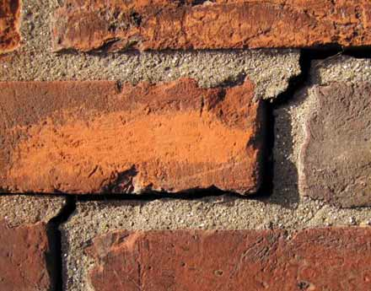
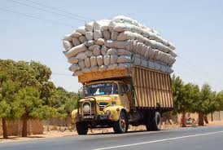
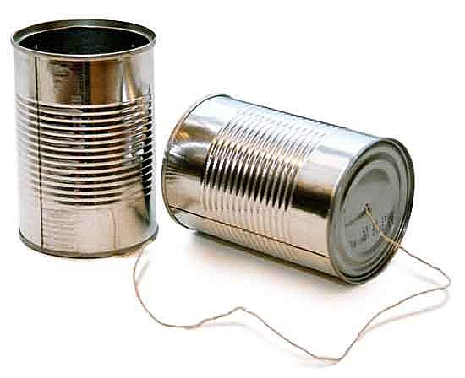
What Do Proteins Do?
Signaling
Structure
Transport
Communication
Notes:
Signaling, building block of life, involved in cell transport and communication, involved in almost every of the cell function and they rarely act alone

Slide 3
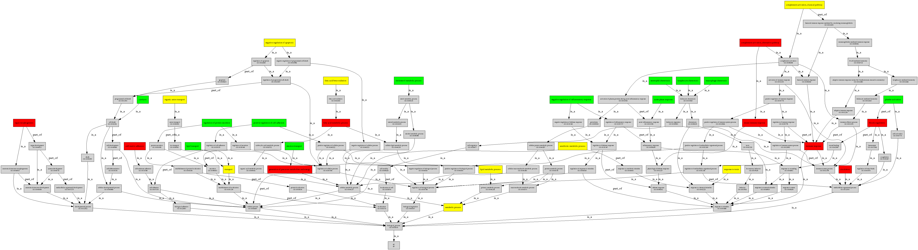
Gene Ontology
Standardizes Function Vocabulary
  Biological Process (BPO)
  Molecular Function (MFO)
  Cellular Component (CCO)
Sample GO BPO directed acyclic graph
Notes:
CCO – the parts of the cell or its extracellular envrion
MFO – activities at the molecular level
BPO – funcitons of cells , tissues, rogans and organims
The GO ontology is structured as a directed acyclic graph, and each term has defined relationships to one or more other terms in the same domain, and sometimes to other domains. The GO vocabulary is designed to be species-neutral, and includes terms applicable to prokaryotes and eukaryotes, single and multicellular organisms.
The controlled vocabularies are structured so that they can be queried at different levels: for example, you can use GO to find all the gene products in the mouse genome that are involved in signal transduction, or you can zoom in on all the receptor tyrosine kinases.

Slide 4
Standardizing Function: Gene Ontology
=2/3
DNA binding
=2/5
rRNA binding

Slide 5
How Proteins Interact and Detection
Many different types of interactions:
  Physical association
  Direct Interaction
  Biochemical
  Signal Transduction etc.
Many different experiment types to detect interactions
  Yeast two-hybrid (Y2H)
  Tandem affinity purification (TAP)
  Co-immunoprecipitation etc.
Notes:
Y2H screen investigates the interaction between artificial fusion proteins inside the nucleus of yeast.
Tandem affinity purification (TAP) detects interactions within the correct cellular environment (e.g. in the cytosol of a mammalian cell) (Rigaut et al., 1999).

Slide 6
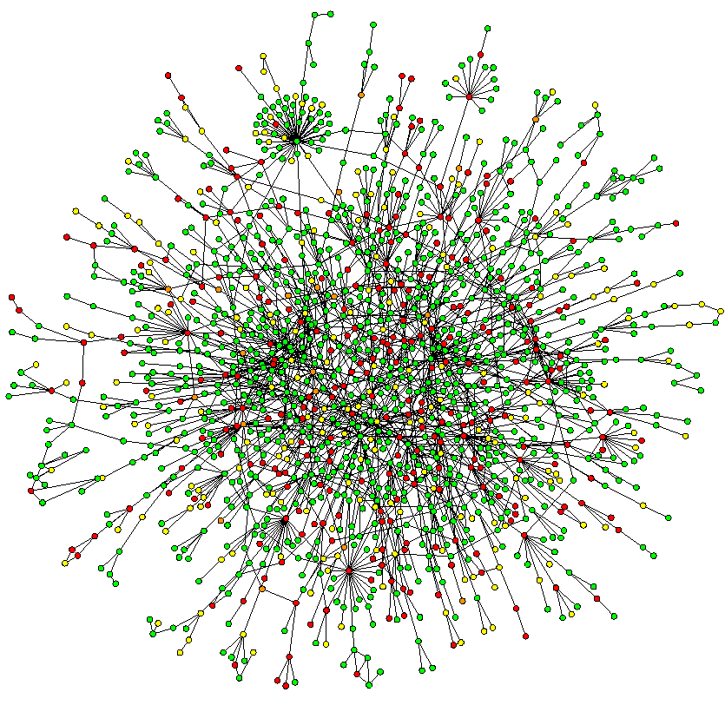
Protein-protein interaction (PPI)
PPI data from IntAct
  A database that provides information on interactions from literature curation or direct user submissions
Sample yeast protein-protein interaction network
Notes:
Rigorous review process for direct user submissions, includes experiment type by which protein-protein interaction was found

Slide 7
Protein-protein interaction
More formally:
Set of Vertices and Edges, Function Annotations
p₂
Vertices are proteins
p₁
p₃
Undirected edges
p₄
Functions denoted as set membership
Notes:
Y2H screen investigates the interaction between artificial fusion proteins inside the nucleus of yeast.
Tandem affinity purification (TAP) detects interactions within the correct cellular environment (e.g. in the cytosol of a mammalian cell) (Rigaut et al., 1999).

Slide 8
Neighborhood-Based Methods
Simple Transfer
{F₇, F₁₀}
{F₇, F₁₀}
{F₇, F₁₀}
{F₇, F₁₀}
{F₇, F₁₀}
Schwikowski et al. (2000)

Slide 9
Functional Flow
  “Whole-proteome prediction of protein function via graph-theoretic analysis of interaction maps”, Nabieva et al. (2005)
Diffuses function annotations through protein-protein interaction network

Slide 10
Functional Flow
Iteration = 0
?
?
0
0
0
?
F₁
∞
?
?
0
0
?
0
?
0
∞
F₁
Nabieva et al. (2005)
Notes:
Add author name

Slide 11
Functional Flow
Iteration = 1
0
0
0
∞
0
0
0
0
∞
Nabieva et al. (2005)

Slide 12
Functional Flow
Iteration = 1
1
1
0
∞
1
0
1
0
∞
Nabieva et al. (2005)

Slide 13
Functional Flow
Iteration = 2
2
2
.33
∞
2
.5
2
.33
∞
Nabieva et al. (2005)

Slide 14
Conditional Function Flow
Extends Functional Flow by allowing flow between functions based on conditional probability
Notes:
Shows that

Slide 15
Relationship Between Terms
Term1ID | Term2ID | Expected Pair Count | Observed Pair Count | Expected Pair Freq | Observed Pair Freq | Chi-Squared | Pvalue | Count Term 1 | Term 1 Freq | Count Term 2 | Term 2 Freq | Average Degree 1 | Average Degree 2 | Relative?
exonuclease activity | ribonuclease activity | 0.89031 | 20 | 0.00017756 | 0.0039888 | 364.52 | 0 | 62 | 0.012365 | 72 | 0.01436 | 3.4444 | 4.2353 | 0
exonuclease activity | ribonuclease activity | 0.66055 | 17 | 0.00013174 | 0.0033905 | 361.44 | 0 | 46 | 0.0091743 | 72 | 0.01436 | 3.2857 | 4.2353 | 0
3'-5' exonuclease activity | ribonuclease activity | 0.58875 | 16 | 0.00011742 | 0.0031911 | 361.6 | 0 | 41 | 0.0081771 | 72 | 0.01436 | 3.1538 | 4.2353 | 0
exoribonuclease activity | exonuclease activity | 0.51376 | 13 | 0.00010247 | 0.0025927 | 274.31 | 0 | 56 | 0.011169 | 46 | 0.0091743 | 4.3077 | 3.2857 | 0
exoribonuclease activity | 3'-5' exonuclease activity | 0.45792 | 12 | 9.13E-05 | 0.0023933 | 263.81 | 0 | 56 | 0.011169 | 41 | 0.0081771 | 4.3077 | 3.1538 | 0
passive transmembrane transporter activity | substrate-specific transmembrane transporter activity | 0.74252 | 11 | 0.00014809 | 0.0021939 | 129.1 | 0 | 51 | 0.010172 | 73 | 0.014559 | 1.5938 | 1.4314 | 0
channel activity | substrate-specific transmembrane transporter activity | 0.74252 | 11 | 0.00014809 | 0.0021939 | 129.1 | 0 | 51 | 0.010172 | 73 | 0.014559 | 1.5938 | 1.4314 | 0
passive transmembrane transporter activity | substrate-specific transporter activity | 0.89509 | 11 | 0.00017852 | 0.0021939 | 104 | 0 | 51 | 0.010172 | 88 | 0.017551 | 1.5938 | 1.5439 | 0
channel activity | substrate-specific transporter activity | 0.89509 | 11 | 0.00017852 | 0.0021939 | 104 | 0 | 51 | 0.010172 | 88 | 0.017551 | 1.5938 | 1.5439 | 0
exoribonuclease activity | 3'-5' exonuclease activity | 0.35162 | 10 | 7.01E-05 | 0.0019944 | 241.8 | 0 | 43 | 0.008576 | 41 | 0.0081771 | 3.5833 | 3.1538 | 0
3'-5' exonuclease activity | exonuclease activity | 0.37615 | 10 | 7.50E-05 | 0.0019944 | 224.91 | 0 | 41 | 0.0081771 | 46 | 0.0091743 | 3.1538 | 3.2857 | 0
hydrolase activity | deacetylase activity | 0.79079 | 9 | 0.00015772 | 0.001795 | 78.338 | 0 | 61 | 0.012166 | 65 | 0.012964 | 4.6923 | 5.9091 | 0
hydrolase activity | protein deacetylase activity | 0.79079 | 9 | 0.00015772 | 0.001795 | 78.338 | 0 | 61 | 0.012166 | 65 | 0.012964 | 4.6923 | 5.9091 | 0
kinase activator activity | protein kinase regulator activity | 0.81193 | 9 | 0.00016193 | 0.001795 | 75.914 | 0 | 59 | 0.011767 | 69 | 0.013761 | 4.9167 | 3.6316 | 0
hydrolase activity | deacetylase activity | 0.84264 | 9 | 0.00016806 | 0.001795 | 72.61 | 0 | 65 | 0.012964 | 65 | 0.012964 | 3.8235 | 5.9091 | 0
Notes:
Shows that unexpected proteins are related!!

Slide 16
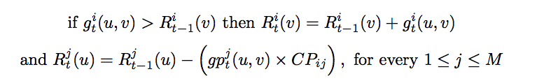
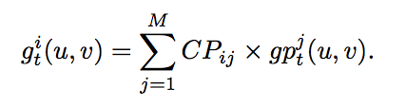
Conditional Function Flow
v
u

Slide 17
Conditional Functional Flow
F₁
P(F_{j}|F₁)
F_{i}
F₂
P(F_{j}|F₂)
u
F_{j}
F₃
v
F_{i}
...
F_{M}
P(F_{j}|F_{M})

Slide 18
Conditional Functional Flow
F₁
P(F_{i}|F₁)
F_{i}
F₂
P(F_{i}|F₂)
u
F_{j}
F₃
v
F_{i}
...
F_{M}
P(F_{i}|F_{M})

Slide 22
Conclusion
Conditional Functional Flow works for molecular function
Does not work for “higher level” definitions of function
Can be applied to other graph based data where “guilt by association” might not be the rule

Slide 23
Thank you
Wyatt Clark
Professor Mark Gerstein
Ian Gonzalez
Everyone in the lab!

Slide 24
Another Neighborhood Method
Neighborhood Count
  Count the number of each function in a radius n of the protein p
Radius = 2
{F₇, F₁₀}
{F₇, F₁₀}
{F₇, F_{8,} F₁₀}
{F₇, F_{8,} F₁₀}
?
{F₇}
{F₈}
{F₈}
{F₆, F₇}
{F₆, F₇}
{F₇}
{F₇}
Hishigaki et al. (2001)

