Slide 1
SV-bkpt-nc-pgene
Yan Zhang
4/16/2014

Slide 2
SV breakpoint region overlap with others (no gap, at least 1 base overlap):
Annotation (Gencode 19) | #unique SV bkpt regions
pseudogene | 294
sense_intronic (Long non-coding transcript in introns of a coding gene that does not overlap any exons) | 20
3prime_overlapping_ncrna (Transcripts where ditag and/or published experimental data strongly supports the existence of short non-coding transcripts transcribed from the 3'UTR) | 0
lincRNA (Long, intervening noncoding (linc) RNAs, that can be found in evolutionarily conserved, intergenic regions) | 684
transcribed_processed_pseudogene | 11
transcribed_unprocessed_pseudogene | 53
protein_coding | 3479
Processed_transcript | 1304
Notes:
Gencode 19 Annotation
SV bkpt – Alex & Shantao
“Overlap” can also mean “very close”.

Slide 3
Bkpt vs. others
Pseudogene value 157
15:20276428-20832610 NHR
Protein_coding value 411
3:131943658-132556055 NAHR
Eyeballing the plot: protein_coding signal covers the rest.
Some peaks of different biotypes overlap.
Notes:
SV.Chrom SV.Start SV.End SV.Type pseudogene sense_intronic lincrna transcribed_processed_pseudogene transcribed_unprocessed_pseudogene protein_coding processed_transcript
2611 3 131943658 132556055 NAHR 11 0 0 0 0 411 63
1205 15 20276428 20832610 NHR 157 0 15 0 40 15 66

Slide 4
Bkpt vs. nc & transcribed pgenes
lincRNA value 64
1:148771620-149518091 NAHR
Transcribed_unprocessed_pseudogene value 40
15:20276428-20832610 NHR
Notes:
SV.Chrom SV.Start SV.End SV.Type pseudogene sense_intronic lincrna transcribed_processed_pseudogene transcribed_unprocessed_pseudogene protein_coding processed_transcript
182 1 148771620 149518091 NAHR 92 0 64 1 12 16 16
1205 15 20276428 20832610 NHR 157 0 15 0 40 15 66

Slide 5
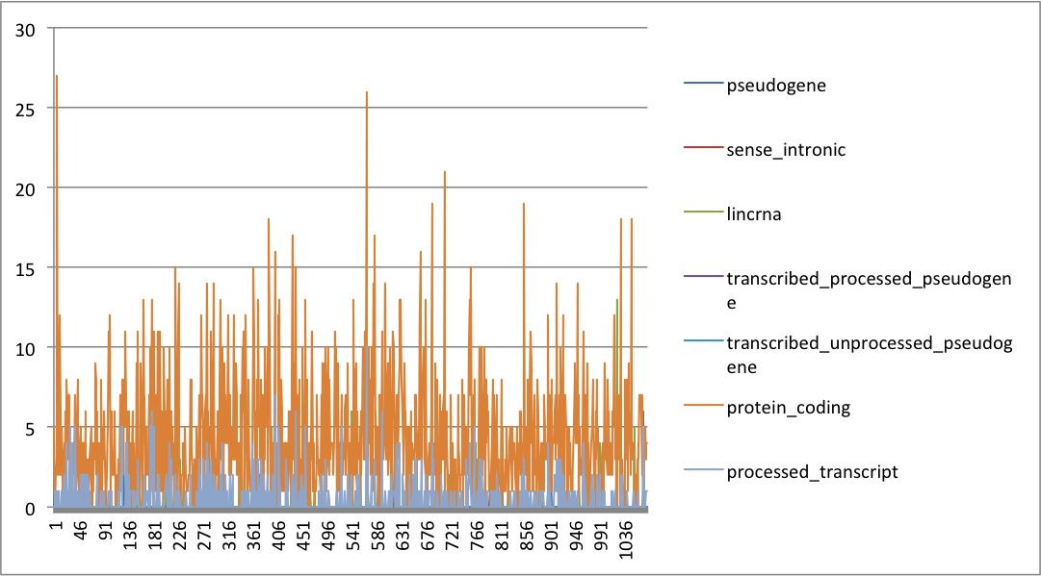
TEI

Slide 6
TEI

Slide 7
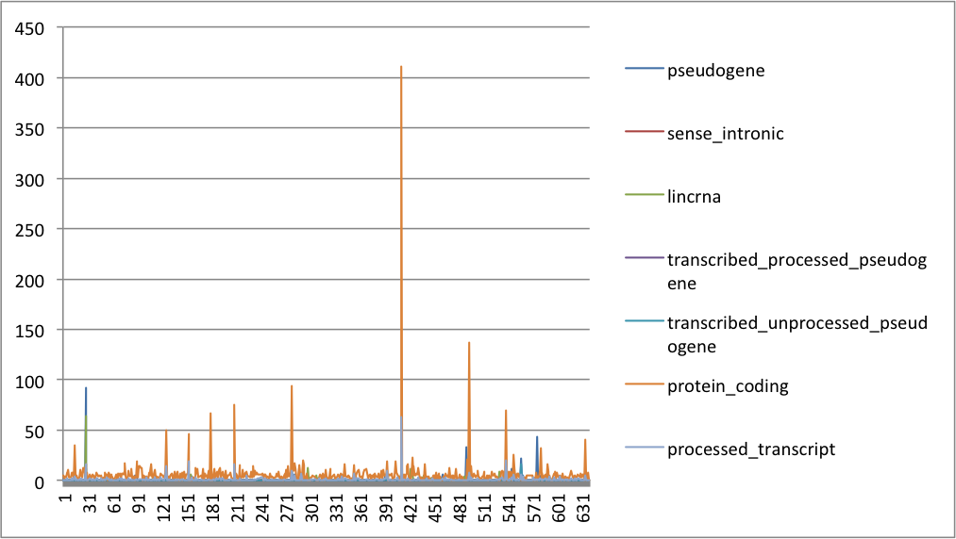
NAHR

Slide 8
NAHR

Slide 9
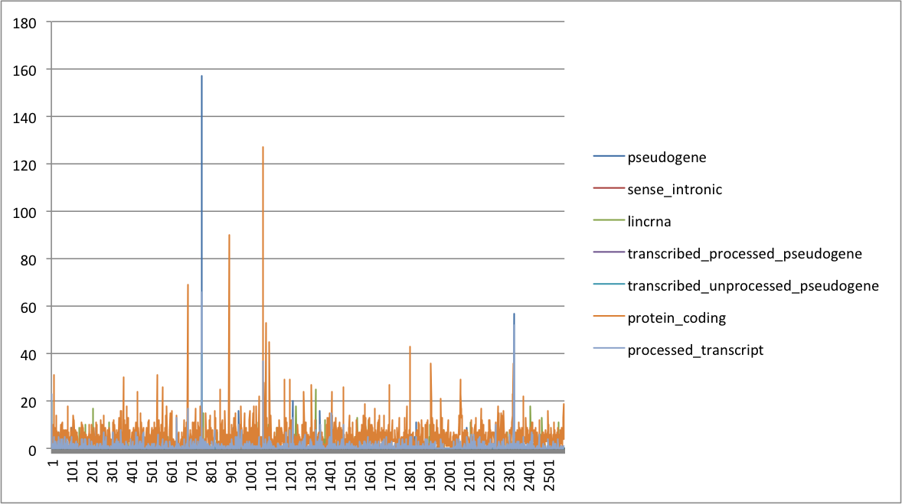
NHR

Slide 10
NHR

Slide 11
Observations
Bkpts overlap more with protein coding (and processed transcript) region than non-coding region.
Several regions have significantly high peak (overlap count) of certain biotypes.
Some peaks of different biotypes overlap (weak).

