Slide 1
RNA-binding motif SNP analysis
JZ
04/16/2014

Slide 2
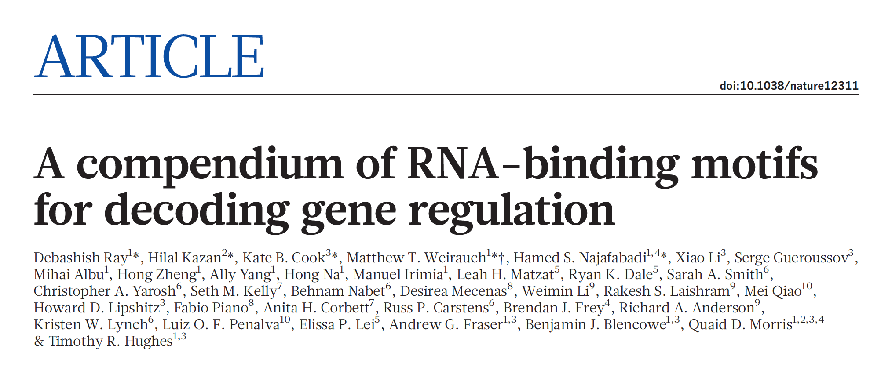
Motif for splicing events
204 different proteins
5~7mer motifs
Predicted by experiments in vitro
Goal: answer two questions:
Is the motif region enriched or depleted with SNPs?
Is the motif region enriched or depleted with rare SNPs?

Slide 3
mutation
+ strand
Search start : [pos-len+1, pos]
- strand
Search start : [pos-len+1, pos]
Search region is strand independent, just reverse and complement it for the - strand

Slide 9
Another hypothesis: is the sequence near weak splice sites are under stronger or weaker selection?
Answer is no!
Currently the signals we have are
  Experimentally discovered RNA-protein binding site, similar signals for a variation of datasets
  Conserved RNA-secondary structures (EVOFOLD)
  miRNA binding sites, limited binding sits, but signal is strong
What is next?
  PolyA sites: the sites before the PolyA starting sites are presumably under selection
Other RNA level regulatory signals?
  RNA degradations… (from Shantao)
  Check Gerps Score and overlap with the ultra conserved regions from FunSeq (from Ekta)

