Slide 1
AlleleDB Paper Figure Pack v3
Jieming
Allele
2014

Slide 2
AlleleDB: Allele-specific binding and expression variation in 380 individuals
Jieming Chen^{1,2}, Joel Rozowsky^{1,3}, Jason Bedford¹, Arif Harmanci^{1,3}, Alexei Abyzov^{1,3,6}, Yong Kong^{4,5}, Robert Kitchen^{1,3}, Lynne Regan^{1,2,3}, Mark Gerstein^{1,3,4}
¹Program in Computational Biology and Bioinformatics, Yale University, New Haven, CT 06520, USA.
²Integrated Graduate Program in Physical and Engineering Biology, Yale University, New Haven, CT 06520, USA.
³Department of Molecular Biophysics and Biochemistry, Yale University, New Haven, CT 06520, USA.
⁴Department of Computer Science, Yale University, New Haven, CT 06520, USA.
⁵Keck Biotechnology Resource Laboratory, Yale University, New Haven, CT 06511, USA.
⁶Current address: Department of Health Sciences Research, Mayo Clinic, Rochester, MN 55905
Notes:
Remove AlleleDB
In a database framework?
NAR
GB
GR
MSB
Bioinformatics

Slide 3
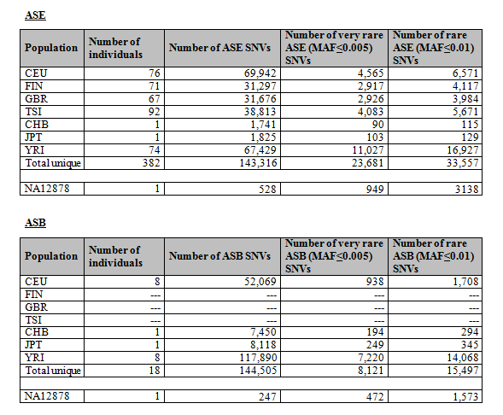
Table 1: AlleleDB data

Slide 4
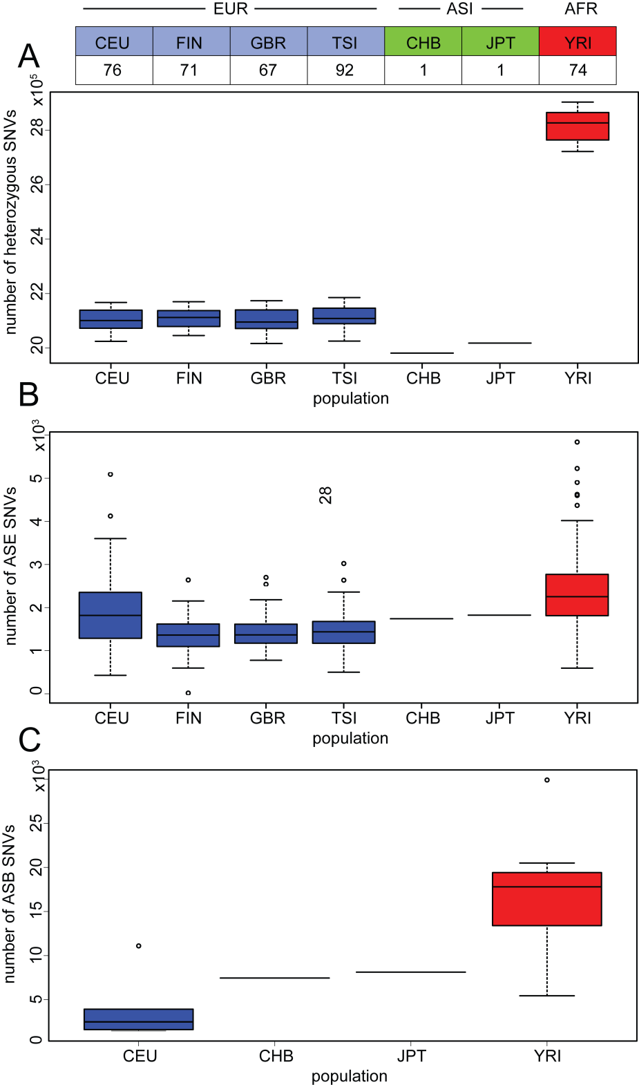
Supp fig :
Boxplots of het SNVs, ASE and ASB per individual in each population

Slide 5
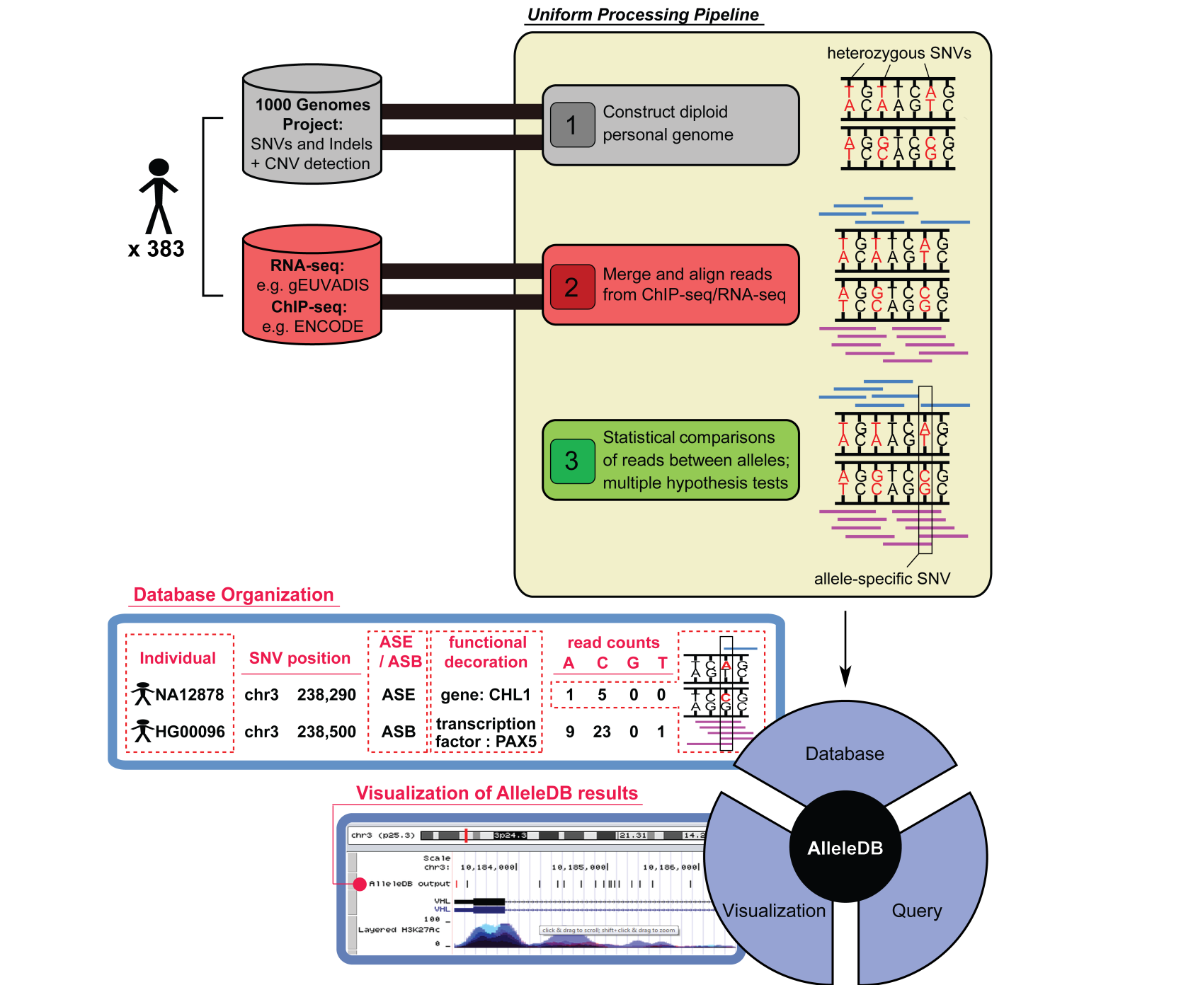
Figure 1. Construction of AlleleDB.
Notes:
v5a

Slide 6
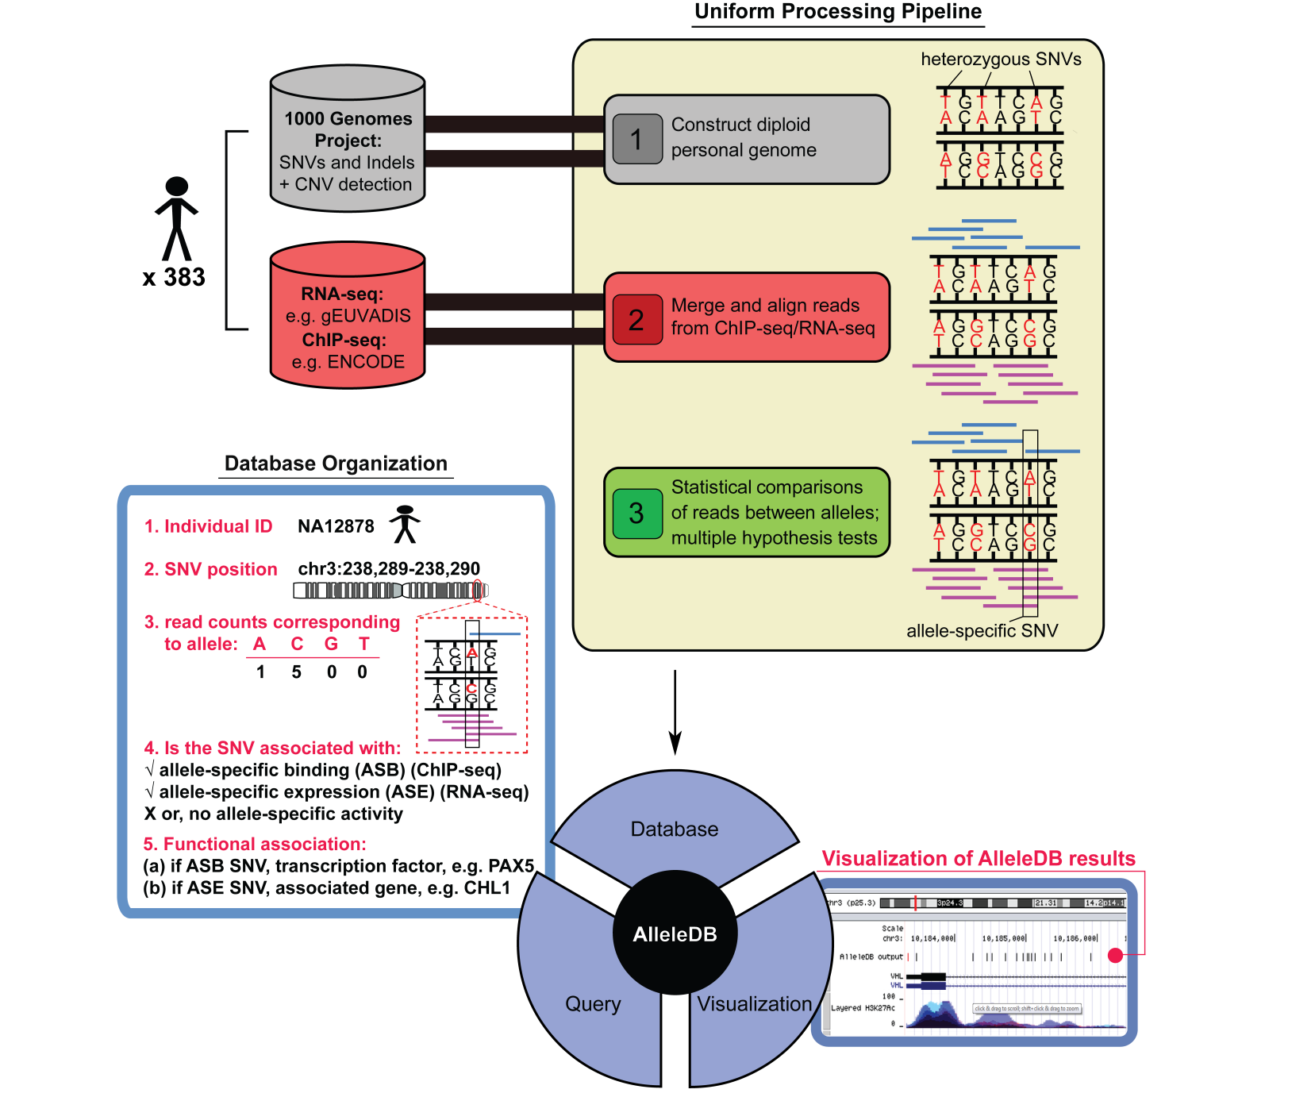
Figure 1. Construction of AlleleDB.
Notes:
v5b

Slide 7
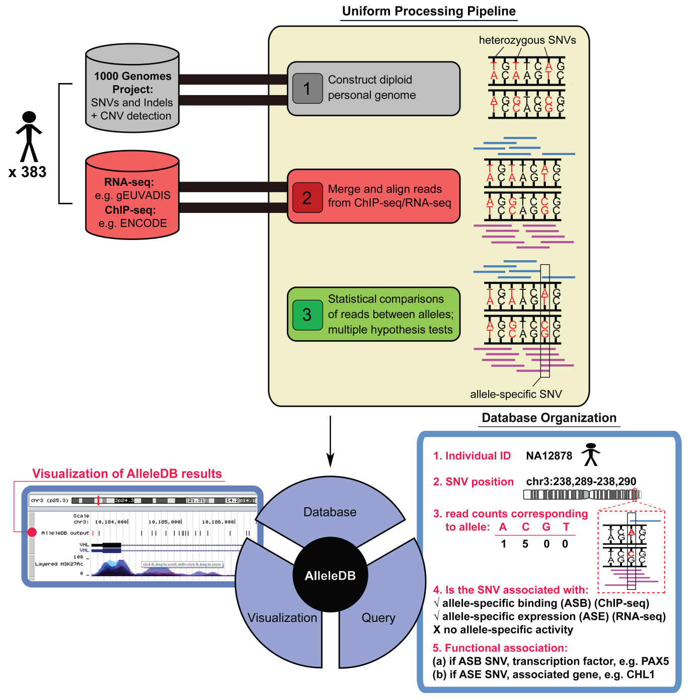
Figure 1. Construction of AlleleDB.
Notes:
v5c

Slide 8
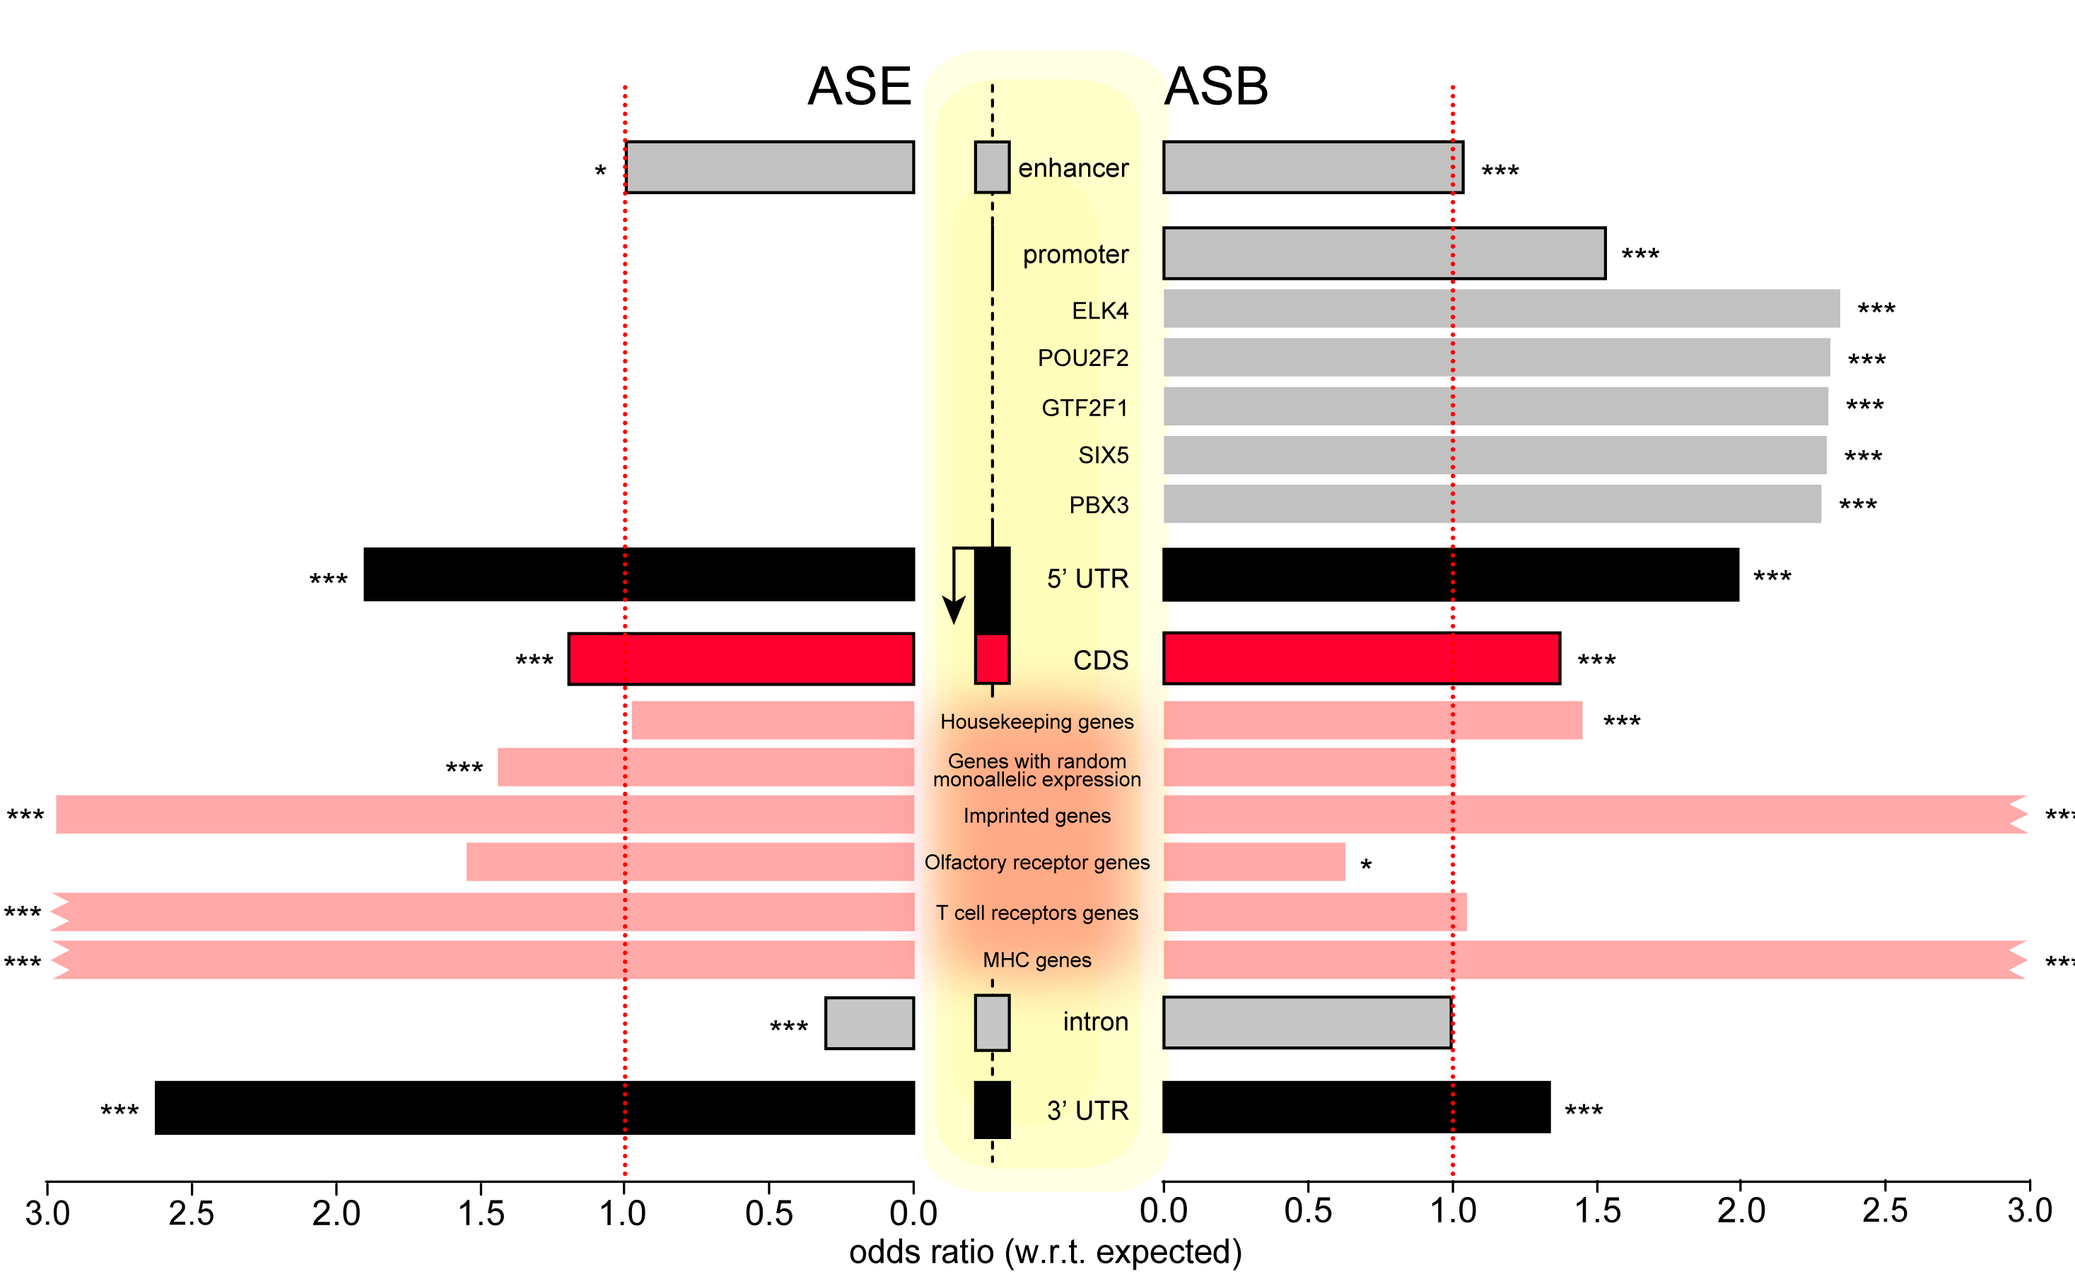
Figure 2. Enrichment of ASE and ASB SNVs in different genomic categories.
(Version A)
Notes:
v7a

Slide 9
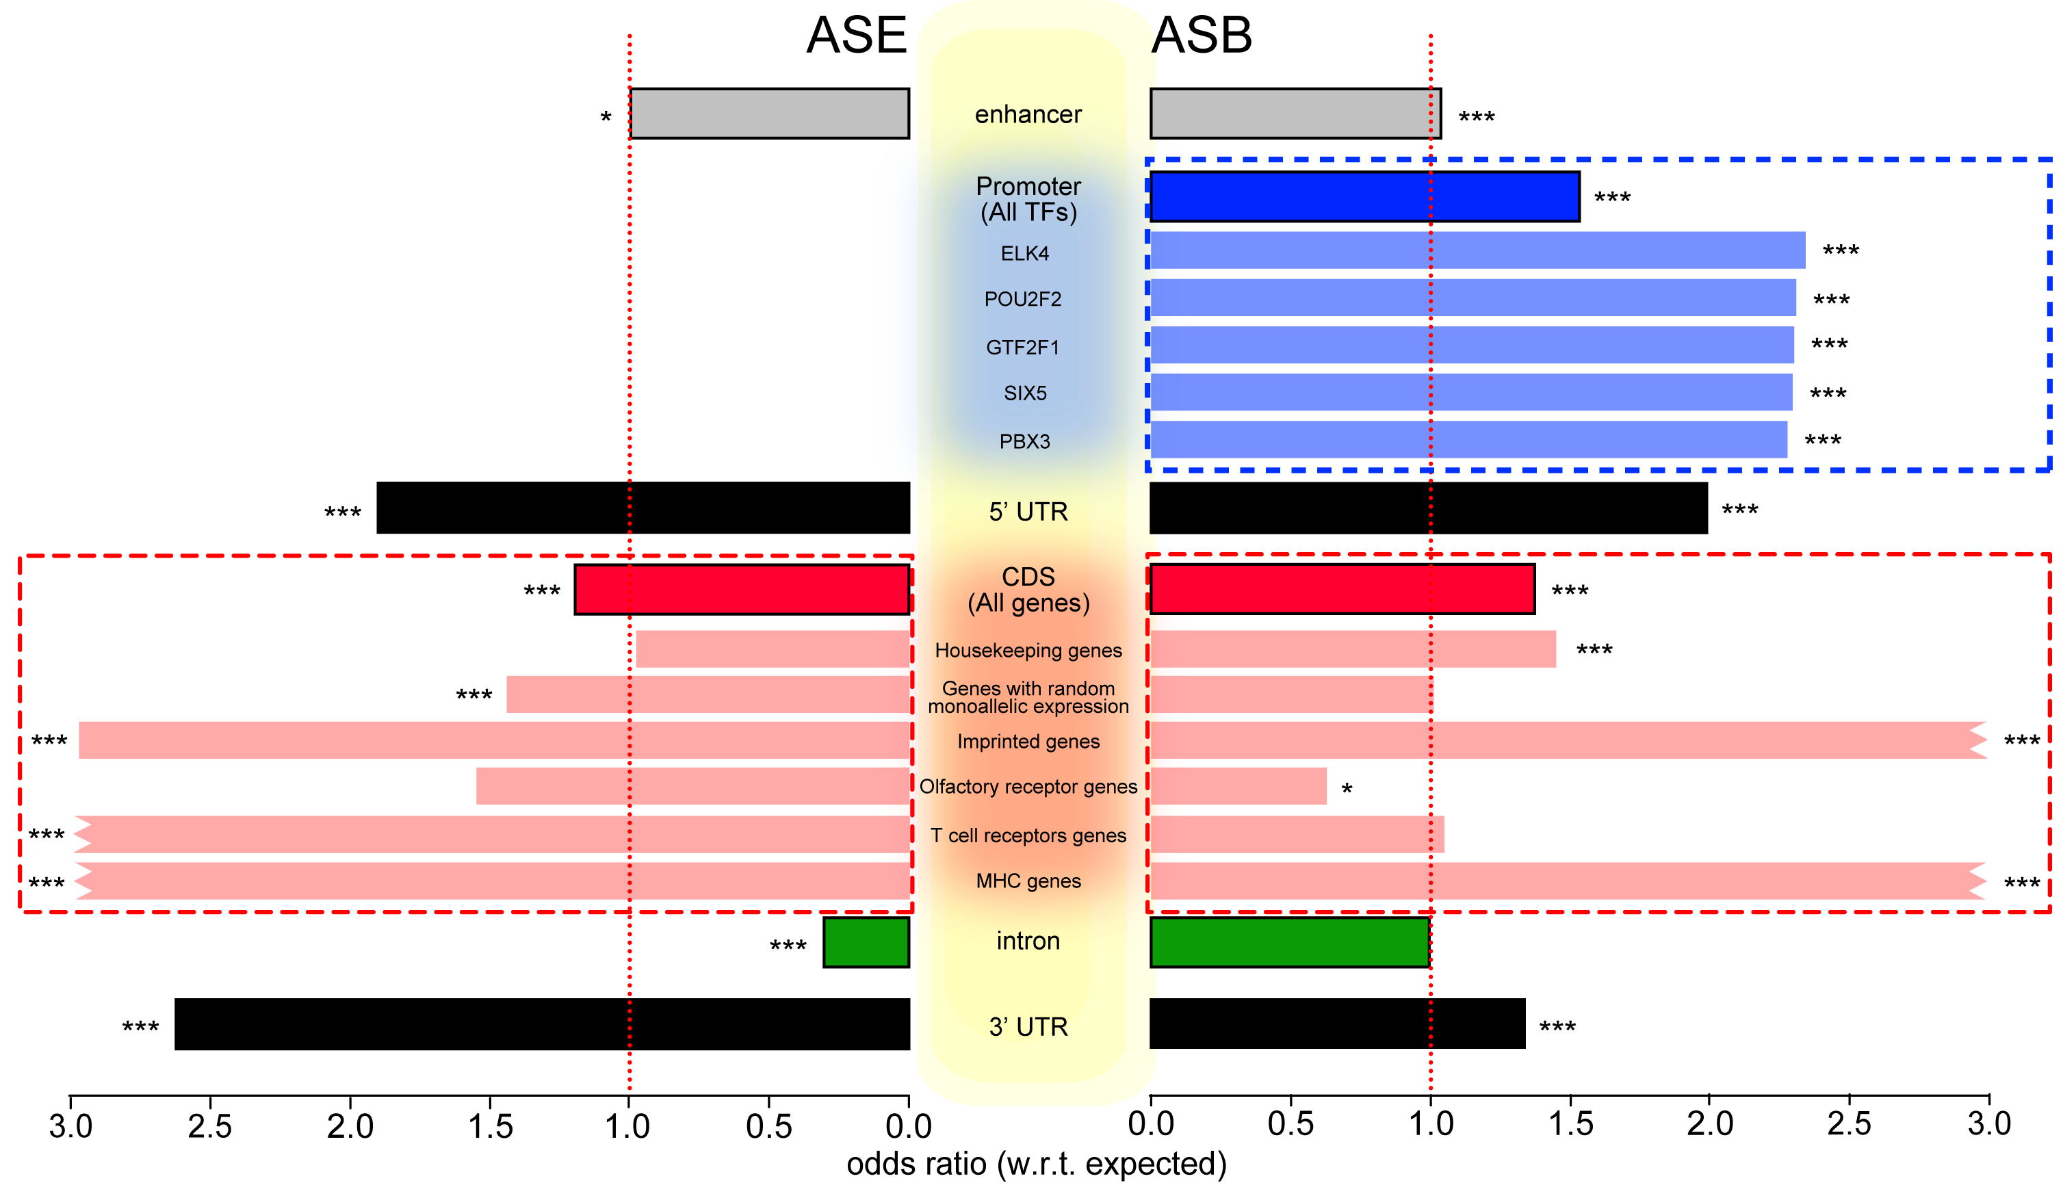
Figure 2. Enrichment of ASE and ASB SNVs in different genomic categories.
Notes:
V7b dotted line and color

Slide 10
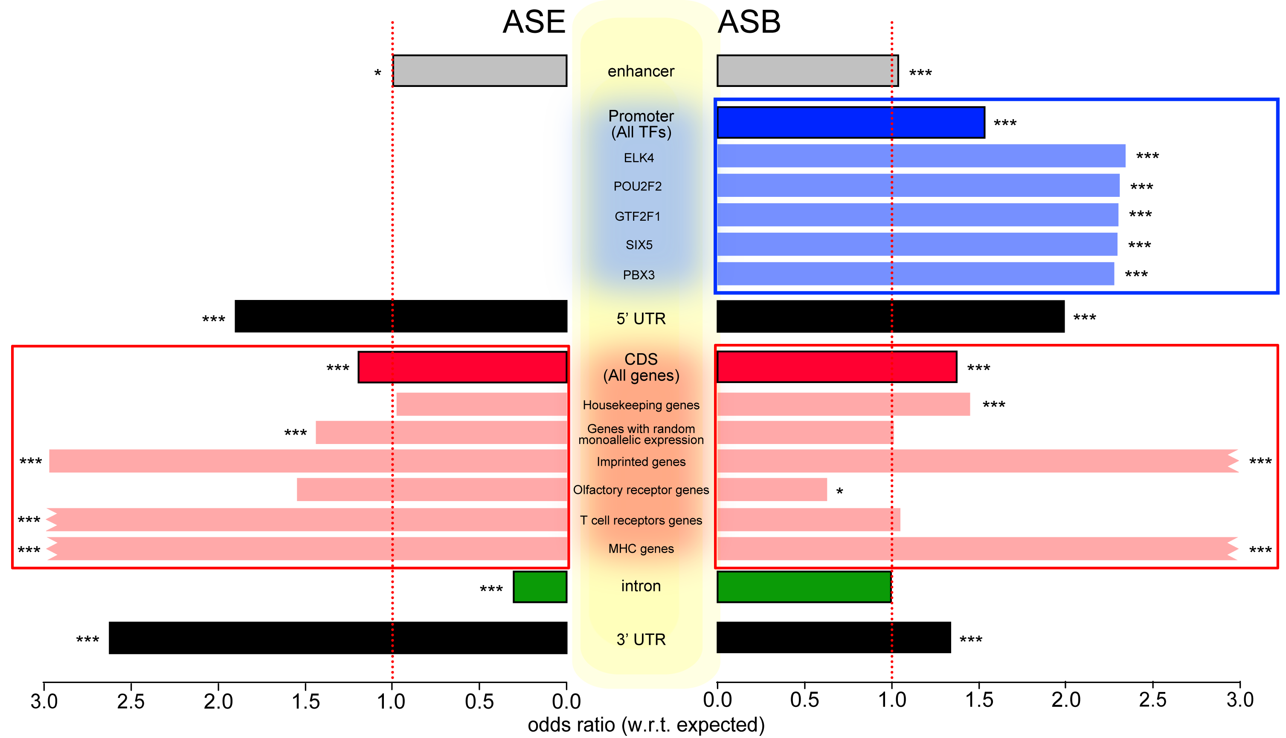
Figure 2. Enrichment of ASE and ASB SNVs in different genomic categories
Notes:
v7b

Slide 11
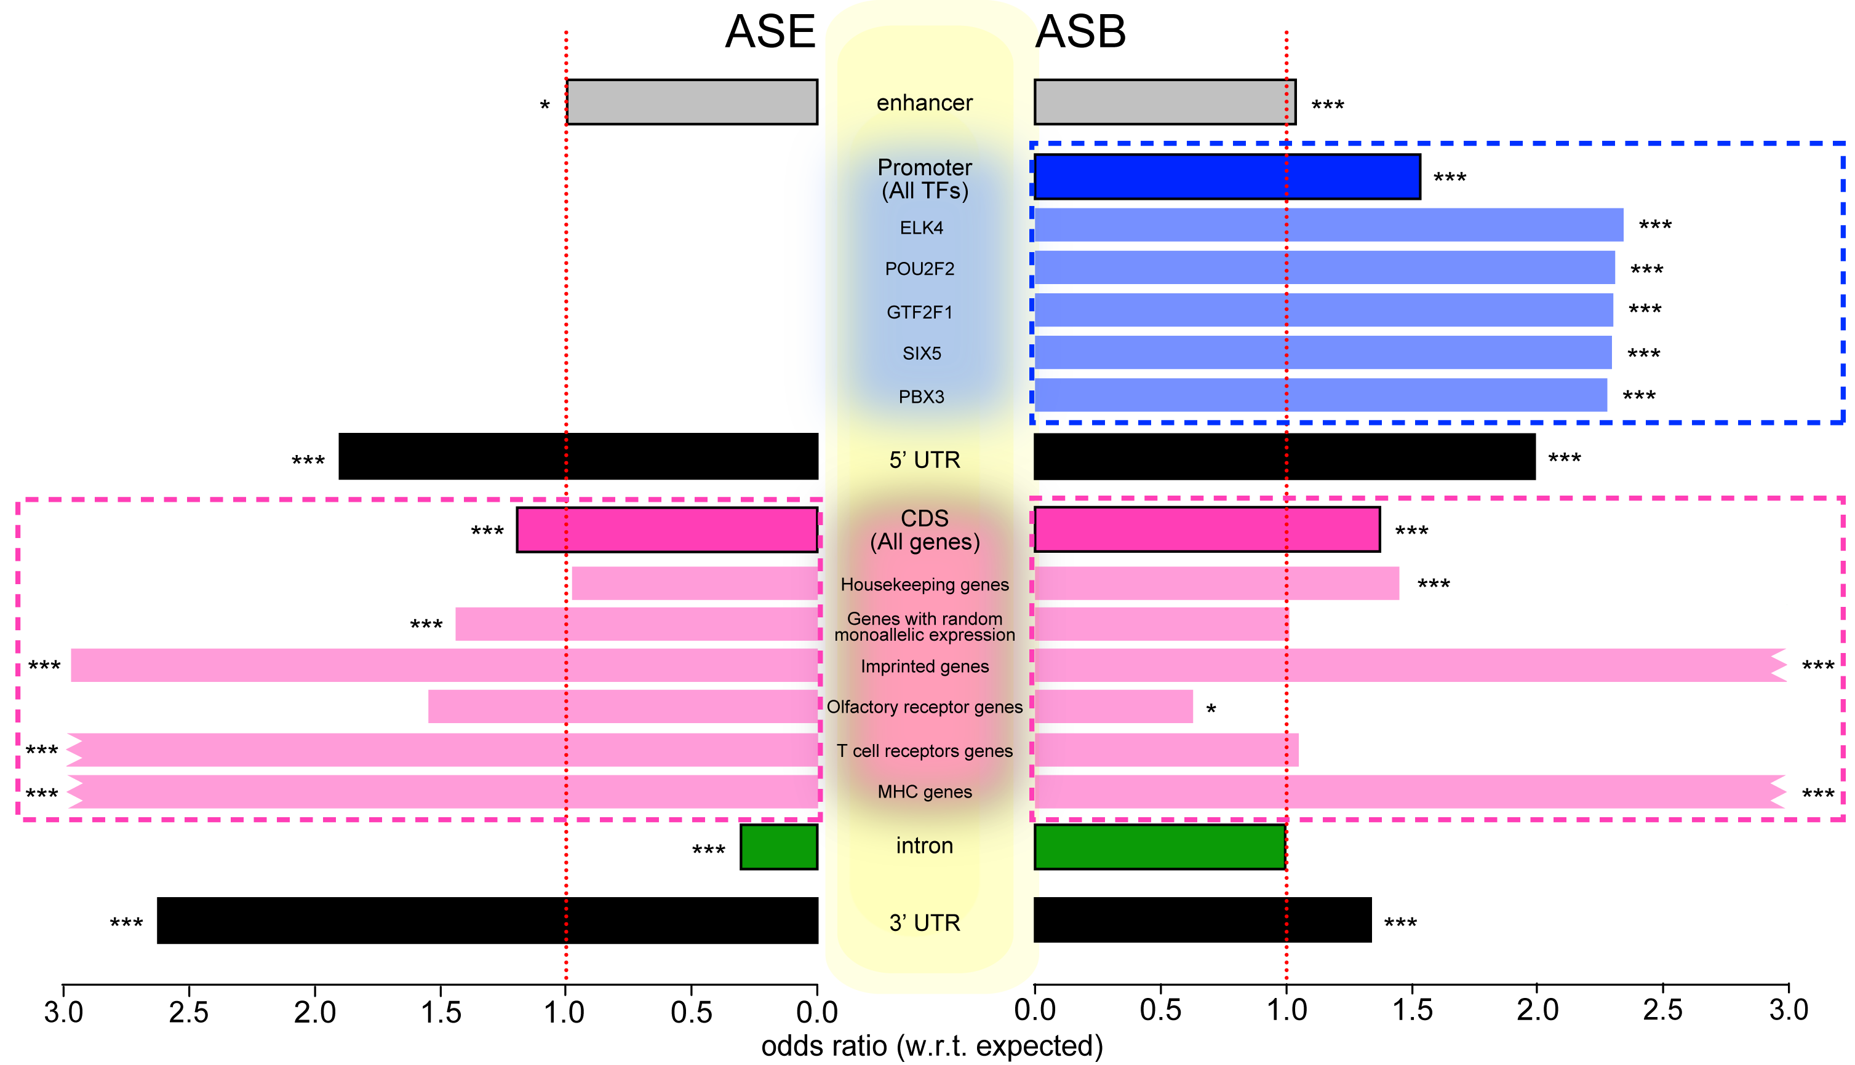
Figure 2. Enrichment of ASE and ASB SNVs in different genomic categories.
Notes:
v7c

Slide 12
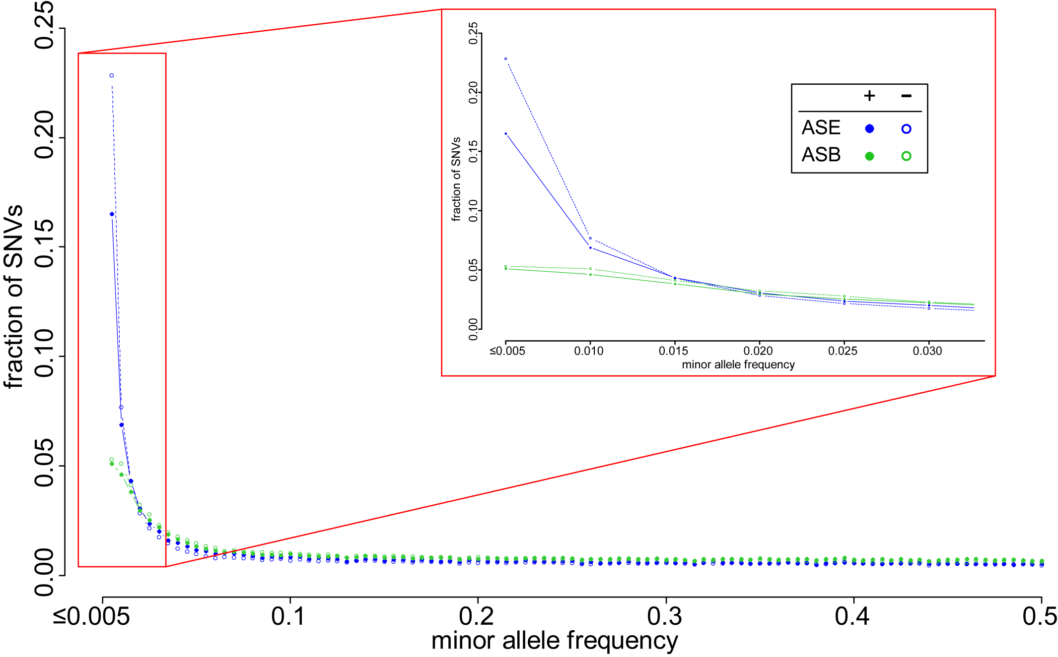
Figure 3. Enrichment of very rare SNVs (MAF<0.005) in AS SNVs.
But less so than non-AS SNVs, implies less selective constraints

Slide 13
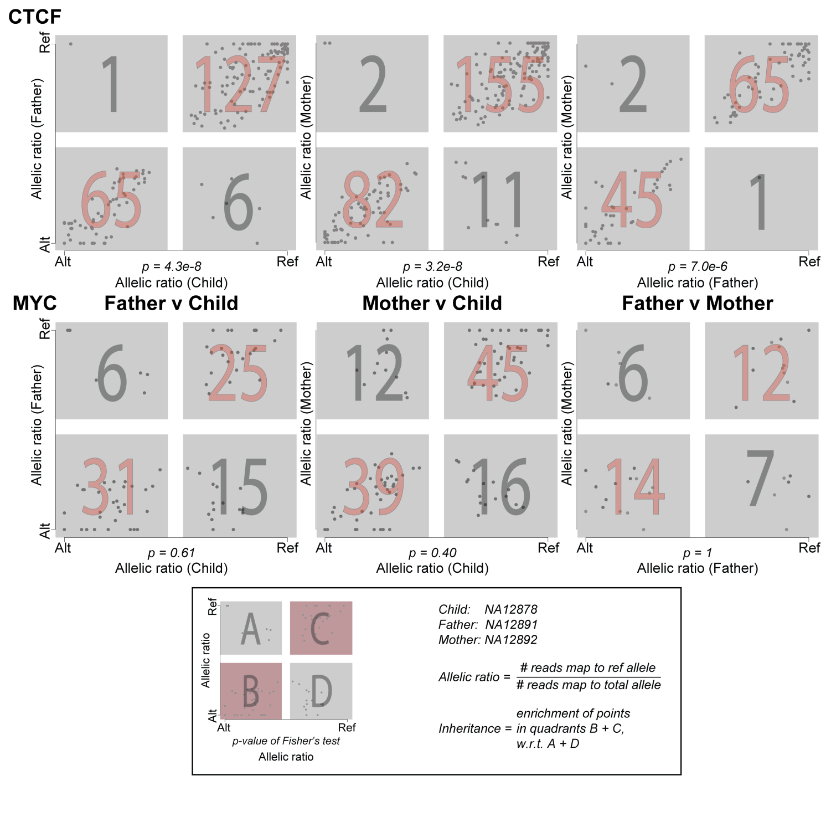
Figure 4. AS behavior is inherited in some TFs but not all.
Notes:
Remove **
Put mum and dad on axes
Put ratio of reference reads
Replace 1 by ref and 0 by alternate
Allelic ratio

Slide 14
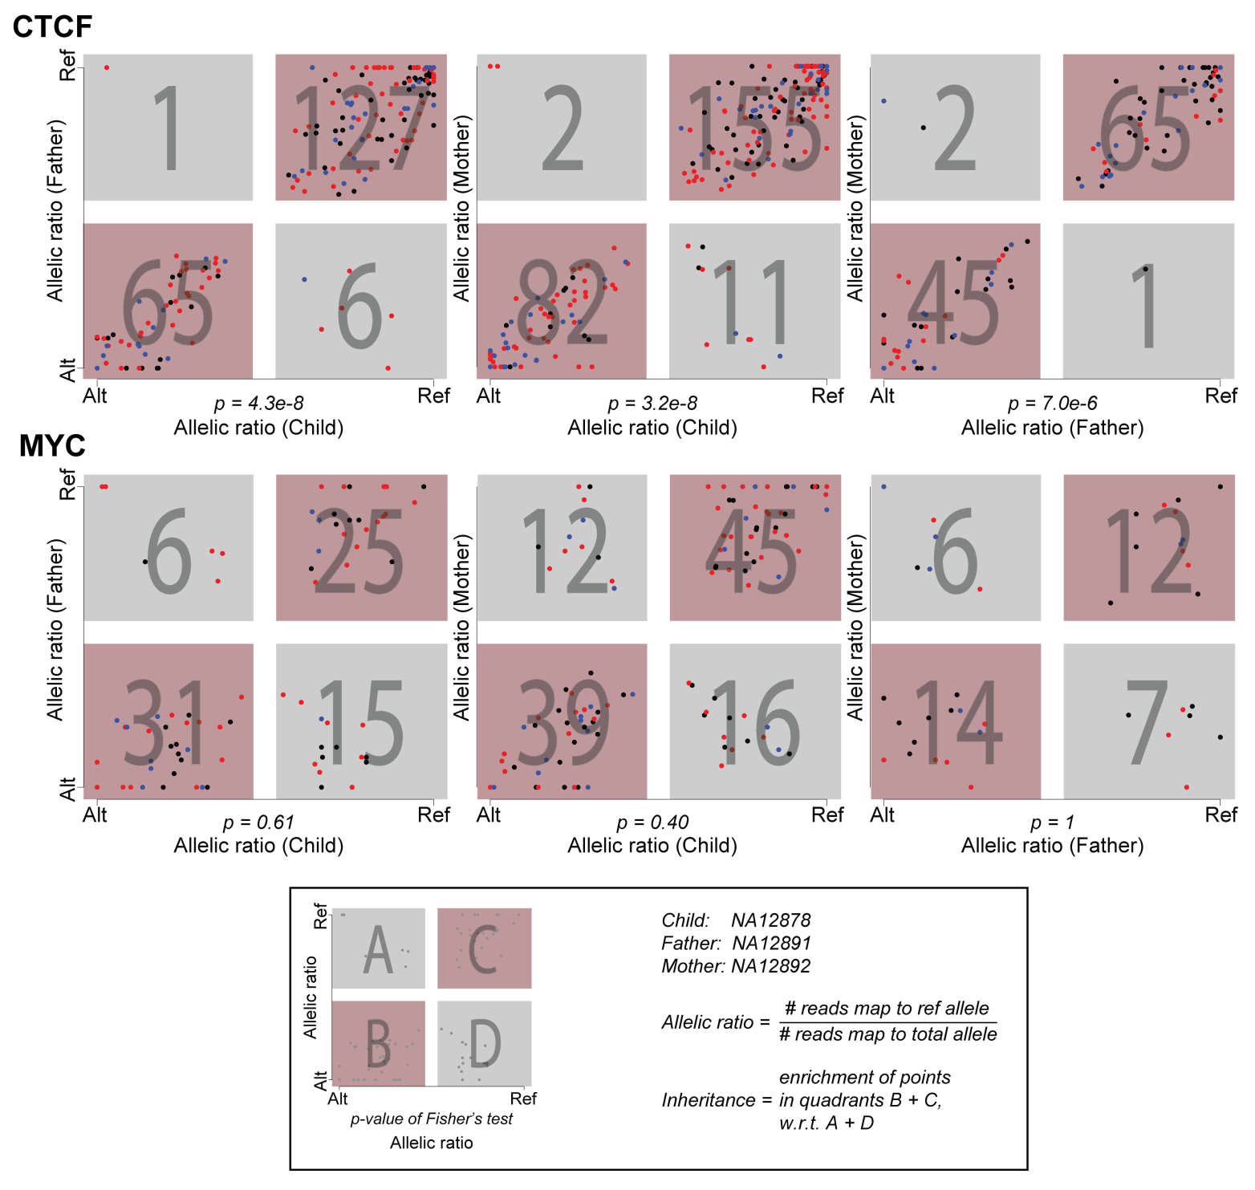
Figure 4. AS behavior is inherited in some TFs but not all.
Notes:
Remove **
Put mum and dad on axes
Put ratio of reference reads
Replace 1 by ref and 0 by alternate
Allelic ratio

Slide 15
Discuss
Abstract
Draft

