Slide 1
Bkpnt-Exprsn

Slide 2
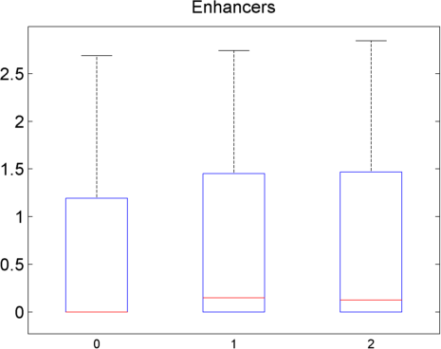
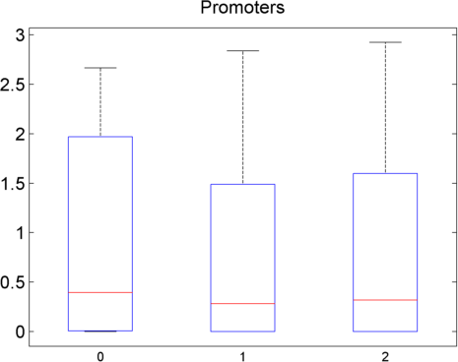
Deletion-Expression Correlations
Expression
Expression
Homozygous
deletion
Homozygous
reference
Homozygous
deletion
Homozygous
reference
Genotype
Genotype
All deletions

Slide 3
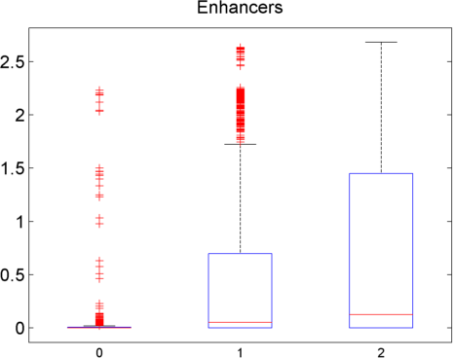
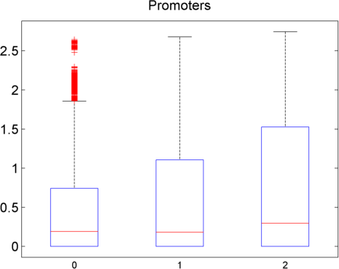
Deletion-Expression Correlations
Expression
Expression
Genotype
Genotype
Deletions > 2kb

Slide 4
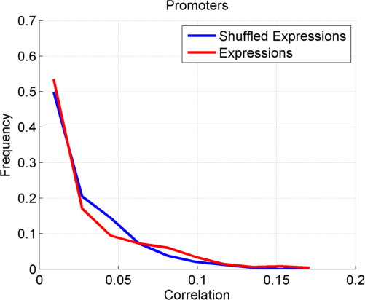
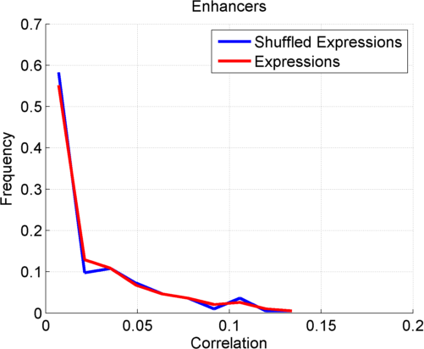
Deletion-Expression Correlations
Not much difference from shuffled Correlations.

