Slide 1
1E5X

Slide 2
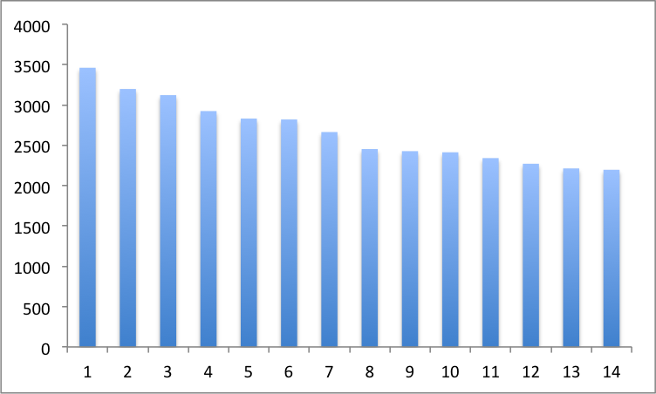
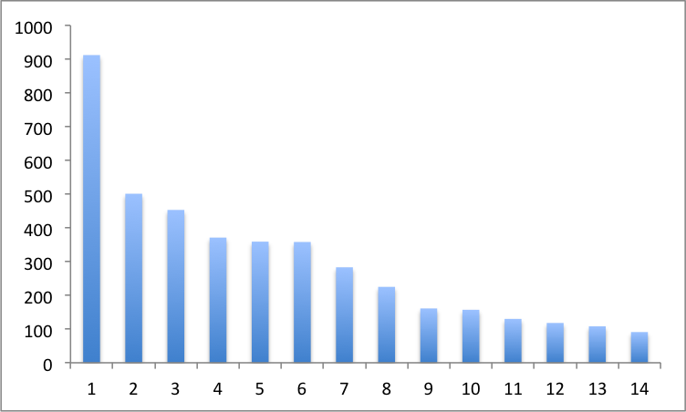
1E5X
CA-only
Heavy atom model (param = -0.05)

Slide 3
1J3H
(No method performs well)

Slide 4
3PFK

Slide 5
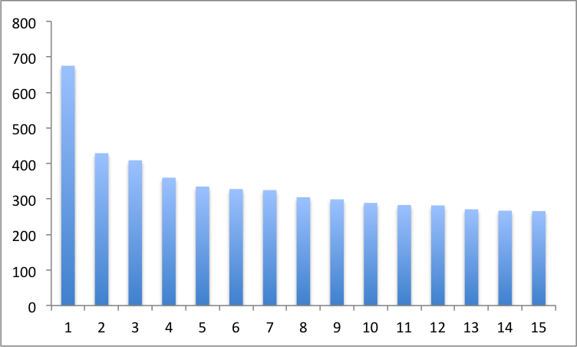
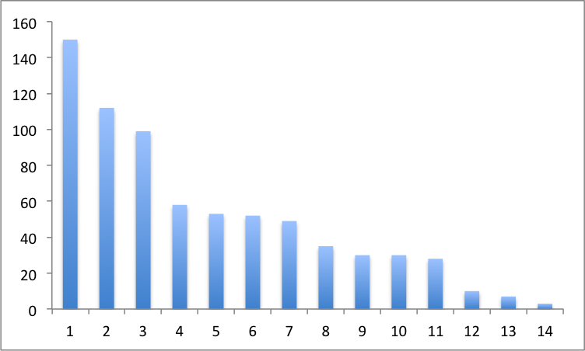
CA-only
3PFK
Heavy atom model (param = -0.05)

Slide 6
1NR7

Slide 7
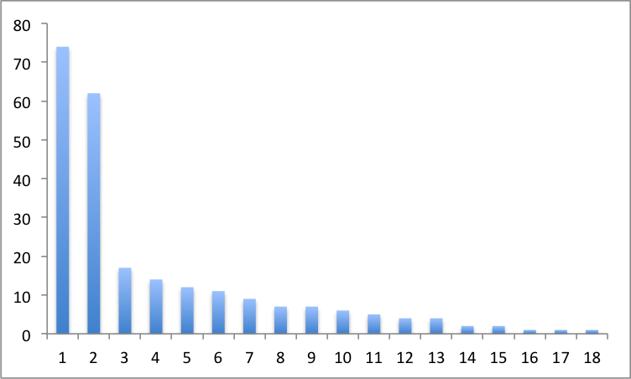
1NR7
Heavy atom model (param = -0.05)

