Slide 1
PrivaSeq

Slide 2
GTex
Datasets:
Total 22k eQTLs:
3,392 have matching genotype and expression data
Total 181 Subjects
101 have matching genotype and expression data
Age, height, weight, gender
Normalized MI:
MI(Expression, Phenotype)/H(Phenotype): Predictability of phenotype from expression

Slide 3
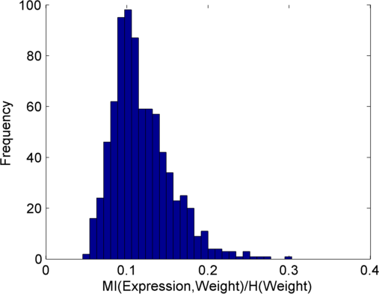
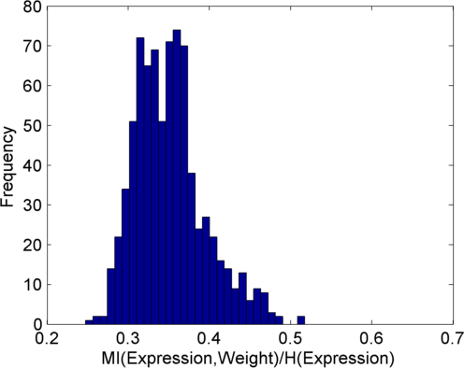
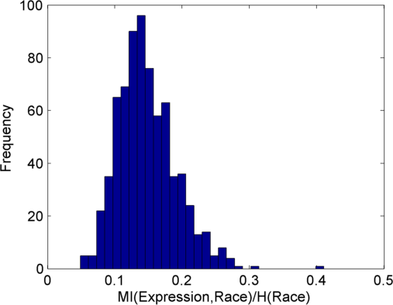
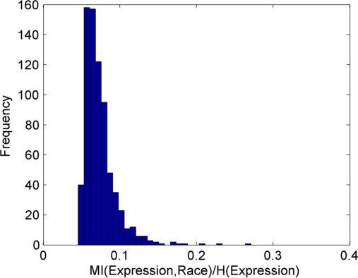
Distribution of Normalized MI
Weight
Race

Slide 4
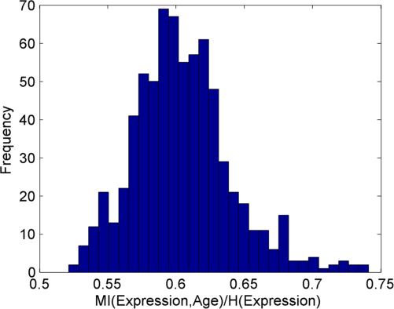
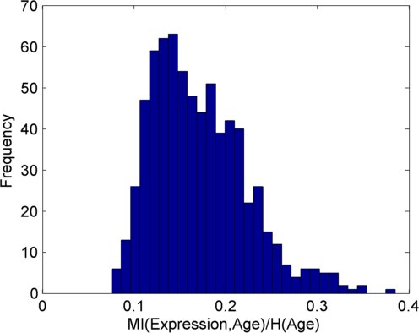
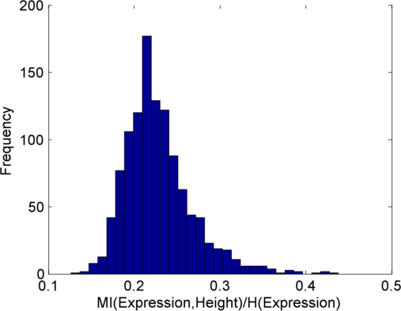
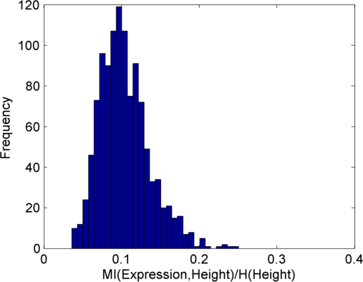
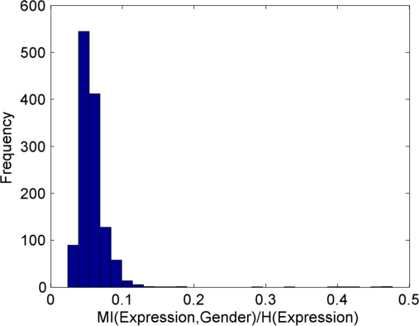
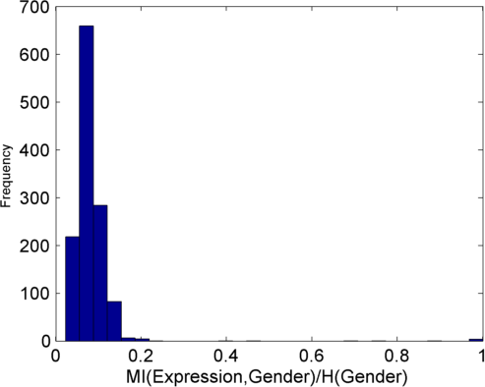
Age
Height
Gender

Slide 5
Next
Total amount of information estimate
Add other phenotypes and the genotypes
Estimate total amount of personally identifying predictable data

