Slide 1
Random matrix approach reveals sub-compartments in chromosomal spatial organization
KKY
April, 2014

Slide 2
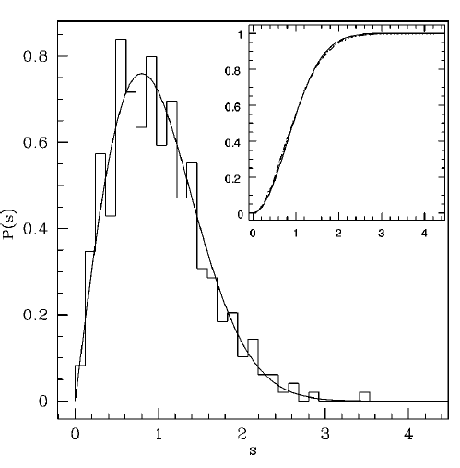
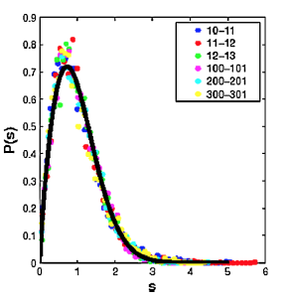
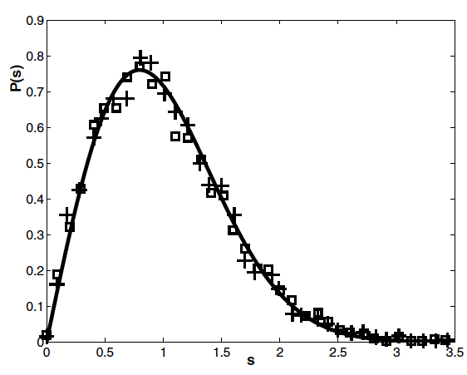
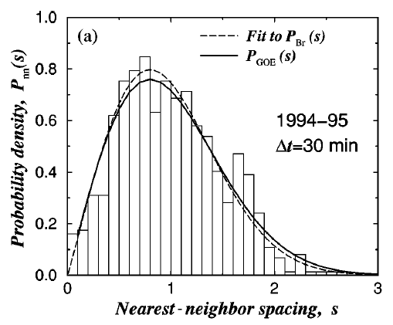
Recap: Random matrix theory captures bulk universality in many complex systems
Correlation patterns between constituents in many complex interacting systems exhibit universal behavior.
Major of eigenmodes can be captured by random matrix theory -> null model
Eigenvalues:
Sea-level pressure
Brody distribution:
Eigenvalues: Stock market
Eigenvalues:
EEG Data
Eigenvalues:
Protein dynamics

Slide 3
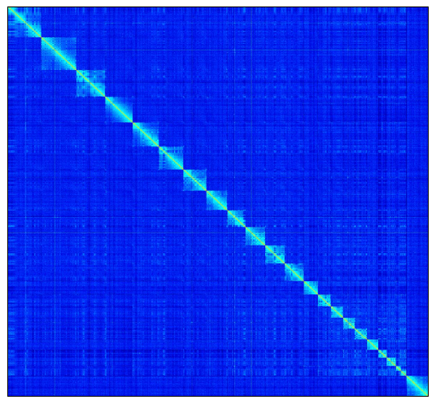
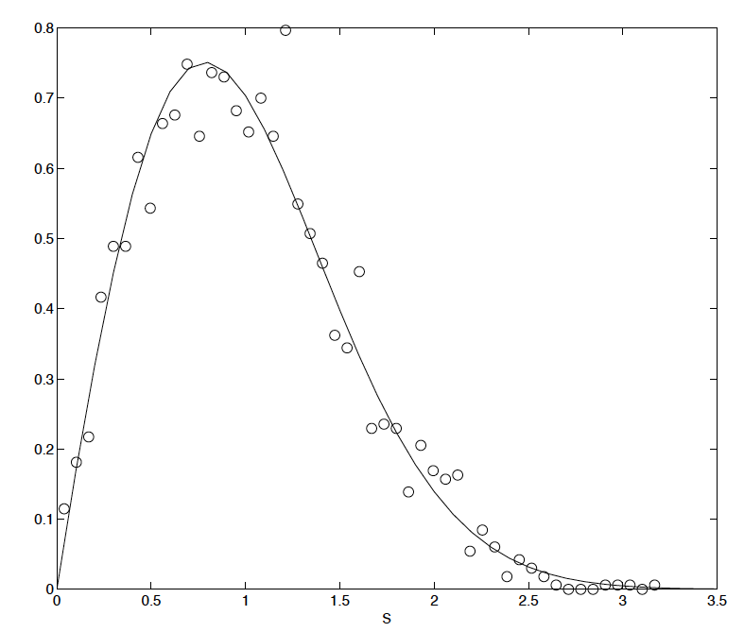
Recap: the same for Hi-C data
K562
GM06990
β=0.960±0.055
β=0.938±0.054
Lieberman et. al.
Science 2009
contact matrix
-> correlation matrix
mouse TH1
β=0.963±0.058
Nagano et. al.
Nature 2013

Slide 4
Inspiration from network modularity
Network modularity function
prob. that i and j are connected in
a null model. e.g.
Nodes within modules are more likely to be connected compared to nodes between modules
Highly expected links are downplayed
Empty links make negative contribution (repulsion)

Slide 5
Inspiration from network modularity
Network modularity function
prob. that i and j are connected in
a null model. e.g.
random correlation between i and j
Nodes within modules are more likely to be connected compared to nodes between modules
Highly expected links are downplayed
Empty links make negative contribution (repulsion)
Nodes within modules are more correlated compared to nodes between modules

Slide 6
Algorithm for breaking down chromosomes into modules
Start with the Hi-C interaction matrix
Subtract the null model as predicted by the random matrix theory
Assign bins to a set of modules 1,2,…q so as to optimize the function Q_{C} (There are various heuristics that could be employed.)
Optional step 1.5: perform iterative correction to the Hi-C matrix (Imakaev et.al. Nature methods 2012)

Slide 7
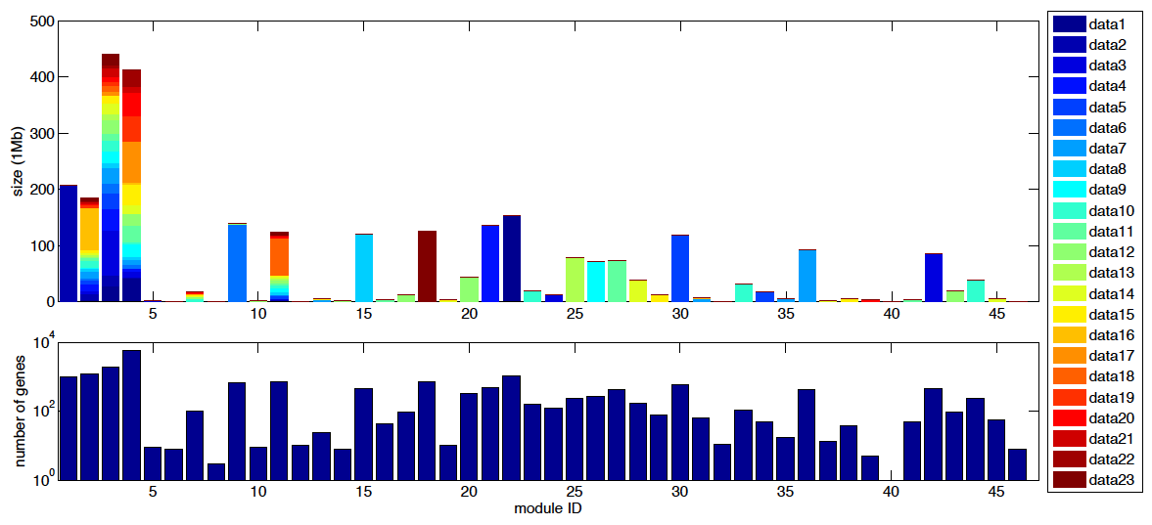
Example: GM06990

Slide 8

Example: GM06990
Not accurate !

Slide 9
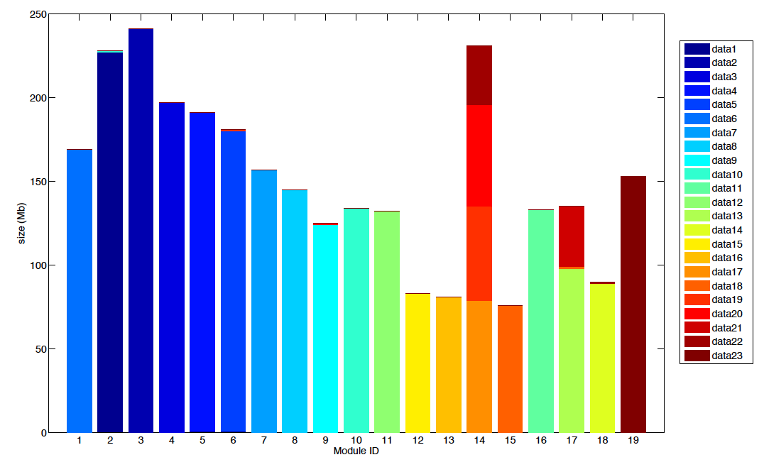
Example: GM06990

Slide 10
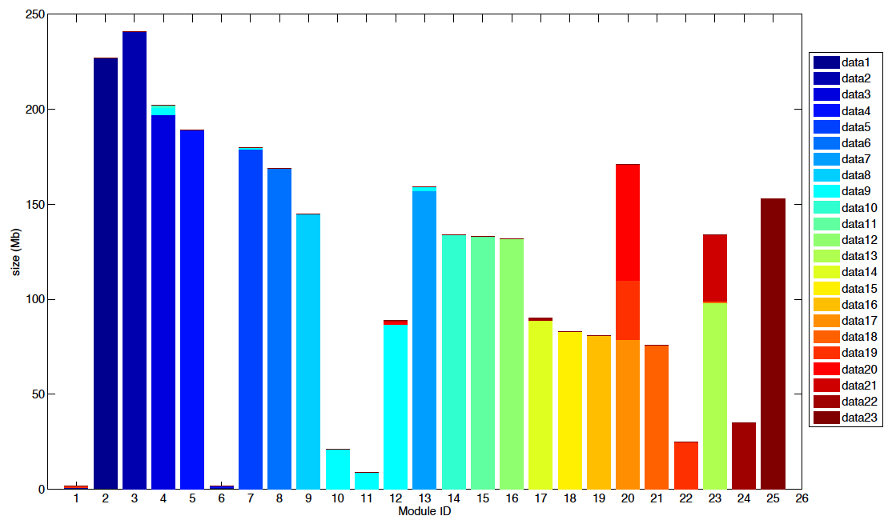
Example: K562

Slide 11
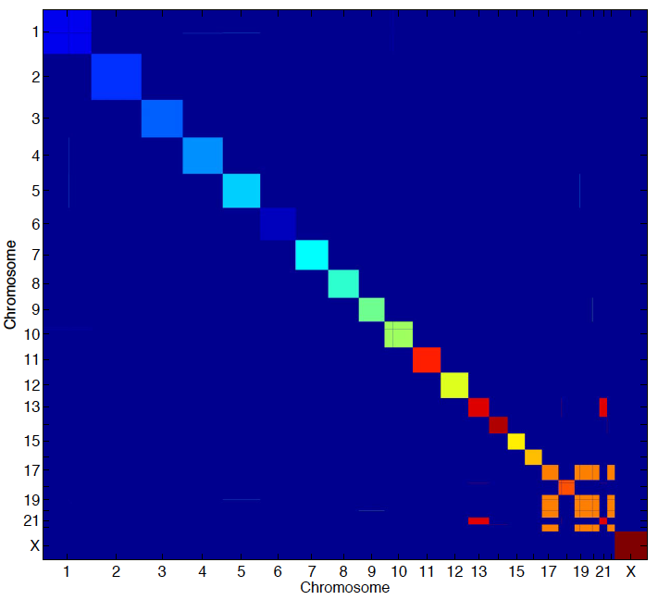
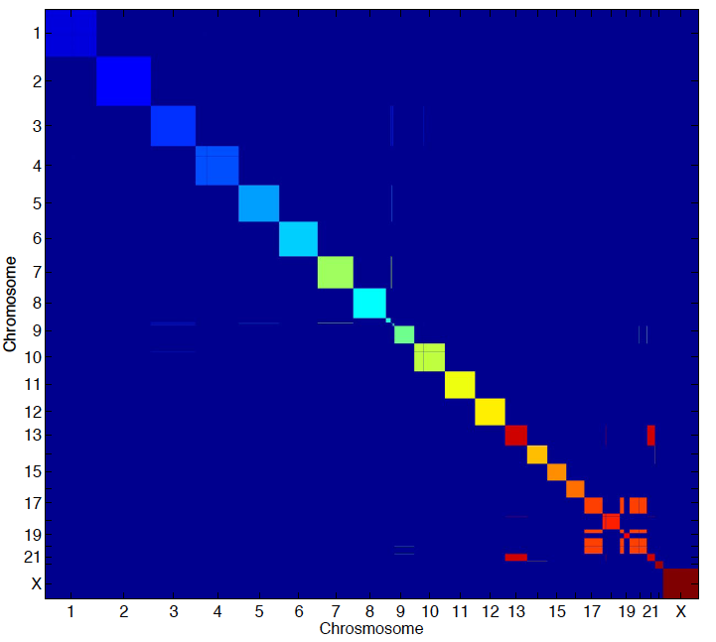
Compare modules between two cell lines
GM06990
K562
mutual information=4.14
Normalized mutual information=0.97

Slide 12
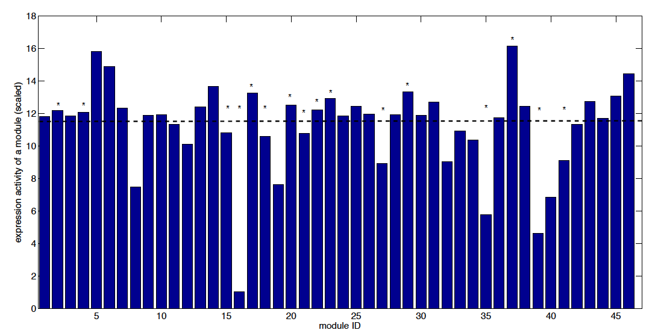
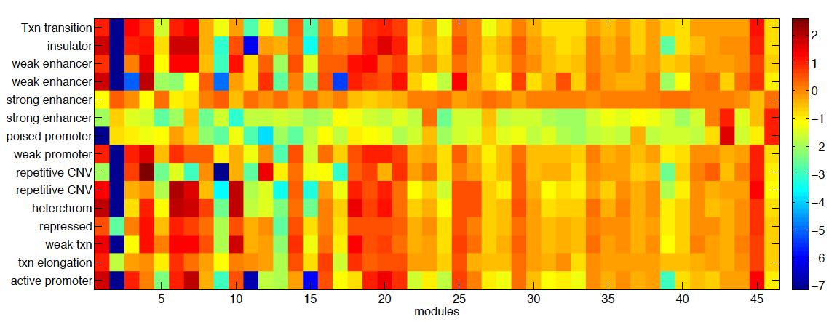
Downstream analysis (be careful, they are based on the old set of modules)
Expression activity
of various compartments
Expression activity
of various compartments

Slide 13
Working Hypothesis
Genes belonging to the same compartment have similar expression activity.
Cell-type specific compartments vs cell-type specific expression patterns: expressed genes are spatially re-organized
Cell-type specific compartments are related to cell-type specific chromatin states
The immediate step is to increase the resolution of the algorithm (break down the modules)

Slide 14
Quantifying the statistical significance of pairs of interactions
Quite a few studies have been around: significant pairs may be related to enhancers (holy grail)
In principle we can get a score based on the random matrix null model
Unlike most methods that fit the data by ad-hoc distributions, random matrix approach offers a global null model
Unlike most methods which focus on the interaction matrix, our approach works on the correlation matrix

Slide 15
Summary
Making use of the Hi-C data, we have a tool to decompose chromosomes into sub-compartments (working on increasing the resolution)
To probe large-scale structures (too large?) compared to typical long range interactions
Offer a framework to compare two interaction matrices: a relatively un-explored area
Looking for more analysis to make sense out of the sub-compartments
To figure out the effects of bin size: 1Mb -> 100kb or 10kb. 1Mb is probably too large for interesting biology.

Slide 16
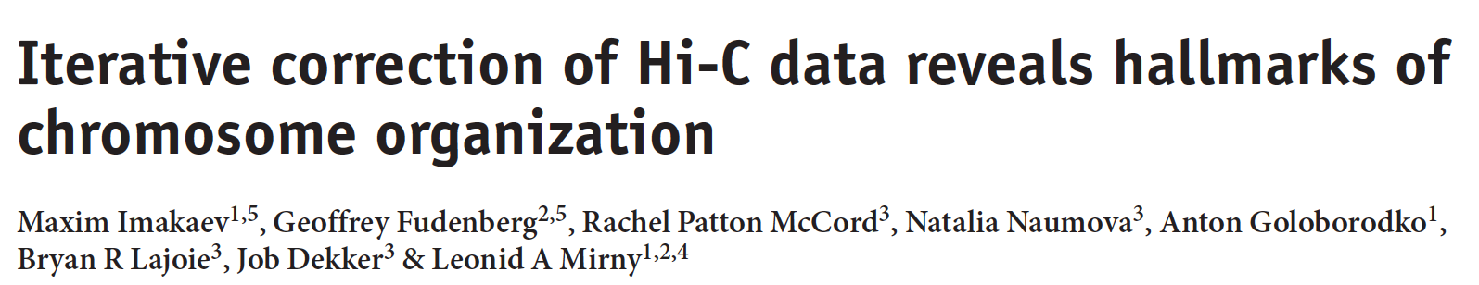
Corrected contact map
Matrix T: “true” relative contact probabilities
equal visibility
For each loci i, there is a bias factor B_{i} (summarize all sorts of sources)
the expected contact frequency between i and j is given by
Given the observed contact frequency O_{ij,} they inferred the values of T and B by
maximum likelihood.
Solve equations by iteration.
Notes:
Instead of independent sources, Bi
Separation of bias…
Cf. to previous all pairs have independent bias, but here is the simplification…
Iteration -> names of the program..

Slide 17
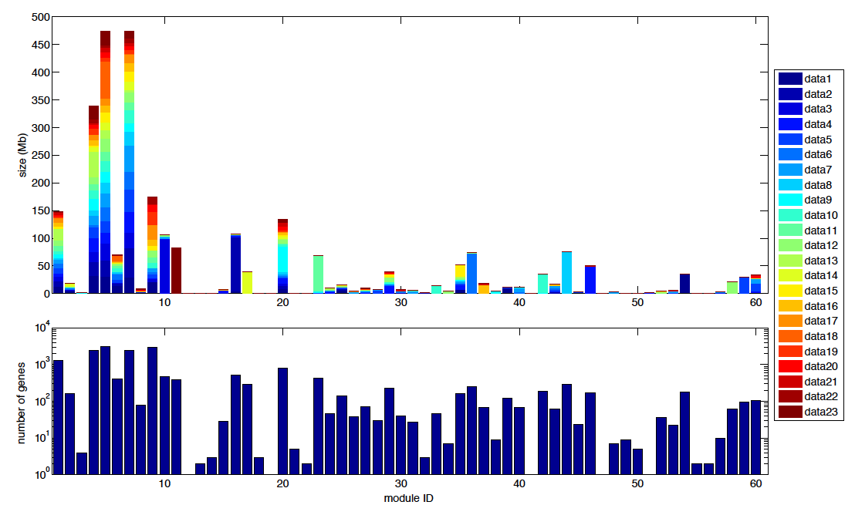
Example: K562

Slide 18
Compare modules between two cell lines
GM06990
K562
mutual information=1.27
Normalized mutual information=0.30

Slide 19
Gene expression of modules

Slide 20
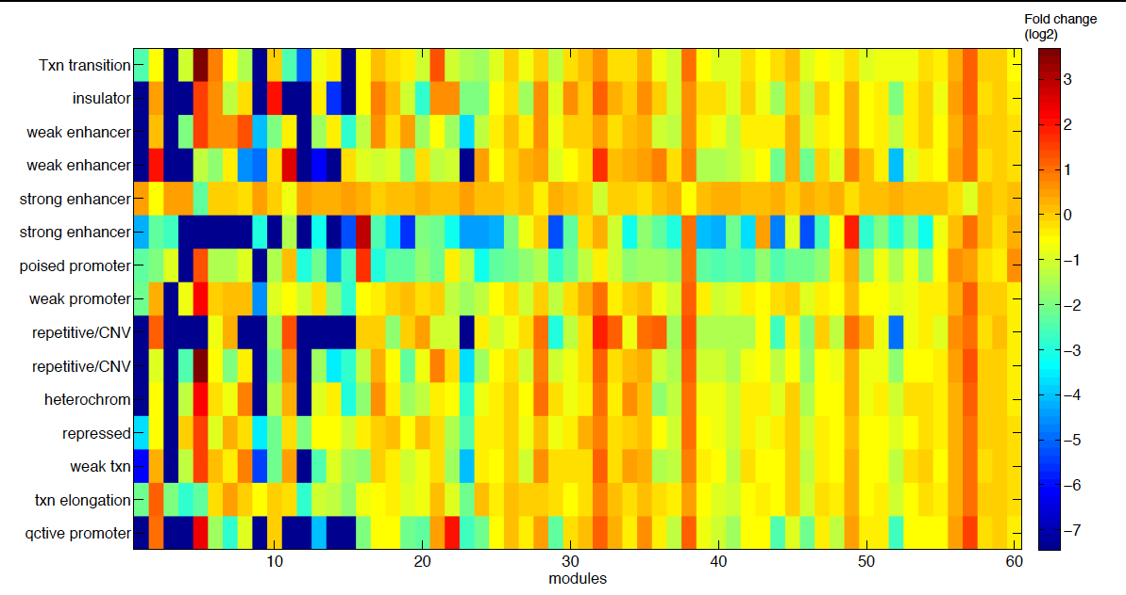
Chromatin features in different sub-compartments
ENCODE 2 chromatin states (K562) found by HMM

Slide 21
Chromatin features in different sub-compartments
ENCODE 2 chromatin states (GM12878) found by HMM
How cell-type specific compartments relate to cell-type specific chromatin states?

