Slide 1
AlleleDB: Allele-specific binding and expression variation in 380 individuals Jieming Chen^{1,2}, Joel Rozowsky^{1,3}, Jason Bedford¹, Arif Harmanci^{1,3}, Alexei Abyzov^{1,3}, Yong Kong¹, Robert Kitchen^{1,3}, Lynne Regan^{1,2,3}, Mark Gerstein^{1,3,4} ¹ Program in Computational Biology and Bioinformatics, ² Integrated Graduate Program in Physical and Engineering Biology, ³Molecular Biophysics and Biochemistry Department, ⁴ Department of Computer Science, Yale University, New Haven, CT 06520, USA

Slide 2
Figure 1. Workflow of AlleleDB.

Slide 3
Table 1. Data sources.

Slide 4
Figure 2. Enrichment by gene parts.

Slide 5
Figure 3. Allele frequency of allele-specific (AS) SNVs compared with the matched non-AS SNVs.

Slide 6
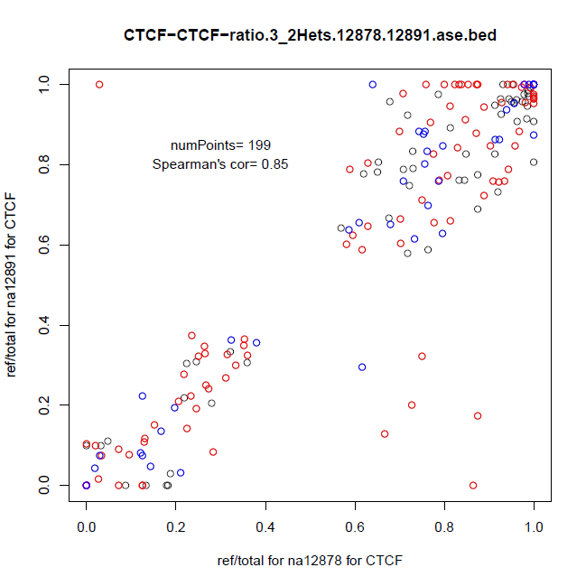
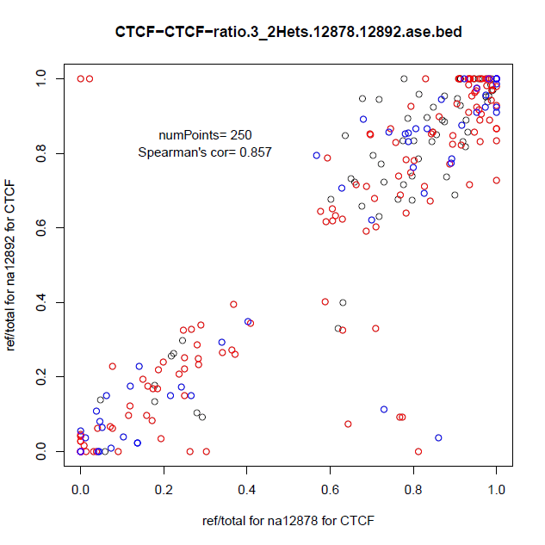
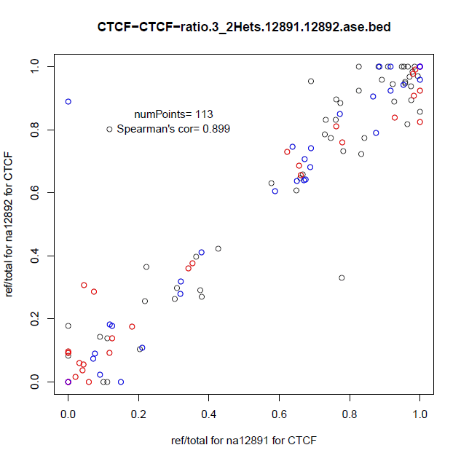
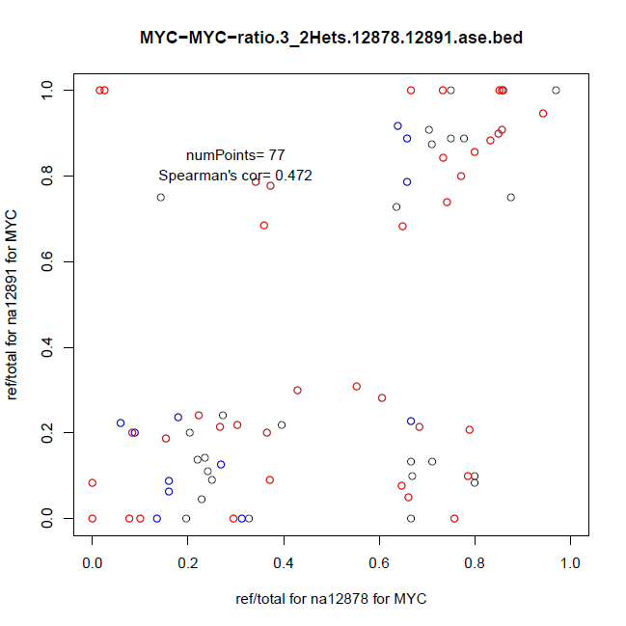
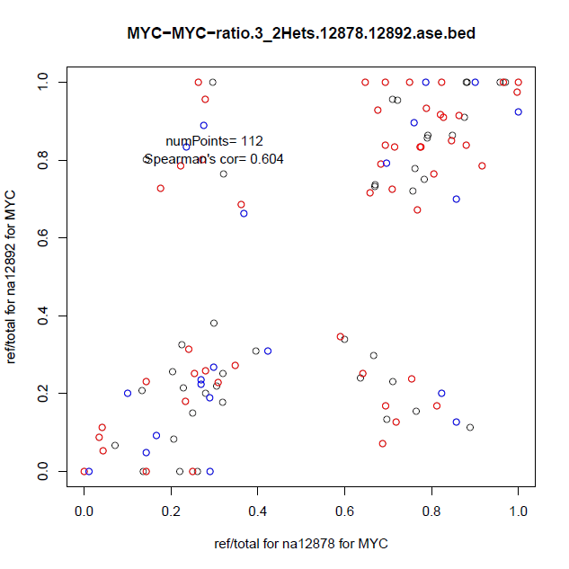
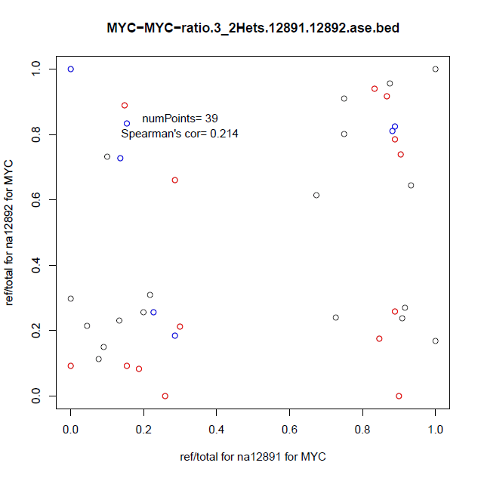
CTCF
Figure 4. ASB inheritance in different TFs in CEU trio
MYC
Child v Pat Child v Mat Pat v Mat

Slide 7
Analysis
Query
Repository
Figure 5. AlleleDB.

Slide 8
Supp figure. Enrichment by gene categories associated with mono-allelic gene expression.

Slide 9
Loss-of-function variants
Premature stop codons and splice site
** gEUVADIS found an enrichment of ASE SNVs in LoF variants
Pursue “Transcriptome/Allelic effects of loss-of-function variants”? → allelic ratios of LoF
Split by premature stop and splice?

Slide 10
Enhancers
Depletion of AS SNVs in enhancers
Not statistically significant except for seg.enh.asb
Any other analyses worth pursuing?
** Kasowski et al. found more variability in seg.enhancers than promoters, in ChIP-seq of chromatin marks and CTCF data

Slide 11
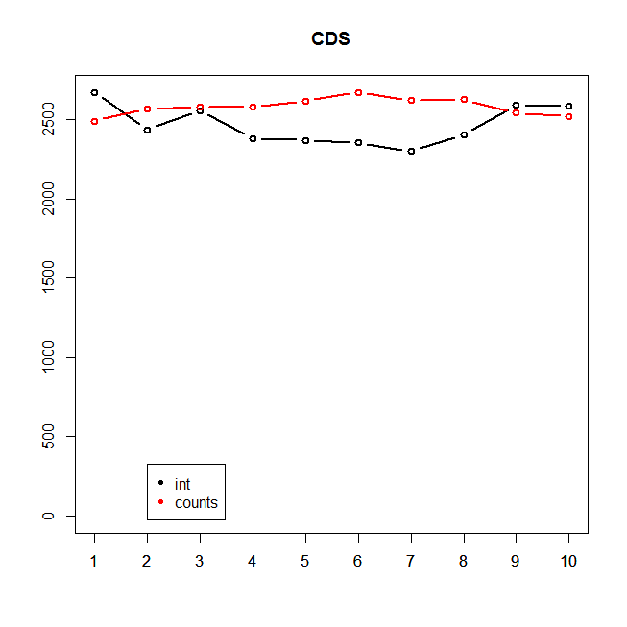
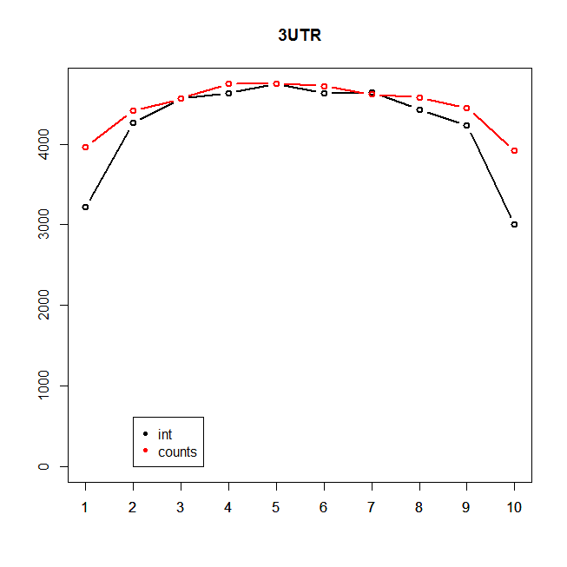
3’ Bias in RNA-seq data
**Note the y axes are different

Slide 12
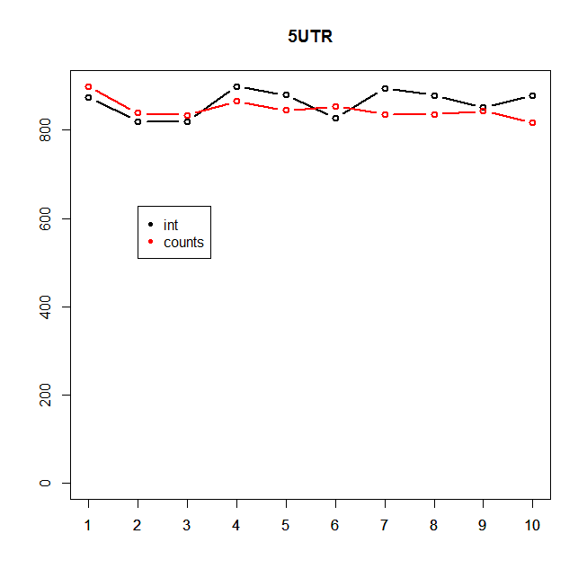
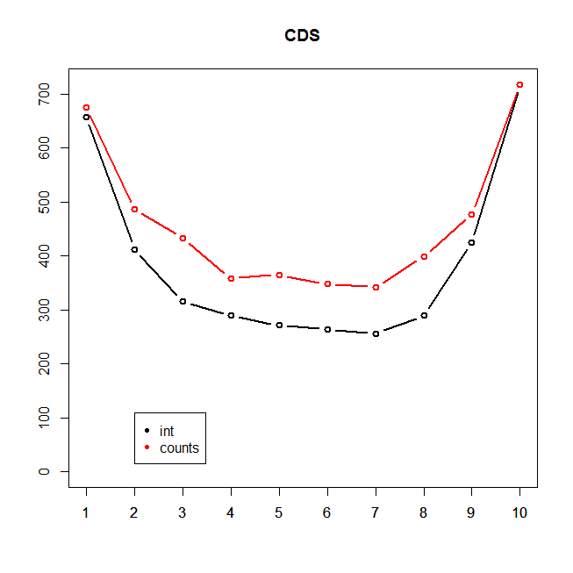
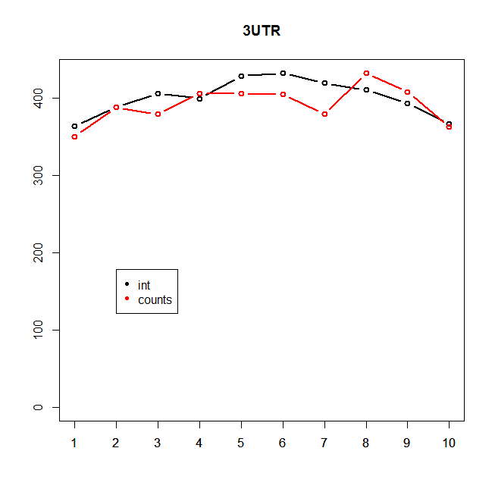
Bias in ChIP-seq data
**Note the y axes are different

