Slide 1
Rotation Presentation
Mohammed Khan
3.17.2014

Slide 2
Background
Genome sequencing → Computational analysis → identify genetic causes of disease.
Difficulty in analysis: separating true positives from false positive.
Notes:
Summary:
-Genome sequencing: advances help cheaply sequence entire genomes → produces massive amount of data;
-computers: analyze data quickly, cheaply, & reliably
-computers to analyze genomic data to identify cancer-driver genes;
-Problem: identifying false positives

Slide 3
My Project – Identify null genes
Question: Can we discover null genes by analyzing non-diseased dataset?
Null genes: potential false positives
Notes:
-Summary: what problem am I addressing, and how am I addressing it

Slide 4
My Project – Identify null genes
How?
Look at different genetic characteristics in 1000 Genomes, and compare it to 31 cancer datasets (e.g. Melanoma, Head & Neck, Uterus, Lung adenocarcinoma, etc.) to see if we can identify null genes.
1000 genomes
Dataset of sequenced exome genomes of 1092 human subjects across 14 populations (East Asian, European, African, etc.)
Notes:
-Summary: be able to identify null genes, used 1000 Genomes to try to establish null genes, compare to cancer datasets

Slide 5
Results
SNV Density
The amount of single mutations in a given length of a gene.
KaKs
Ratio of non-synonymous mutations to synonymous mutations.
False Positives vs. Cancer-drivers
Comparing an identified false positive gene set to 1000 Genomes.
Rare SNVs
Conserved single mutations that can distinguish mutagenic sequences from selected mutations.

Slide 6
Results
SNV Density
The amount of single mutations in a given length of a gene.
KaKs
Ratio of non-synonymous mutations to synonymous mutations.
False Positives vs. Cancer-drivers
Comparing an identified false positive gene set to 1000 Genomes.
Rare SNVs
Conserved single mutations that can distinguish mutagenic sequences from selected mutations.

Slide 7
SNV density
Why:
The similarity in SNV density trend between 1000 Genomes and cancer could be used to differentiate null genes and cancer driver genes.
What:
Correlation between 1000 Genomes and cancer dataset was calculated by comparing the SNV density for each gene in all the datasets.
Notes:
Summary:
-calculate SNV density
-how we calculated SNV density
-why: comparing between 1000 G & cancer gives us better understanding of what differences in cancer can lead to the cancerous phenotype
----- Meeting Notes (3/15/14 23:14) -----
-Spearman: compares the general trend of SNV density between healthy & cancer.
-Reason: see overall trend, cut out genes that do show similar.
----- Meeting Notes (3/15/14 23:30) -----
-show future steps at end

Slide 8
Correlation: Spearman Rho
Cancer Type | P-value (spearman) | Spearman Stat Sig
ALL | 0.8899 | NS
AML | 0.2479 | NS
Bladder | 0.1555 | NS
Breast | 0.01089 | 0.02511277
Cervix | 0.3267 | NS
CLL | 0.1844 | NS
Colorectum | 0.009286 | 0.02275337
Esophageal | 6.15E-05 | 0.04767969
Glioblastoma | 0.1257 | NS
Glioma Low Grade | 0.0005826 | 0.03987819
Head and Neck | 0.0002819 | 0.03497883
Kidney Chromophobe | 0.9082 | NS
Kidney Clear Cell | 0.9469 | NS
Kidney Papillary | 0.1571 | NS
Liver | 0.7482 | NS
Lung Adeno | 2.20E-16 | 0.1082819
Lung Small Cell | 1.31E-06 | 0.0647506
Lung Squamous | 2.20E-16 | 0.08570654
Lymphoma B-cell | 0.3341 | NS
Medulloblastoma | 0.4836 | NS
Melanoma | 2.20E-16 | 0.2153476
Myeloma | 0.7692 | NS
Neuroblastoma | 5.85E-05 | 0.07922083
Ovary | 0.0002894 | 0.04165659
Pancreas | 0.4378 | NS
Pilocytic Astrocytoma | 0.9782 | NS
Prostate | 0.3583 | NS
Stomach | 0.353 | NS
Thyroid | 0.2964 | NS
Uterus | 0.4025 | NS
Notes:
Summary:
-interpretation: heterogeneity in cancers – some more correlated to 1000 G than others
-interpretation: with higher correlation datasets (e.g. melanoma, lung adeno) – more potential null genes in common.
----- Meeting Notes (3/15/14 23:30) -----
-talk more about interpretation of dataset: dataset with correlation – perhaps can find potential null genes in these datasets.
-further suggestive steps: with weak correlation, may want to look at subclasses of genes.
-transition into KaKs calculation

Slide 9
Summary of SNV Density
SNV density showed a possible correlation between 1000 Genomes and Melanoma (0.21), Lung Adeno (0.108), and Lung Squamous (0.085)
Genes with strong correlation in 1000 genomes compared to cancer sets would be possible false positives
Possible caveats: The calculation of entire genome trends may mask possible correlations between healthy and cancer genomes.

Slide 10
Results
SNV Density
The amount of single mutations in a given length of a gene.
KaKs
Ratio of non-synonymous mutations to synonymous mutations.
False Positives vs. Cancer-drivers
Comparing an identified false positive gene set to 1000 Genomes.
Rare SNVs
Conserved single mutations that can distinguish mutagenic sequences from selected mutations.

Slide 11
KaKs
Why:
The KaKs value takes into account whether the mutations are nonsynonymous or synonymous.
The distribution of KaKs values gives insight into the types of selection forces present in each dataset - purifying selection, neutral selection, or positive selection.
What:
KaKs = (NS mutations/NS sites) / (Syn mutations/Syn sites)
Calculated the KaKs for each gene in all datasets (1000 Genomes & cancer dataset) & plotted the histogram for each dataset.
Notes:
----- Meeting Notes (3/15/14 23:30) -----
-Summary: what is the KaKs, how NS & S sites calculated, what =1, <1, & >1 mean
----- Meeting Notes (3/15/14 23:38) -----
-for results, show 1000 G, melanoma, lung adeno, colorectum,

Slide 12
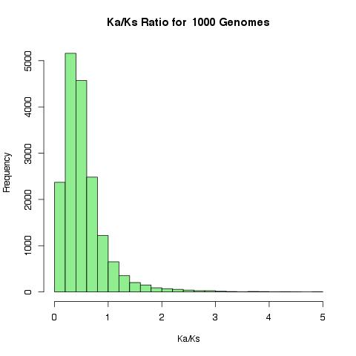

Slide 13
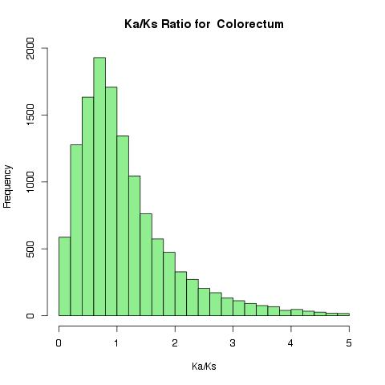

Slide 14
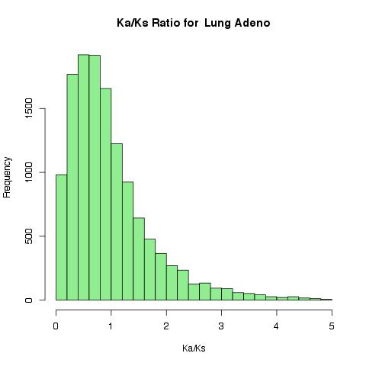

Slide 15
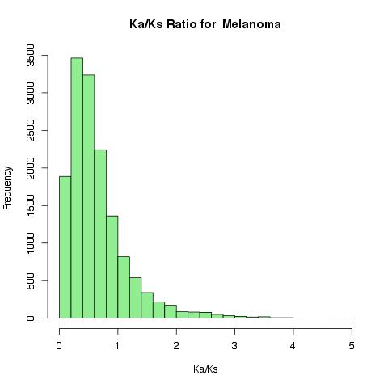

Slide 16
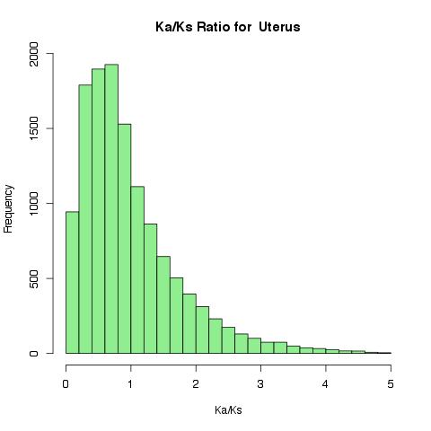

Slide 17
Simulated KaKs
Why:
Since many of the cancer datasets showed KaKs < 1 (purifying selection), would random mutations lead to neutral evolution (KaKs = 1)?
What:
Simulate random mutations in made in a dataset of genes and calculate the KaKs.
Notes:
Summary
-KaKs < 1 in actual data, is that the same as with random mutations

Slide 18
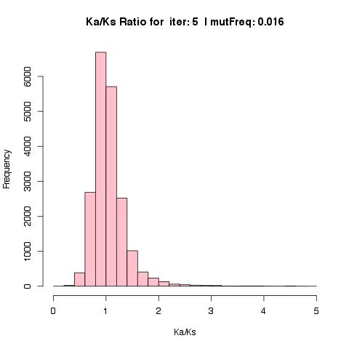

Slide 19
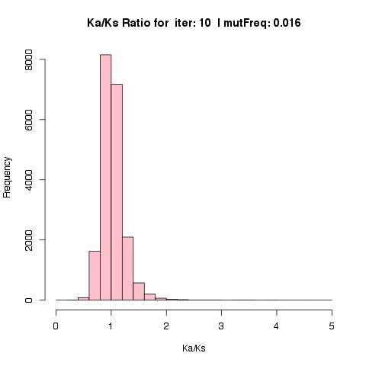

Slide 20
Summary – KaKs
Comparing the KaKs between the actual datasets and simulated KaKs, the actual datasets do not show a random mutation pattern.
Comparing 1000 Genomes to the cancer datasets, the tail end of the cancer datasets are longer. This means more genes are positively selected for in cancers.
1000 Genomes dataset does have genes with KaKs > 1. These genes could be null genes.
Notes:
----- Meeting Notes (3/15/14 23:56) -----
-longer tail in cancer datasets - implies that cancer has more AA changing mutations.
----- Meeting Notes (3/16/14 00:03) -----
-further investigation - look into genes in cancer with KaKs > 1 as there are more in cancer than in 1000 G. Maybe even subtract out KaKs > 1 in 1000 G as these would not be cancer-drivers

Slide 21
Results
SNV Density
The amount of single mutations in a given length of a gene.
KaKs
Ratio of non-synonymous mutations to synonymous mutations.
False Positives vs. Cancer-drivers
Comparing an identified false positive gene set to 1000 Genomes.
Rare SNVs
Conserved single mutations that can distinguish mutagenic sequences from selected mutations.

Slide 22
False Positives in Current Datasets
Using current analytical methods Lawrence et al. identified 450 genes as potential cancer drivers in Lung Squamous.
Some identified seemed as implausible cancer-drivers, including olfactory genes.
A new algorithm was designed to consider mutational heterogeneity when identifying cancer-driver genes.
11 of the 450 genes passed mutational heterogeneity test.
Lawrence, M. S. et al. (2013). Mutational heterogeneity in cancer and the search for new cancer-associated genes. Nature, 499(7457), 214–8. doi:10.1038/nature12213
Notes:
-current analytical methods: set mutational background frequency “mu”,
-mutational heterogeneity: mutational frequency background, type of base mutation (C to T, C to A, etc.), intragenomic

Slide 23
1000 Genomes vs. MutSig datasets
Why:
Could the false positive dataset have a higher distribution of SNVs compared to the non-diseased dataset?
What:
We compared the distribution of SNV density in the 439 false positives and the 11 cancer-driver genes to the 1000 Genomes to identify a shift in that distribution.
Lawrence, M. S. et al. (2013). Mutational heterogeneity in cancer and the search for new cancer-associated genes. Nature, 499(7457), 214–8. doi:10.1038/nature12213

Slide 24
1000 Genomes vs. MutSig datasets
"Wilcox value for 11 genes”
W = 123287.5, p-value = 0.9192
alternative hypothesis: true location shift is less than 0
"Wilcox value for 439 genes”
W = 3003926, p-value = 1.152e-12
alternative hypothesis: true location shift is less than 0
Notes:
----- Meeting Notes (3/16/14 00:40) -----
-Summary: compare false & true positives, though we see distribution shift may need to compare other false & true positive sets
-QUES: how was 11 genes identified?!?!? – look at page 16 of supplementary info, Method S3
-QUES: 450 genes calculated?? – look at page 16 of supplementary info, Method S2
-not a definitive result, will need to compare more false positive & true positive results to verify this technique of Mann-Whitney U.

Slide 25
1000 Genomes vs. MutSig datasets
The SNV density distribution in the 439 false positive is greater than in the 1000 genomes.
False positive dataset showed higher SNV Density in non-diseased samples, but not cancer drivers genes identified by MutSig CV.
Genes that show higher SNV distribution in 1000 Genomes could be null genes.
May need to repeat this for other known true & false positives dataset for further validation.
Notes:
----- Meeting Notes (3/16/14 00:40) -----
-Summary: result, Caveat - will need to repeat this for known true & false positives.

Slide 26
Results
SNV Density
The amount of single mutations in a given length of a gene.
KaKs
Ratio of non-synonymous mutations to synonymous mutations.
False Positives vs. Cancer-drivers
Comparing an identified false positive gene set to 1000 Genomes.
Rare SNVs
Conserved single mutations that can distinguish mutagenic sequences from selected mutations.

Slide 27
Rare SNVs
Why:
To distinguish between mutagenic sequences and selected mutations, we look at the rare SNVs in each gene.
What:
Calculated the rare nonsynonymous SNVs for each gene in 1000 Genomes to see which genes show a deviation in rare NS-SNV trend.
Notes:
----- Meeting Notes (3/16/14 01:13) -----
-Summary: what we do (look at rare SNVs), why we do it (separate out confounding effect of mutagenicity & selection)

Slide 28
Cook’s Distance

Slide 29
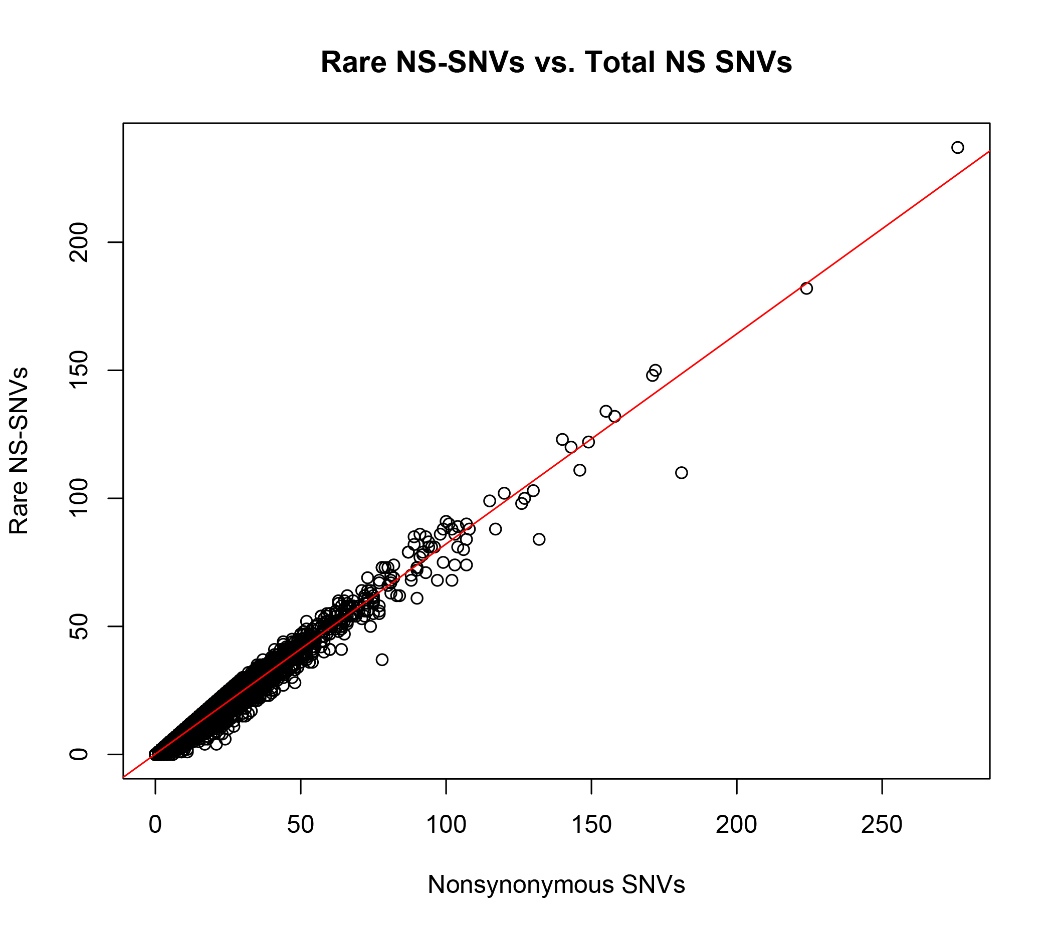

Slide 30
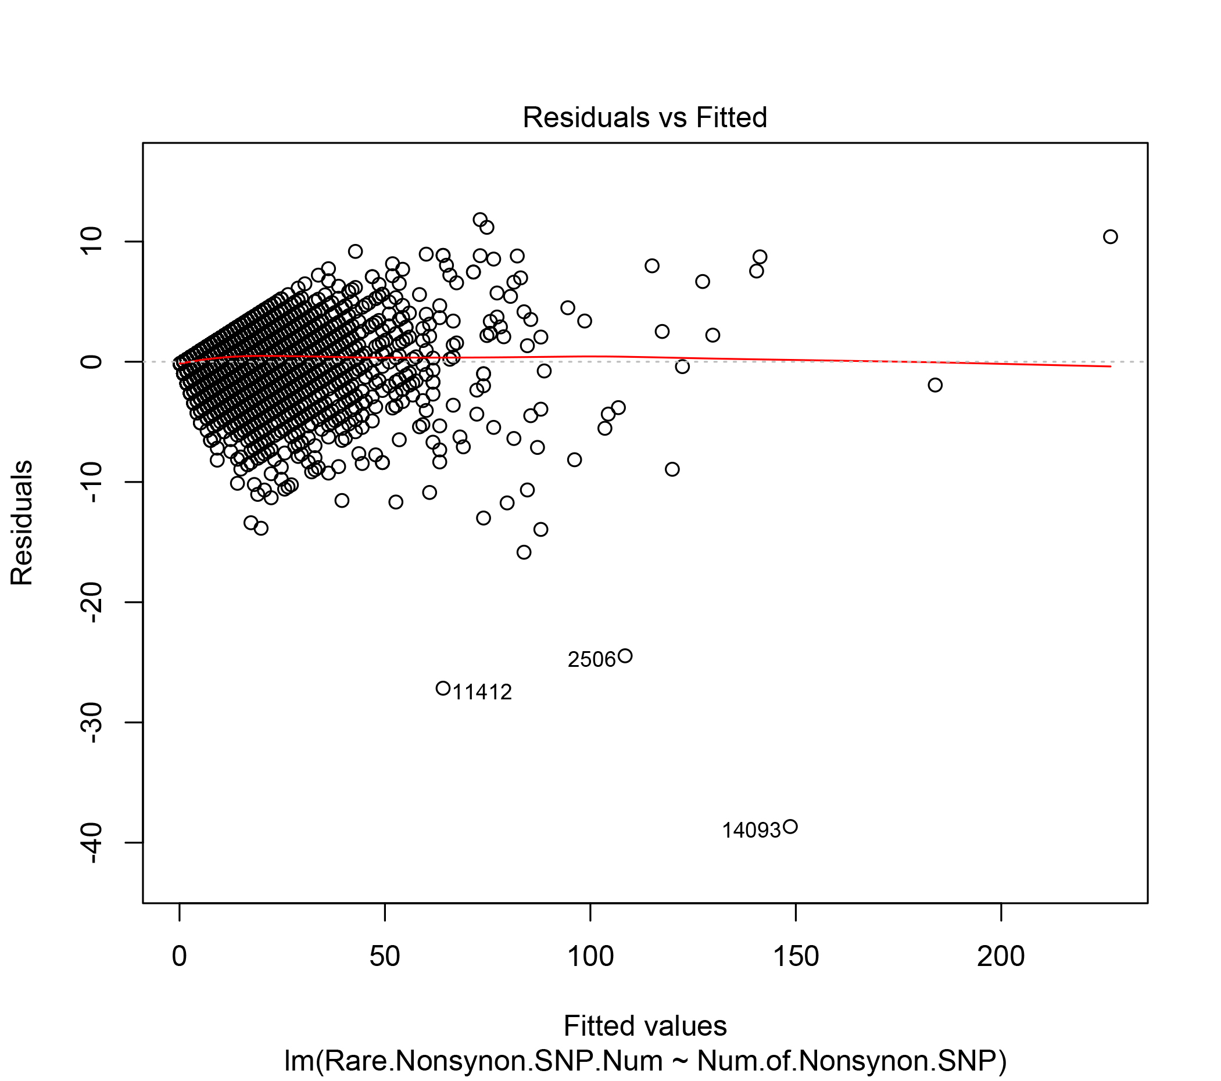

Slide 31
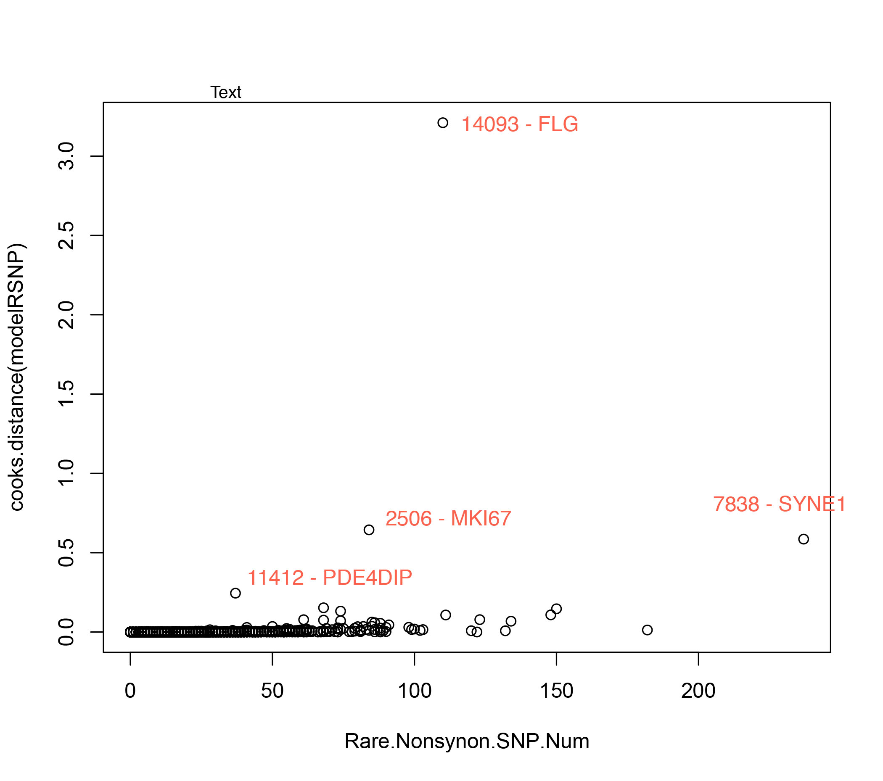

Slide 32
Identifying Outlier Genes
FLG – Epidermal Filaggrin (in 439 genes in MutSig 1.0 Algorithm)
Intermediate filament-associated protein.
Mutations – associated with ichthyosis vulgaris.
MKI67 – Proliferation-Related Ki67 Antigen
Gene encodes a nuclear protein that is associated with cellular proliferation
PDE4DIP – Cardiomyopathy-associated protein
Gene encodes protein that anchors phosphodiesterase 4D to Golgi/centrosome region of cell.
Defects could lead to myeloproliferative disorder.
SYNE1 – Spectrin-repeat protein
Gene encodes protein expressed in skeletal & smooth muscle that localizes to nuclear membrane.
Mutations could lead to autosomal recessive cerebellar ataxia type 1.

Slide 33
Summary to Rare SNVs
This technique can be used to identify null genes by separating the effects of mutagenicity and selection.
Found one of these genes (FLG) is in the false positive dataset.

Slide 34
Interpretation/Future Directions
SNV Density
Observed weak correlation between 1000 Genomes and cancer dataset. We can look at the similarities between these datasets to identify potential null genes.
KaKs
Observed genes in 1000 Genomes with KaKs > 1 in tail of histograms. These genes could be null genes.
False Positives vs. Cancer-Drivers
Observed a distribution difference between 1000 Genomes & 439 false positives. Perhaps we can use this technique to identify null genes by seeing enrichment of higher SNV Density.
Rare SNVs
By separating mutagenic sequences from selected mutations, one of the genes identified was in the 439 false positives gene list.
Will need to find other characteristics to identify null genes.

Slide 35
Acknowledgements
Mark Gerstein & Frank Slack
Ekta Khurana
Yao Fu
Entire Gerstein lab

