Slide 1
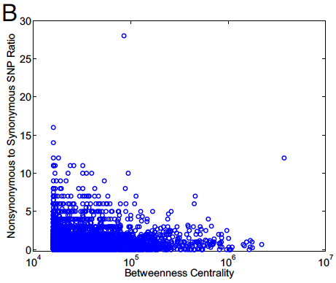
Tinkering versus Design: Connectivity and Constraint
More Connectivity, More Constraint : A theme borne out in many evolutionary studies of biological network
  Centrality is correlated with variation in technological systems, Reusable components need to be constantly fine-tuned
r=-0.1, P=4x10⁻⁴
r=0.29, P=3x10⁻⁹⁷
Kim et a. PNAS 2007
Yan KK et al. PNAS 2010
Notes:
We further look at where are the guys that required tweaking in the network? A theme borne out in many evolutionary studied of biological network is, more connectivity, more constraint. One of the first paper is by Fraser, studied the relationship between the number of interacting partners, and the rate of evolution, measured by number of substitution per site. The more substitution, the faster is the evolution. The observation is, they are negatively correlated. The intuition is, being related to many others, it all sort of constraint and forbid a fast evolution. In the case of Linux, the situation is exactly opposite. Degree is positively correlated with the rate of evolution. This is essentially how an intelligent designer works. Hubs, more useful, more central of the networks, require more fine-tune.

