Slide 1
About the ERCP Consortium
Joel Rozowsky
GPMTG
Mar 11, 2014

Slide 2
Extracellular RNA
From Wikipedia, the free encyclopedia
Extracellular RNA (also known as exRNA or exosomal RNA) describes RNA species present outside of the cells from which they were transcribed. In Homo sapiens, exRNAs have been discovered in bodily fluids such as venous blood, saliva, breast milk, urine, semen, menstrual blood, and vaginal fluid. Although their biological function is not fully understood, exRNAs have been proposed to play a role in a variety of biological processes including syntrophy, intercellular communication, and cell regulation. Due to their potential biological and clinical significance, the National Institutes of Health published in 2012 a Request for Applications (RFA) for investigating extracellular RNA biology. The Extracellular Communication program is supported by the NIH Common Fund, and offers grants towards exRNA based research.

Slide 3
Extracellular RNA Communication Program

Slide 4
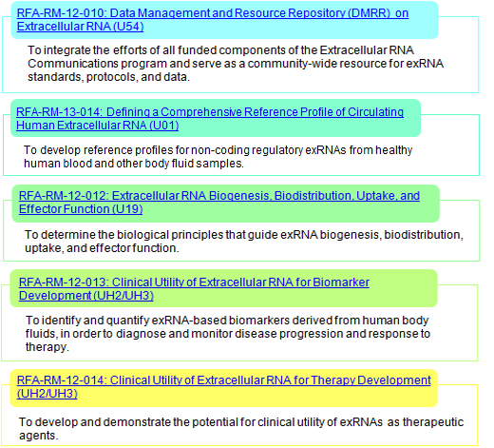
Us
In Review
Funded

Slide 5
Data Management and Resource Repository
(DMRR)
Data Coordination and Component (DCC)
  Aleks Milosavljevic (Baylor)
Scientific Outreach Component (SOC)
  David Galas (PNDR)
Data Integration and Analysis Component (DIAC)
  Mark Gerstein (Yale)

Slide 6
Extracellular RNA Biogenesis, Biodistribution, Uptake, and Effector Function (U19)

Slide 7
Clinical Utility of Extracellular RNA for Biomarker Development (UH2/UH3)

Slide 8
Clinical Utility of Extracellular RNA for Therapy Development (UH2/UH3)

Slide 9
Working Groups
Sample and Assay Standards (SAS)
Data – Metadata Standards (MADS)
Scientific Outreach (SO)
Resource Sharing (RS)
Us

Slide 10
Role of the DIAC
Provide analysis expertise to the consortium
Develop RNA-Seq analysis tools that are useful for the consortium
Help DCC implement the tools we develop on the Genboree Workbench website for members of the consortium to use
Help with integrated consortium wide analyses
  important to have common analysis pipelines for integrated analyses

Slide 11
Genboree.org Workbench

Slide 12
Activities of DIAC
Developed a long RNA-Seq analysis pipeline
  Makes use of the tool RSeqTools developed in Gerstein Lab

Slide 13
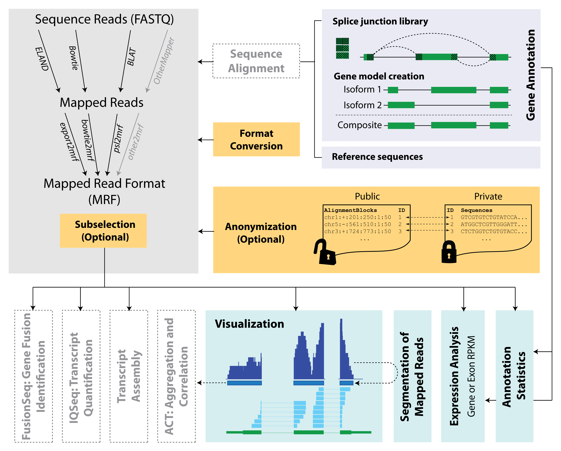
RSeqTools is a modular and flexible framework to perform common RNA-Seq analysis tasks
RSEQtools
Habegger et al., Bioinformatics, 2010

Slide 14
Mapped Read Format
Mapped Read Format (MRF)
  Compact data summary format for short and long read alignments
  Enables the anonymization of confidential information
  Still possible to carry out most functional genomics analyses
MRF flat file consists of three components
  Comment lines
  Header line
  Mapped reads (alignment blocks, sequences, quality scores, queryID)
Habegger et al., Bioinformatics, 2010

Slide 15
RSeqTools Implemented at Genboree.org
Sai Lakshmi (Baylor)

Slide 16
long RNA-Seq analysis pipeline
Current implemented pipeline:
  Generates genome-wide signal maps (hg18/19) as well as gene level expression quantifications (RPKM) for UCSC known genes.
Further functionality of RSeqTools which could be implemented:
  Expression measurements (RPKMs)
    Transcripts, exons, novel transcribed regions
  Transcript fusion detection
  Splice junctions
    Transcript isoforms
  Identification of non-coding RNAs
  Aggregation and correlation of signal tracks

Slide 17
Activities of DIAC
Developed a long RNA-Seq analysis pipeline
  Makes use of the tool RSeqTools developed in Gerstein Lab
  Implemented by DCC at Genboree.org
Developed a small exRNA analysis pipeline

Slide 18
sm-exRNA-Seq Analysis Pipeline
Courtesy of Rob Kitchen

Slide 19
small exRNA-Seq analysis pipeline
smallRNA analysis has several distinct considerations compared to long-RNAseq
pre-processing: remove adapter & primer sequences
contaminants: no poly-A purification leaves rRNAs, etc
mapping: small reads tend to multi-map to large genomes
diversity: many species of small RNA (not just miRNAs!)
quantification: different normalisation

Slide 20
sm-ex-exRNA considerations
would be nice to also assess small exogenous exRNAs
(sm-ex-exRNA):
pipeline should therefore quantify smallRNAs (in order):
1) endogenous
2) plants
3) viruses
4) bacteria/archea

Slide 24
Output
read-length distribution for QC
endogenous mapping results (rRNA, miRNA, tRNA, snoRNA, piRNA, Rfam)
exogenous mapping results (plant & virus miRNAs in miRBase)
4 files containing sequence reads following adapter-removal, rRNA removal, endogenous mapping, and exogenous mapping

Slide 25
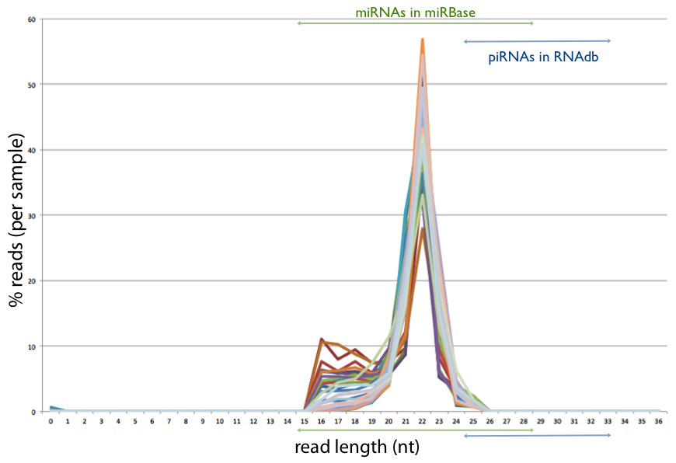
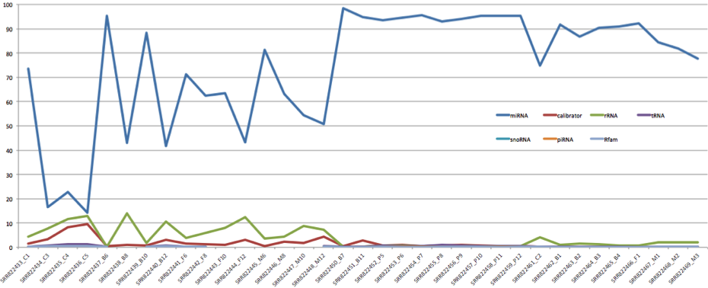
QC of output
from pipeline
(exRNA-Seq data
From Tuschl Lab)
Length distribution
Mapping summary

Slide 26
Activities of DIAC
Developed a long RNA-Seq analysis pipeline
  Makes use of the tool RSeqTools developed in Gerstein Lab
  Implemented by DCC at Genboree.org
Developed a small exRNA analysis pipeline
Draft document describing analysis needs of consortium (need your feedback)

Slide 27
Feedback from the Consortium
Are the tools we are developing useful?
  hands on demo’s at May consortium meeting
Solicit more participation on Metadata Standards and Data Analysis working group to discuss analysis issues
What further analysis tools do people need?
  Differential expression tools?
Contact me if you would like to discuss how the DIAC can help you with your analysis:
      joel.rozowsky@yale.edu

Slide 28
Acknowledgements
Mark Gerstein
  Rob Kitchen
  Anurag Sethi
  Cristina Sisu
Aleks Milosavljevic (Baylor)
  Sai Lakshmi

