Slide 1
Variation Meeting
Mohammed Khan
2.25.2014

Slide 2
Outline
SNV Density in 1000 Genomes and cancer data sets
Ka/Ks in 1000 Genomes and cancer data set

Slide 3
SNV Density
Why look at SNV Density?
Compare overall mutation rate between normal (1000 Genomes) to cancer data sets by comparing the SNV density.
How did I calculate?
Counted # of SNVs per gene
SNV Density = (# of SNVs)/(gene length)

Slide 4
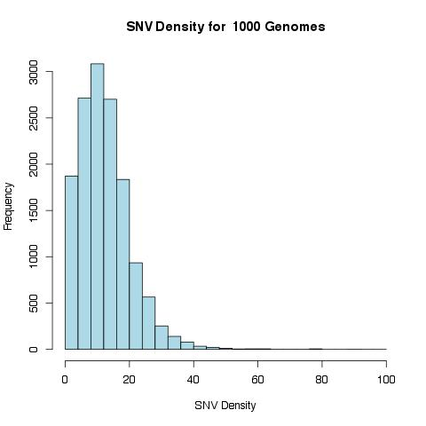

Slide 5
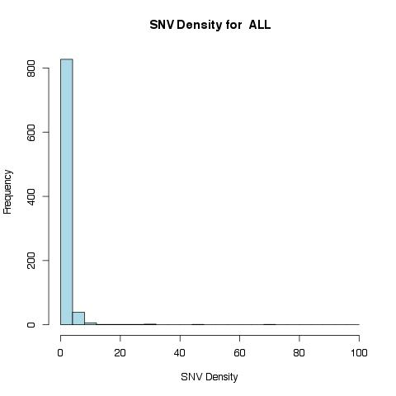
Nonsynonymous | 1128
removedStop | 2
Synonymous | 224
prematureStop | 95
spliceOverlap | 4

Slide 6
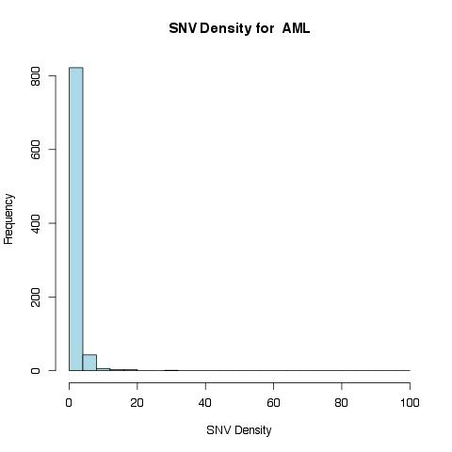
Nonsynonymous | 1009
removedStop | 4
Synonymous | 355
prematureStop | 79
spliceOverlap | 9

Slide 7
Nonsynonymous | 23675
removedStop | 54
Synonymous | 9200
prematureStop | 2170
spliceOverlap | 503

Slide 8
Nonsynonymous | 30798
removedStop | 14
Synonymous | 9895
prematureStop | 2389
spliceOverlap | 170

Slide 9
Nonsynonymous | 4769
removedStop | 1
Synonymous | 1892
prematureStop | 474
spliceOverlap | 7

Slide 10
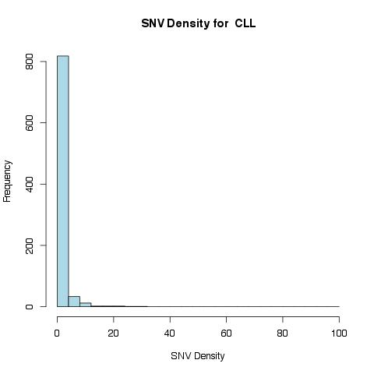
Nonsynonymous | 1093
removedStop | 169
Synonymous | 326
prematureStop | 107
spliceOverlap | 16

Slide 11
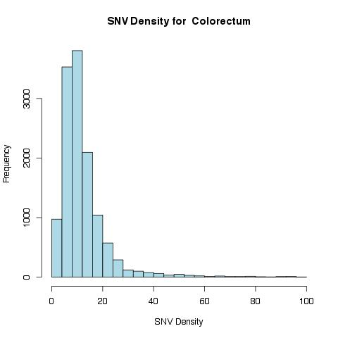
Nonsynonymous | 136193
removedStop | 21
Synonymous | 39487
prematureStop | 11033
spliceOverlap | 278

Slide 12
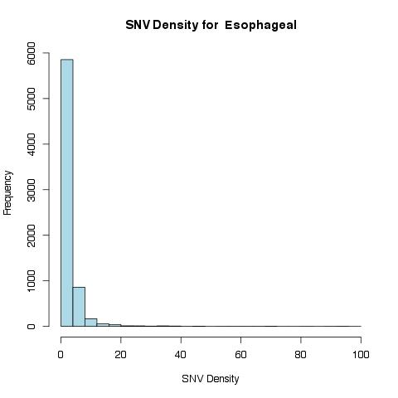
Nonsynonymous | 15159
removedStop | 14
Synonymous | 5231
prematureStop | 850
spliceOverlap | 297

Slide 13
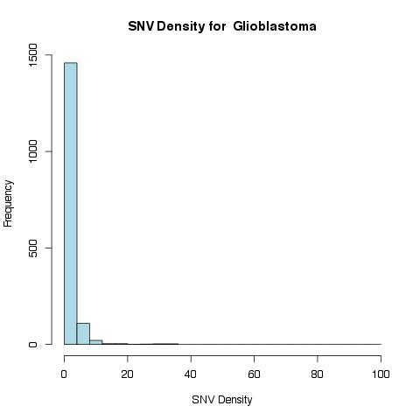
Nonsynonymous | 2130
removedStop | 58
Synonymous | 1018
prematureStop | 122
spliceOverlap | 4

Slide 14
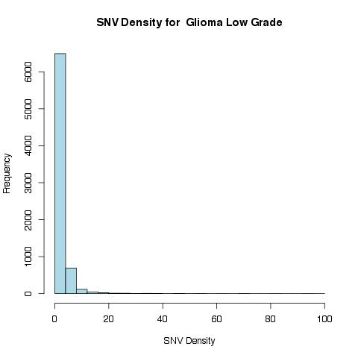
Nonsynonymous | 13658
removedStop | 3
Synonymous | 4977
prematureStop | 887
spliceOverlap | 369

Slide 15
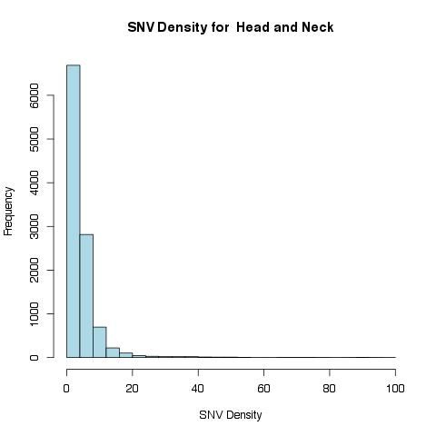
Nonsynonymous | 37167
removedStop | 30
Synonymous | 13805
prematureStop | 2977
spliceOverlap | 117

Slide 16
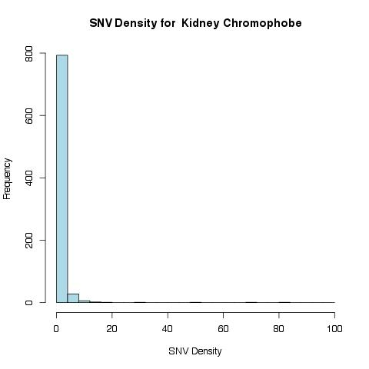
Nonsynonymous | 825
removedStop | 2
Synonymous | 359
prematureStop | 60
spliceOverlap | 33

Slide 17
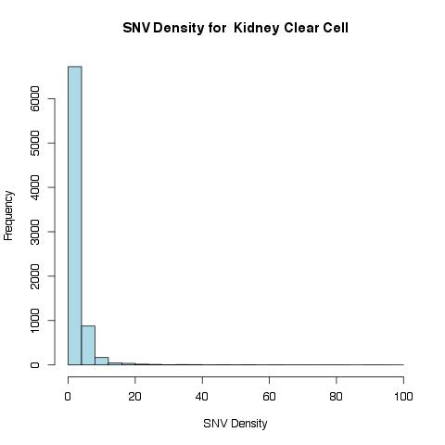
Nonsynonymous | 16054
removedStop | 13
Synonymous | 5663
prematureStop | 1052
spliceOverlap | 49

Slide 18
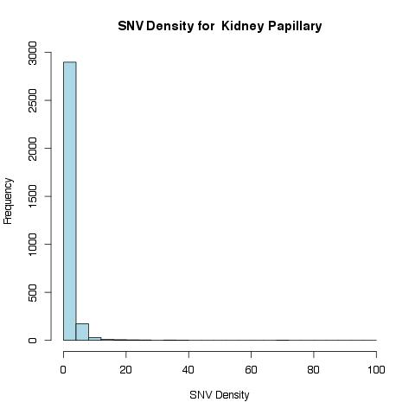
Nonsynonymous | 3763
removedStop | 183
Synonymous | 1325
prematureStop | 213
spliceOverlap | 20

Slide 19
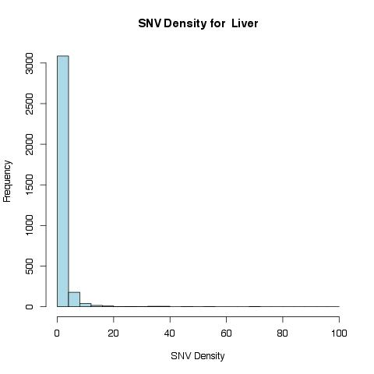
Nonsynonymous | 4479
removedStop | 23
Synonymous | 1547
prematureStop | 262
spliceOverlap | 121

Slide 20
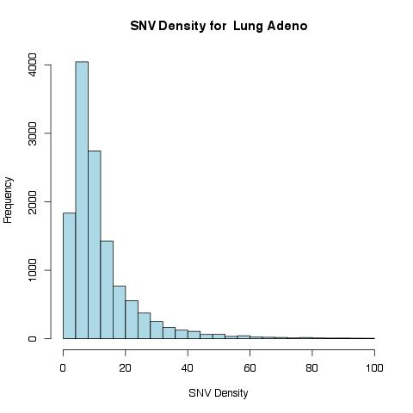
Nonsynonymous | 132415
removedStop | 64
Synonymous | 43695
prematureStop | 10335
spliceOverlap | 616

Slide 21
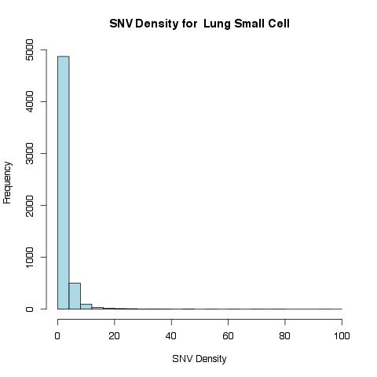
Nonsynonymous | 11045
removedStop | 1
Synonymous | 1633
prematureStop | 804
spliceOverlap | 32

Slide 22
Nonsynonymous | 41369
removedStop | 65
Synonymous | 14569
prematureStop | 3515
spliceOverlap | 122

Slide 23
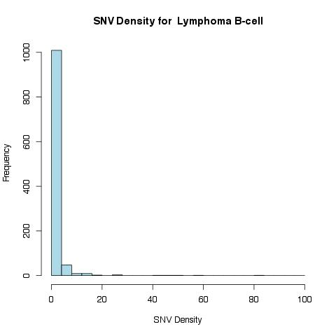
Nonsynonymous | 1492
removedStop | 43
Synonymous | 314
prematureStop | 129
spliceOverlap | 25

Slide 24
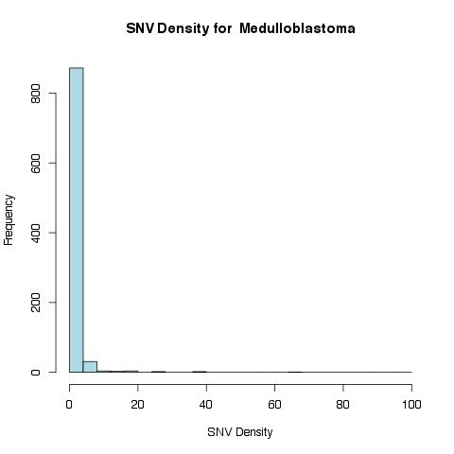
Nonsynonymous | 1037
removedStop | 1
Synonymous | 328
prematureStop | 103
spliceOverlap | 24

Slide 25
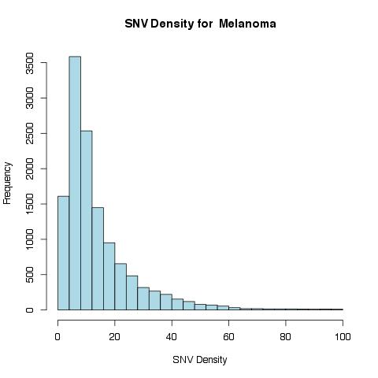
Nonsynonymous | 139304
removedStop | 5
Synonymous | 75024
prematureStop | 8795
spliceOverlap | 264

Slide 26
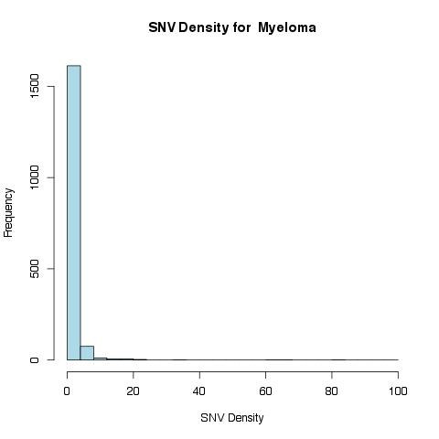
Nonsynonymous | 2116
removedStop | 20
Synonymous | 753
prematureStop | 168
spliceOverlap | 7

Slide 27
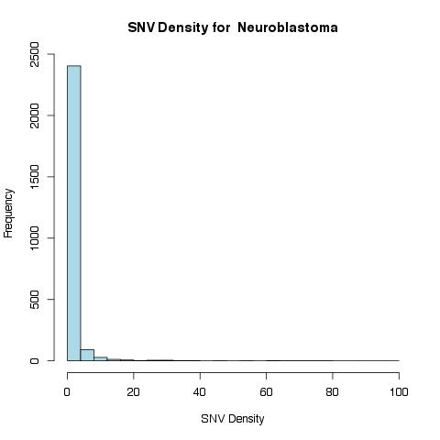
Nonsynonymous | 3245
removedStop | 10
Synonymous | 921
prematureStop | 254
spliceOverlap | 18

Slide 28
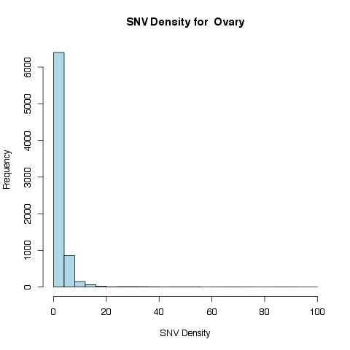
Nonsynonymous | 15366
removedStop | 69
Synonymous | 4686
prematureStop | 932
spliceOverlap | 50

Slide 29
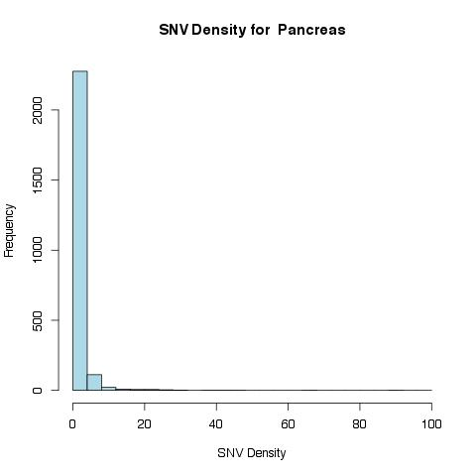
Nonsynonymous | 3069
removedStop | 4
Synonymous | 1072
prematureStop | 207
spliceOverlap | 34

Slide 30
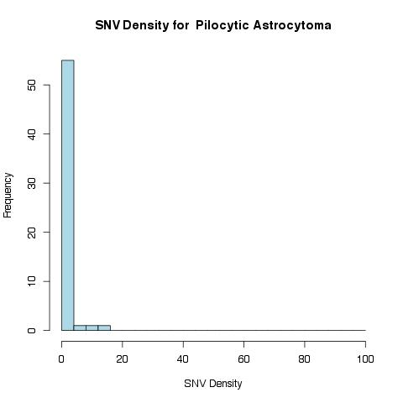
Nonsynonymous | 64
removedStop | 149
Synonymous | 33
prematureStop | 6
spliceOverlap | 2

Slide 31
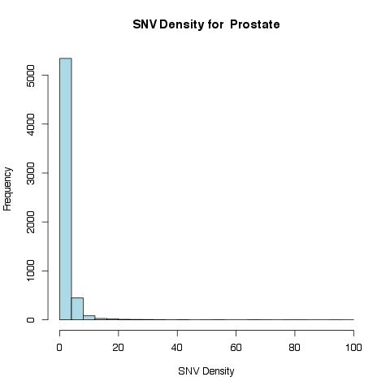
Nonsynonymous | 9538
removedStop | 0
Synonymous | 3465
prematureStop | 602
spliceOverlap | 18

Slide 32
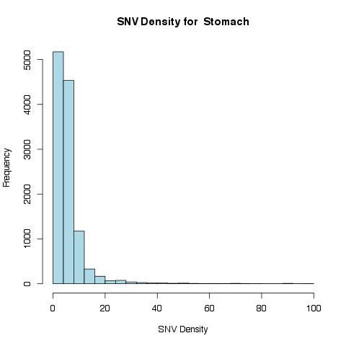
Nonsynonymous | 51609
removedStop | 0
Synonymous | 19953
prematureStop | 2419
spliceOverlap | 187

Slide 33
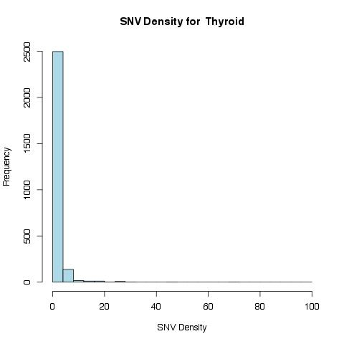
Nonsynonymous | 3217
removedStop | 0
Synonymous | 1236
prematureStop | 174
spliceOverlap | 9

Slide 34
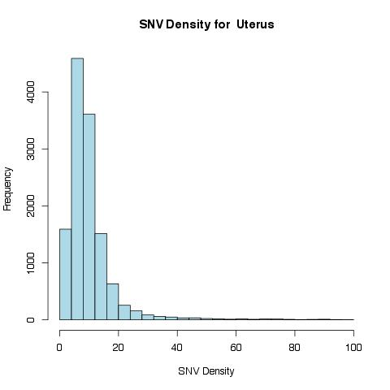
Nonsynonymous | 107132
removedStop | 0
Synonymous | 35299
prematureStop | 10908
spliceOverlap | 301

Slide 35
Correlation: Spearman Rho
Cancer Type | P-value (spearman) | Spearman Rho
ALL | 0.8899 | NS
AML | 0.2479 | NS
Bladder | 0.1555 | NS
Breast | 0.01089 | 0.02511277
Cervix | 0.3267 | NS
CLL | 0.1844 | NS
Colorectum | 0.009286 | 0.02275337
Esophageal | 6.15E-05 | 0.04767969
Glioblastoma | 0.1257 | NS
Glioma Low Grade | 0.0005826 | 0.03987819
Head and Neck | 0.0002819 | 0.03497883
Kidney Chromophobe | 0.9082 | NS
Kidney Clear Cell | 0.9469 | NS
Kidney Papillary | 0.1571 | NS
Liver | 0.7482 | NS
Lung Adeno | < 2.2e-16 | NS
Lung Small Cell | 1.31E-06 | 0.0647506
Lung Squamous | < 2.2e-16 | NS
Lymphoma B-cell | 0.3341 | NS
Medulloblastoma | 0.4836 | NS
Melanoma | < 2.2e-16 | NS
Myeloma | 0.7692 | NS
Neuroblastoma | 5.85E-05 | 0.07922083
Ovary | 0.0002894 | 0.04165659
Pancreas | 0.4378 | NS
Pilocytic Astrocytoma | 0.9782 | NS
Prostate | 0.3583 | NS
Stomach | 0.353 | NS
Thyroid | 0.2964 | NS
Uterus | 0.4025 | NS

Slide 36
SNV Density Interpretation
SNV density does not account for mutation type (nonsynonymous, synonymous, etc.)
Higher nonsynonymous mutations to synonymous mutations in each cancer data set.

Slide 37
Ka/Ks
Why look at Ka/Ks?
Compare mutation rate between nonsynonymous vs. synonymous sitesHow did I calculate?
Ka = (# of nonsynonymous mutations per gene) / (# of nonsynonymous sites per gene)
Ks = (# of synonymous mutations per gene) / (# of synonymous sites per gene)
Note: nonsynonymous = missense + premature stop.

Slide 38
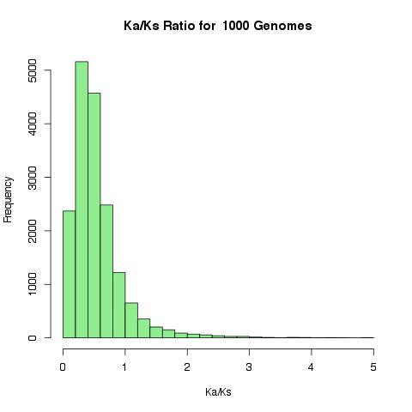

Slide 39
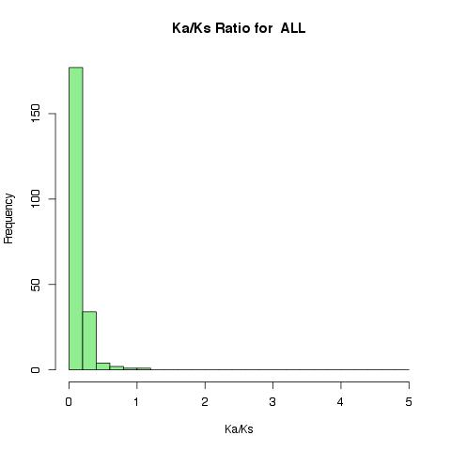

Slide 40
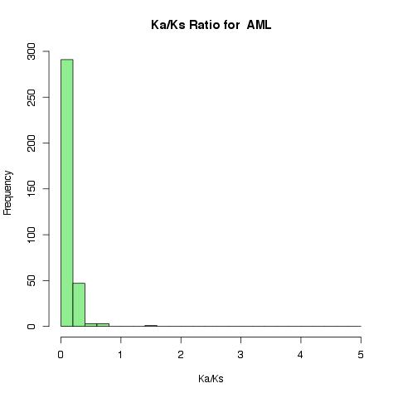

Slide 41
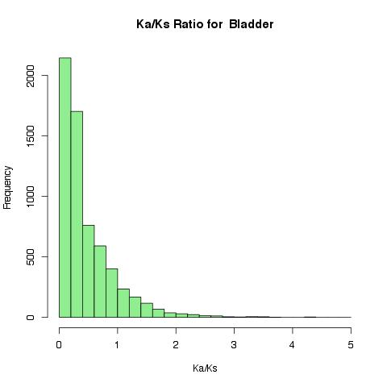

Slide 42
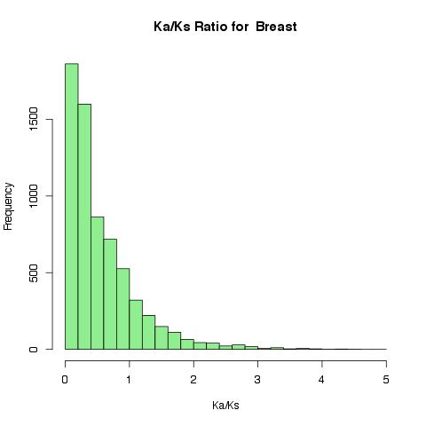

Slide 43
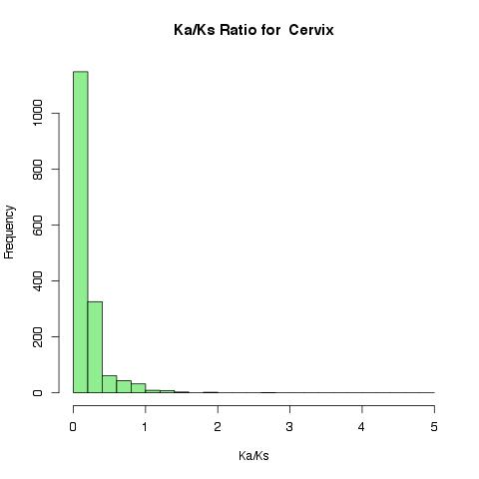

Slide 44
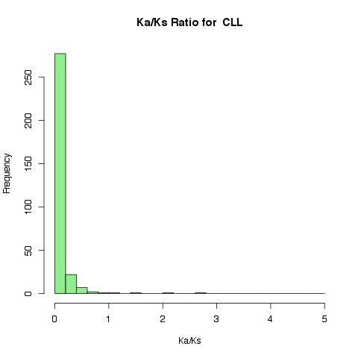

Slide 45
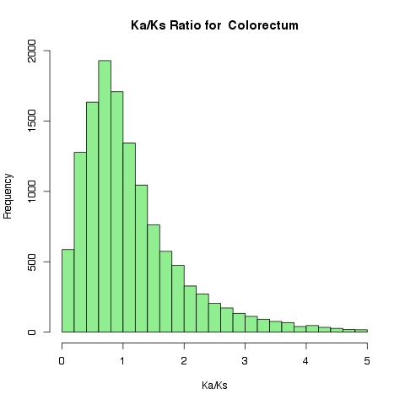

Slide 46
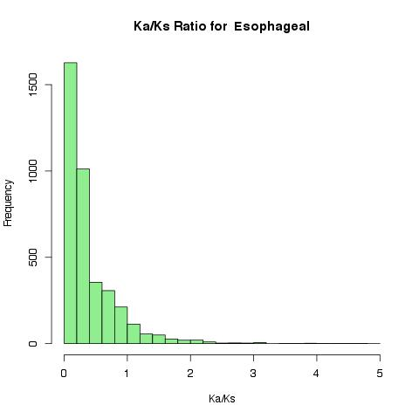

Slide 47
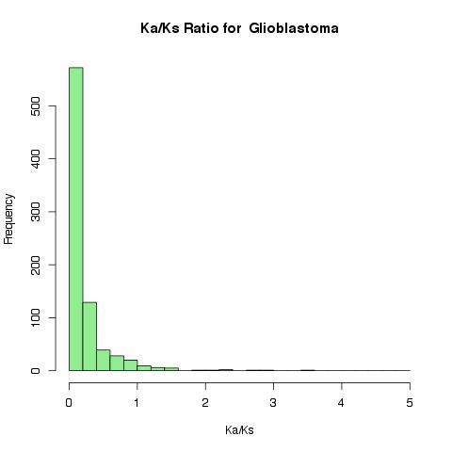

Slide 49
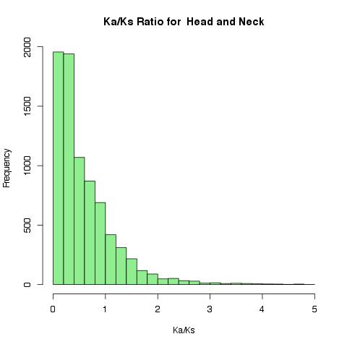

Slide 50
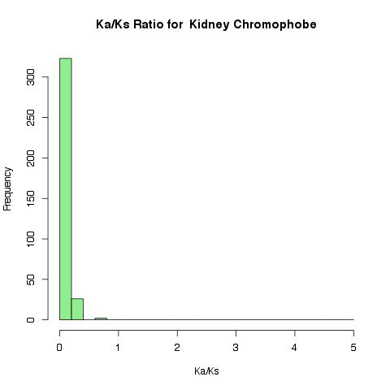

Slide 51
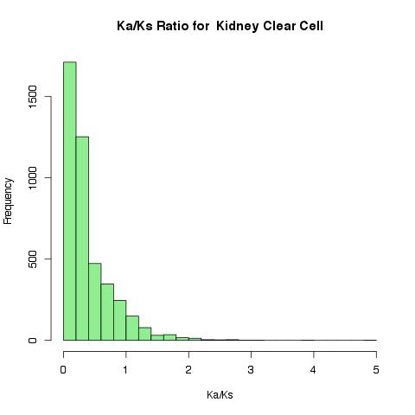

Slide 52
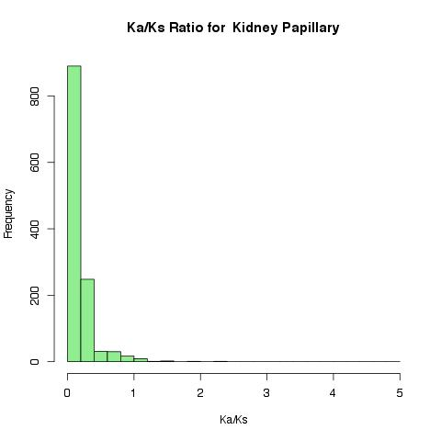

Slide 54
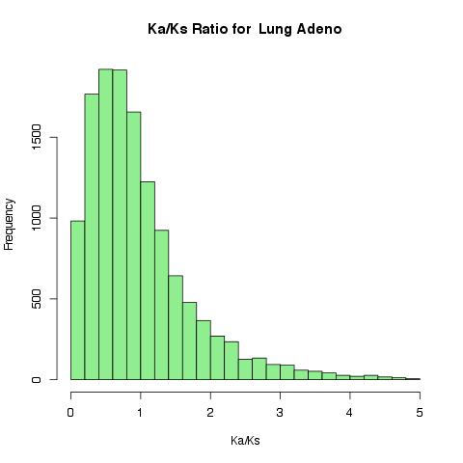

Slide 55
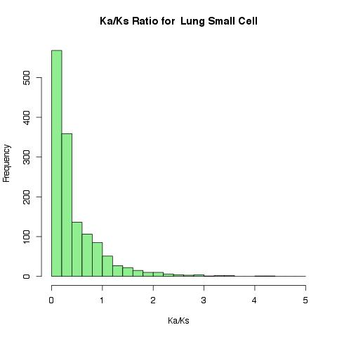

Slide 56
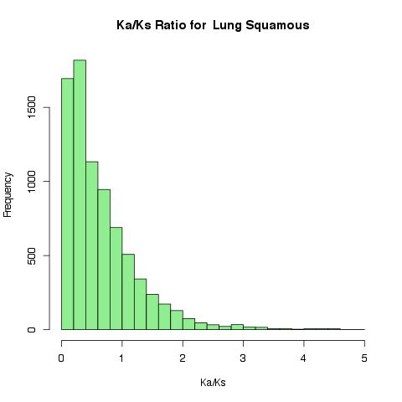

Slide 57
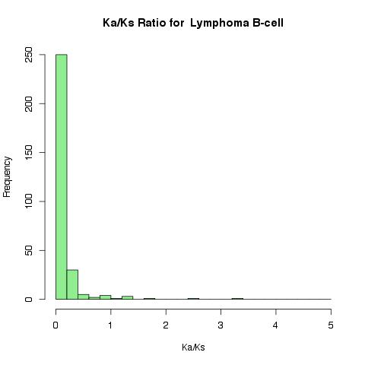

Slide 58
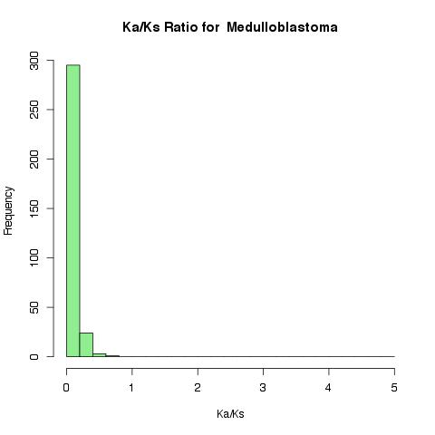

Slide 59
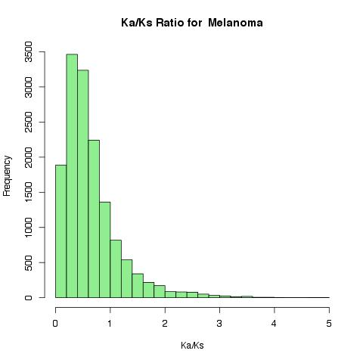

Slide 69
Next Steps
Identify genes with high mutation rate in 1000 Genomes data set, and subtract them from cancer data set to find genes with high mutations in specific cancers.

