Slide 1
ASE SNPs detected in Pseudogenes
Variation
Jieming
25th Feb 2014

Slide 2
Enrichment of ASE SNPs in various elements
AlleleSeq: 130,127 unique het ASE SNPs detected from RNA-seq of 380 individuals
“matched controls” 341,500 “accessible” het SNPs
Enrichment of 954 FIG categories
Acc SNP
ASE SNP
e.g. enhancer

Slide 3
Enrichment
 | Cat | Non-cat
intHets | a | b
accHets | c | d
Fisher’s exact test
-- Odds ratio, hypergeometric p value

Slide 4
All pseudogenes categories

Slide 5
All pseudogenes categories
PG.Processed.Pgene.Ori | 14.6 | 0 | 5135 | 956 | 124992 | 340544
PG.Pgene.Ori | 10.3 | 0 | 6059 | 1618 | 124068 | 339882
PG.Duplicated.Pgene.Ori | 4.8 | 2.83E-98 | 486 | 269 | 129641 | 341231
PG.Transcribed.Processed.Pgene.Ori | 3.9 | 7.95E-34 | 195 | 131 | 129932 | 341369
PG.Transcribed.Duplicated.Pgene.Ori | 3.1 | 1.54E-31 | 243 | 209 | 129884 | 341291
PG.Polymorphic.Pgene.Ori | 1.3 | 0.313692468 | 26 | 53 | 130101 | 341447
PG.Unitary.Pgene.Ori | 0.7 | 0.534081393 | 6 | 23 | 130121 | 341477

Slide 6
FIG/Encode/Ensembl Genomic annotations
954 categories (TFs, enhancers, distal regulatory regions etc.)
Top 7 odds ratio
PG.Processed.Pgene.Ori | 14.6 | 0.00E+00 | 5135 | 956 | 124992 | 340544
PG.Pgene.Ori | 10.3 | 0.00E+00 | 6059 | 1618 | 124068 | 339882
ncRNA.rRNA.Ori | 5.0 | 7.81E-03 | 21 | 11 | 130106 | 341489
PAX5.Proximal | 4.8 | 0.00E+00 | 115328 | 211291 | 14799 | 130209
PG.Duplicated.Pgene.Ori | 4.8 | 2.70E-95 | 486 | 269 | 129641 | 341231
SREBF2 | 3.9 | 6.31E-05 | 39 | 26 | 130088 | 341474
PG.Transcribed.Processed.Pgene.Ori | 3.9 | 7.58E-31 | 195 | 131 | 129932 | 341369

Slide 7
Effects of pseudogenes
Based on unique reads with only max 2 mismatch positions → not multi-mapping (to parent gene) → lead to wrong read counts in parent gene -- mapping of reads to pgenes due to sequencing error -- highly expressed parent gene with too many erroneous reads → actual transcription of transcribed pgenes → compounded if more false het SNPs are detected in pgenes

Slide 8
How do we get accessible het SNPs
In AlleleSeq, each het SNP is tested for a binomial probability.
For each p value, you can get a corresponding FDR, #FP (from simulation) /# actual (P).

Slide 9
How do we get accessible het SNPs
Not all het SNPs are available, simply because there are no reads there -- not accessible
So for a certain p value, -- can we come up with min(N) reads required, -- so that a het SNP is accessible

Slide 10
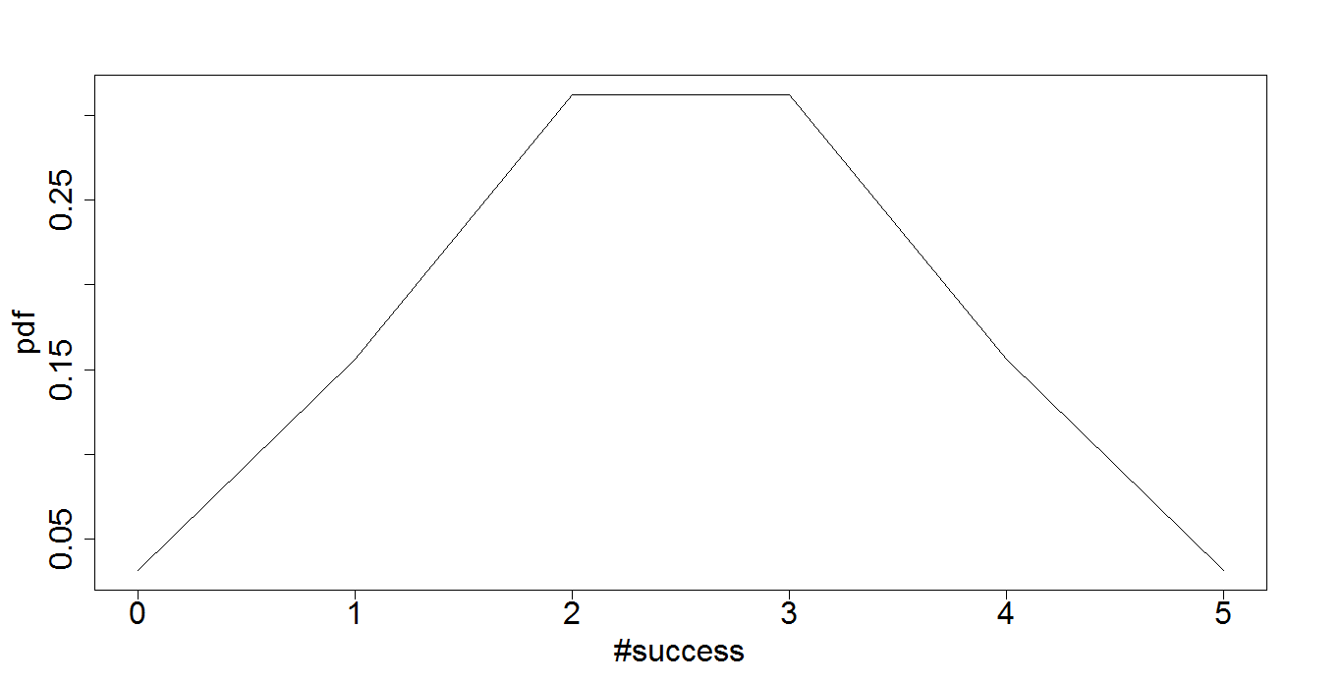
How do we get accessible het SNPs
For a het SNP, if reads, n=5,
n=5
Ref:alt | P val
0:5 | 0.0625
1:4 | 0.3125
2:3 | 0.625
3:2 | 0.625
4:1 | 0.3125
5:0 | 0.0625
For each p value cutoff per dataset, find the minimum N

Slide 11
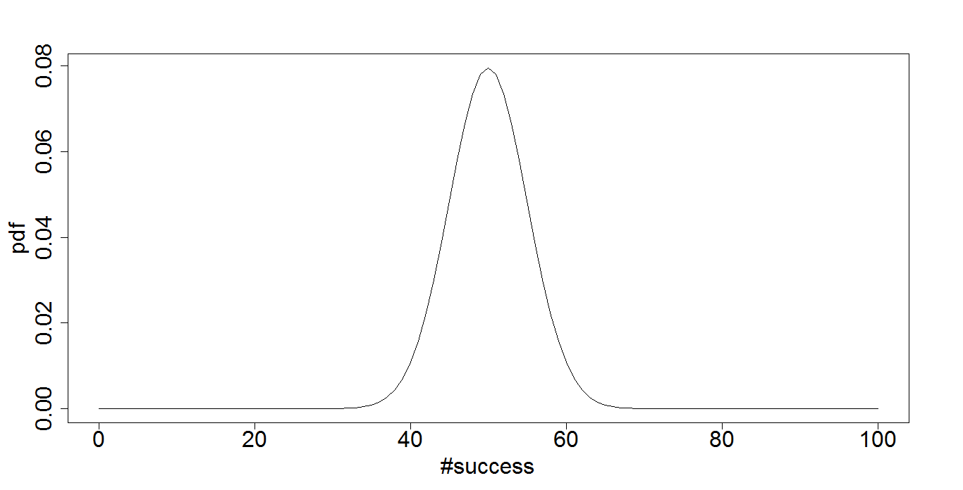
How do we get accessible het SNPs
For a het SNP, if reads, n=5,
n=5
Ref:alt | P val
0:5 | 0.0625
1:4 | 0.3125
2:3 | 0.625
3:2 | 0.625
4:1 | 0.3125
5:0 | 0.0625
…..
n=100
For each p value cutoff per dataset, find the minimum N

Slide 12
How do we get accessible het SNPs
Binomial Chart (n=0:n=10) (2-tailed)
0 1
1 1
2 0.5
3 0.25
4 0.125
5 0.0625
6 0.03125
7 0.015625
8 0.0078125
9 0.00390625
Acc SNP (min reads = 8)
ASE SNP
e.g. enhancer
For HG00096,
at FDR 5% (RNA-seq)
p value 0.009286
min n = 8

Slide 13
Distribution by chromosome

