Slide 1
PrivaSeq: Analysis of sensitive information in RNA-seq datasets

Slide 2
Sensitive Information
Anything that can be used to discriminate or identify an individual.
Anything that can be used to link to any other database
Personally identifiable information (PII)
Example: Low frequency multi-SNP genotypes
Disease information
Population information
Phenotypic Information (Age, eye color, …)

Slide 3
Attacks
Personally identifying information:
“Identify whether a person is in a pool of DNA”
Homer et al
“Identify a person using dataset within a database of individuals”
Schadt et al
“Identify a person using dataset and a query-able database”
Gymrek et al
Linking attacks: Any information that is predicted can be combined with external databases to increase the power of individual identification

Slide 4
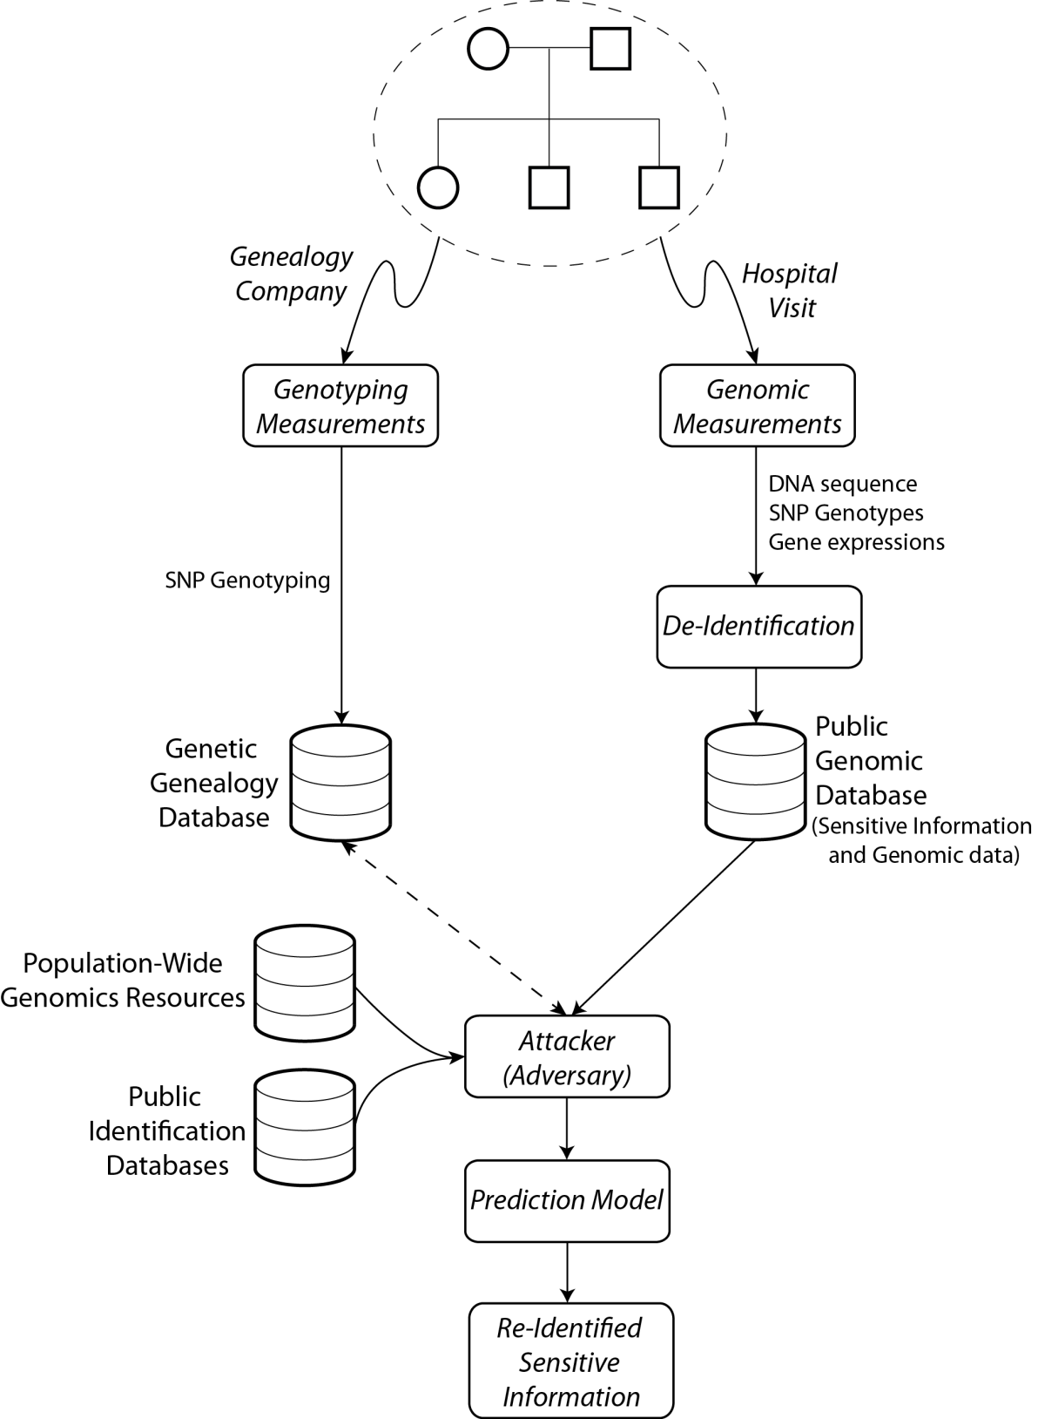
Possible Attack
Familial correlation of genetic information increases the extent of the breach

Slide 5
More Formally
Let a SNP genotype be denoted by a 2-tuple:
$s_{j}=(x_{j},g_{j})$
$x_{j}$ represents the position of the SNP
$g_{j}$={0,1,2} (Genotype)
Let $I_{a}$ represent the genotype (SNPs only) of individual $a$.
$I_{a}$is a set of SNP genotypes: $I_{a}={\{s_{j}\}}_{j<\# of SNPs}$
A multi-SNP genotype is a set of SNP genotypes:
Example:${ S}_{i}=\{s_{j}\}$
Number of multi-SNP genotypes increases exponentially
$S_{i}$ is a sensitive multi-SNP genotype if $P_{pop}\text{(}S_{i}\text{)} \text{<} p_{privacy}$
$p_{privacy}$ quantifies the level of required privacy
Let the random variable${ S}_{S_{i}}^{I_{a}}$denote whether individual $a$has a sensitive genotype:
${ S}_{S_{i}}^{I_{a}}=\left\{\begin{aligned}1 if{S_{i} ⊆I}_{a} \\ 0 otherwise\end{aligned}\right.$
For now, we are focusing on the SNPs whose coordinates match with the eQTLs in the literature

Slide 6
More Formally
Let$E_{a}$denote the 20k-tuple (protein coding genes) with the log expression levels of all the genes for individual $a$
$E_{a}={(e}_{i}^{a})$
The total amount of sensitive information can be quantified by mutual information:
$\sum_{i}{\frac{MI\left(E_{∙},{ S}_{S_{i}}^{I_{∙}}\right)}{H(S_{S_{i}}^{I_{∙}})} }$
Assume that the SNP genotypes are independent:
$MI\left(E_{∙},{ S}_{S_{i}}^{I_{∙}}\right)=\sum_{s_{j}∈S_{i}}{MI(E_{∙},{ S}_{s_{j}}^{I_{∙}^{}})}$

Slide 7
More Formally
De-Individualization:
Update the expression matrix: ${\tilde{E}}_{a}$
It is necessary to minimize the predictability of ${ S}_{S_{i}}^{I_{a}}$ from$E_{a}$among all the individuals in the dataset for all the possible sensitive genotypes:
$\underset{{\tilde{E}}_{∙}}{argmin}{⁡(\sum_{i}{\frac{MI\left({\tilde{E}}_{∙},{ S}_{S_{i}}^{I_{∙}}\right)}{H\left(S_{S_{i}}^{I_{∙}}\right)}\text{)} }}$
Equivalently, we need to maximize the conditional entropy:
$\underset{{\tilde{E}}_{∙}}{argmax}\left(\sum_{i}{H({ S}_{S_{i}}^{I_{∙}}|{\tilde{E}}_{∙})}\right)$
Maximize the entropy in the sensitive multi-genotype indicator given the de-individualized expression values
Notes:
Conditional entropy is a measure of predictability of sensitive genotype indicator

Slide 8
More Formally
It is also necessary to bound the distance between the new expression matrix and updated expression matrix:
$\underset{{\tilde{E}}_{∙}}{argmax}\left(\sum_{i}{H(S_{S_{i}}^{I_{∙}}|{\tilde{E}}_{∙})}\right)$ s.t. cost($E_{∙}$, ${\tilde{E}}_{∙}$) <$∆_{max}$
$i$ increases exponentially
Practically: Inspect the joint distribution of expression levels and sensitive multi-SNP genotypes, add the minimal amount of noise that that ensures that the entropy is above certain level.
If we can de-individualize one SNP genotype, remaining genotype set is most probably not sensitive any more.

Slide 9
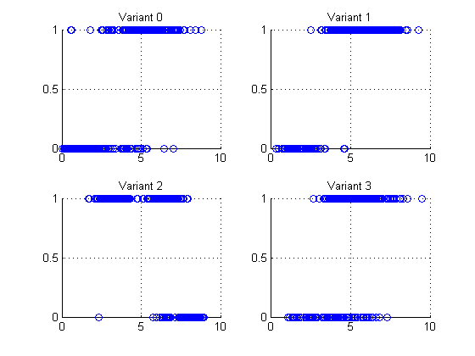
Example: 4 eQTL SNP genotypes (1,0,1,0): Shared among only 3 individuals
Expression levels are outliers and are predictive of the genotype!
Example: Vulnerable sample variants, expressions
Variant 0 (1, 6)
Variant 1 (0, 2)
Variant 2 (1, 3)
Variant 3 (0, 2)
Genotype (0,1)
Log RPKM of overlapping gene

Slide 10
How can this be implemented practically?
New file format:
MRF: Removes the nucleotide sequence but prediction attack can still be performed from quantifications
CRAM: Aims to compress the file, no intension of anonymization in the specification
Two approaches for de-identification:
Remove all the correlation information
We can just get rid of all the predictable SNPs. We would lose too much information, i.e., all eQTLs would be lost.
Remove all the sensitive SNP genotypes from the data:
Protected file can be distributed separately
Tamper the expression levels of genes for only the individuals with breachable SNPs genotypes that are easily predictable from expression levels.
Dataset-wise statistics stay intact. For example, eQTL correlations do not change since we do not change the expression levels for all the individuals

Slide 11
Next Todos
Indicator RV,${ S}_{S_{i}}^{I_{a}}$, can be made to reflect the distance between a sensitive genotype and the individual’s genotype rather than indicating an exact match
Need to get around enumerating all possible sensitive multi SNP genotypes
We need to incorporate additional types of sensitive information and define the corresponding indicator RVs
Population, age, race, …
Disease associated variants
How can we integrate CNVs and indels into the framework?
Should follow the same formulations
Implement the de-individualization procedure

