Slide 1
MUSIC Figures

Slide 2
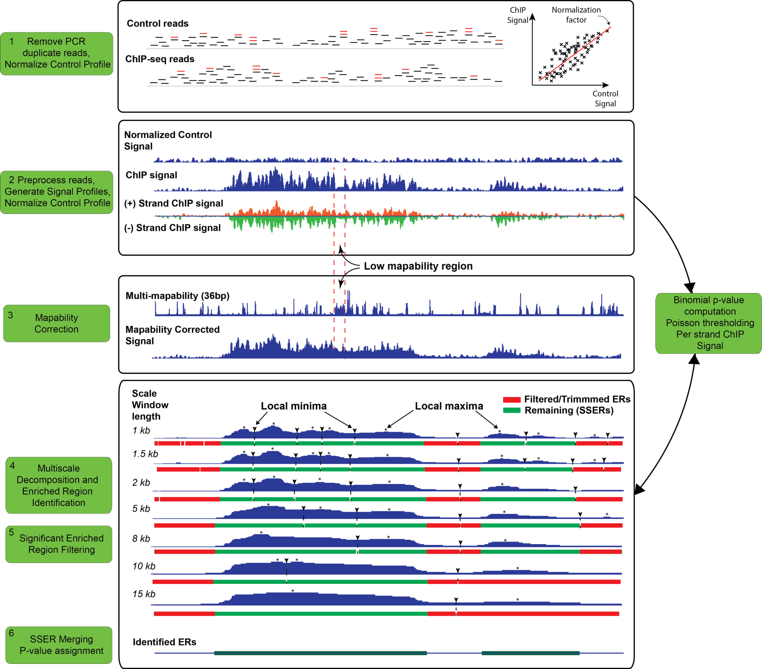
Figure 1
Notes:
Figure 1: Flowchart of the processing steps of MUSIC using the H3k36me3 ChIP and control data from ENCODE project in region chr1:55,170,679-55,240,996 for K562 cell line. (1): ChIP and control reads (represented by short horizontal lines) are filtered for PCR duplicates (red colored) and control signal is normalized with respect to ChIP signal. (2):. (3): ChIP-seq profile is corrected for mapability (labeled “Mapability Corrected Signal” profile) using the multi-mapability (36bp) profile. Higher values in the multi-mapability profile correspond to the regions with lower mapability. Note the region indicated between the dashed lines that lost signal because of low mapability are filled with correction. (4) 7 scale decomposition of the ChIP-seq signal. Under each decomposition the enrichment features with the corresponding local minima and local maxima are shown. (5): The enrichment features are filtered with respect to p-values and the ends are trimmed. The remaining significant enrichments features (SEFs) are shown in green under each decomposition. The unfiltered ChIP-seq profile, per strand ChIP signal, and the control profile are used for filtering of the enrichment features (Refer to text). (6): The ERs are formed by merging the SEFs and the final p-values are computed for the ERs using the ChIP and control profiles.
(One thing that may be useful is that the there is a hole in the smaller scales and it is filled in the upper scales)
“Remove duplicates”
Keys for minima

Slide 3
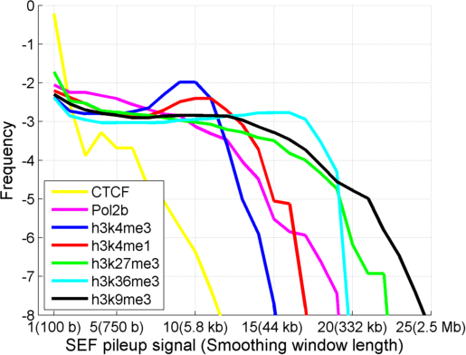
Figure 2
Notes:
Figure 2: Distribution of SEF pileup signal for CTCF, RNA Polymerase II (Pol2b), and several different HMs on chromosome 1. X-axis shows the SEF pileup signal level and the corresponding smoothing window length and y-axis shows the log frequency. CTCF and h3k9me3 show the fastest and slowest decrease, respectively, in frequency.

Slide 4
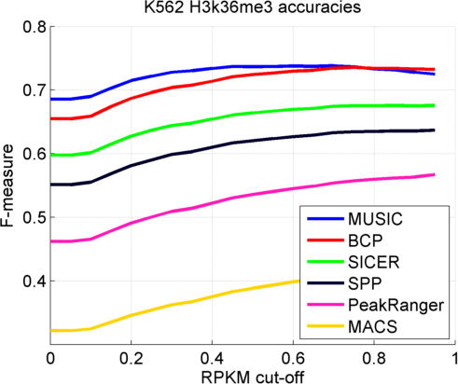
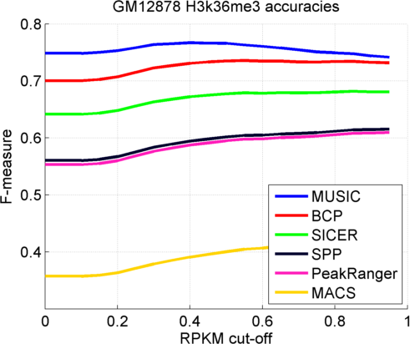
Figure 3
Notes:
Figure 3: F-measure vs RPKM threshold (Used to generate the ground truth expressed regions) for H3k36me3 peaks for GM12878 (left) and K562 (middle). The F-measure vs RPKM cut-off for H3k36me3 peaks for K562 and GM12878 with (blue) and without mapability correction (red)

Slide 5
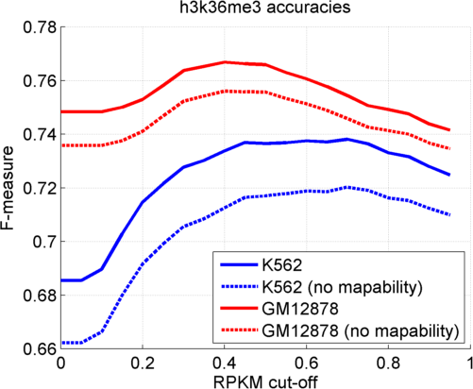
Fig 3c

Slide 6
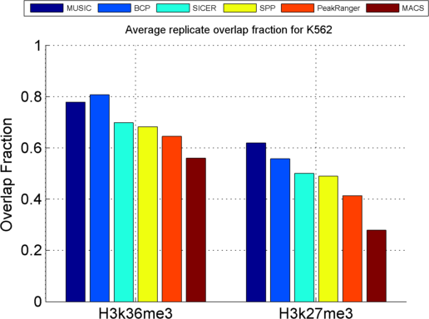
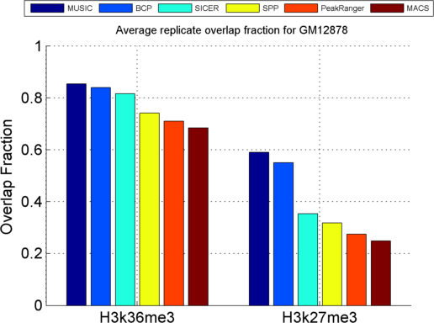
Figure 4
Notes:
Figure 4: Average of the overlap fractions of replicates for H3k36me3 and H3k27me3 ERs identified by each method.

Slide 7
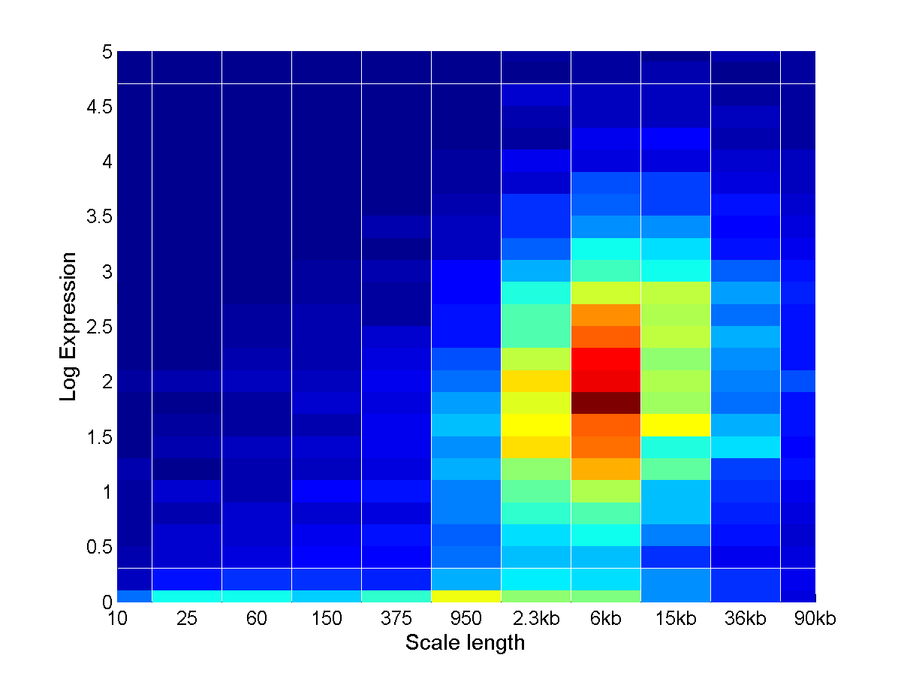
Figure 5a
Notes:
Figure 5: (a) Two orientations of 2 dimensional histogram of SEF pileup signal and Log expression. (b) The distribution of the gene expression versus SEF pileup signal.

Slide 8
Figure 5a
Elongating
Stalled
Notes:
Figure 5: (a) Two orientations of 2 dimensional histogram of SEF pileup signal and Log expression. (b) The distribution of the gene expression versus SEF pileup signal.

Slide 9
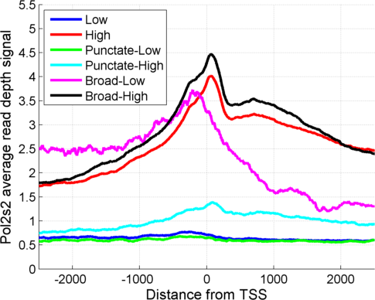
Figure 5b
Upstream
Gene body
Notes:
Figure 5: (a) Two orientations of 2 dimensional histogram of SEF pileup signal and Log expression. (b) The distribution of the gene expression versus SEF pileup signal.

Slide 10
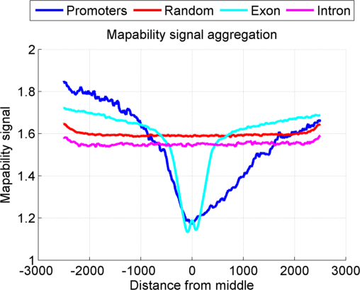
Figure S1
Notes:
Figure 6: The aggregation of the mapability read depth signal signal over promoters, exon, introns, and random regions with at least 1 read that is mapped in any control dataset. Aggregation over promoters is performed in a strand specific manner such that left side corresponds to the upstream of the promoter and the right side corresponds to the downstream.
Multi-mapability in title

Slide 11
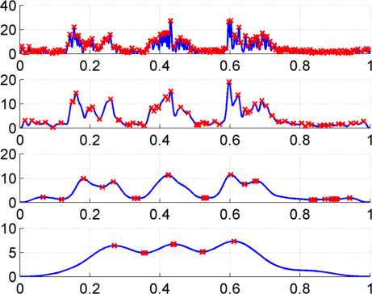
Figure S2
Sigma
1kb
4kb
16kb
Maxima
64kb
Minima

Slide 12
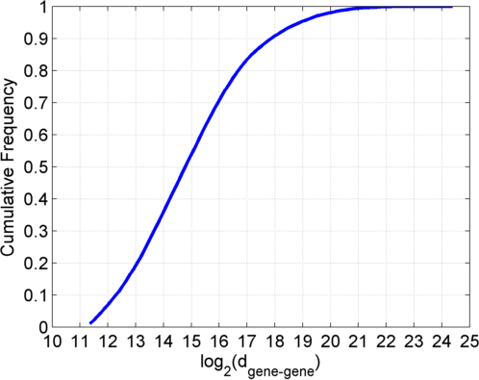
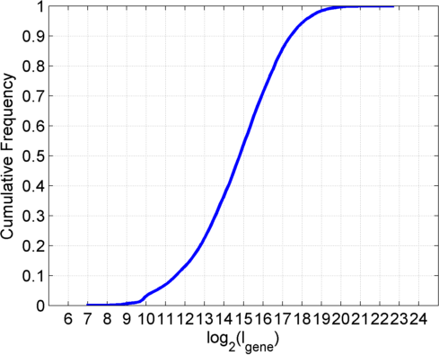
Figure S3
(A)
$$l_{gene}$$
$$d_{gene−gene}$$
(D)
(B)
$$x$$
$$l_{1}$$
$$x_{filtered}$$
Output is zero for $l_{filter}>({2×l}_{1})$
(C)
(E)
$$l_{1}$$
$$l_{2}$$
$$d_{1−2}$$
$$x_{filtered}$$
$$l_{filter}>{(2×d}_{1−2})$$
Notes:
The illustration for gene-gene distance computation b) The cumulative distribution of intergene distance for genes that are at least 2.5kb apart.
c) The cumulative distribution of gene lengths
(We do not want to make the filter end length too large since it leads to overmerging of the features. For this, we use the above rule to set the filtering length. To detect a feature of length l, we make sure that the filter length is at least 2l. This way, we set the minimum scale length to 1kb. For the maximum
Filter length, we set it to 2*d_g2g where d_g2g is identified from the cdf of log(d_g2g). From (d), we see that 12.5 is around 10%. We use log(d_g2g) value 13, and set the maximum filter length to 2*2^13=2^14=16kb. This enables us to also be more inclusive of the genes, whose length distribution is shown In (E).)

Slide 13
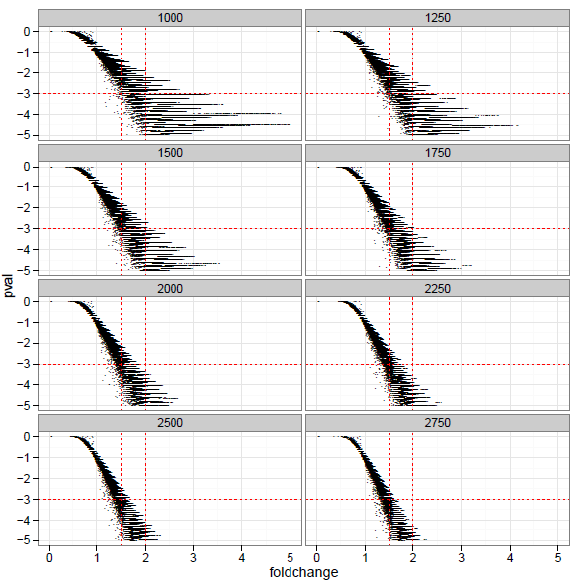
Figure S4: Normalization window length for p-val computation
Notes:
The FC is not dependent on the sequencing depth but p-value is and this is what we use.
Therefore we set a cutoff of 1.5 for the significance change for the fold change between 1.5 and 2 where below 1.5 is not significantly enriched and
Above 2 is significantly enriched. We want all the windows which have FC to correspond to that.

