Slide 1
ASE for 380 genomes
Jieming
19th Feb 2014

Slide 2
Samples
380 individuals (excl. Snyder and trios)
7 populations: CEU (74), FIN (71), GBR (67), TSI (92), YRI (74), CHB (1), JPT (1)

Slide 3
Average genome coverage distribution
Mean = 8
Min = 2.2
Max = 24.2

Slide 4
#ASE SNPs distribution
Mean = 1775
Min = 20
Max = 6405

Slide 5
GCov vs #ASE
Mean = 8
Min = 2.2
Max = 24.2
Mean = 1775
Min = 20
Max = 6405

Slide 6
GCov vs #ASE vs pop

Slide 7
Enrichment of ASE SNPs in various elements
AlleleSeq: 130,127 unique SNPs detected from 380 individuals
“matched controls” 341,500 accessible het SNPs

Slide 8
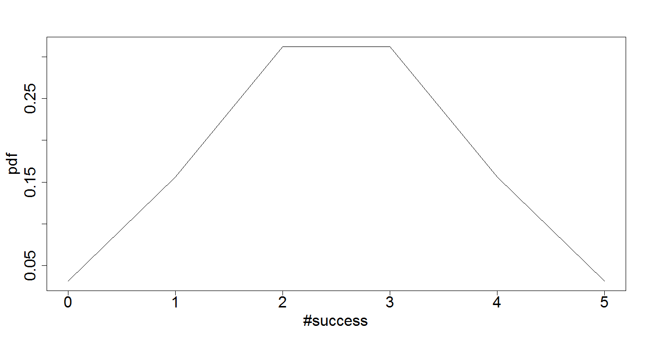
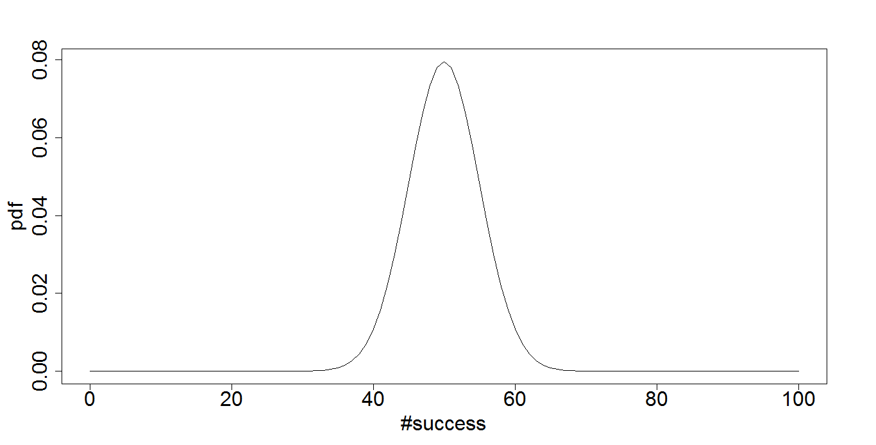
How do we get accessible het SNPs
For reads, n=5
n=5
Ref:alt | P val
0:5 | 0.0625
1:4 | 0.3125
2:3 | 0.625
3:2 | 0.625
4:1 | 0.3125
5:0 | 0.0625
…..
n=100
For each p value cutoff per dataset, find the minimum N

Slide 9
How do we get accessible het SNPs
Binomial Chart (n=0:n=10)
0 1
1 1
2 0.5
3 0.25
4 0.125
5 0.0625
6 0.03125
7 0.015625
8 0.0078125
9 0.00390625
For HG00096,
at FDR 5% (RNA-seq)
p value 0.009286
min n = 8

Slide 10
Distribution by chromosome

Slide 11
Enrichment
 | Cat | Non-cat
intHets | a | b
accHets | c | d
Fisher’s exact test
Odds ratio, p value

Slide 12
Gencode annotation

Slide 13
FIG/Encode/Ensembl Genomic annotations
954 categories (TFs, enhancers, distal regulatory regions etc.)
PG.Processed.Pgene.Ori | 14.6 | 0.00E+00 | 5135 | 956 | 124992 | 340544
PG.Pgene.Ori | 10.3 | 0.00E+00 | 6059 | 1618 | 124068 | 339882
ncRNA.rRNA.Ori | 5.0 | 7.81E-03 | 21 | 11 | 130106 | 341489
PAX5.Proximal | 4.8 | 0.00E+00 | 115328 | 211291 | 14799 | 130209
PG.Duplicated.Pgene.Ori | 4.8 | 2.70E-95 | 486 | 269 | 129641 | 341231
SREBF2 | 3.9 | 6.31E-05 | 39 | 26 | 130088 | 341474
PG.Transcribed.Processed.Pgene.Ori | 3.9 | 7.58E-31 | 195 | 131 | 129932 | 341369

Slide 14
PLoS comp biol topic page

Slide 15
Things to do
How to introduce the idea of an allelic element/region?
Gene ontology enrichment?
Fst?
Allele frequency spectra of both accHets and intHets
Redo accHets -1
Read distribution in ASE

