Slide 1
MUSIC Figures

Slide 2
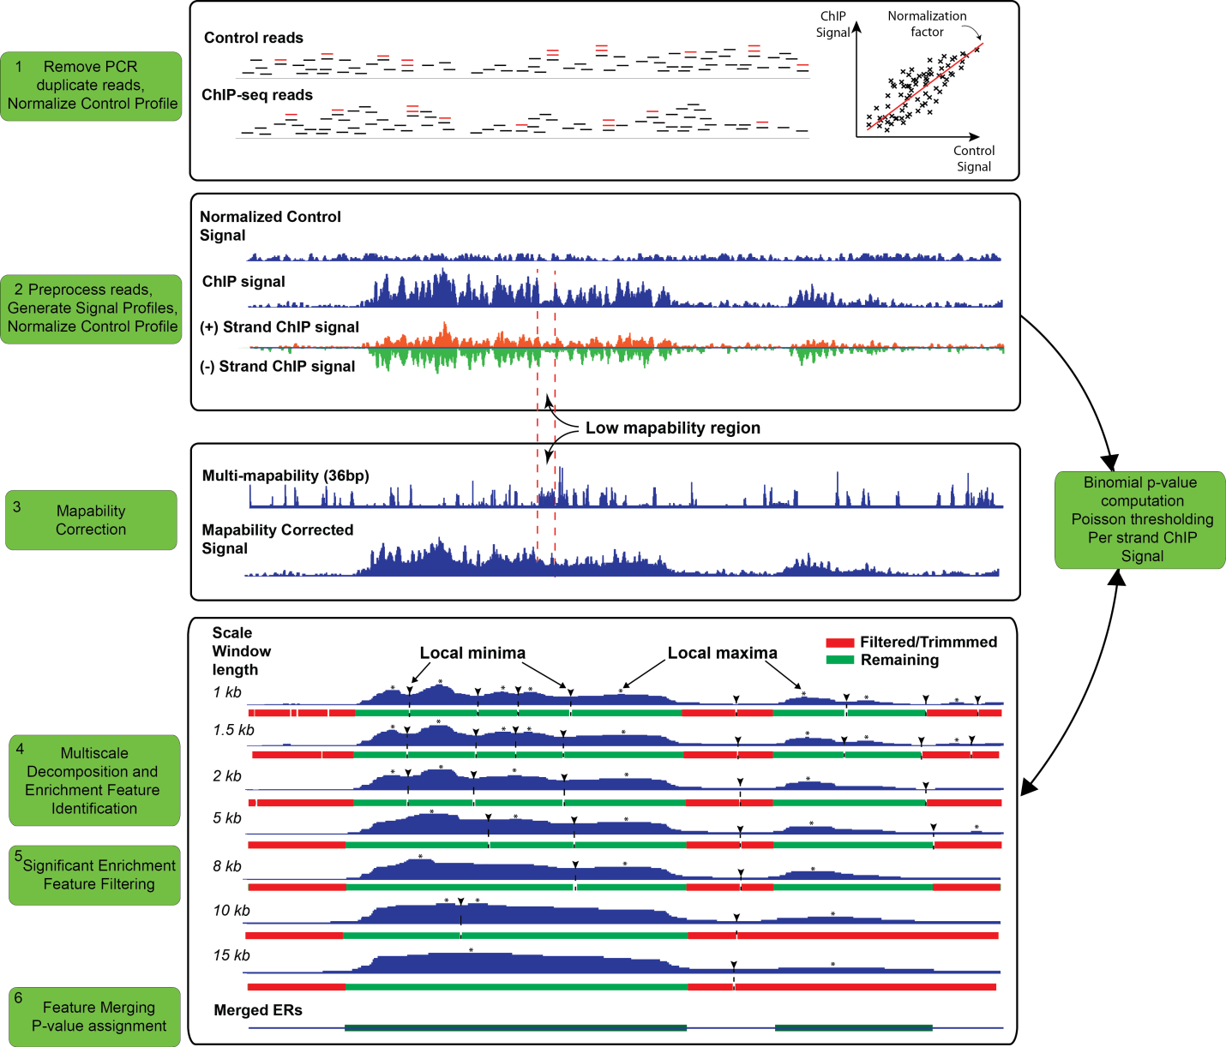
Figure 1
Notes:
Figure 1: Flowchart of the processing steps of MUSIC using the H3k36me3 ChIP and control data from ENCODE project in region chr1:55,170,679-55,240,996 for K562 cell line. (1): ChIP and control reads (represented by short horizontal lines) are filtered for PCR duplicates (red colored) and control signal is normalized with respect to ChIP signal. (2):. (3): ChIP-seq profile is corrected for mapability (labeled “Mapability Corrected Signal” profile) using the multi-mapability (36bp) profile. Higher values in the multi-mapability profile correspond to the regions with lower mapability. Note the region indicated between the dashed lines that lost signal because of low mapability are filled with correction. (4) 7 scale decomposition of the ChIP-seq signal. Under each decomposition the enrichment features with the corresponding local minima and local maxima are shown. (5): The enrichment features are filtered with respect to p-values and the ends are trimmed. The remaining significant enrichments features (SEFs) are shown in green under each decomposition. The unfiltered ChIP-seq profile, per strand ChIP signal, and the control profile are used for filtering of the enrichment features (Refer to text). (6): The ERs are formed by merging the SEFs and the final p-values are computed for the ERs using the ChIP and control profiles.

Slide 3
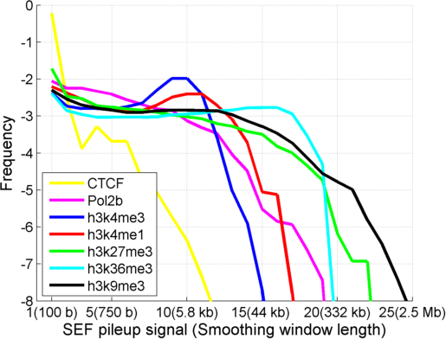
Figure 2
Notes:
Figure 2: Distribution of SEF pileup signal for CTCF, RNA Polymerase II (Pol2b), and several different HMs on chromosome 1. X-axis shows the SEF pileup signal level and the corresponding smoothing window length and y-axis shows the log frequency. CTCF and h3k9me3 show the fastest and slowest decrease, respectively, in frequency.

Slide 4
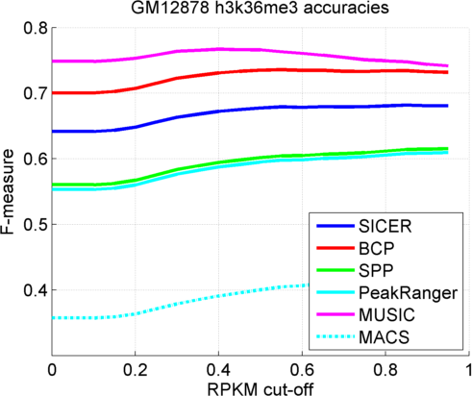
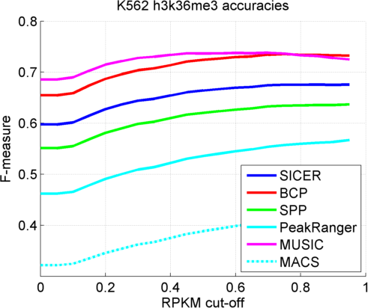
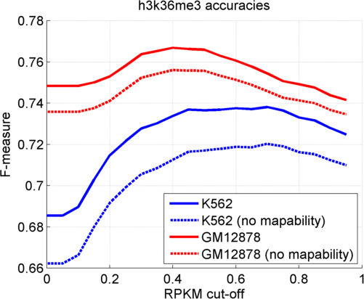
Figure 3
Notes:
Figure 3: F-measure vs RPKM threshold (Used to generate the ground truth expressed regions) for H3k36me3 peaks for GM12878 (left) and K562 (middle). The F-measure vs RPKM cut-off for H3k36me3 peaks for K562 and GM12878 with (blue) and without mapability correction (red)

Slide 5
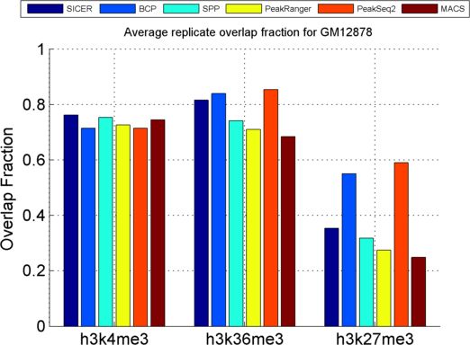
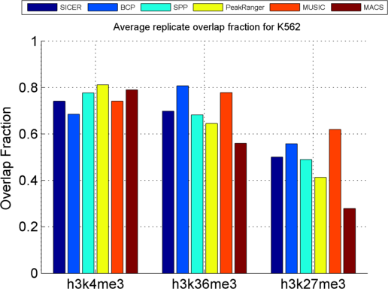
Figure 4
Notes:
Figure 4: Average of the overlap fractions of replicates for H3k36me3 and H3k27me3 ERs identified by each method.

Slide 6
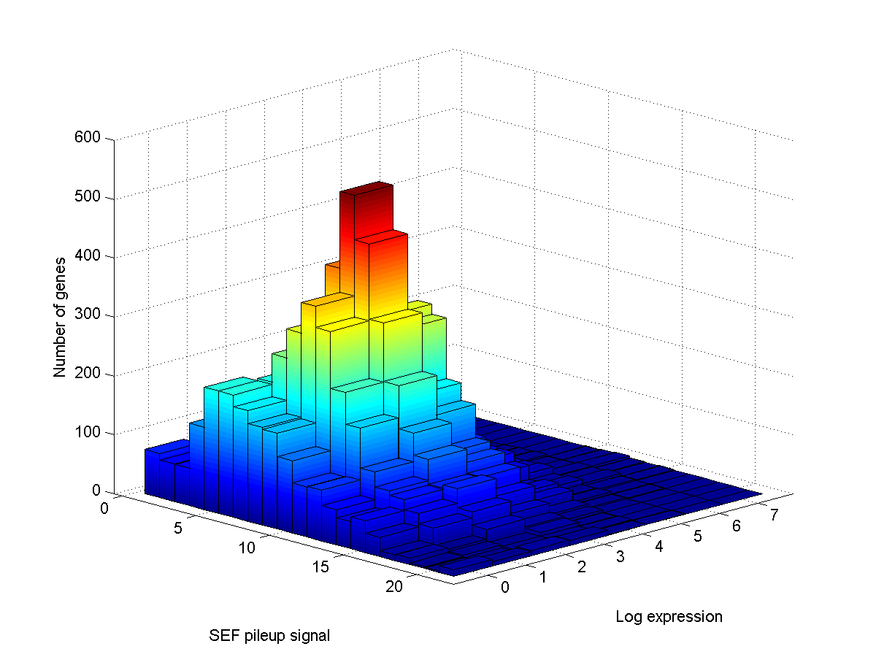
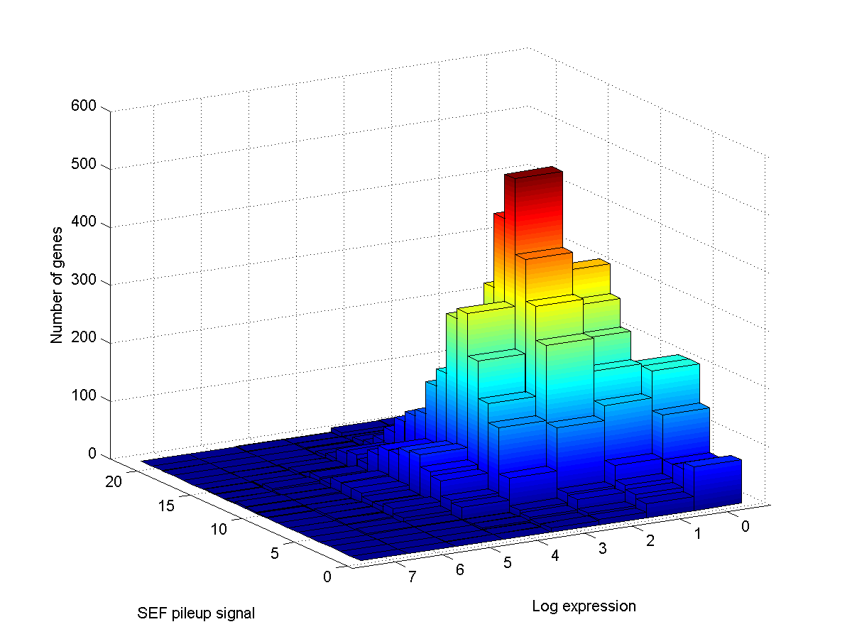
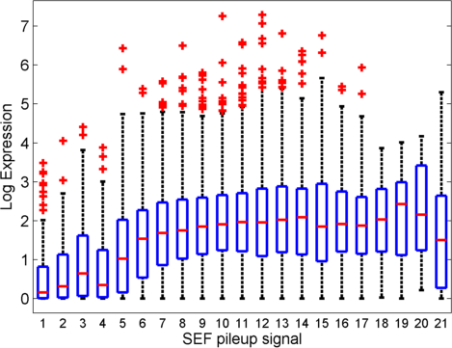
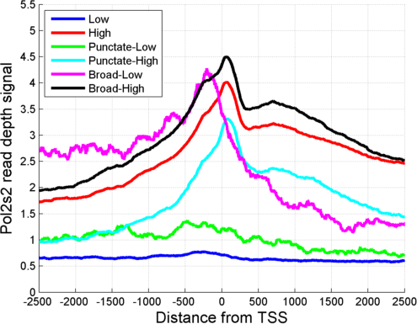
Figure 5
Notes:
Figure 5: (a) Two orientations of 2 dimensional histogram of SEF pileup signal and Log expression. (b) The distribution of the gene expression versus SEF pileup signal. (c)

Slide 7
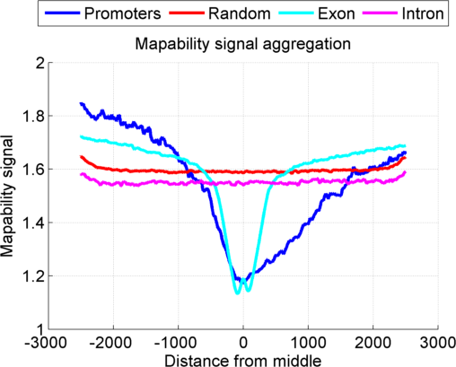
Supplementary Figure 1
Notes:
Figure 6: The aggregation of the mapability read depth signal signal over promoters, exon, introns, and random regions with at least 1 read that is mapped in any control dataset. Aggregation over promoters is performed in a strand specific manner such that left side corresponds to the upstream of the promoter and the right side corresponds to the downstream.

