Slide 1
ApoBEC
What we know…
  NAHR bkps related with enhancers/ssDNA
    Histone markers (FIG)
    Hi-C (new)
  SNP peaks around bkps
What ApoBEC does
  Causes hypermutation in certain motifs
  Clustered around bkps in cancer genome

Slide 2
ApoBEC
Scan TCW/WGA motifs
ApoBEC signature mutations: TCW=>TTW/TGW or WGA => WAA or WCA
Do the SNP aggregation plot again

Slide 3
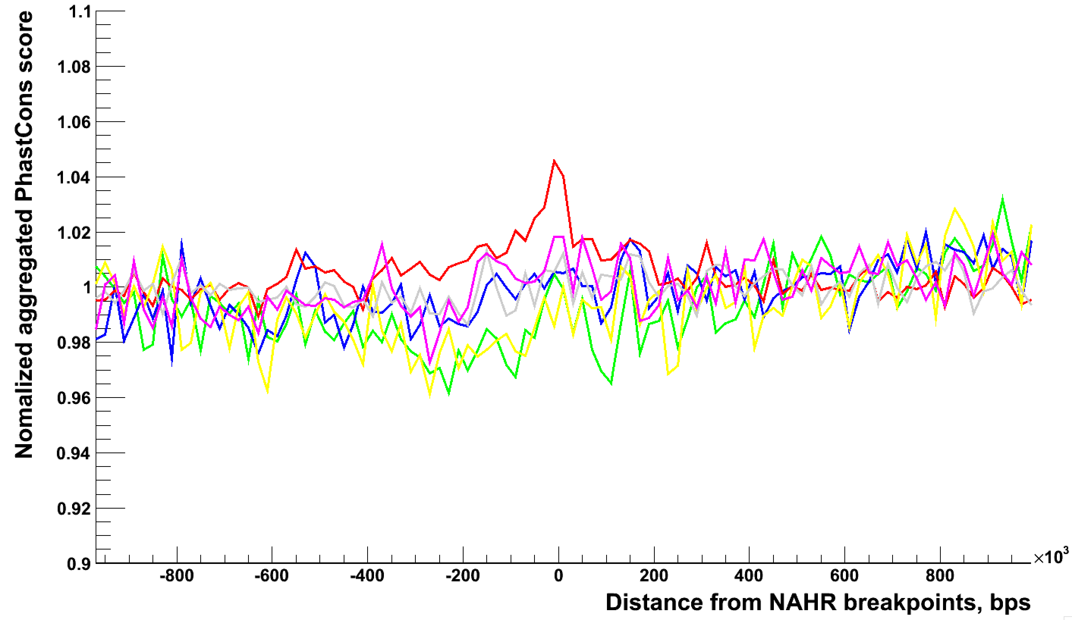
SNP aggregation for NAHR
C>A, C>G, C>T, T>A, T>C, T>G
Possible APOBEC mutation
(DNA editing)

Slide 4
Association with Hi-C
←←← More silent, ridged, compacted…
46%
More active, flexible, loose… →→→
54%
MTEI
STEI
NAHR
NHR

Slide 5
Hi-C (1MB)
Sign(Eigenvector) | NHR | NAHR | STEI | MTEI | Sum
+/1439 (50%) | 4814/45% | 1535/66% | 1878/46% | 256/54% | 8567/48%
-/1443 | 6012 | 775 | 2182 | 202 | 9249
Total/2872 | 10826 | 2310 | 4060 | 478 | 17816
1,000/+ | NHR | NAHR | STEI | MTEI
Mean | 5401.9 | 1152.5 | 2025.7 | 228.4
Std | 93.9 | 69.7 | 53.0 | 15.4
percentile | 0% | 100% | 0.01% | 4.1%
Z-score | -6.26 | 5.49 | -2.79 | 1.79

Slide 6
Better Visualization

Slide 7
300MB & 1GB

